Slide 2
Computer and Network Security

Slide 3
What is security?
System correctness
  If user supplies expected input, system generates desired output
Security
  If attacker supplies unexpected input, system does not fail in certain ways

Slide 4
What is security?
System correctness
  Good input ⇒ Good output
Security
  Bad input ⇒ Bad output

Slide 5
What is security?
System correctness
  More features: better
Security
  More features: can be worse

Slide 6
Security concepts
CIA?
Confidentiality
  Information about system or its users cannot be learned by an attacker
  (a set of rules that limits access to information )
Integrity
  The system continues to operate properly, only reaching states that would occur if there were no attacker
  (the assurance that the information is trustworthy and accurate )
Availability
  Actions by an attacker do not prevent users from having access to use of the system
  (a guarantee of reliable access to the information by authorized people)

Slide 7


General picture
System
Alice
Attacker
Security is about
  Honest user (e.g., Alice, Bob, …)
  Dishonest Attacker
  How the Attacker
    Disrupts honest user’s use of the system (Integrity, Availability)
    Learns information intended for Alice only (Confidentiality)

Slide 8
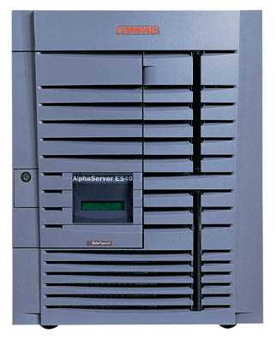
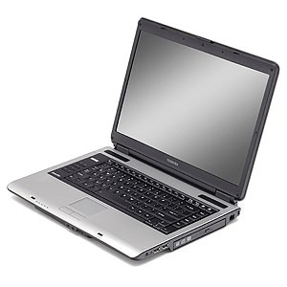
Network security
Network Attacker
Intercepts and controls network communication
System

Slide 9
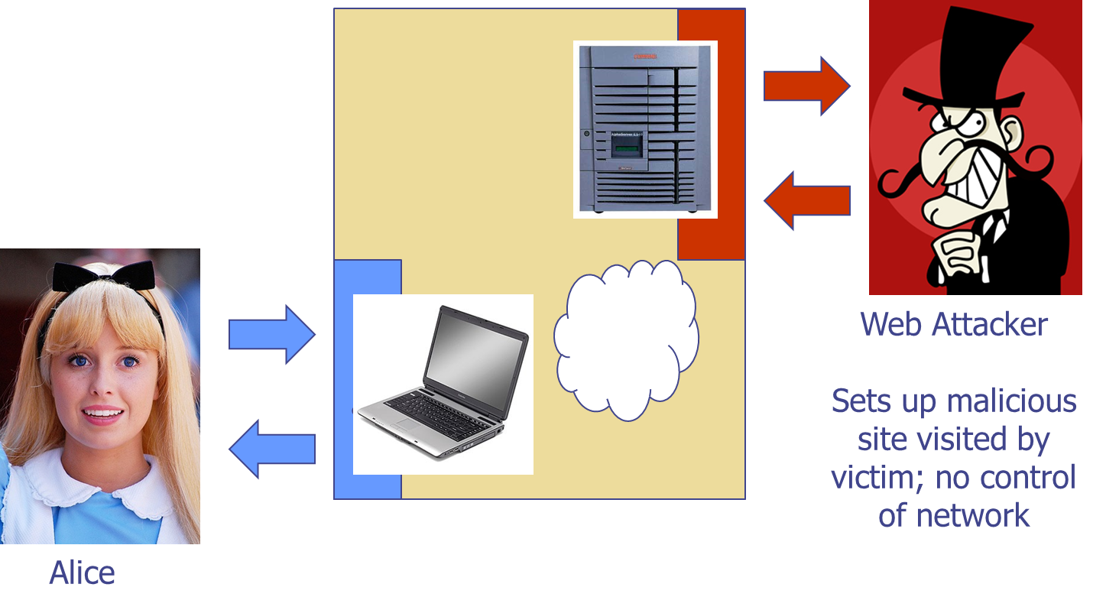
Web security

Slide 10
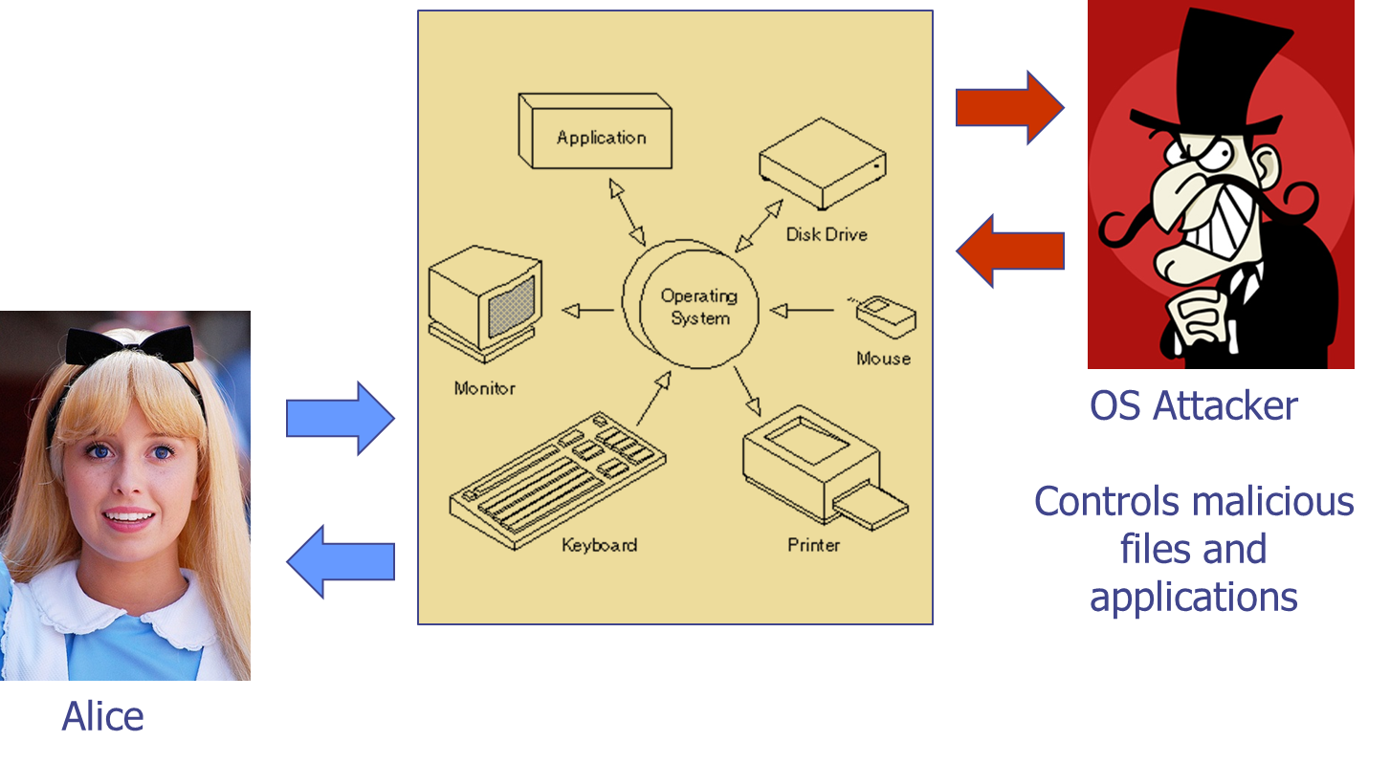
Operating system security

Slide 11
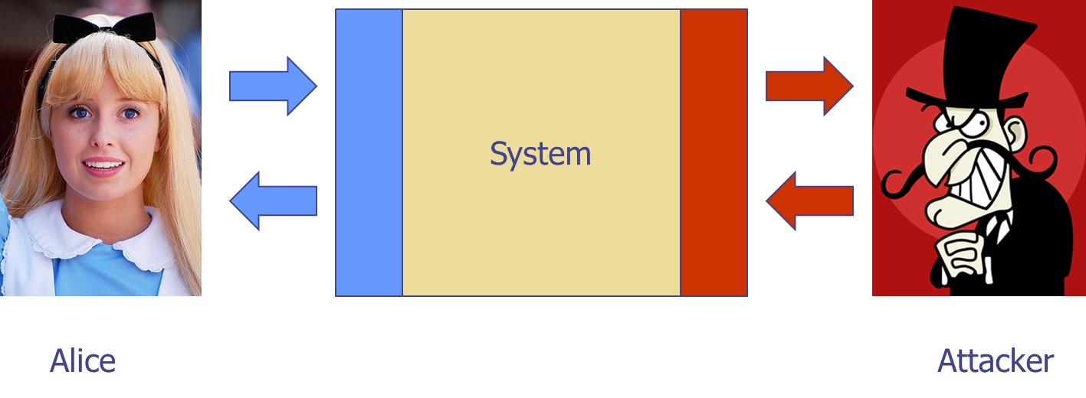
Concepts
Confidentiality: Attacker does not learn Alice’s secrets
Integrity: Attacker does not undetectably corrupt system’s function for Alice
Availability: Attacker does not keep system from being useful to Alice

Slide 12
Threat 1
Hacking
  Information theft
  Data alteration
  Information damage
  Financial damage

Slide 13
Threat 2
Web site defacement
  Page content alteration
  Information damage and deletion
  Embarrassment for organization

Slide 14
Threat 3
Viruses
  Spreading effect
  Information damage
  Slowing down the system

Slide 15
Threat 4
Denial of Service
  Business cannot serve clients
  Overloading of servers

Slide 16
Examples
 | Availability | Confidentiality | Integrity
Hardware | Equipment is stolen or disabled, thus denying service.
Software | Programs are deleted, denying access to users. | An unauthorized copy of software is made. | A working program is modified, either to cause it to fail during execution or to cause it to do some unintended task.
Data | Files are deleted, denying access to users. | An unauthorized read of data is performed. An analysis of statistical data reveals underlying data. | Existing files are modified or new files are fabricated.
Communication Lines | Messages are destroyed or deleted. Communication lines or networks are rendered unavailable. | Messages are read. The traffic pattern of messages is observed. | Messages are modified, delayed, reordered, or duplicated. False messages are fabricated.

Slide 17
Measures
Firewalls
Backup
Encryption
Digital signatures
Digital certificates
SSL

Slide 18
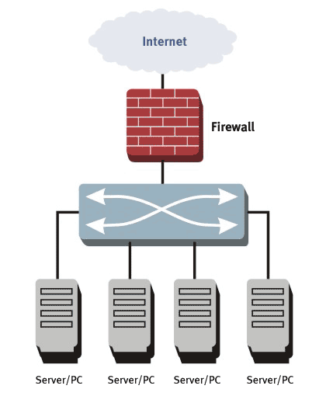
Firewall
A firewall inspects network traffic and denies or permits passage based on a set of rules.
a network security device that monitors traffic to or from your network. It allows or blocks traffic based on a defined set of security rules.
A firewall can be hardware, software, or both.

Slide 19
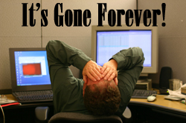
Backup
Making a copy of data

Slide 20
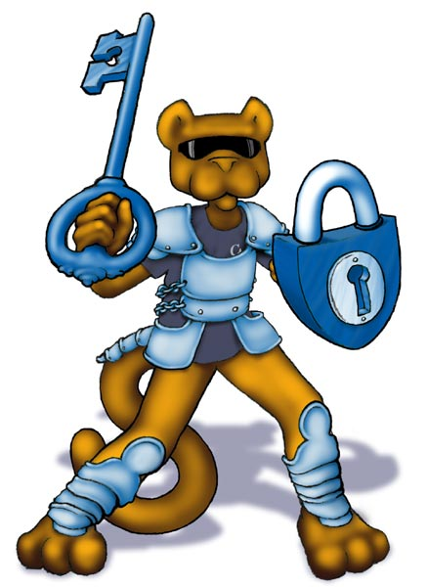
Authentication (2FA)
Authentication is used to verify that the information comes from a trusted source.

Slide 21
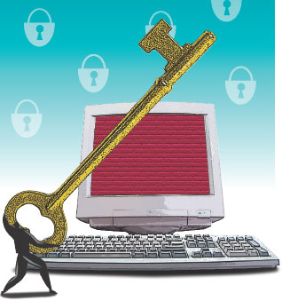
Encryption
The process of encoding messages or information in such a way that only authorized parties can access it.
Encryption does not of itself prevent interference, but denies the intelligible content to a would-be interceptor.
In an encryption scheme, the intended information or message, referred to as plaintext, is encrypted using an encryption algorithm, generating ciphertext that can only be read if decrypted

Slide 22
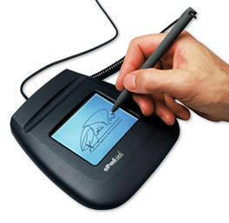
Digital signature
The cryptographic operation allows Digital Signatures to verify and assure the following:
The document is authentic and comes from a verified source
The document has not been tampered with since being digitally signed as the signature would be displayed as invalid if changes were made
Your identity has been verified by a trusted organization

Slide 23
Digital signatures
Digital signatures, like handwritten signatures, are unique to each signer.
Digital signature solution providers, follow a specific protocol, called PKI.
PKI requires the provider to use a mathematical algorithm to generate two long numbers, called keys. One key is public, and one key is private.
When a signer electronically signs a document, the signature is created using the signer’s private key, which is always securely kept by the signer.
The mathematical algorithm acts like a cipher, creating data matching the signed document, called a hash, and encrypting that data.
The resulting encrypted data is the digital signature.
The signature is also marked with the time that the document was signed.
If the document changes after signing, the digital signature is invalidated.

Slide 24
SSL/TLS
Secure Socket Layer - cryptographic protocol that provides communications security over a computer network
The connection is private (or secure) because symmetric cryptography is used to encrypt the data transmitted. The keys for this symmetric encryption are generated uniquely for each connection and are based on a shared secret negotiated at the start of the session. The server and client negotiate the details of which encryption algorithm and cryptographic keys to use before the first byte of data is transmitted.
The identity of the communicating parties can be authenticated using public-key cryptography. This authentication can be made optional, but is generally required for at least one of the parties (typically the server).
The connection ensures integrity because each message transmitted includes a message integrity check using a message authentication code to prevent undetected loss or alteration of the data during transmission

