Slide 1
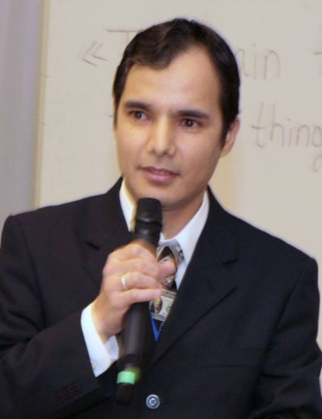
Practical workshops in Marketing Management
Mamurjon Rahimov
mrahimov@wiut.uz

Slide 2

Future of world business:
Jack Ma’s Valdai speech analysis
Mamurjon Rahimov
Mamurjon@gmail.com

Slide 3

Notes:
The Valdai Discussion Club was established in 2004. It is named after Lake Valdai, which is located close to Veliky Novgorod, where the Club’s first meeting took place.
The Club aims to promote dialogue of Russian and international intellectual elites and to deliver independent objective scholarly analysis of political, economic, and social developments in Russia and the world.

Slide 4
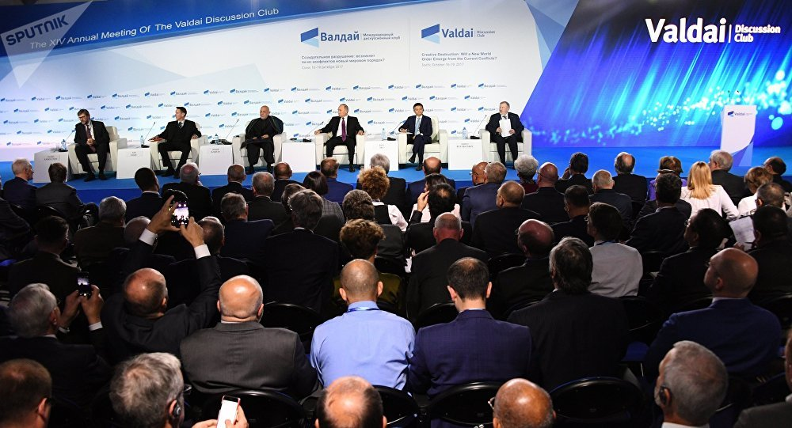
Notes:
The intellectual potential of the Valdai Discussion Club is highly regarded both in Russia and abroad. More than 1,000 representatives of the international scholarly community from 63 countries have taken part in the Club’s work. They include professors from major world universities and think tanks, including Harvard, Columbia, Georgetown, Stanford, Carleton Universities, the University of London, Cairo University, the University of Tehran, East China University, the University of Tokyo, Tel Aviv University, the University of Messina, Johns Hopkins University, the London School of Economics, King’s College London, Sciences Po and the Sorbonne.

Slide 5
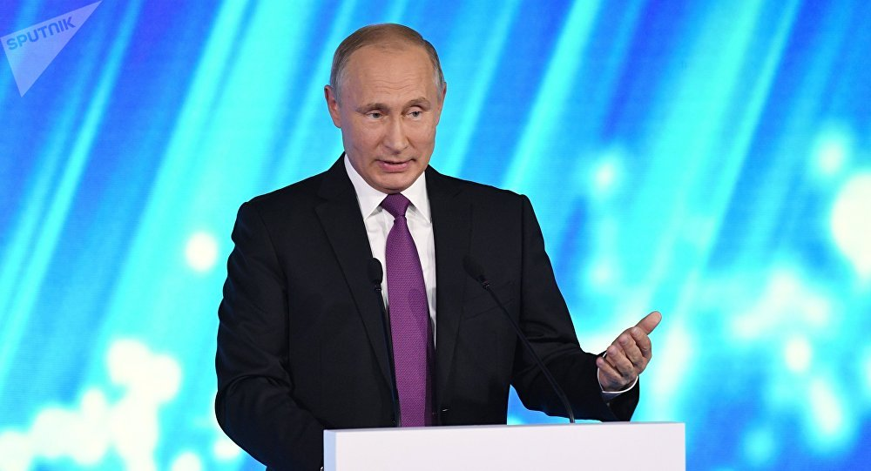

Slide 6
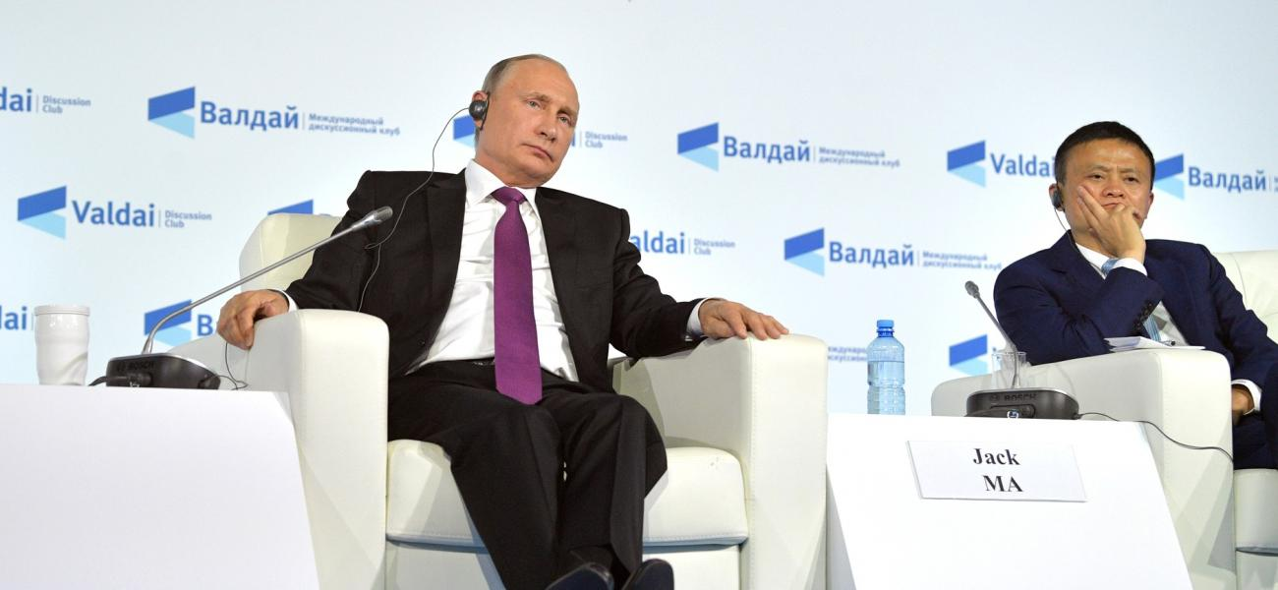

Slide 7
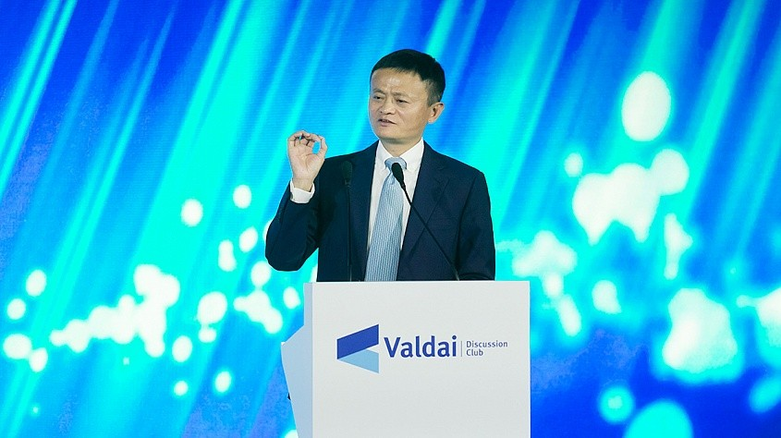

Slide 8
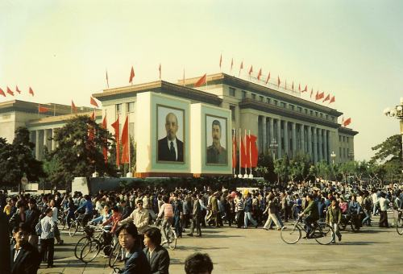
Notes:
In 1995, when I started my internet business in China, I was invited to join a group of experts, IT Expert Discussion, in Beijing, about 30 people. We sat in a room discussing how terrible the internet will be, what are the things we should worry about, any policy we should make. We had a whole night discussing the worries about the internet. Today, twenty years past, those things we worried about never came up. Those things we never worried about all came up.

Slide 9
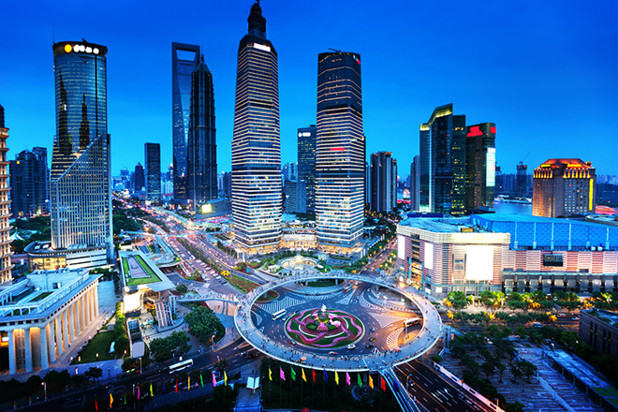

Slide 10

Notes:
I am very thankful for those worries, because this gave Alibaba opportunity. We did not have a lot of smart competitors join us. We grew so fast over the past 18 years, today we create more than 33 million jobs for China, and we ourselves made last year over $550 billion. Where other people worry, we try to figure out the way how to solve the worries.
All the problems we have today will become bigger problems, if we do not see this with great optimism.

Slide 11

Notes:
About globalisation, I think globalisation has nothing wrong. But globalisation today is not perfect. It is only a baby. One thousand years ago, global trade was determined by a few kings and queens. The last thirty or forty years, globalisation benefited only 60,000 big companies. What if we can support 60 million small and medium-sized companies that can grow global trade? What if we can help young people so that they can buy, sell, pay, deliver and travel globally?

Slide 12
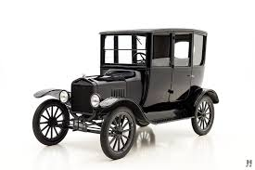
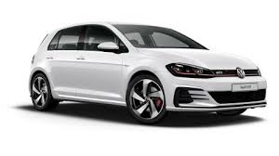
Notes:
We think that over the last century, massive, large-scale standardisation is the key. This century, with personal-made, with small and medium-sized companies we may have a lot of things that are different.

Slide 13

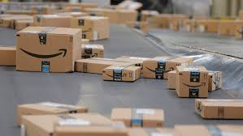
Notes:
From containers to packages

Slide 14

Notes:
From B2B to B2C

Slide 15
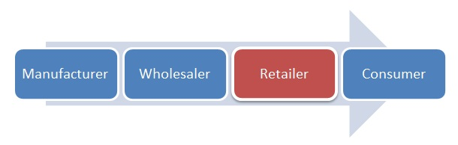

Slide 16


Notes:
From G20 to G200
The other thing is that we should never stop trade. When trade stops, war starts. Trade is something to build trust. When we build trade, we respect the other culture. When we do trade, it means that we appreciate the other culture. So we should encourage more trade. We should encourage more young people, small and big business to engage across the board. I think that the world needs not only a G20, we also need a G200. The world should not only have a B20, but also a B200.

Slide 17
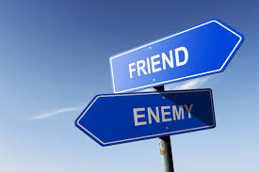
Notes:
This is what I want finally to say: technology is scary. The first technology revolution caused World War I. The second technology revolution caused, directly or indirectly, World War II. Now we are in the third technology revolution. What if a Third World War? If the human beings do not have the same enemy, we will fight among ourselves. The enemy should be poverty, the enemy should be environment, the enemy should be disease. I think that all those countries: China, Russia, USA, European, should share the technology, unite together to fight this war, and this is the war that, if we fight it together, young people will be much happier.

Slide 18

Notes:
Finally, the bad news is that we are entering into a world that we do not know. The good news is no one knows. Please pay special attention to the next thirty years. Please, pay special attention to those people who are below 30 years old, because they might be the leaders of tomorrow. They are the challengers, they are the changers. Please, pay attention to those companies who have less than 30 employees. If we pay attention to small, and small is powerful, small is beautiful, and if we pay attention to the young people, small businesses, I think that the world economy could be much more sustainable.

Slide 19
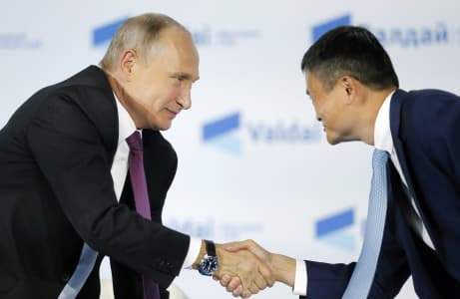

Slide 20
THANK YOU FOR YOUR ATTENTION!

