Slide 1
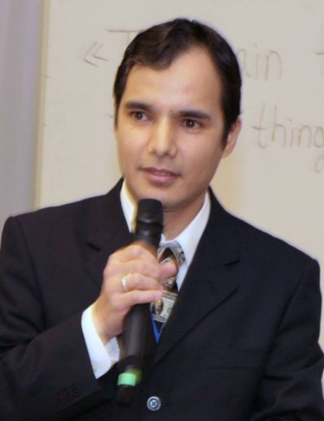
Practical workshops in Marketing Management
Mamurjon Rahimov
mrahimov@wiut.uz

Slide 2

Diversification strategy:
3M
Mamurjon Rahimov
Mamurjon@gmail.com

Slide 3
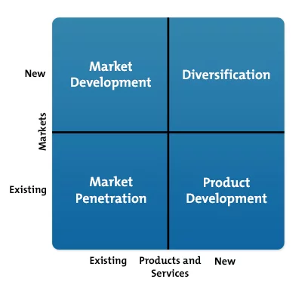

Slide 4
3M Story
Our beginnings were humble rocks, but after more than 100 years, we know how to rock science. Every day at 3M, we explore, we connect and we invent. And we’ve opened the door to show the world the unique, multi-dimensional ways 3M science can touch your life.
We’ve started the conversation with a fresh new look and new way of talking about ourselves that makes us excited to share. We’ve always been storytellers and inventors at heart, but now we will show you why we do what we do. And while we may look different, we’re still the same 3M, ready to connect and work together with you to create the future.
So explore with us. We think you will be amazed by all the ways 3M science impacts your life.
From 3m.com
Notes:
https://www.3m.com/3M/en_US/company-us/3m-science-applied-to-life/

Slide 5
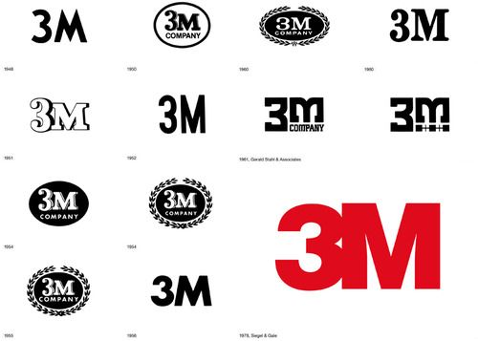

Slide 6
Segmenting B2C market
Notes:
https://www.3m.com/3M/en_US/consumer-us/

Slide 7
One of the top brands
Notes:
Best Global Brands 2017
Rankings
http://interbrand.com/best-brands/best-global-brands/2017/ranking/

Slide 8
Mission statement of 3M
To solve unsolved problems innovatively

Slide 9

Notes:
10% rule at 3M
Watch Player’s uprising

Slide 10


Slide 11


Slide 12
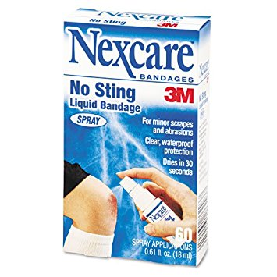

Slide 13
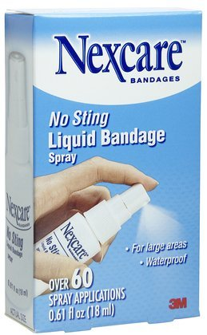
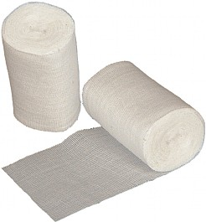
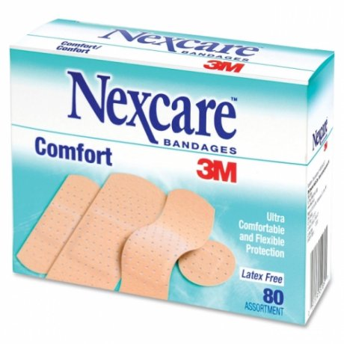

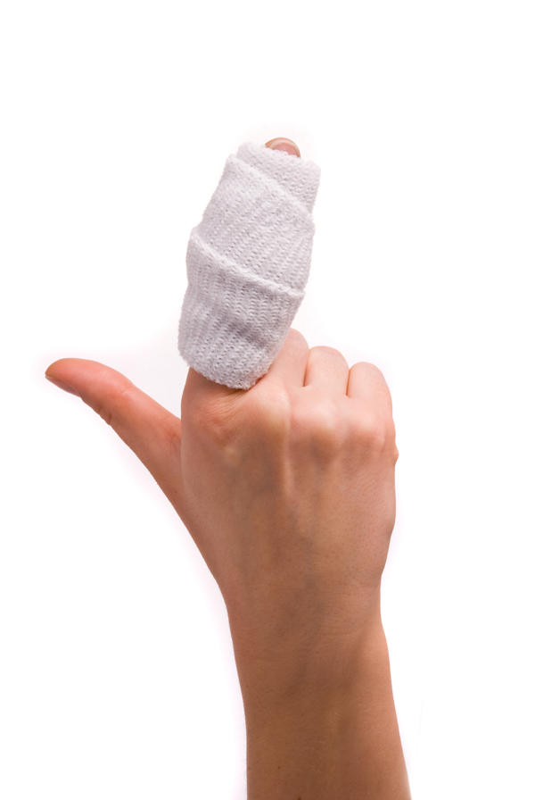


Slide 14
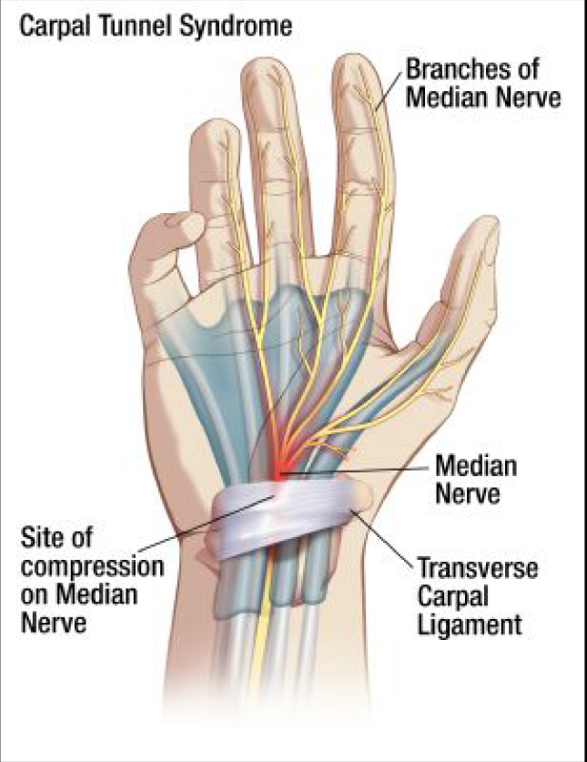

Slide 15
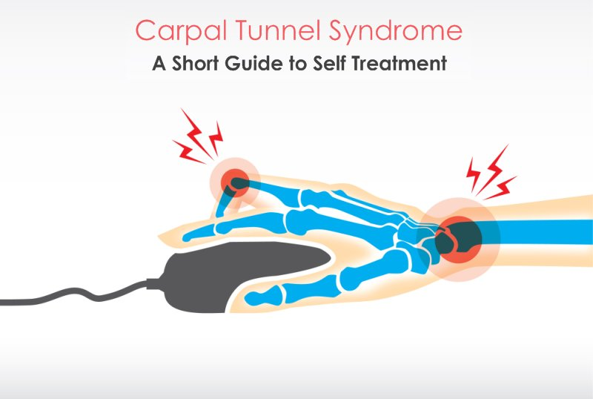

Slide 16
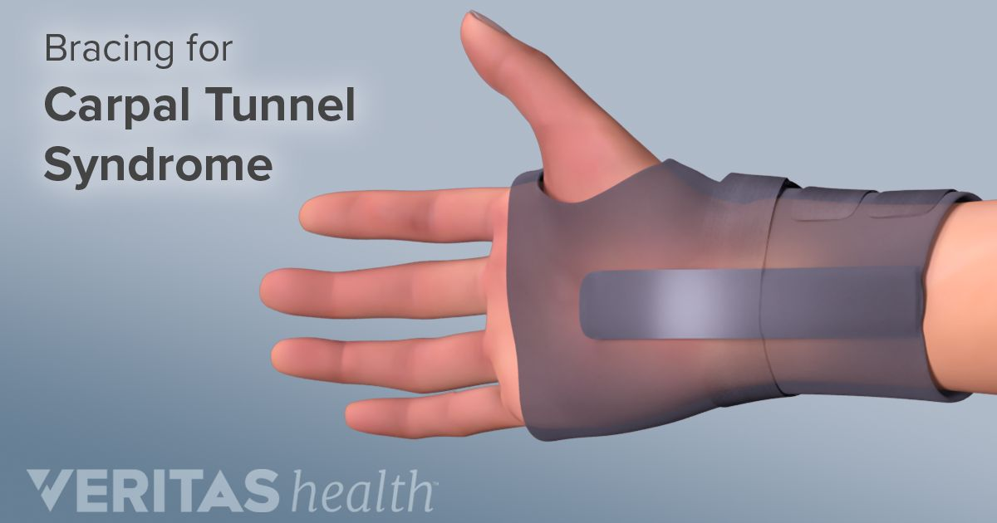

Slide 17
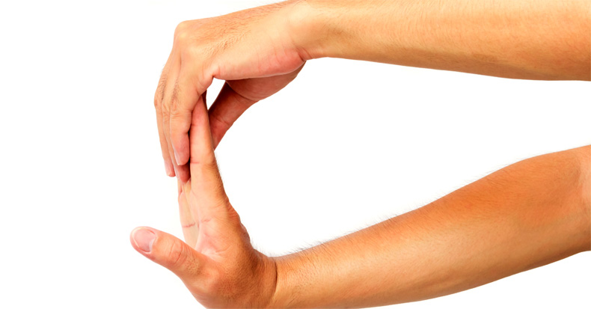
Notes:
https://chiro-trust.org/carpal-tunnel-syndrome/carpal-tunnel-syndrome-exercises/

Slide 18


Slide 19


Slide 20
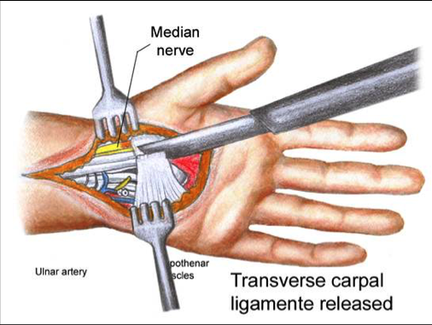
Notes:
https://www.mycarpaltunnel.com/content/carpal-tunnel-pain-relief.shtml

Slide 21
ergonomics
: an applied science concerned with designing and arranging things people use so that the people and things interact most efficiently and safely — called also biotechnology, human engineering, human factors
Notes:
https://www.merriam-webster.com/dictionary/ergonomics

Slide 22
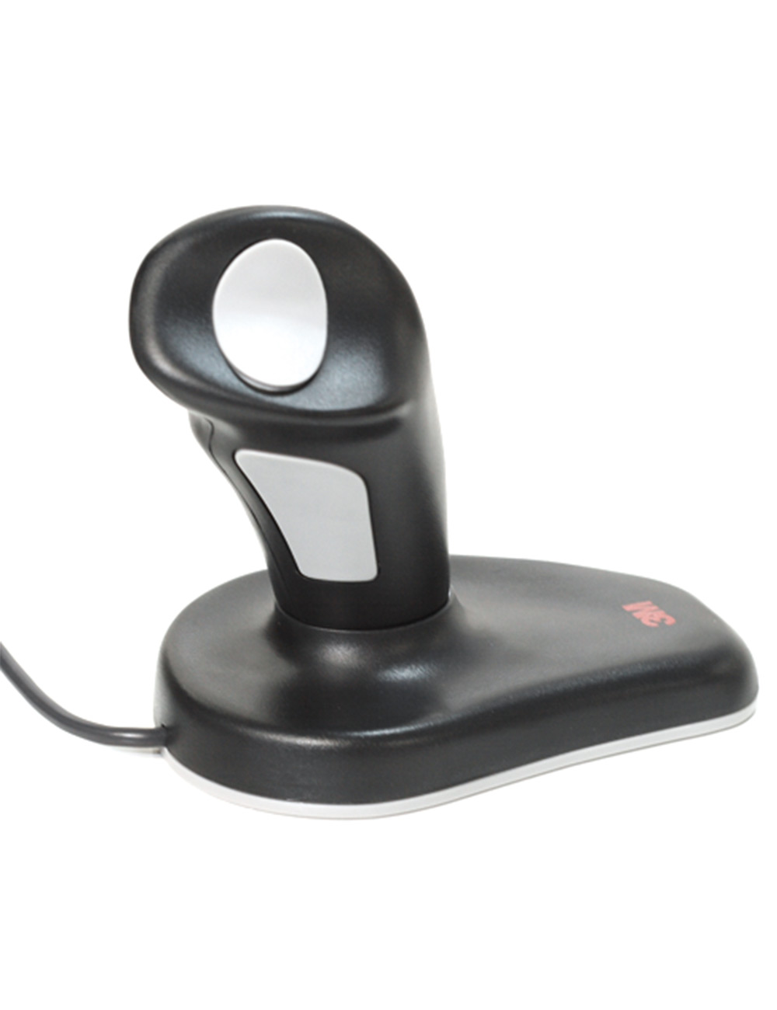

Slide 23
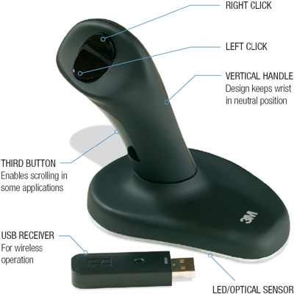

Slide 24
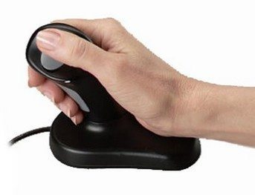

Slide 26
THANK YOU FOR YOUR ATTENTION!

