Slide 1

Practical workshops in Marketing Management
Mamurjon Rahimov
mrahimov@wiut.uz

Slide 2

Specialization strategy:
WD-40
Mamurjon Rahimov
Mamurjon@gmail.com

Slide 3
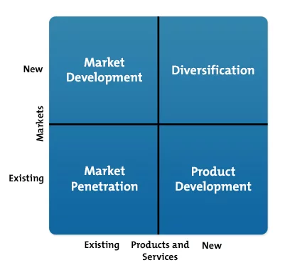

Slide 4


Slide 5


Slide 6
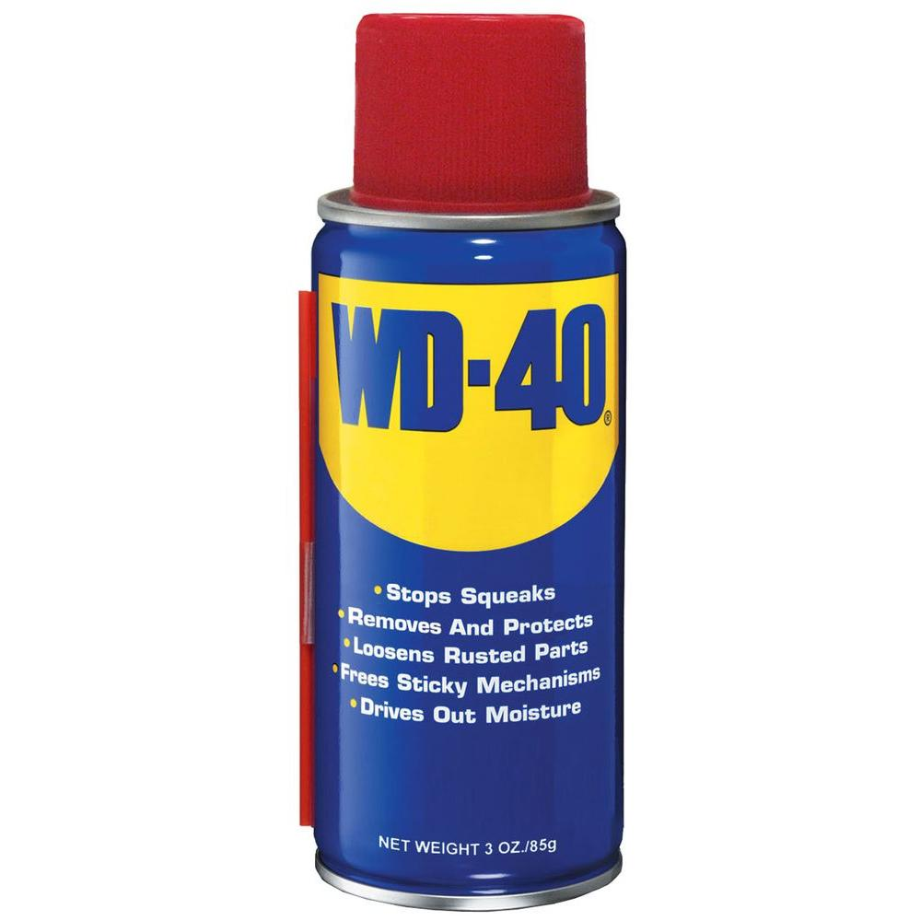

Slide 7
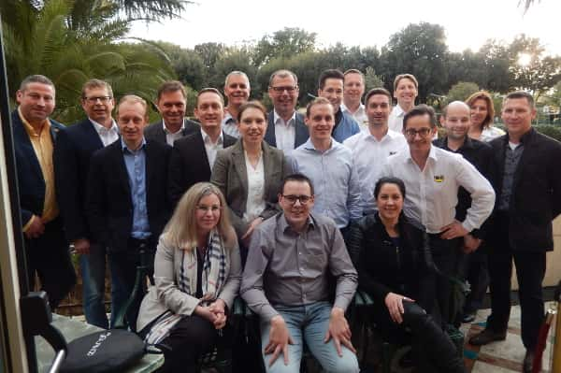
Notes:
We’re more than just a company that sells products
WD-40 Company is a tribe of passionate, committed professionals, all dedicated to the same goal: to create positive lasting memories in every interaction we have.
We’re a global marketing organization dedicated to creating positive lasting memories by developing and selling products that solve problems in workshops, factories and homes around the world.
We employ nearly 450 people globally, and we have loyal end-users and dedicated fans in more than 176 countries and territories worldwide who rely on our portfolio of well-known and popular brands to solve problems.
https://www.wd40company.com/who-we-are/

Slide 8


Slide 9
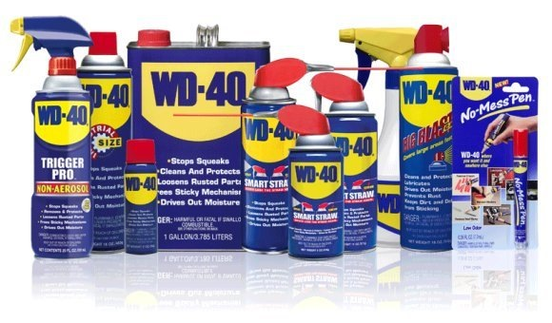

Slide 10


Slide 11
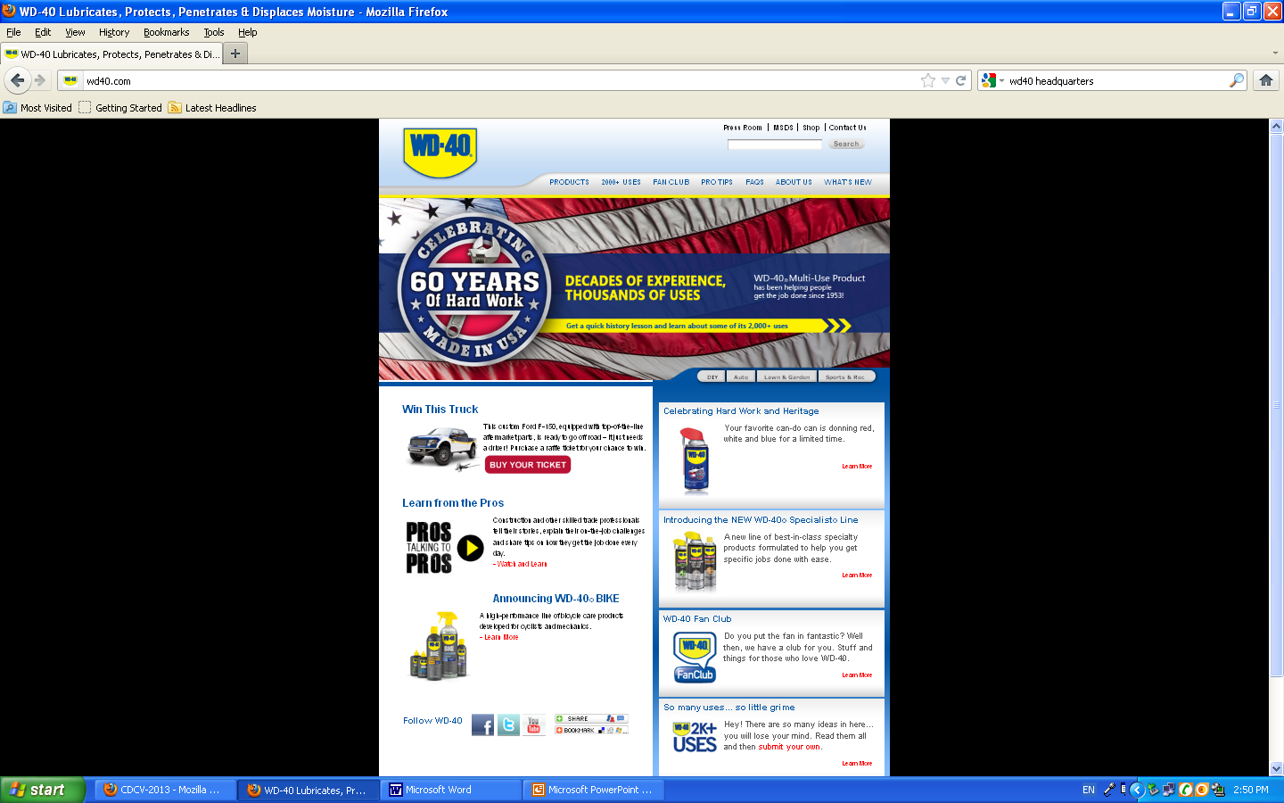

Slide 12
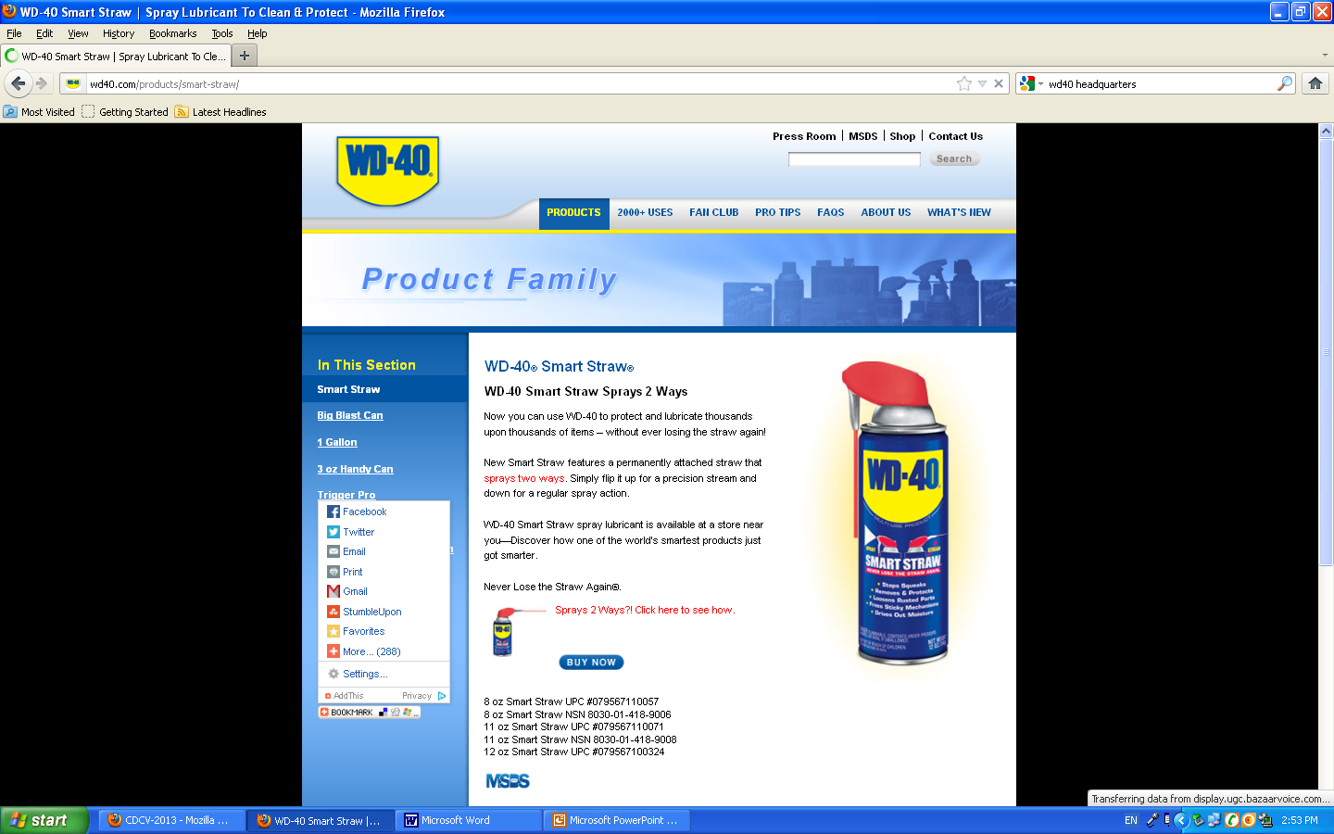

Slide 13
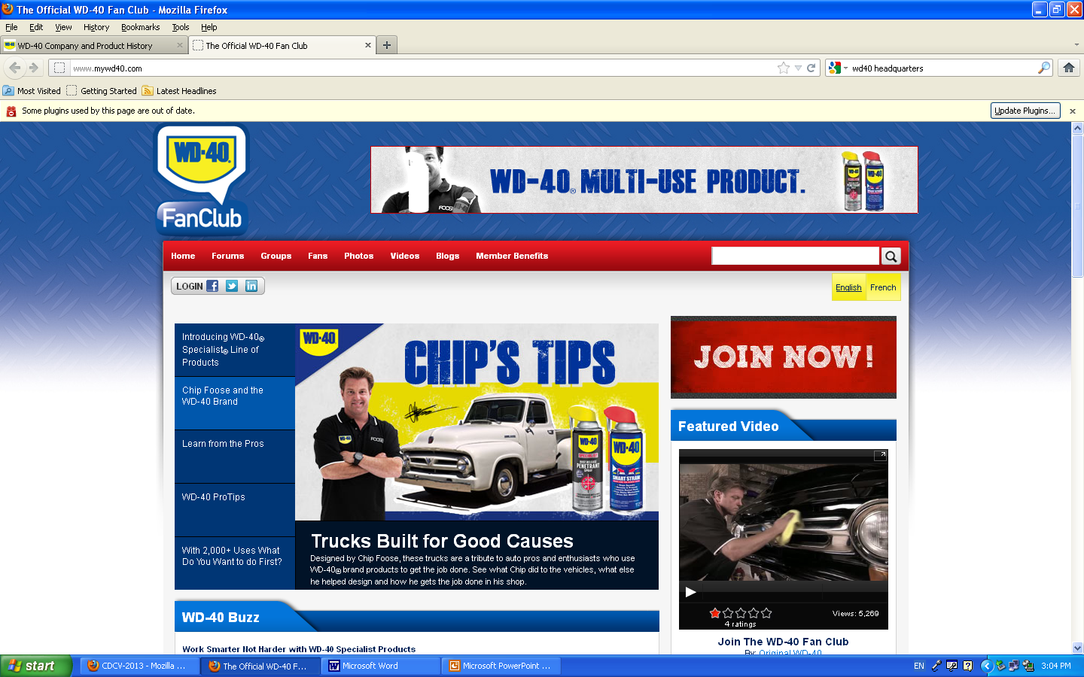

Slide 14


Slide 15


Slide 16


Slide 17


Slide 18


Slide 19
Notes:
http://investor.wd40company.com/investors/news-and-events/press-releases/press-release-details/2018/WD-40-Company-Reports-First-Quarter-2018-Financial-Results/default.aspx
SAN DIEGO, Jan. 9, 2018 /PRNewswire/ -- WD-40 Company (NASDAQ:WDFC), a global marketing organization dedicated to creating positive lasting memories by developing and selling products that solve problems in workshops, factories and homes around the world, today reported financial results for its first fiscal quarter ended November 30, 2017.
Financial Highlights and Summary
Total net sales for the first quarter were $97.6 million, an increase of 9 percent compared to the prior year fiscal quarter.
Translation of the Company's foreign subsidiary results from their functional currencies to U.S. dollars had a favorable impact on sales for the current quarter. On a constant currency basis total net sales for the first quarter would have been $96.2 million, an increase of 8 percent compared to the prior year fiscal quarter.
Net income for the first quarter was $12.6 million, an increase of 7 percent from the prior year fiscal quarter.
Diluted earnings per share were $0.90 compared to $0.82 in the prior year fiscal quarter.
Gross margin percentage was 55.5 percent compared to 57.2 percent in the prior year fiscal quarter.
Selling, general and administrative expenses were up 8 percent in the first quarter to $31.2 million when compared to the prior year fiscal quarter.
Advertising and sales promotion expenses were up 6 percent to $5.1 million compared to the prior year fiscal quarter.
"The tribe has delivered solid first quarter results, reflecting excellent execution of our first and second strategic initiatives and the fact that for the first time in a long-time, foreign currency exchange rates are not diluting our reported net sales results," said Garry Ridge, WD-40 Company's president and chief executive officer.
"Our flagship product, WD-40 Multi-Use Product grew 10 percent in the first quarter, and our WD-40 Specialist product line grew 29 percent compared to the prior year quarter.
"Overall we are off to a good start in 2018 and we believe our focus on executing against our strategic initiatives will continue to drive revenue growth, further strengthen our financial foundation, and enhance shareholder value," Ridge concluded.

Slide 20
THANK YOU FOR YOUR ATTENTION!

