Slide 1
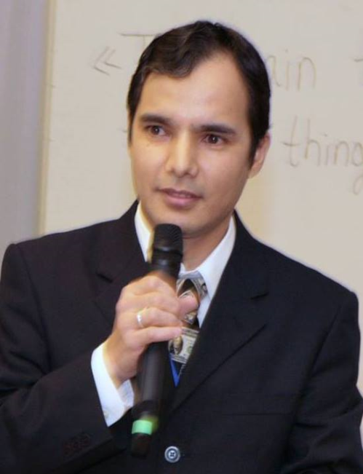
Practical workshops in Marketing Management
Mamurjon Rahimov
mrahimov@wiut.uz

Slide 2

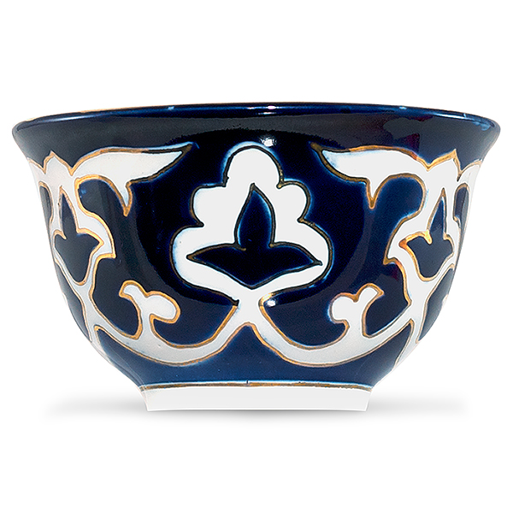
Product analysis: a comparative analysis of Uzbek Piyola
Mamurjon Rahimov
Mamurjon@gmail.com

Slide 3
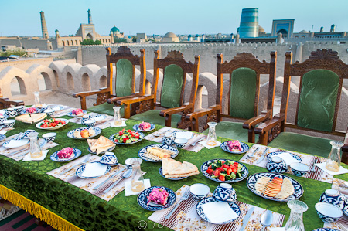

Slide 4
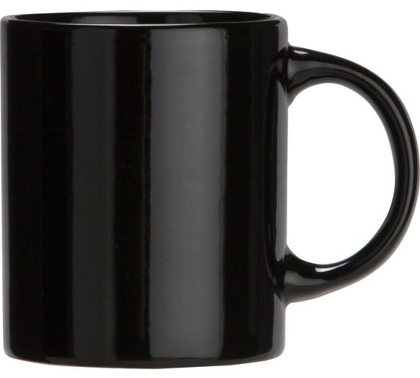

Slide 5
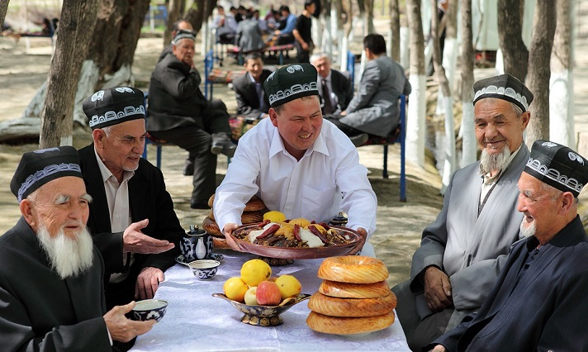

Slide 6
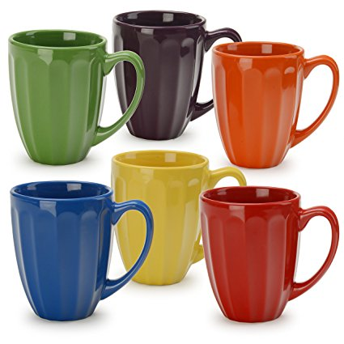

Slide 7
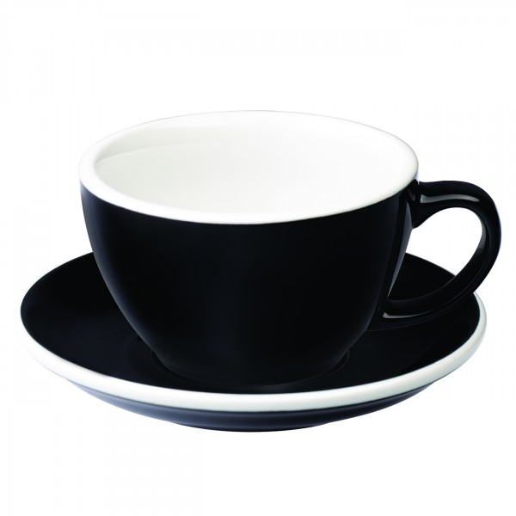

Slide 8
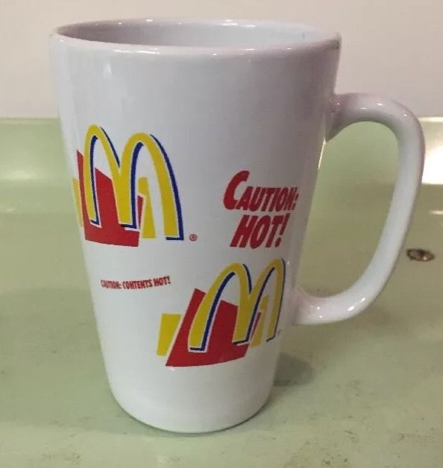

Slide 9
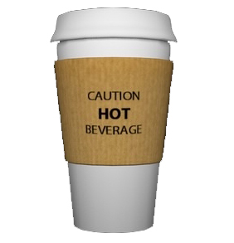

Slide 10
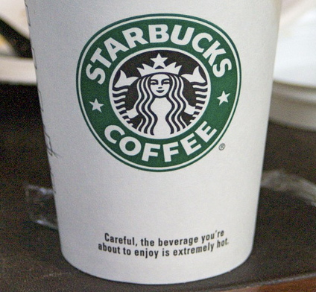

Slide 11
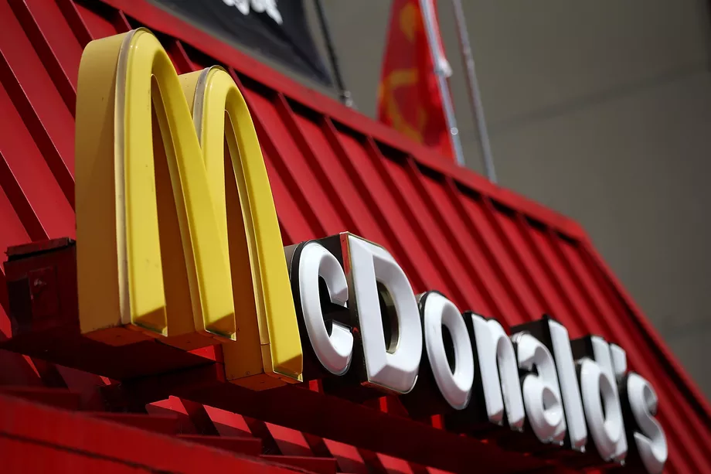
McDonald's Settles Another Hot-Beverage Lawsuit
Details of the settlement have not been disclosed.
Notes:
https://www.eater.com/2015/11/12/9725546/mcdonalds-lawsuit-hot-water-spilled-settlement

Slide 12


Slide 13
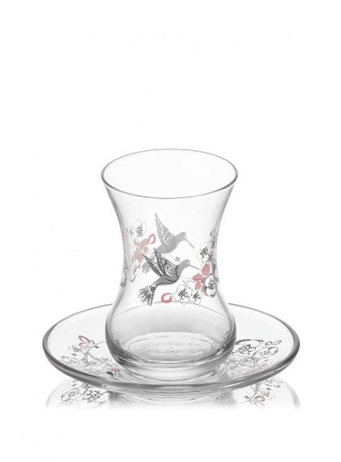

Slide 14
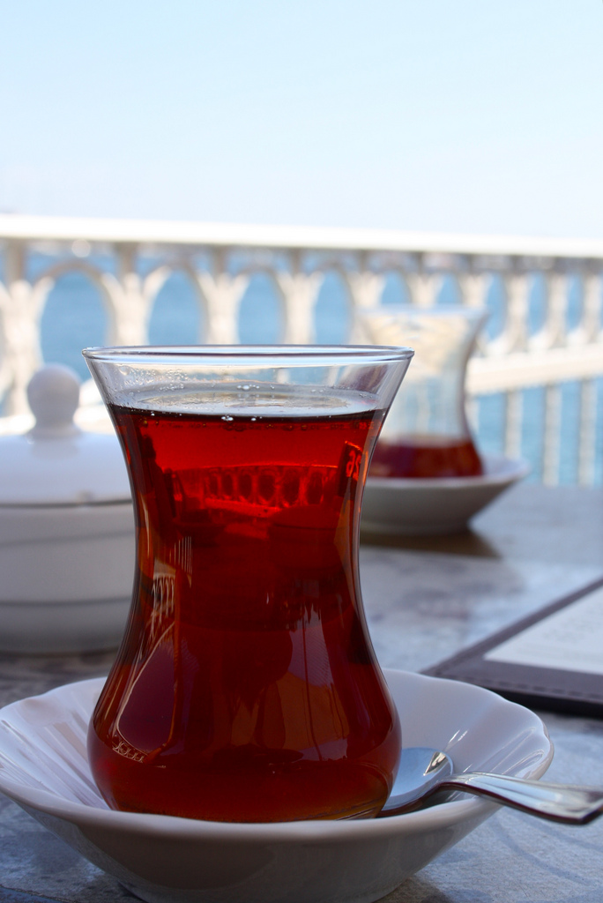

Slide 16
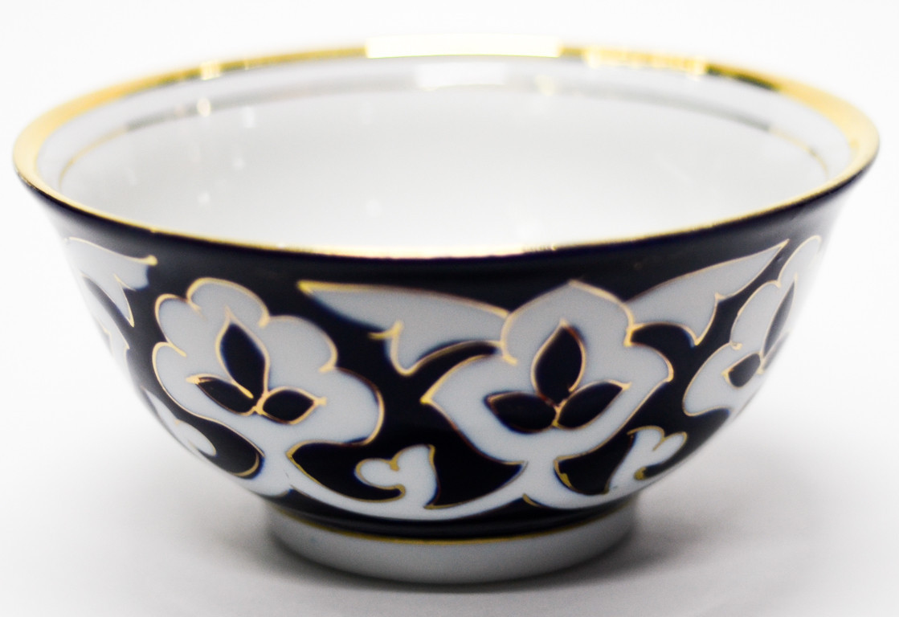

Slide 17


Slide 18
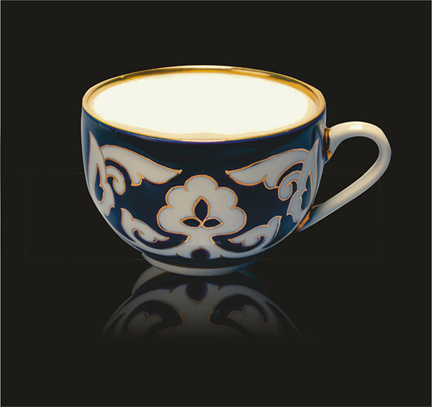

Slide 20
Product/Factor | Material | Color | Shape/design
American mug | Porcelain | Multicolor | Cylinder
Turkish bardak | Glass | Transparent | Two cones merged on top
Uzbek Piyola | Porcelain+gold | White | Upside down dome

Slide 21
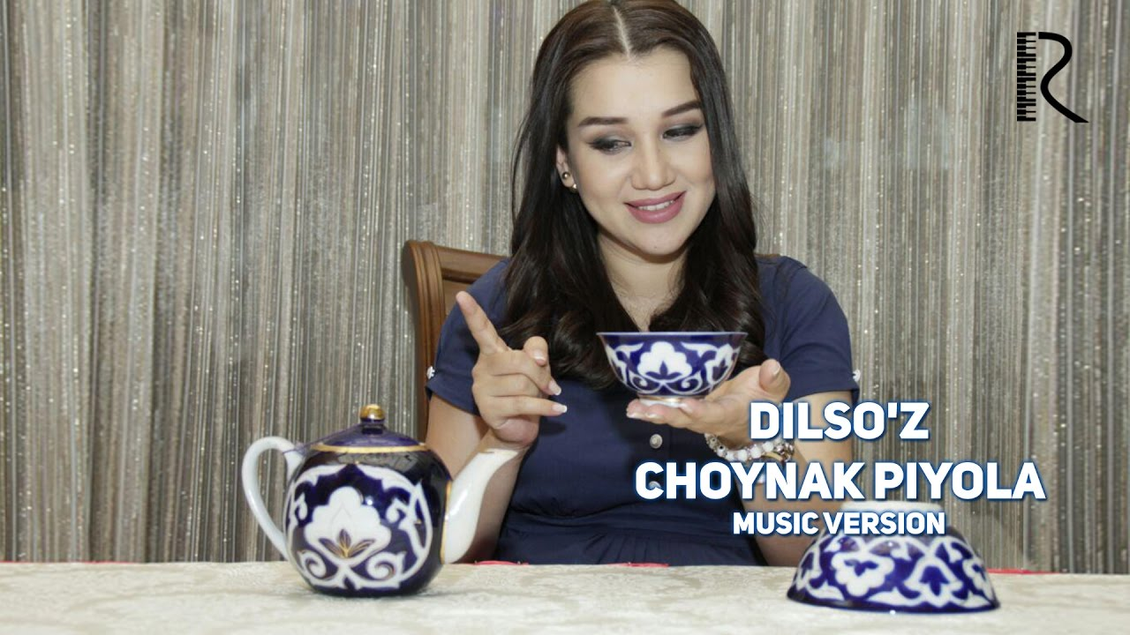
Notes:
Uzbek proverbs about piyola

Slide 22
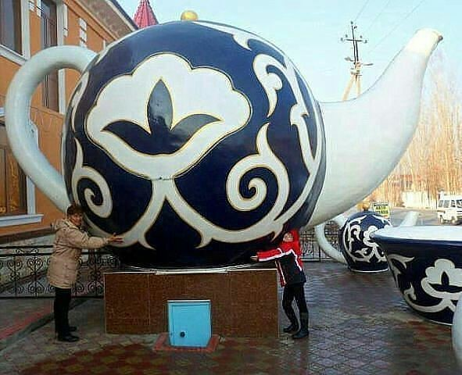

Slide 23
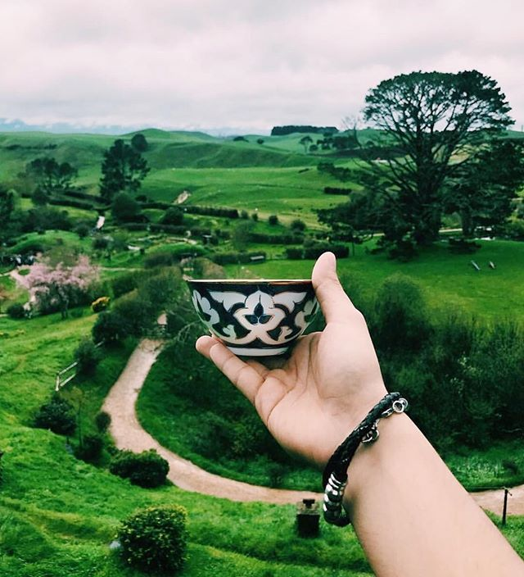
#piyola
Notes:
https://www.instagram.com/explore/tags/piyola/

Slide 24
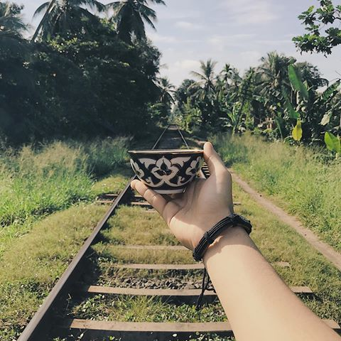

Slide 25
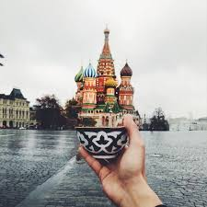
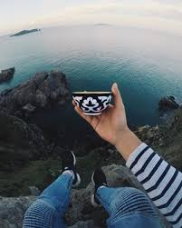
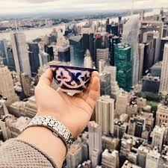
#teazeal

Slide 26
THANK YOU FOR YOUR ATTENTION!

