Slide 1
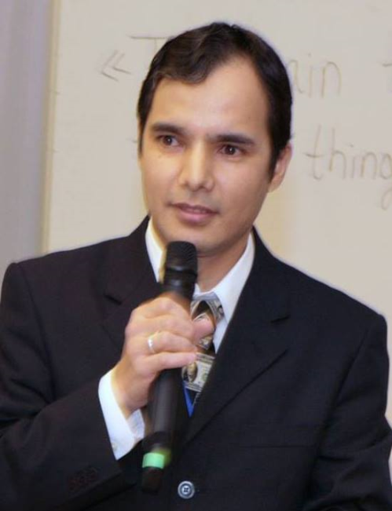
Practical workshops in Marketing Management
Mamurjon Rahimov
mrahimov@wiut.uz

Slide 2

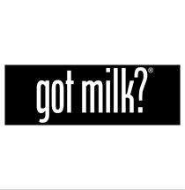
Intra-industry cooperation: Milk producers joining forces
Mamurjon Rahimov
Mamurjon@gmail.com

Slide 3


Slide 4
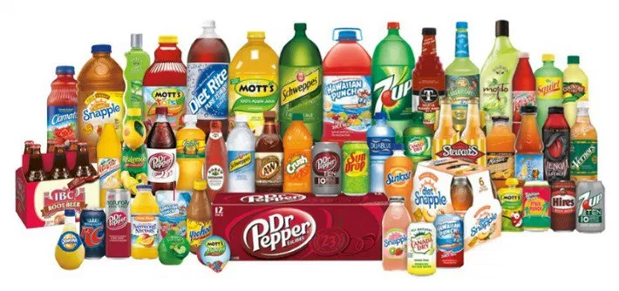

Slide 5
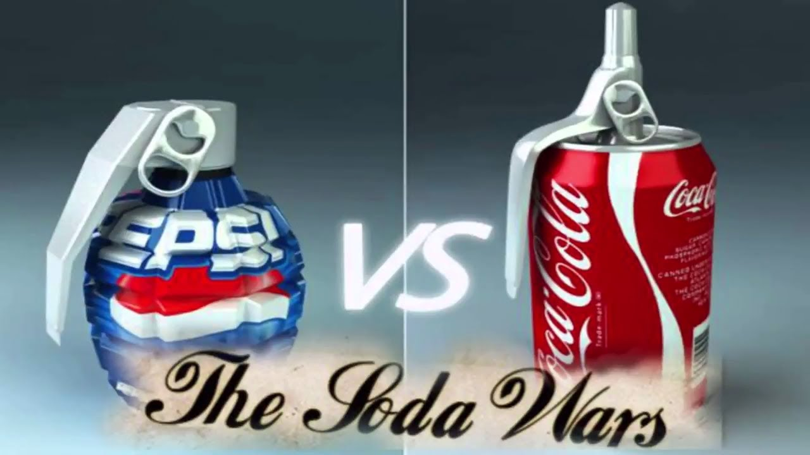

Slide 6
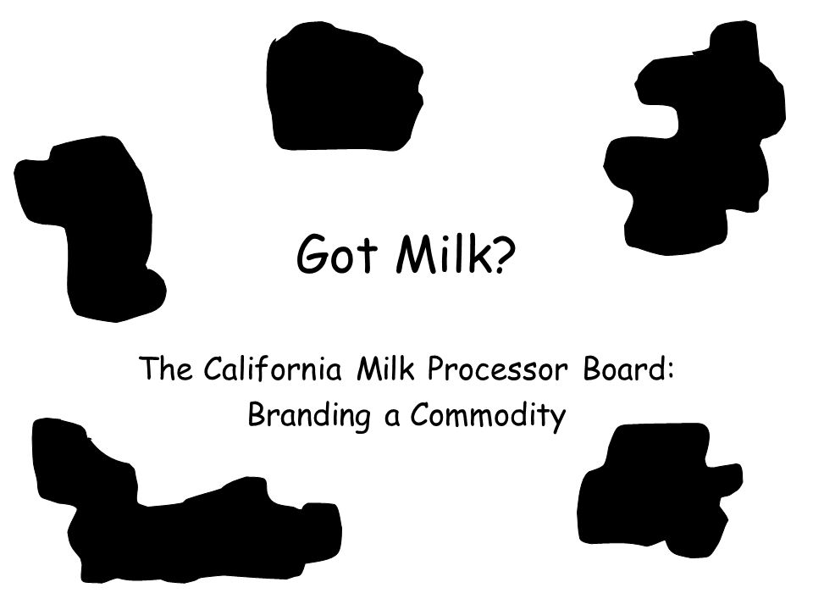
Notes:
http://www.adweek.com/creativity/20-years-got-milk-153399/
—Jeff Goodby of Goodby, Silverstein & Partners wrote "got milk?"—one of the greatest marketing taglines ever. Here, he looks back at the campaign on its 20th anniversary.
It is perhaps the most boring product imaginable.
We have all tried it. Most of us already own some. There is very little to say about it.
Milk is not new. It is not improved. It is white.
And so it was that when the California Milk Processor Board first asked us to pitch their business in 1993, we were shockingly ambivalent. A number of us simply thought the product was inherently too boring.
Oversimplifications of the history abound. Here's what really happened: Jon Steel and Carole Rankin were at a focus group when the clouds parted and a woman said, "The only time I even think about milk is when I run out of it." Goodby scrawled "got milk?" on a poster board for a meeting and decided it might be a tagline. And Silverstein set it in that typeface that has by now been appropriated ("got ____?") by lots of junk, donuts, wine and Jesus folks.
And of course, a 20-year downturn in California milk consumption leveled off and has even headed upward now and then.

Slide 7
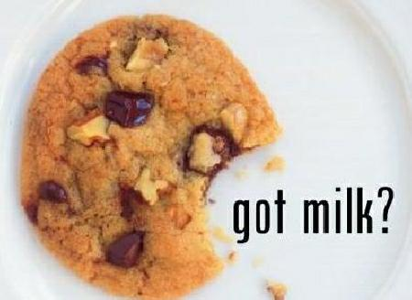

Slide 8
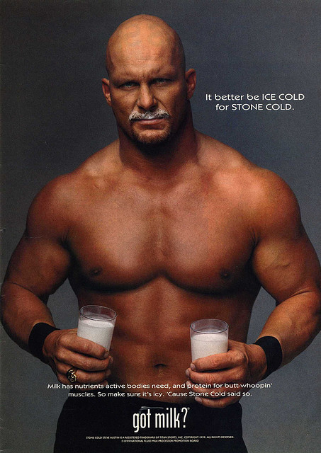

Slide 9
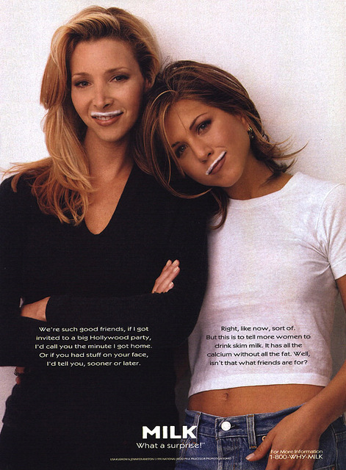

Slide 10
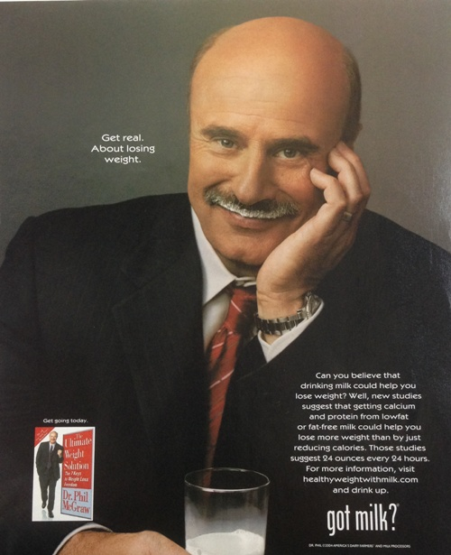

Slide 11
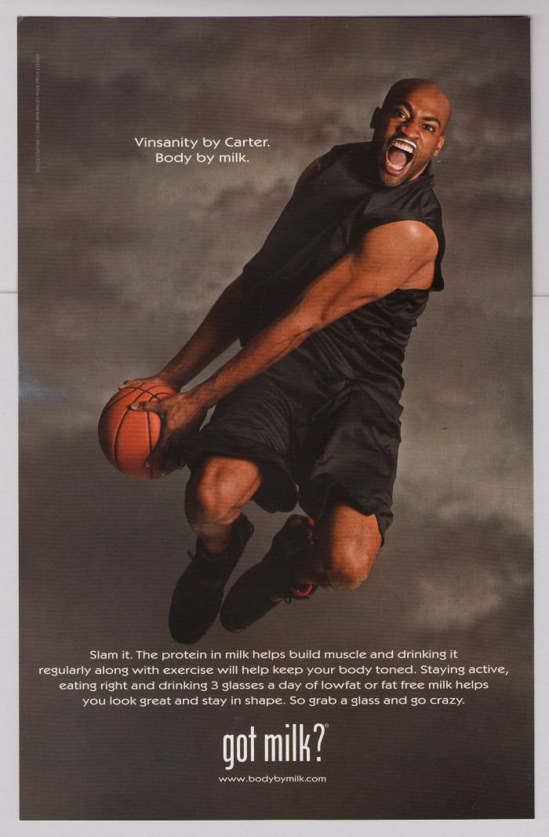

Slide 12
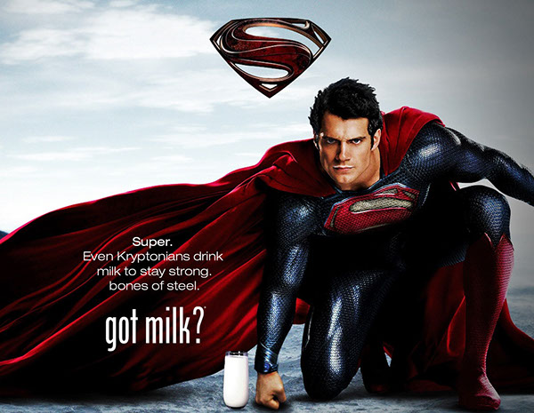

Slide 13
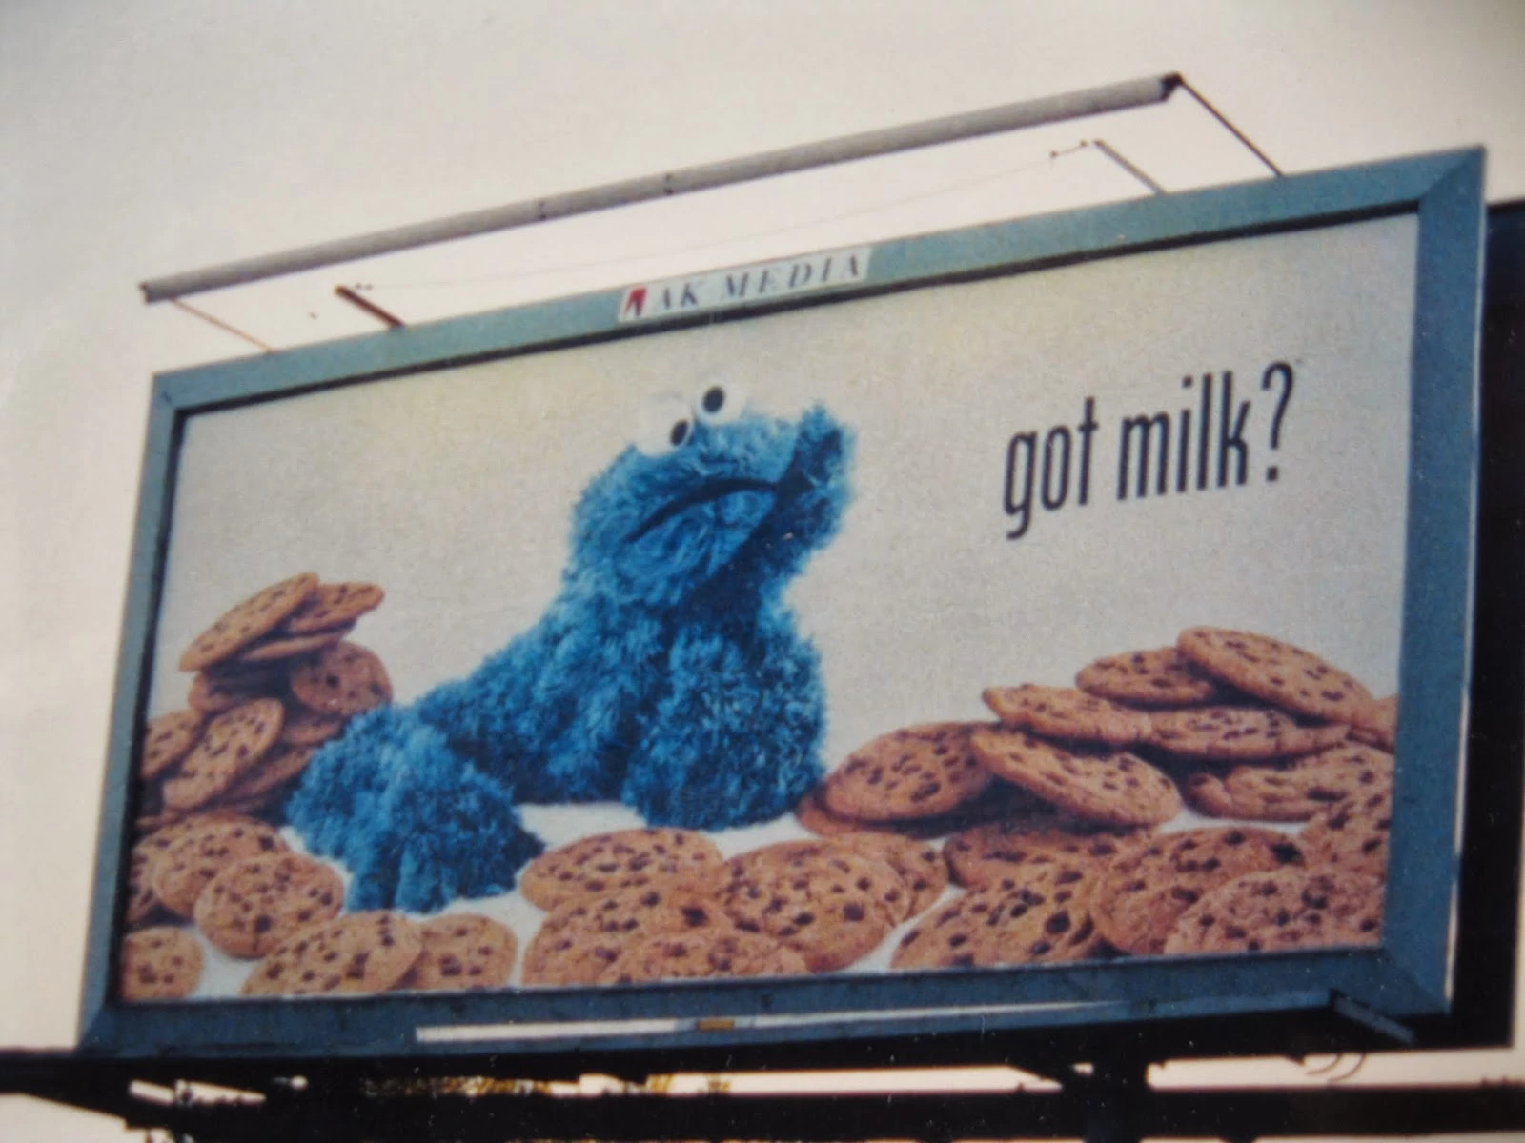

Slide 14
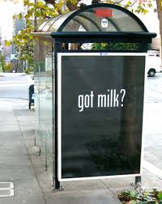

Slide 15
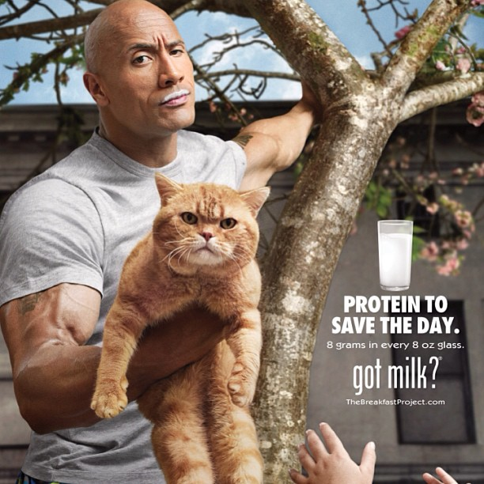

Slide 16
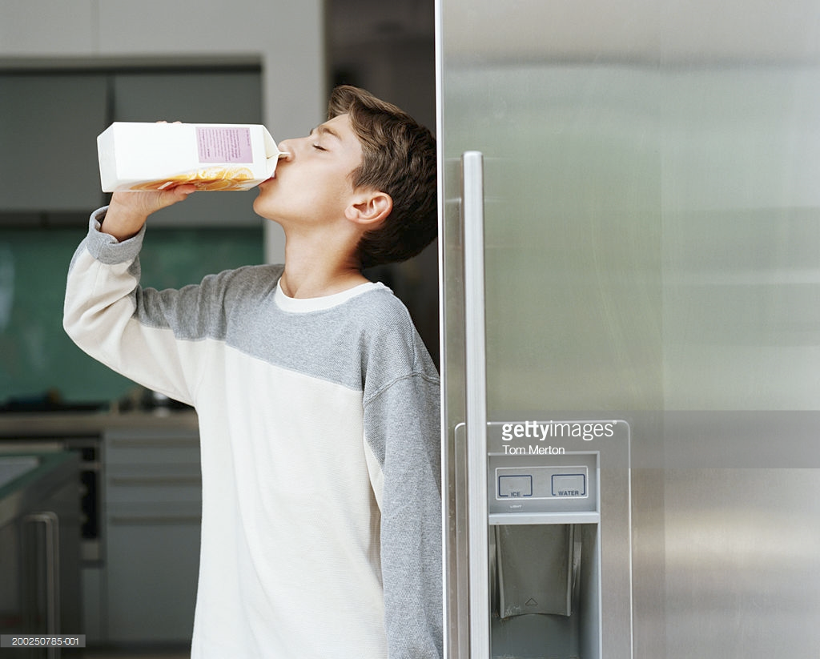

Slide 17


Slide 18
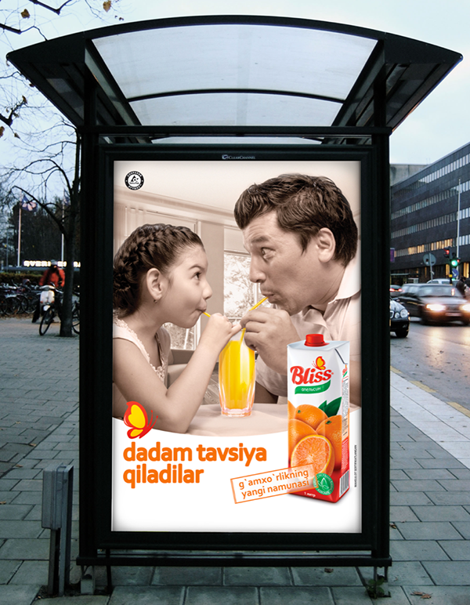

Slide 19
THANK YOU FOR YOUR ATTENTION!

