Slide 1

Practical workshops in Marketing Management
Mamurjon Rahimov
mrahimov@wiut.uz

Slide 2

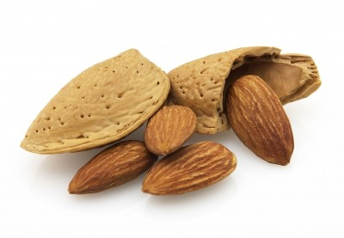
Inter-industry cooperation: in the case of California almonds
Mamurjon Rahimov
Mamurjon@gmail.com

Slide 3


Slide 4


Slide 5
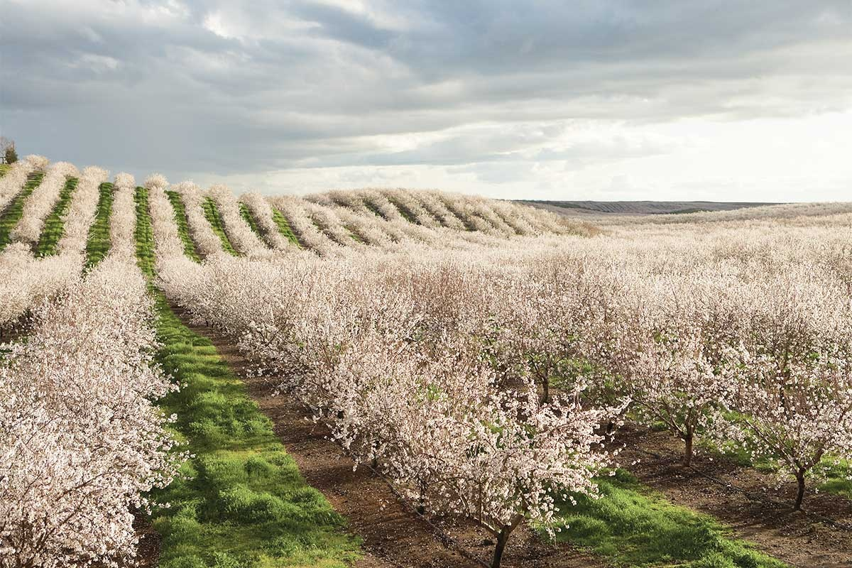

Slide 6
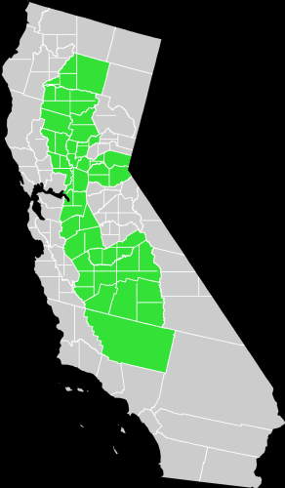
Central Valley of California
Notes:
Most almond farms are there.

Slide 7
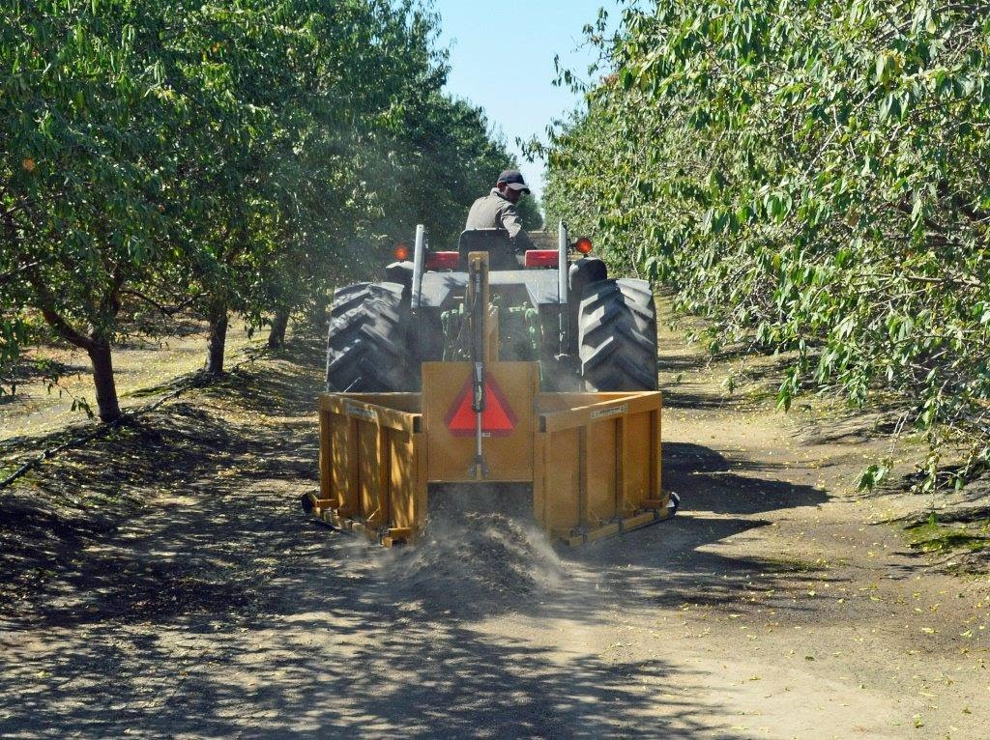
Notes:
Of course, farming there is more mechanized.

Slide 8
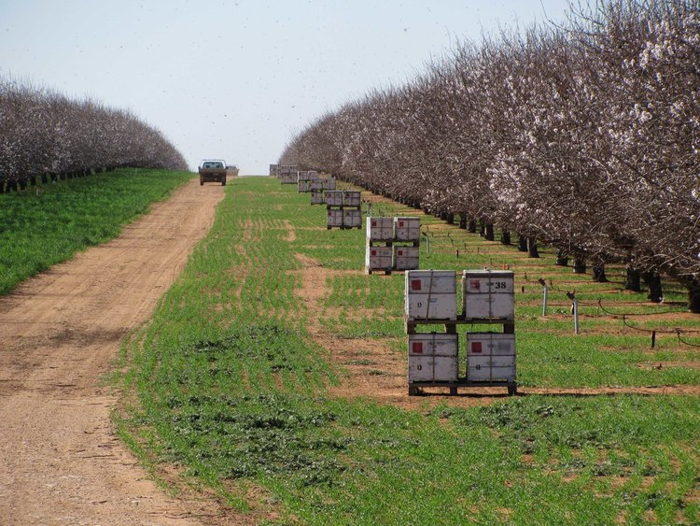

Slide 9
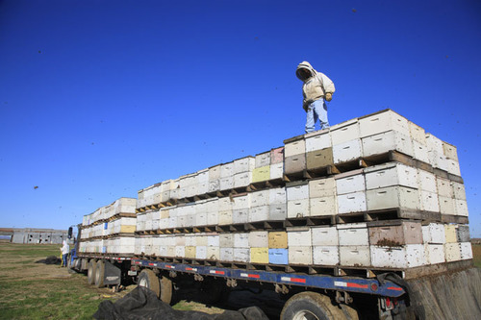
Notes:
2/3 of all honeybees are hauled to California during almond bloom!

Slide 10
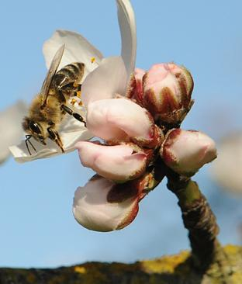

Slide 11


Slide 12
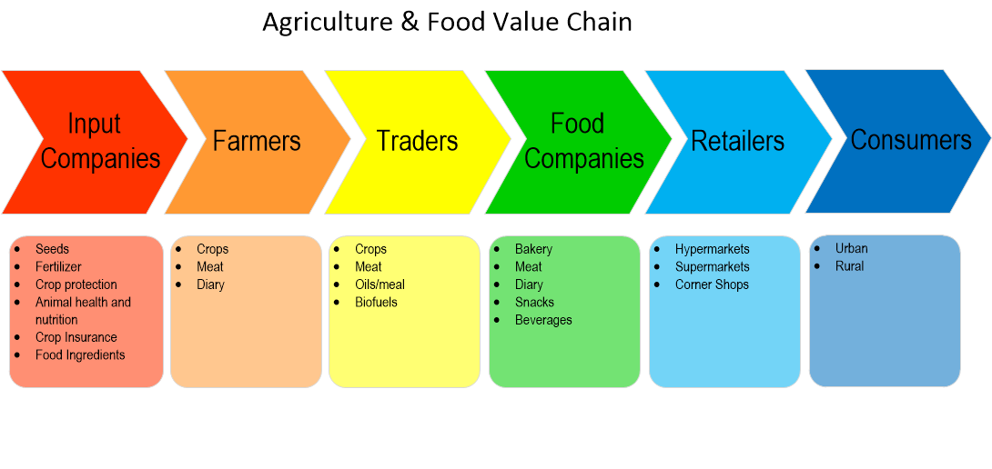

Slide 13
THANK YOU FOR YOUR ATTENTION!

