Slide 1
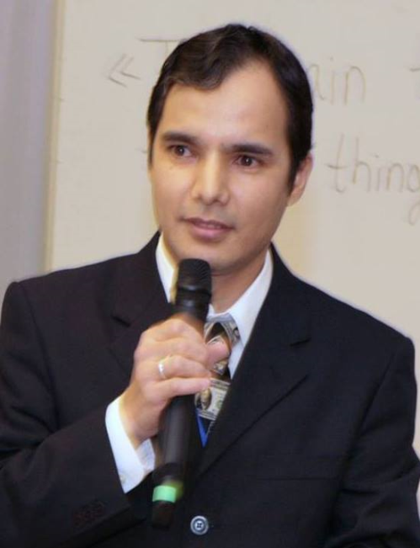
Practical workshops in Marketing Management
Mamurjon Rahimov
mrahimov@wiut.uz

Slide 2

Cases from the marketplace
Mamurjon Rahimov
Mamurjon@gmail.com

Slide 4
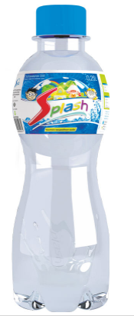
Splash – positioned as water for children…
Splash 0,25L - natural water for children
A miniature bottle, which so comfortably fits in the palm of the child. It can be put in a children's backpack, where it does not take much space. The bottle cap can be easily and quickly opened by your child. The wide neck of the bottle will allow the child to effortlessly drink enough water!

Slide 5
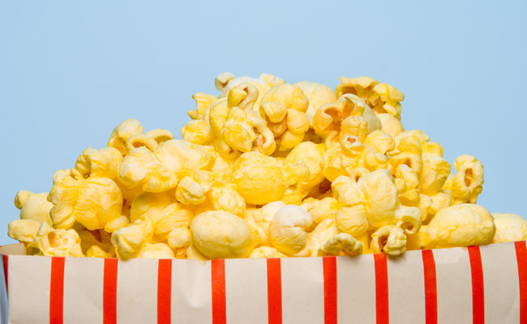

Slide 6
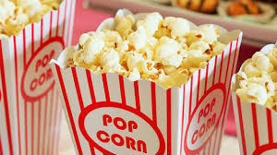

Slide 9
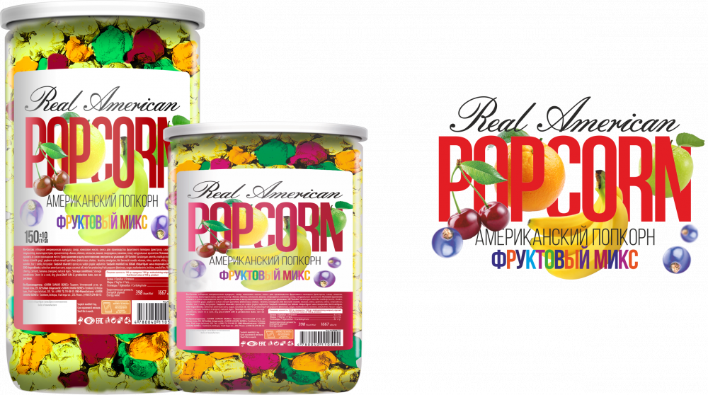

Slide 10
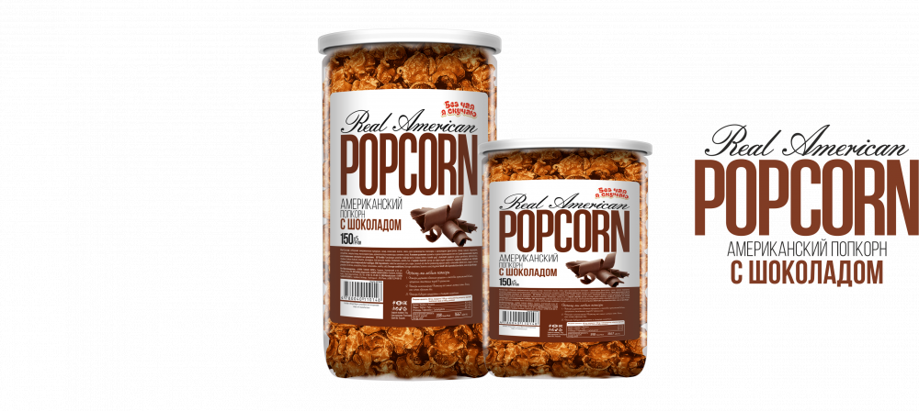

Slide 11
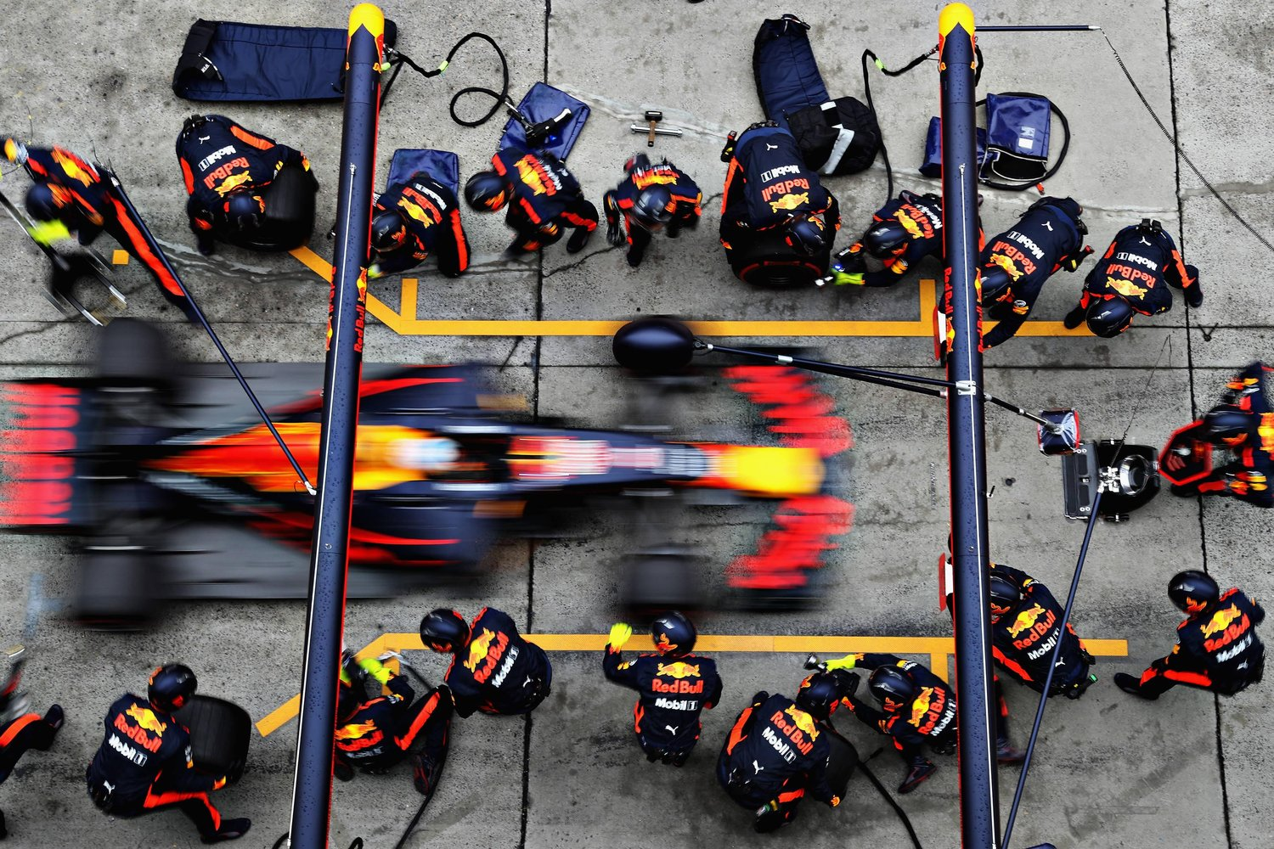

Slide 12
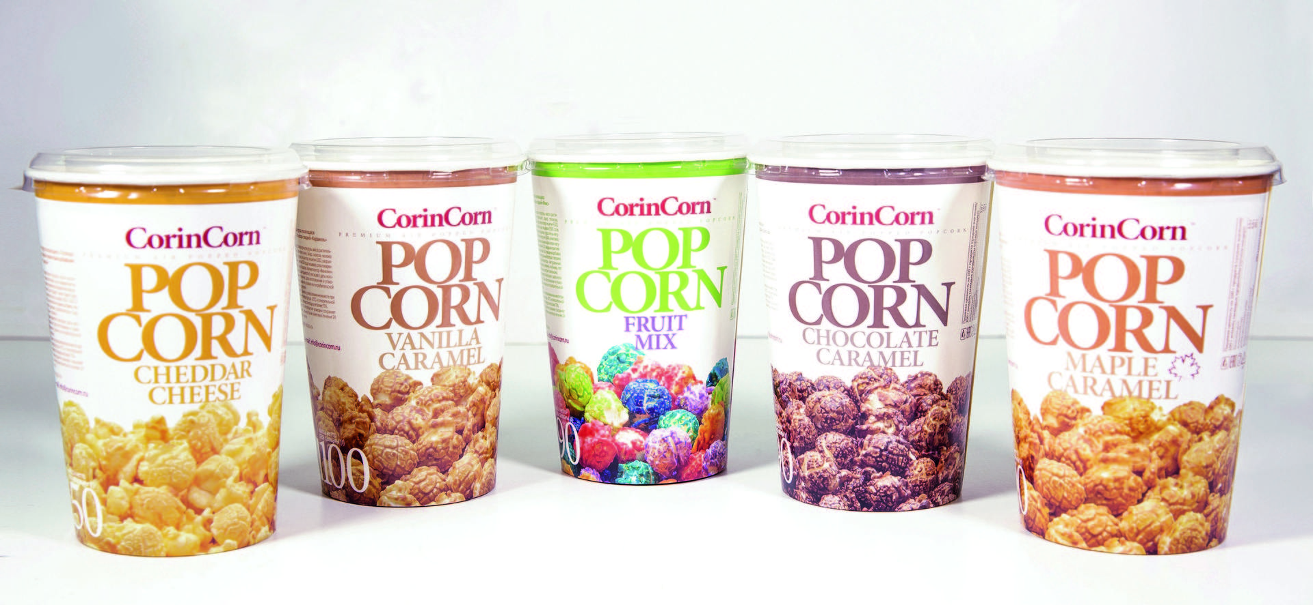

Slide 13
THANK YOU FOR YOUR ATTENTION!

