Slide 1
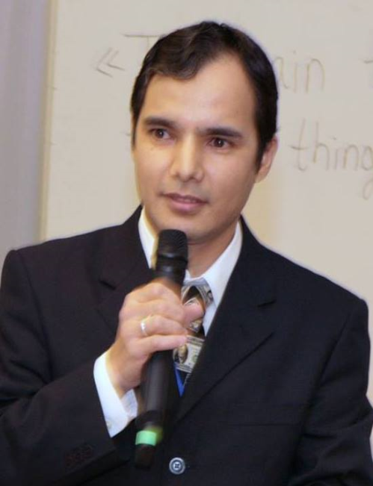
Practical workshops in Marketing Management
Mamurjon Rahimov
mrahimov@wiut.uz

Slide 2

State of Marketing in Uzbekistan
Mamurjon Rahimov
Mamurjon@gmail.com

Slide 3

This is the year of Marketing
Notes:
Because Innovation is the second name of Marketing!

Slide 4

Startups in all spheres are being supported.

Slide 5
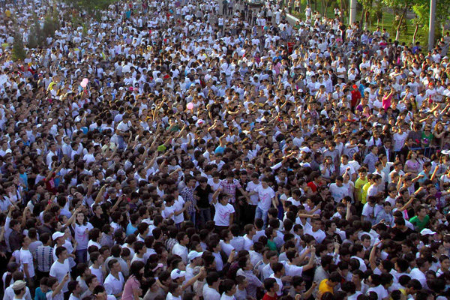
Factors which are necessitating Marketing
Notes:
Growing population
https://www.uzdaily.com/en/articles-id-40366.htm
Population of Uzbekistan reach 32.43 million people
07 August 2017 13:49
Tashkent, Uzbekistan (UzDaily.com) -- As of 1 July 2017, the resident population of Uzbekistan, according to preliminary data, made up 32.345 million people and increased since the beginning of 2017 by 224,500 people or by 0.7%.According to the State Statistics Committee of Uzbekistan, the urban population of Uzbekistan reached 16.353.0 million people (50.6% of the total population), the rural population – 15.992 million people (49.4%).
Birth
In January-June 2017, the number of births was 311,900 people and, compared to the corresponding period of 2016 (317,900 people) decreased by 6,000 people, respectively, the birth rate was 19.5 ppm.
The most significant decrease in the birth rate was observed in Tashkent city (from 19.1 ppm to 18.0 ppm), Kashkadarya (from 22.2 ppm to 21.3 ppm), Ferghana (from 19.4 ppm to 18.5 ppm), Khorezm (from 17.5 ppm to 16.6 ppm), Jizzakh (from 22.7 ppm to 21.9 ppm), Namangan (from 20.9 ppm to 20.2 ppm), Bukhara (from 17.8 ppm to 17 ppm), Samarkand (from 21.6 ppm to 21.0 ppm) and the Republic of Karakalpakstan (from 19.2 ppm to 18.1 ppm).
Mortality
The number of deaths in January-June 2017 reached 78,800 people and, compared to the corresponding period of 2016 (73,900 people) increased by 4,900 people, respectively, the death rate was 4.9 per mil (in January-June 2016 - 4.7 ppm).
The death rate increased significantly in Andijan (from 5.0 to 5.5 ppm), Jizzakh (from 4.0 to 4.4 ppm), Kashkadarya (from 3.8 to 4.2 ppm), Namangan (from 4.4 To 4.8 ppm), Surkhandarya (from 4.1 to 4.5 ppm), the Ferghana (from 4.7 to 5.0 ppm), Khorezm (from 4.3 to 4.6 ppm) and the Republic of Karakalpakstan (from 4.2 to 4.5 ppm).

Slide 6
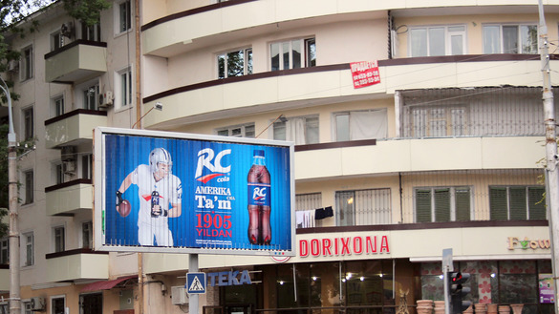
Factors which are necessitating Marketing
Notes:
Increased competition

Slide 7

A chance to win a car by shopping there?

Slide 8
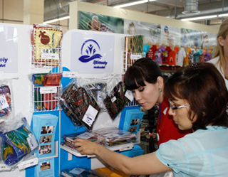
Factors which are necessitating Marketing
Notes:
More demanding consumers

Slide 9
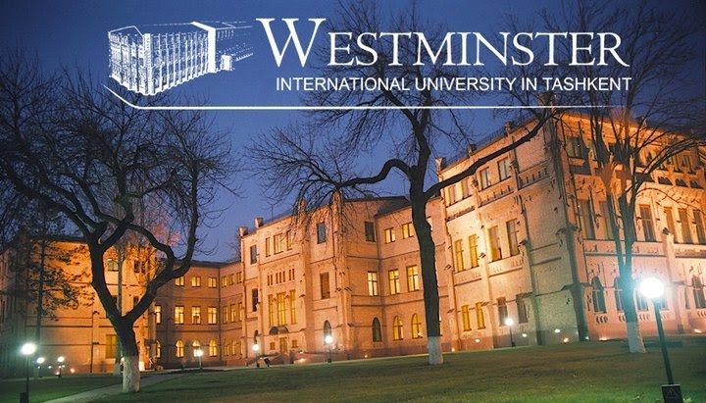
Notes:
No wonder, Marketing is the most popular area at our University!

Slide 10
THANK YOU FOR YOUR ATTENTION!

