Slide 2
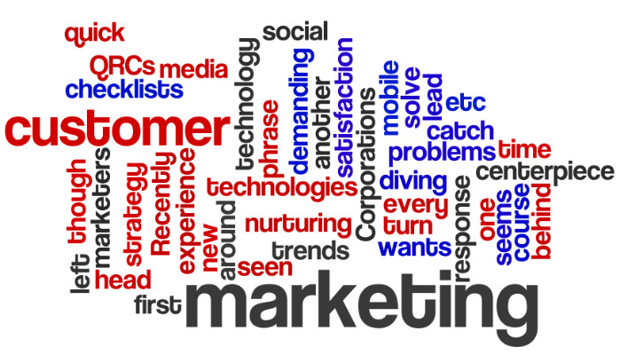
How marketing mix is impacted by digital environment?
Lecture 3
By Zamira Ataniyazova
© Zamira Ataniyazova

Slide 3
“A marketer is like a chef in a kitchen . . . a mixer of ingredients.”
Bartels (1963)
© Zamira Ataniyazova

Slide 4
What is the Marketing Mix?
© Zamira Ataniyazova

Slide 5
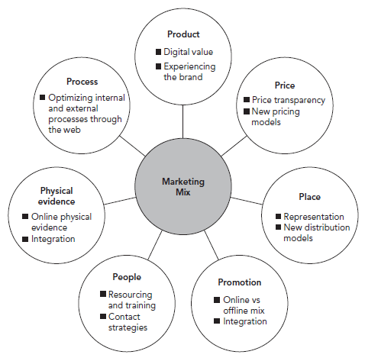
The 7Ps of the Classic Marketing Mix

Slide 6
Beyond the Mix
Decisions on the mix are not made until marketing strategy first determines target markets and required brand positionings.
Professor Peter Doyle: segmentation is the key to marketing. If there is one golden rule for upcoming marketers, then it is segmentation.
  People are heterogeneous.
  People are prepared to pay different prices.
Positioning is central to marketing strategy.

Slide 7
The Mix is Morphing
Social media has changed everything. Generating conversations on social media platforms enhances the product experience (product), promotes the brand (promotions), and spreads the accessibility of a brand (place) and is totally dependent on well-trained teams (people) who are given crystal-clear systems and processes (processes).

Slide 8
IKEA Place Video
© Diana Khutsishvili 2018

Slide 9

Product
Remember to keep asking, ‘How can I help my customer?’
Prosumer – the proactive consumer who participates in the design of products or services.
Cohen et al. (2006) from the Harvard Business School believe that ‘all products become services’ as the after-sales market opens up new opportunities.
Online opportunities for enhancing
product value can also be identified.
The different elements of the extended
product can be highlighted or delivered
online.

Slide 10

Price
Pricing and price models are being turned upside down by the Internet.
New buying models require new pricing approaches.
As prices are published on the web, buyer comparison of prices is more rapid than ever before. Such comparison sites create customer empowerment which leads to further downward pressure on prices.
Pricing is such an important variable, but it can be complex when there are hundreds or even thousands of products competing in a busy marketplace packed with competitors that constantly change their prices.

Slide 11
Place
Place means the place of purchase, distribution and, in some cases, consumption.
Online or offline the principle is the same: increase your representation and make it widely and readily available to target customers.
Marketers today need to think of multi-channels for distribution to ensure they make their products and services easily available to as many ideal customers as possible.

Slide 12

Promotion
GUIDELINES FOR EFFECTIVE PROMOTION
  Promotional mix
  Integration
  Creativity
  Interaction
  Globalization
  Resourcing

Slide 13
People
In services marketing, people, or staff, are considered a crucial element of the marketing mix.
  Happy Staff = Happy Customers = Happy Shareholders
Contact strategies should be developed that give customers choice of contact, but minimize costly interactions with staff.

Slide 14
Physical Evidence
As services are intangible, customers look for reassurance that the service is going to be alright.
They look for cues such as a well-designed site (as well as endorsements) to give them clues about the quality of the intangible service.
Web sites can provide these in the form of high-quality site design and reassurance – through guarantees, refund policies, privacy policies, security icons, trade body memberships, awards, customer lists, customer endorsements, independent reviews, news clippings and more.
Physical evidence should help to integrate the online and offline world.

Slide 15
Process
Process refers to the internal and sometimes external processes, transactions and internal communications that are required to run a business.
Optimization involves minimizing the people involved with responding to each event and providing them with the right information to serve the customer.
Processes continue beyond the sale with after-sales service, generating customer feedback, upselling, cross-selling, product development and improvement built in as part of the processes.

Slide 16
Partnership
Kenichi Ohmae (Smith, 1996) said that no company can succeed globally without partners.
Some companies have people specializing in partnerships; other companies employ agencies to be their partners or even agencies to find their partners, whether through a blogger outreach programme (to connect with more bloggers) or an affiliate marketing campaign (to recruit more affiliate marketers).

Slide 17
Essential reading
Chaffey, D., Smith, P. R., & Smith, P. R. (2013). eMarketing eXcellence: Planning and optimizing your digital marketing. Routledge. Chapter 3.
PDF of the full book can be downloaded through the link: http://charsoomarketing.com/wp-content/uploads/downloads/2016/02/Dave_Chaffey_PR_Smith_Emarketing_Excellence_Pl.pdf

Slide 18
Further reading
Chaffey, D. (2011) E-Business and E-Commerce Management: Strategy, Implementation and Practice, 5th edition. Financial Times/Prentice Hall, Harlow. Chapter 8 introduces the concept of E-marketing and its relationship with e-commerce and e-business.
DTI (2003) Business in the Information Age – International Benchmarking Study 2003. Department of Trade and Industry, London.
http://www.cbsnews.com/videos/warby-parker-tops-fast-company-magazines-annual-list-of-most-innovative-companies-in-the-world/

