Slide 2
E-Models
Lecture 4
By Dilmurod Khodiev
©Dilmurod Khodiev

Slide 3
Who Am I
Education:
  BBA in International Business and Management- Fontys University of Applied Science (Netherlands)
  MSc. In Marketing Strategy and Innovation – CASS Business School (London UK)
Career
  Associate Lecturer at WIUT (Tashkent)
  Founder of C-Space CoWorking (fb.com/cspaceuz)
  Co-Founder of Power Up- Taste Energy (Energy flavored soft drink)
  2014-2015 Investment Manager at Ansher Capital (Tashkent)
Contacts:
  fb.com/dilmurod
  tg.me/dillkh
  dilmurod@me.com

Slide 4
Introduction
A models is anything that represents reality.
Current models become redundant and businesses that do not adopt new and better models (ways of doing business) lose their competitiveness over time.
Reduced frictions allow major changes,
New models, previously impossible emerge:
  New patterns of media consumption
  Businesses cross categories (i.e. supermarkets become banks)
  Value chains become restructured to eliminate unnecessary components
  Businesses can become “box of contracts” (as many functions are outsourced) *
*Charles Handy 1995

Slide 5
Plan
Online Revenue Models
Communications Models
Customer Information Processing
Intermediary & Attribution Models
Customer Buying Models
Social Media Models
Social Business Models & Ladder of Engagement
© Diana Khutsishvili 2018

Slide 6


Online Revenue Models 1 (sell content)
Subscription access to to documents:
A range of documents or files can be accessed for a period of time. Typically a month or a year
Similar to: Gym, Library, etc.
Examples: Netflix, FT.com, Spotify
Pay per view access to documents
Payment occurs for a single access to a document. Can be downloaded, may or may not be protected with DRM.
Similar to: Going to the cinema
Examples: iTunes Store, online cinemas.

Slide 7
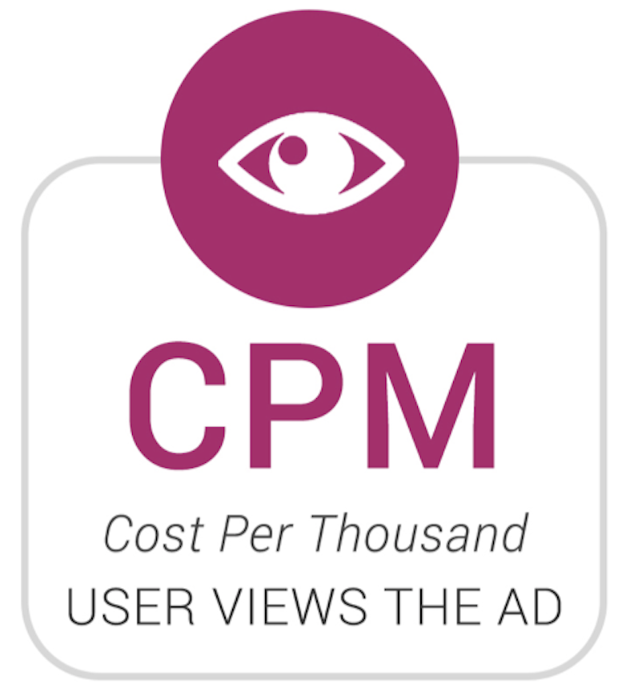
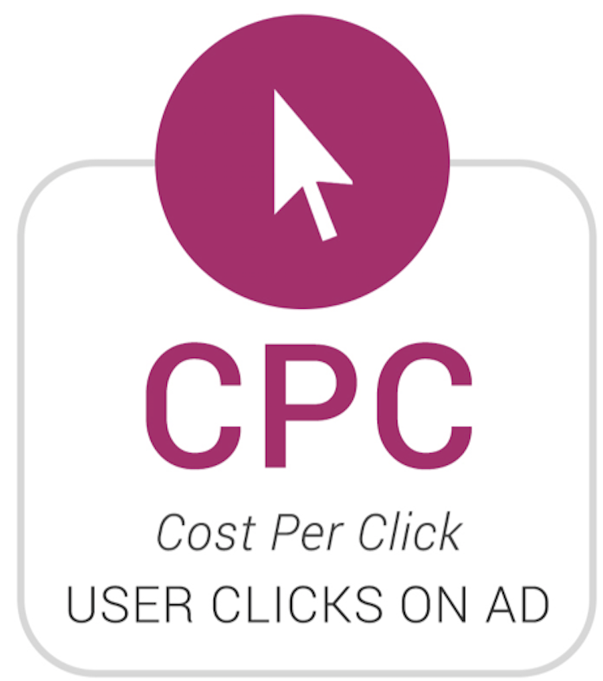
Online Revenue Models 2 (Advertising)
CPM- display advertising
      CPM= Cost Per Mille, Mille means thousand
Ads shown on various web sites in a form of banners or other rich media.
Payment occurs per 1000 views, hence the name.
CPM rates are often cheaper, and advertiser does not know where they are presented (which web site).
Ads can be served through different ad servers such as Google ads.
CPC- Cost Per Click ads on site.
      CPC allows the advertiser to only pay for the number of clicks on the ad, hence they are more targeted
Sponsored links on search engines are also CPC based.
Often these are text based hyperlinks in web sites
For example, when reading a blog about the best universities, you may see a link to certain web-site for students.

Slide 8
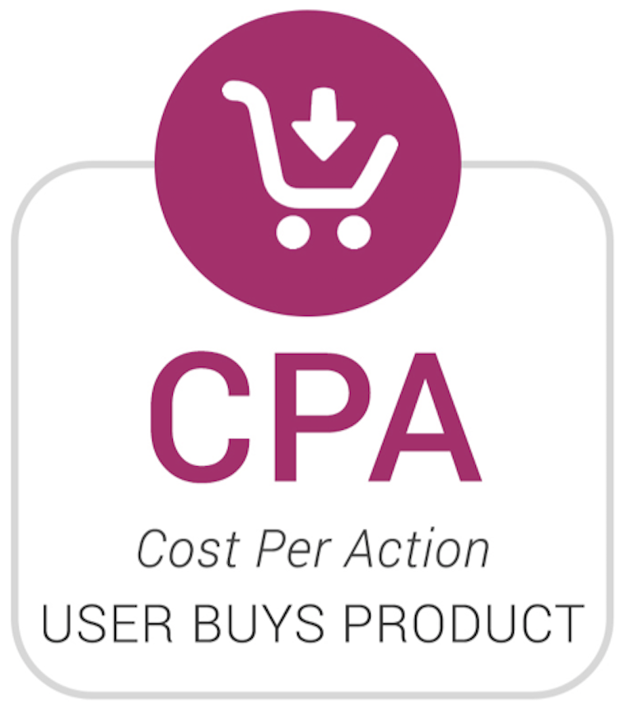
Online Revenue Models 3 (lead generation)
Sponsorship of site or section on the site
A company can sponsor a specific web site or a part of the web site as. It helps the sponsoring party to create awareness and/or create new leads from the website
Typically a fixed fee for a period, but can be CPA (Cost Per Action) or CPC
Affiliate revenue
      Typically CPA (cost per action) but can be CPC.
Web site gets % of profits from the company who sells to people coming from the web site.
i.e. you can display various products from amazon and get paid when somebody arrives on amazon through your site and buys it from amazon.

Slide 9
Online Revenue Models 4 (sell data)
Subscriber data for email marketing
Various web sites sell the email addresses or other contact information of their customers to third parties.
Sometimes ask for the subscriber's permission beforehand.
Access to customer for research
If a site has a very specific type of visitors, companies accessing them could buy access to those customers to do market research on them.
Specific blogs (Niche web-sites)

Slide 10
Online Revenue Models Freemium
Freemium= Free + Premium
Free access with limited functions
Premium options are available to get more advanced functions
Lower adoption barrier
Increased awareness
Increased conversation due to ease of conversion
Other models are possible in combination with freemium
Often used in games.

Slide 11
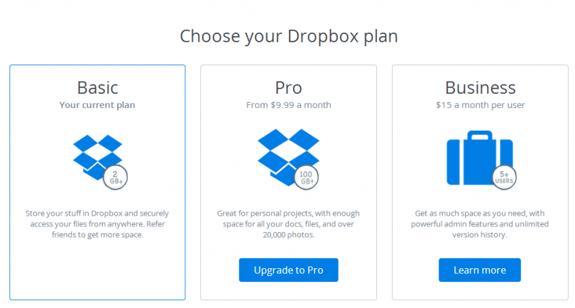
Freemium

Slide 12
Joshua Bell Experiment
VIDEO: https://www.youtube.com/watch?v=hnOPu0_YWhw
Joshua Bell one of the most famous Violin players
Concert tickets sold out at $100 per ticket
His violin is worth $15.000.000
Plays for one hour
Almost nobody notices
He makes only $45
WHY…?

Slide 13
Information Processing Models
ALEA by Rossiter and Bellman(1999)
Online advertisements are experienced as process where
(A)ttention is gained, followed by
(L)earning and
(E)motional response. And it the response is positive or negative further attention may be allocated and further learning can take place until the brand’s position is
(A)ccepted
Non-hierarchical, customer can go in random order depending on the hierarchy of their need (high involvement vs. low involvement)

Slide 14
Information Processing Models
Hofocker’s model (2001)
Can help to measure the effectiveness of an ad or a promotional container
Exposure- is the message presented for long enough?
Attention- what grabs attention?
Comprehension and Perception- how does the customer interpret the stimulus?
Yielding and Acceptance- is the information accepted by the customer?
Retention- how well can the customer recall their experience?
Each step is a hurdle, if the site design or the ad is too difficult customer cannot move to the next stage.

Slide 15
Customer Buying Models
Low Involvement:
When buying cheaper and less important products, we spend less time and effort thinking about the decision. These Models explain the basic process:
  AIDA (Attention > Interest > Desire > Action)
  ATR (Awareness > Trial > Reinforcement)
  Customers should be presented the right information based on which stage of the purchase they are.
High Involvement:
When buying expensive products (car, house, laptop, etc) consumers go through rigorous search to evaluation to decision process.
  Web-rooming vs. Showrooming
  Number of reviews

Slide 16
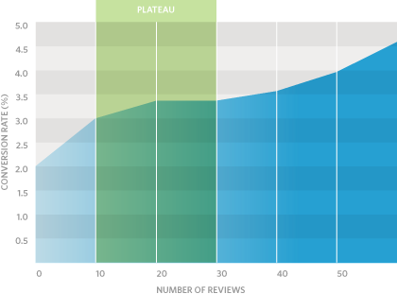
Customer Buying Models
Number of reviews to Conversion rate Correlation

Slide 17
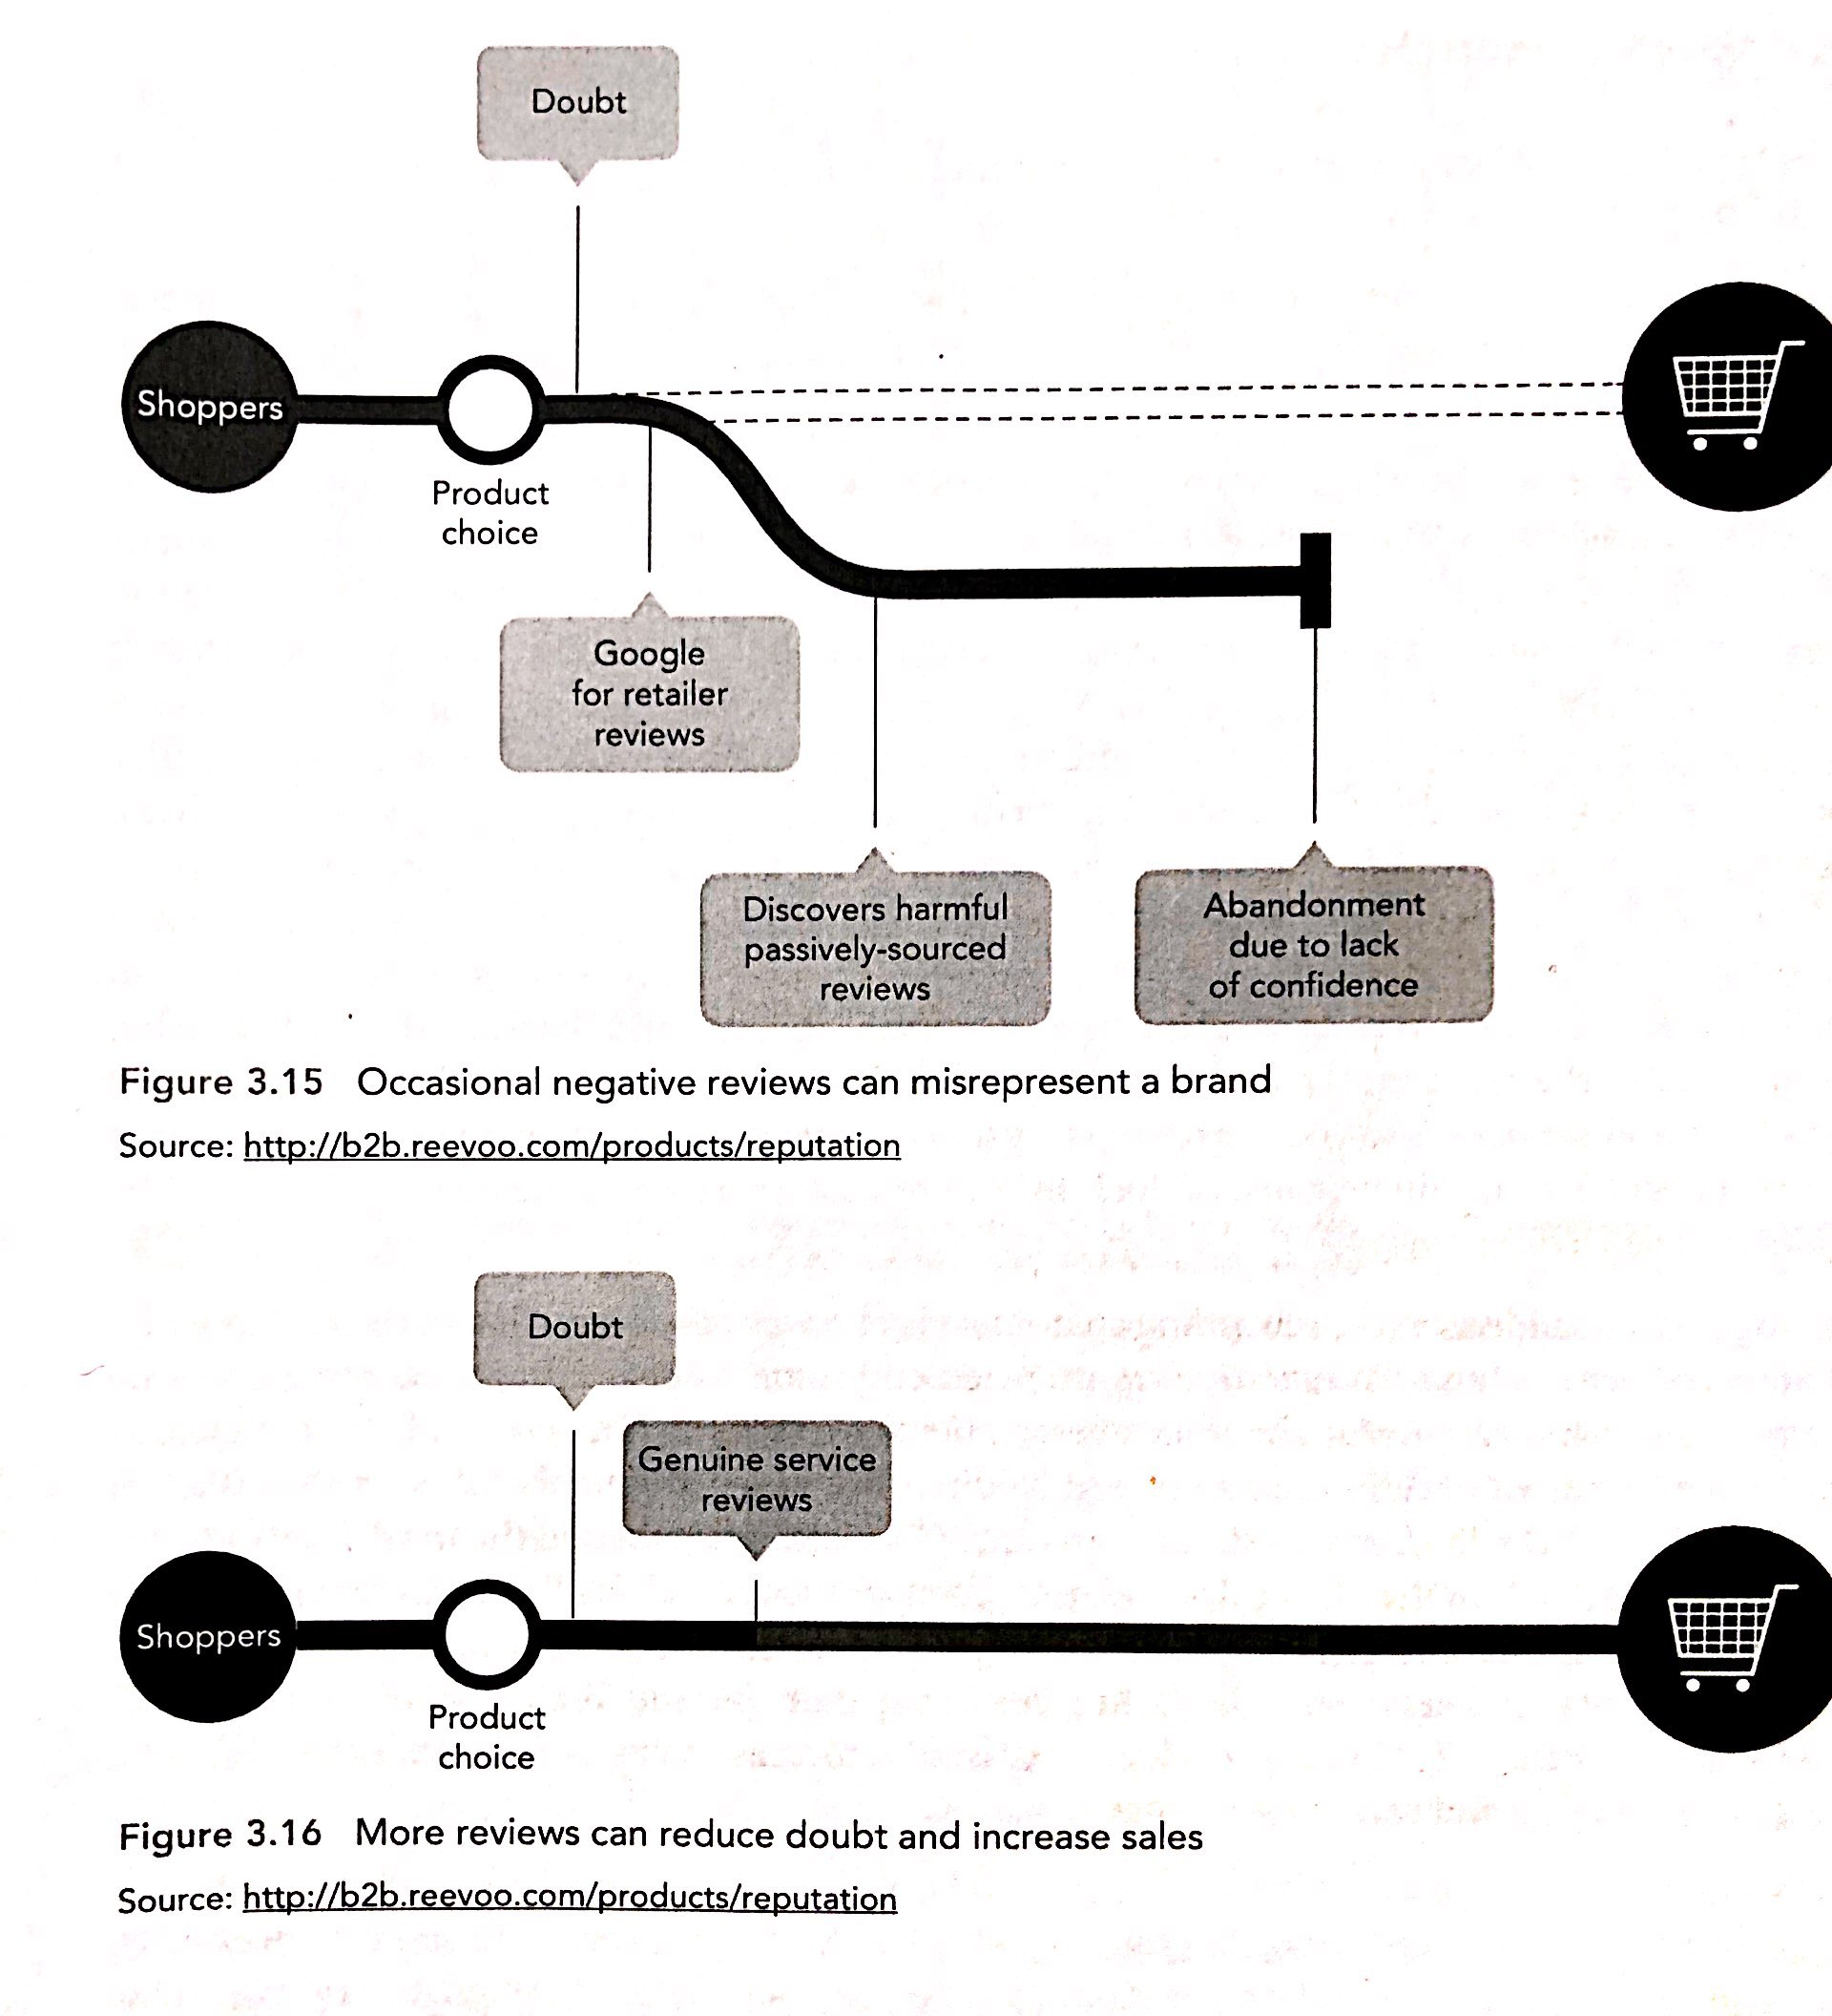
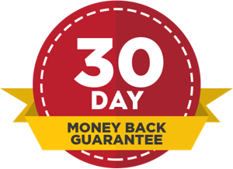


Customer Buying Models
Purchase is not a stage it is a process
Consumer may experience doubt after product choice
As such, reassurance is required to make them move towards purchase

Slide 18
Loyalty Models
Repeat business is more efficient compared to New business
Importance of identifying the key customers and moving them up the loyalty ladder
Importance of engaging your key customer
Achieving customer advocacy
Achieving high Net Promoter score
  “would you recommend us to a friend?”
eWOM vs. WOM
Impact of social media

Slide 19
Loyalty Models
IDIC Loyalty Model (Peppers and Rogers; 1997)
Identification of each customer on first and subsequent visits (using cookies or log-in on site)
Differentiation among customers by segmenting them into heterogeneous groups.
Interaction – provided on-site, i.e. customer service chat, creating tailored product.
Communication refers to personalization or mass customization of content or emails according to the segmentation achieved earlier.

