Slide 2
E-Customer
Lecture 5
By Dilmurod Khodiev
©Dilmurod Khodiev FB.com/Dilmurod

Slide 3
Plan
Motivations and Expectations
Online Buying Process
Relationship and Loyalty
Communities and Social Networks
Online Information Processing
Customer Profiles
Researching the Online Customers

Slide 4

Introduction
Core of marketing is the customer (understanding the customer)
Quality of marketing has been dropping (decade to decade)
Even great products have 5% negative reviews
Word of Mouth vs. Word of Mouse (eWoM)
Zero tolerance for bad service (especially in the online context)
Strong competition and low switching costs
Customers now have more control and choice
Customer Engagement!

Slide 5
Motivations: Why go On-line
Cavemen: Group Behavior
  Purchase behavior and preference can be explained by the purchases and preferences of the customer’s surrounding
Top reasons people go online
  Socializing (Catching up with people and news)
  Shopping/browsing (to buy online or offline)
  Entertainment (movies, music, games, media)

Slide 6
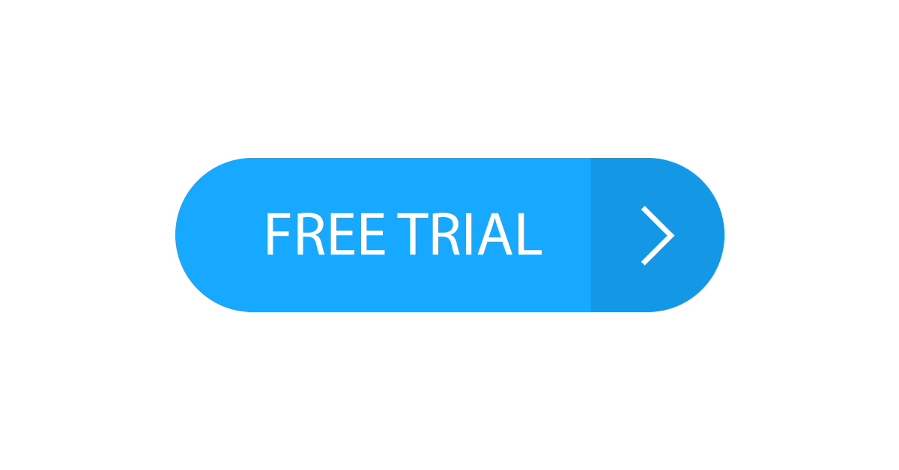
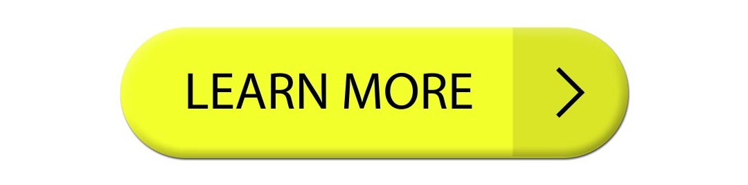
Satisfice vs. Maximize
People are not always rational
Sometimes they buy on impulse
Calls to action must support both types of customers
  Maximizer: More rational, slow, and reasonable
  Satisficer: Impulse buyers, less reasonable, quick
Marketing process becomes simple:
  Identify reasons why people buy, what their aspirations are
  Reflect reasons, aspirations and expectations in your communications. (Live up to the promises)

Slide 7
6Cs of customer motivation
Content
Customization
Community
Convenience
Choice
Cost reduction
de Kare-Silver’s electronic shopping test (good chance if 20+)
Product characteristics (physical element)
Familiarity and confidence
Consumer attributes (internet skills)

Slide 8
Expectations
It is important to manage expectation of customers:
Load time of 2s can reduce revenue by 4%
Multi platform support (pc, mobile, tablets, what else?)
Ease of finding the site and information in the site
Privacy re-assurance
Notifications
Delivery time/dare clarity
Flexible return policies
Price/product specification accuracy

Slide 9
Expectation
Understanding the expectations
Setting and communicating the service promise
Delivering service promise
Example: TV sold for 2.99

Slide 10
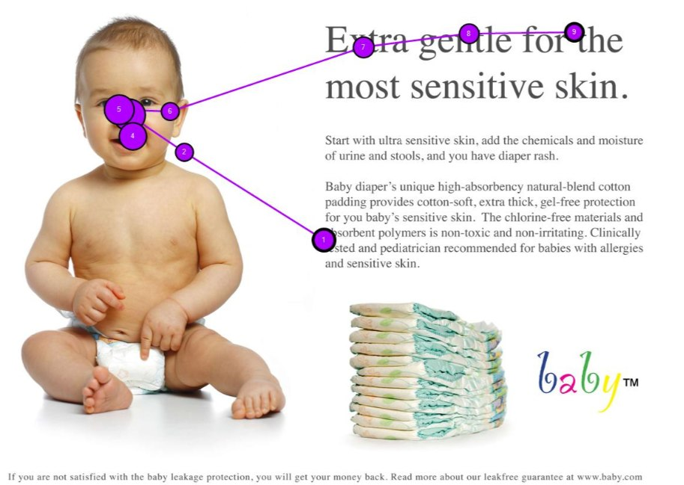
Online Information Processing

Slide 11
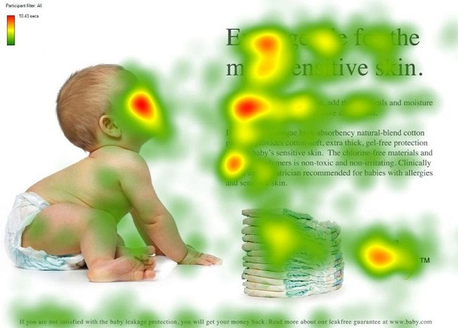
Online Information Processing

Slide 12

Online Information Processing

Slide 13
Online Buying Processes
Problem Recognition
Information Search
Evaluation
Decision
Action(sale)
Post sale

Slide 14
Online Buying Processes
3 types of visitors:
Trackers (I want Rolex watch)
Hunters (I want a nice expensive watch)
Explorers (I want a gift for my dad)
Track and identify each type of customer
Feed them the right information in the right time
Try to bring them up the ladder

Slide 15
Relationship and Loyalty
Retaining new customers is 5x more profitable than acquiring new ones
Repeated Online customers are 10x more profitable
Loyalty Ladder (Considine and Murray 1981):
  Moving customers up the ladder of loyalty:
    Suspects-> Prospects->Customers->Clients-> Advocated
Most companies now PROACTIVELY focus on “Ideal” Customers

Slide 16
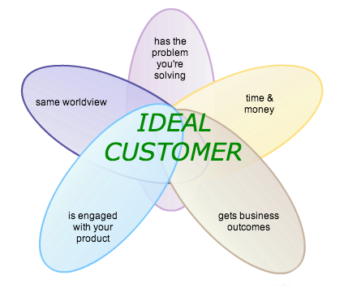

Slide 17
Relationship and Loyalty
The 5 Primary Determinants of Loyalty (Reicheld and Schefter, 2000):
  Quality Customer Support
  On-time Delivery
  Compelling product presentation
  Convenient and Reasonably priced shipping and handling
  Clear Trustworthy Privacy Policies

Slide 18
Relationship and Loyalty
And some methods to “Delight” the customers”
  Extra Service and added value: questions such as “What interests, hobbies, passions does my customer have? How can I help them?”
  Personalization: this has a high end value for the customers, companies can tailor their approach to their key customers by using this.
  Community Creation (discussed in detail later): engage the customer and create a hook to keep them coming.
  Integration: integrating into the customers own system- so it locks them in
  Incentivization: visible promotions, offers, events etc.

Slide 19
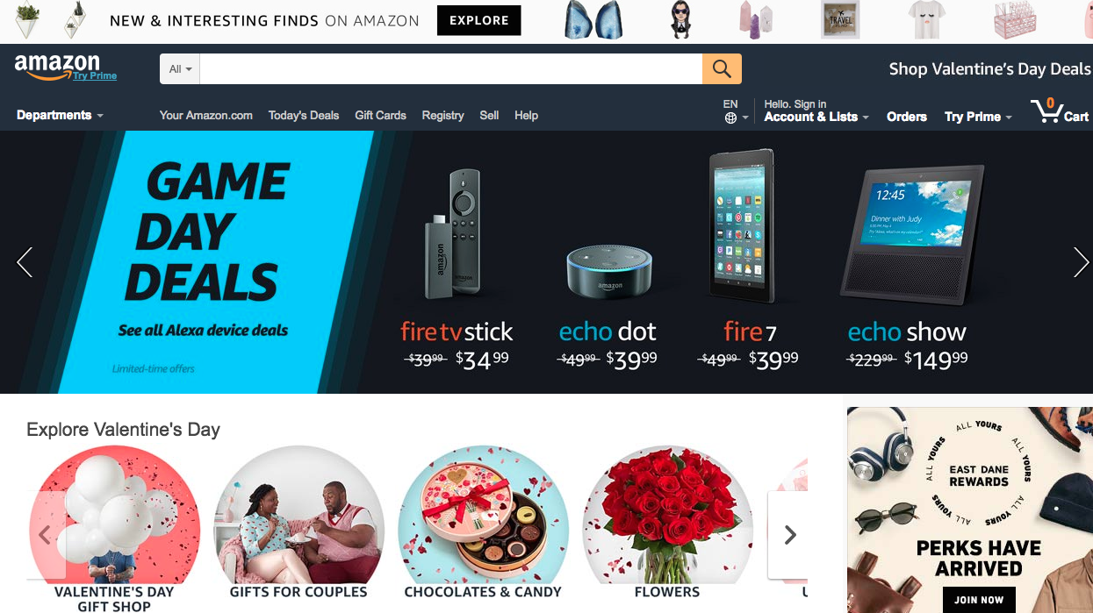

Slide 20
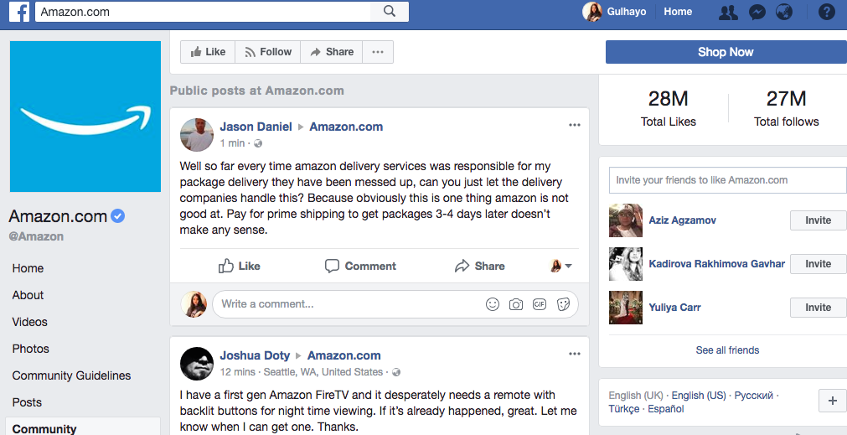
Communities and Social Network

Slide 21
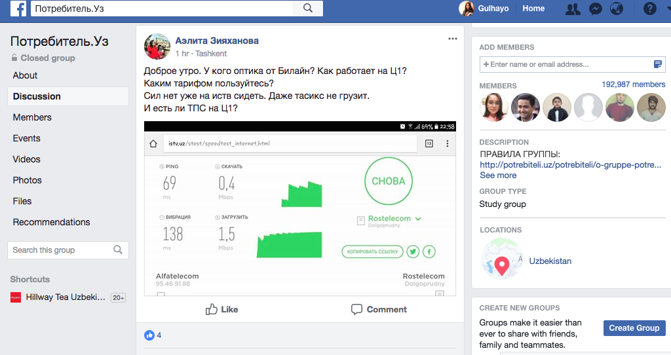
Communities and Social Network

Slide 22
Customer Profiles
In order to identify a Customer Profile, we need to know the proportion of customers who:
Have access to which channel or channels?
  (geographic, demographic, psychographic variables; from what country/continent they are accessing the web; “access device, webographics)
Are influenced by using which channel or channels?
  (how to audience is influenced by online media; research
Purchase using which channel or channels?

Slide 23
Customer Profiles
When profiling online business customers, users may be asked to fill out specific set of characteristics such as:
  Size of company (employees or turnover)
  Industry sector and products
  Organization type (private, public, government, not for profit)
  Division
  Country and region.
We also need to know the following customer variables:
  Name
  Role and responsibility from job title, function or number of staff managed
  Role in buying decision (purchasing influence)
  Department
  Product interest
  Demographics: age, sex and possibly social group.

Slide 24
Customer Profiles
There are always new and interesting ways of defining customer profiles
“The market is divided into those willing to spend time to save money, almost all of whom buy hardware, and those willing to spend money to save time, almost all of whom buy service and support”
(Jonathan Schwartz, chief executive, Sun Microsystems, cited in Anderson, 2008).

Slide 25
Researching the online customer
To understand customers, we need to research them:
  ● Who are they – demographics, psychographics, behavioural?
  ● What do they want – their needs – why do they buy or not buy?
  ● How do they buy (online or offline or mixed mode)?
  ● When do they buy?
  ● How did they find us or our competitors?

Slide 26
Researching the online customer
Guidelines and Ideas to develop a persona:
1. Build personal attributes into personas:
  Demographic: age, gender, education, occupation and for B2B, company size, position in buying unit
  Psychographic: goals, tasks, motivation
  Webographics: web experience (months), usage location (home or work), usage platform (dial-up, broadband), usage frequency, favourite sites.

Slide 27
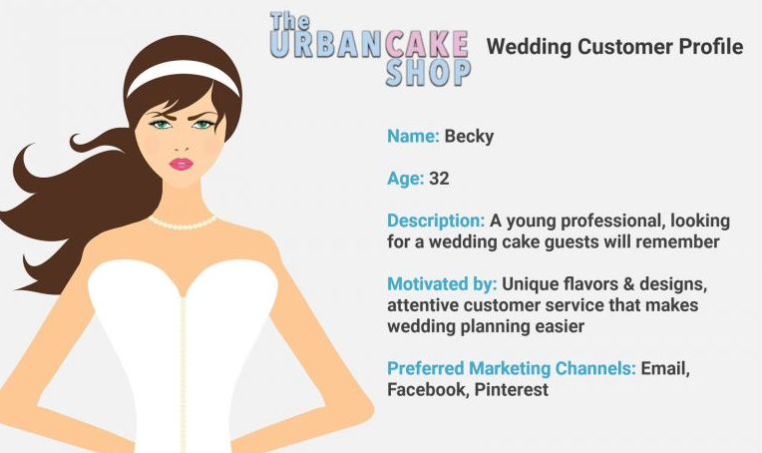

Slide 28
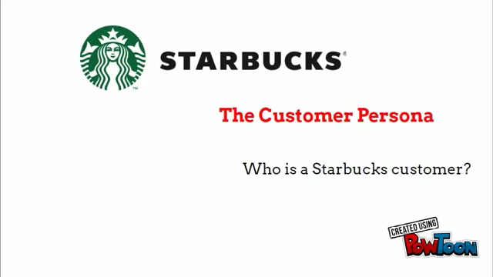

Slide 29
Researching the online customer
2. Remember that personas are only models of characteristics and environment:
  Design targets
  Stereotypes
  Three or four usually suffice to improve general usability, but more are needed for specific behaviours
  Choose one primary persona whom, if satisfied, means others are likely to be satisfied.

Slide 30
Researching the online customer
Your primary persona needs to be a common user type who is both important to the business success of the product and needy from a design point of view – in other words, a beginner user or a technologically challenged one.
(Wodtke, 2002)

Slide 31
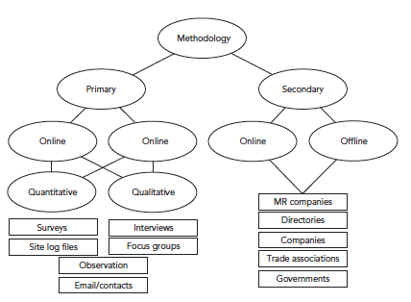
Researching the online customer

Slide 32
Researching the online customer
Technique | Strengths | Weaknesses
Server-based logfile analysis of site activity (web analytics) www.clicktracks.com www.webtrends.com | Directly records customer behaviour on site plus where they were referred from Low Cost | Doesn’t directly record channel satisfaction Undercounting and overcounting Misleading unless interpreted carefully
Browser-based site activity data (web analytics) www.indextools www.google.com/analytics | Greater accuracy than server based analysis Counts all users unlike the panel approach | Similar weakneses to server based technique apart from accuracy Limited demographic information
Panels activity and demographic data www.netratings.com www.comscore.com www.hitwise.co.uk | Records marketing Outcomes | Depends on extrapolation from limited sample that may nor be representative

Slide 33
Researching the online customer
Technique | Strengths | Weaknesses
Outcome date e.g, enquiries,sales, customer service emails | Records marketing outcomes | Difficulty of integrating data with other methods data collection when collected manually or in other information systems
Only Questionnaires Customers are prompted randomly – every nth customer or customer activity or by email | Can record customer satisfaction or profiles Relatively cheap to create and analyse | Difficulty of recruiting respondents who complete accurately Sample bias- tends to be advocates or disgruntled customers who tend to complete
Online focus groups Synchronous recording | Relatively cheap to create | Difficult to moderate and coordinate No visual cues as from offline focus groups

