Slide 2
Site design
Lecture 7
By Zamira Ataniyazova
Zamira Ataniyazova

Slide 3
Intro to site design
“A good site should always begin with the user. Understand who the customer is, how they use the channel to shop, and understand how the marketplace works in that category. This includes understanding who your competitors are and how they operate online. You need continuous research, feedback and usability testing to continue to monitor and evolve the customer experience online. Customers want convenience and ease of ordering. They want a site that is quick to download, well-structured and easy to navigate.”
Lancaster, no date.

Slide 4
Main two approaches of web design
Usability – user needs to be able his/her goal of visiting the website.
Accessibility – the website should be accessible from different devices, different interfaces and by people with disabilities.

Slide 5
Web design principles
Zamira Ataniyazova

Slide 6
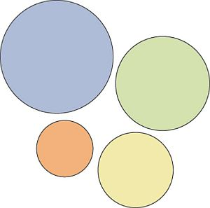
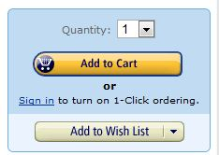
#1: Visual Hierarchy
It’s the order in which the human eye perceives what it sees.
Exercise. Please rank the circles in the order of importance:
Hierarchy does not only come from size. Amazon makes the ‘Add to cart’ call to action button more prominent by using color:

Slide 7
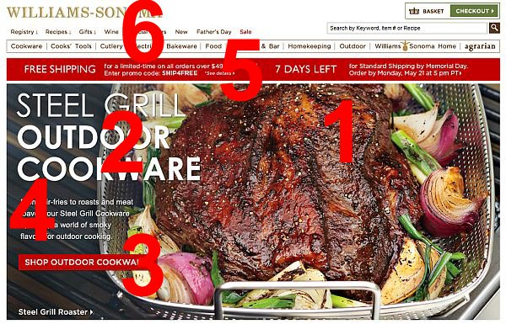
#1: Visual Hierarchy
!!! You should rank elements on your website based on your business objective. If you don’t have a specific goal, you can’t know what to prioritize.

Slide 8
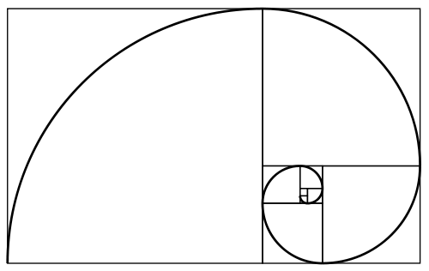
#2: Divine Proportions
Golden ratio is a magical number 1.618
Then there is also the Fibonacci sequence where each term is defined as the sum of the two previous terms: 0, 1, 1, 2, 3, 5, 8, 13, 21 and so on. The interesting thing is that we have two seemingly unrelated topics producing the same exact number.

Slide 9
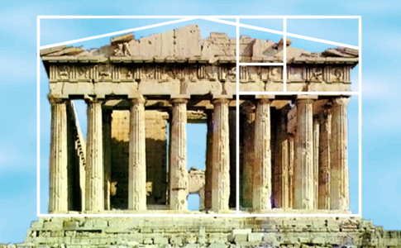
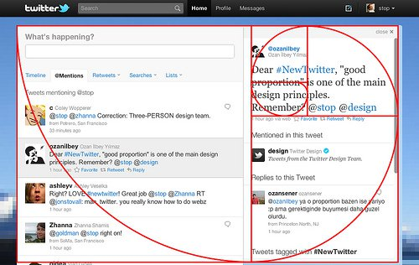
#2: Divine Proportions
Many artists and architects have proportioned their works to approximate the golden ratio. A famous example is Pantheon built in Ancient Greece:
Can it be used for web design? Here’s Twitter:

Slide 10
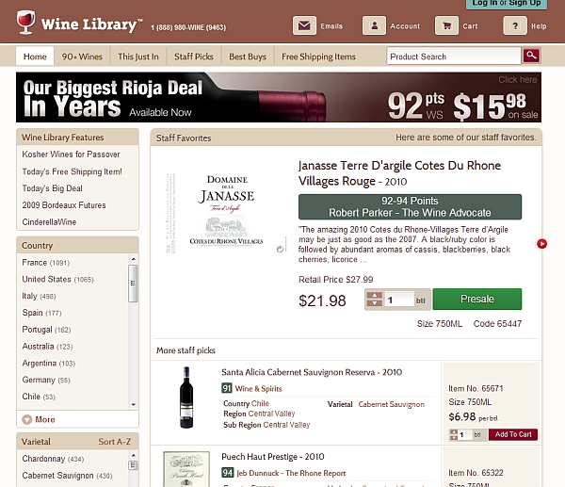
#3: Hick’s Law
Hick’s law says that with every additional choice increases the time required to take a decision.
In the era of infinite choice, people need better filters! If you sell a huge amount of products, add better filters for easier decision making.
Wine Library sells a huge amount of wine. They do a good job with the filters (on the left):

Slide 11

#4: Fitt’s Law
Fitt’s law stipulates that the time required to move to a target area (e.g. click a button) is a function of the distance to the target and the size of the target. In other words, the bigger an object and the closer it is to us, the easier it is to use it.
Spotify makes it easier to hit ‘Play’ than other buttons:
The size of a button should be proportional to its expected frequency of use. You can check your stats for which buttons people use the most, and make popular buttons bigger (easier to hit).
Let’s imagine there’s a form you want people to fill. At the end of the form, there are two buttons: “Submit” and “Reset” (clear fields).

Slide 12
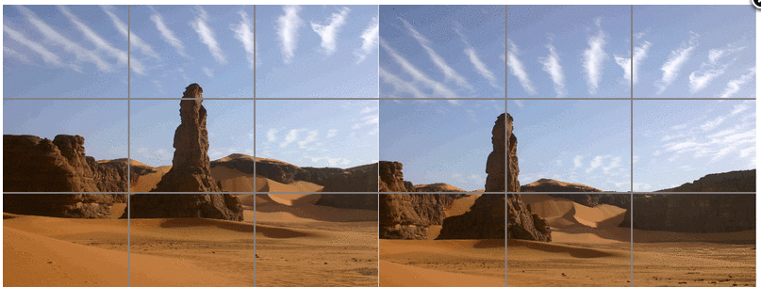

#5: Rule of Thirds
The best images follow the rule of thirds: an image should be imagined as divided into nine equal parts by two equally-spaced horizontal lines and two equally-spaced vertical lines, and that important compositional elements should be placed along these lines or their intersections.
Notes:
Can go to adword.google.com

Slide 13

#6: Gestalt Design Laws
Gestalt psychology is a theory of mind and brain. Its principle is that the human eye sees objects in their entirety before perceiving their individual parts.
The key takeaway here is that people see the whole before they see the parts.
There are 8 so-called gestalt design laws that allow us to predict how people will perceive something.
Notes:
Can go to adword.google.com

Slide 14
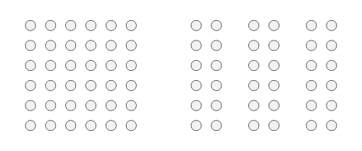
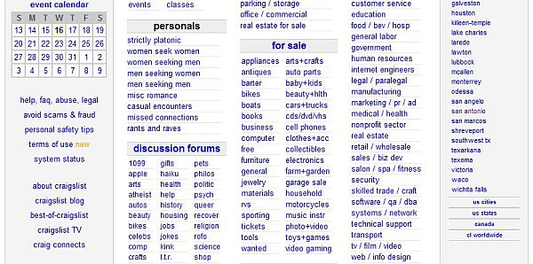
1. Law of Proximity
People group things together that are close together in space. They become a single perceived object.
Craigslist uses this law to make it easy to understand which sub-categories fall under “for sale”:
Notes:
Which of the options provided above is most clickable?

Slide 15
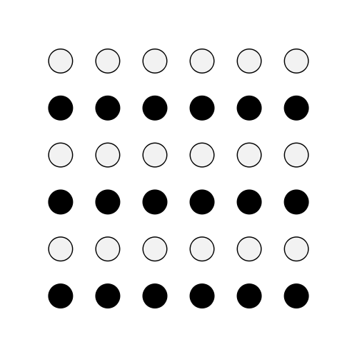
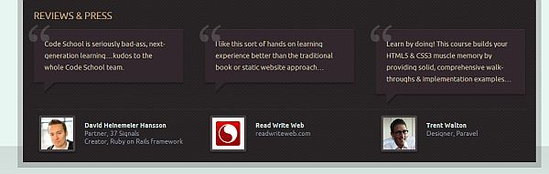
2. Law of Similarity
We group similar things together. This similarity can occur in the form of shape, color, shading or other qualities.
Codeschool makes all the testimonial boxes similar, so we see all the testimonials as a single group:

Slide 16
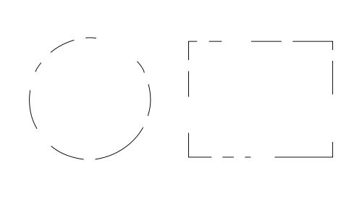

3. Law of Closure
We seek completeness. With shapes that aren’t closed, when parts of a whole picture are missing, our perception fills in the visual gap. We see two squares overlaid on four circles even though none of these shapes actually exist in the graphic.
Using the law of closure can make logos or design elemets more interesting. A good example of this is the World Wide Fund For Nature designed by Sir Peter Scott in 1961:

Slide 17
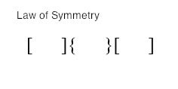
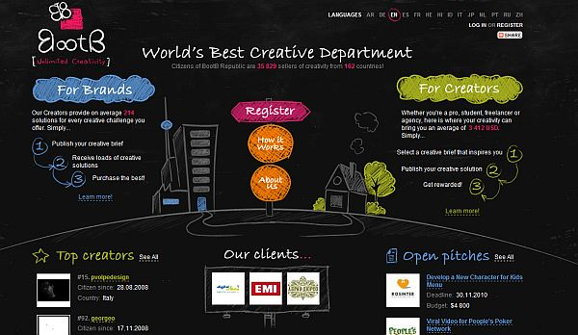
4. Law of Symmetry
The mind perceives objects as being symmetrical and forming around a center point. It is perceptually pleasing to be able to divide objects into an even number of symmetrical parts.
People prefer symmetric appearances over asymmetric ones. Balanced three columns and the curve add to the enjoyment of BootB web design:

Slide 18
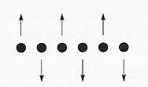

5. Law of Common Fate
We tend to perceive objects as lines that move along a path. We group together of objects that have the same trend of motion and are therefore on the same path.
People mentally group together sticks or raised hands pointing somewhere, because they all point in the same direction. You can use this to guide the user’s attention to something (e.g. a signup form, value proposition etc).
Notes:
Which of the options provided above is most clickable?

Slide 19
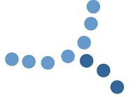
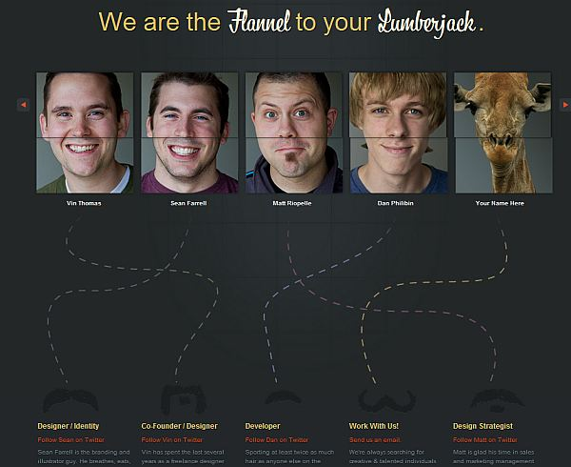
6. Law of Continuity
People have a tendency to perceive a line as continuing its established direction. In cases where there is an intersection between objects (e.g. lines), we tend to perceive the two lines as two single uninterrupted entities. Stimuli remains distinct even with overlap.
Fixel uses this to connect faces to bios:

Slide 20
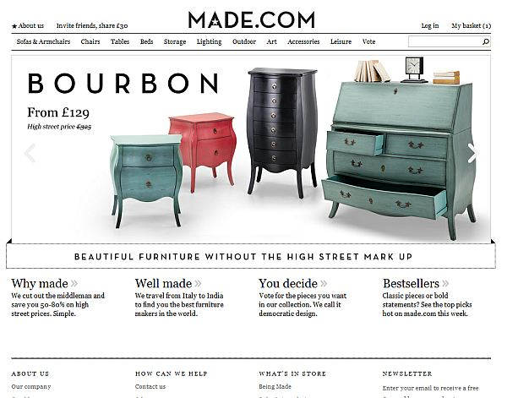
#7: White space and clean design
White space (also called ‘negative space’) is the portion of a page left “empty”. It’s the space between graphics, margins, gutters, space between columns, space between lines of type or visuals.
Made.com does white space well:

Slide 21
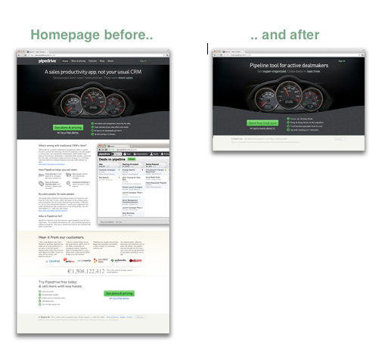
#8: Occam’s Razor
Occam’s razor is a principle urging one to select among competing hypotheses that which makes the fewest assumptions and thereby offers the simplest explanation of the effect. To put it in the design context, Occam’s Razor states that the simplest solution is usually best.
“We removed 80% of the content, and left one sign-up button and one Learn More link on the home page. Conversion to sign up increased by 300%.” Pipedrive reps.

Slide 22
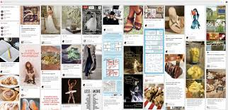

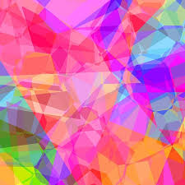
Some 2018 Web design trends
Cards
Illegibility (contrast)
Vibrant colors
HD visuals

Slide 23
Summary
Think of user experience initially
What are you business objectives?
How you can align your business objectives with exemplar user experience?
Monitor the web design trends

Slide 24
Recommended reading/practice
Recommended readings:
Article on 8 Effective Web Design Principles You Should Know Available at:
https://conversionxl.com/blog/universal-web-design-principles/

