Slide 2
Content marketing
Lecture 11
By Zamira Ataniyazova
Zamira Ataniyazova

Slide 3
What we plan to cover today:
Why Google loves great content?
Building content Marketing through various channels
5 principles of Content Marketing
What is Content Marketing and its history of development
Success stories
© Dr. Umidjon Akhunjonov 2018

Slide 4
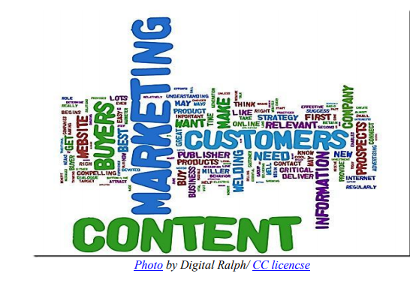
What is content marketing
“ Content marketing is a broad term given to the processes of creating content and marketing it”
Content form:
  Textual
  Infographics
  Images
  Videos
  Etc.

Slide 5
Content marketing includes:
Define your target audience
Decide on the suitable content
Do not forget about suitable design, styling process
Create online presence with blogs and a website
Do not forget about key words, and to optimize title tags, headers, etc. for search engine algorithms
Provide opportunity to receive additional info or to have follow up discussion
Keep updating the content on regular basis

Slide 6
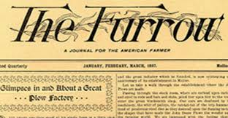
History of content marketing

Slide 7
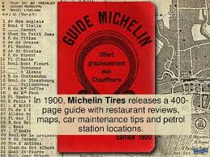
History of content marketing

Slide 8
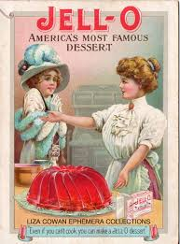
History of content marketing

Slide 9
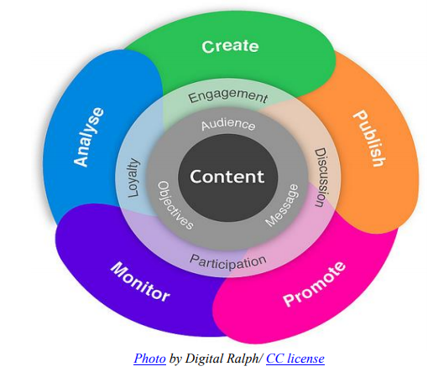
Principles of content marketing
Market online as would marketing offline
WOM is the most powerful online
Build credibility and prove authenticity
Diversify your online presence
Think how to grab more attention

Slide 10
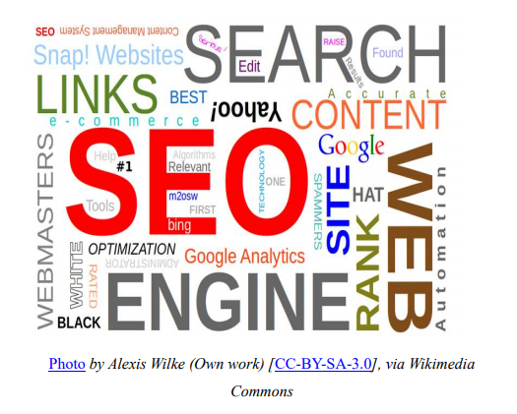
Why google loves great content?

Slide 11

Building content strategy
Complete your profile
Get people to follow you
Post good content

Slide 12

Building content strategy
Place excellent call to action
Post regularly and frequently
Include visual content
Create content that fans find valuable

Slide 13

Building content strategy
Invest some time
Keep things simple
Connect your Pinterest and your physical location

Slide 14

Building content strategy
Keep it short and compelling
Use hashtags
Use @mentions
Include statistics and quotes where possible
Take part in Twitter chats

Slide 15

Success stories
1. General Mills: Perfect content marketing recipe

Slide 16

Success stories
2. Kate Spade: Stylish digital experience

Slide 17

Success stories
3. Patagonia : Keeping it clean

Slide 18

Success stories
4. SEOmoz: creating valuable content

Slide 19

Success stories
5. GE: cater to all
Blogs:
Healthyimagination
Txchnologist
Ecomagination

Slide 20

Success stories
6. IBM: Futuristic marketing

Slide 21
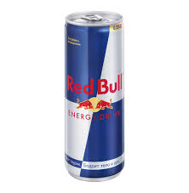
Success stories
7. Red Bull: Adventure is out there

Slide 22

Success stories
8. Oreo: Pop culture marketing

Slide 23
Recommended reading
Recommended readings:
A complete DIY guide to Content Marketing for your Brand or Business: https://www.godotmedia.com/wp-content/uploads/a-complete-how-to-content-marketing-guide-for-business-brand.pdf

