Slide 2
Web analytics
Lecture 12
By Zamira Ataniyazova
Zamira Ataniyazova

Slide 3
What we plan to cover today:
Tools for web analysis
Setting KPIs for the website
What is web analytics?
Type of websites
Objectives for the website

Slide 4
What is web analytics
“Web Analytics is the methodological study of online/offline patterns and trends. It is a technique that you can employ to collect, measure, report, and analyze your website data. It is normally carried out to analyze the performance of a website and optimize its web usage.
We use web analytics to track key metrics and analyze visitors’ activity and traffic flow. It is a tactical approach to collect data and generate reports.

Slide 5
Types of online presence
Chaffey and Ellis-Chadwick (2021) identified five main types of online presence or components possible as part of a site:
Transactional e-commerce site – making products available for purchase (www.Alibaba.com, www.amazon.com, www.lebazar.uz).
Service oriented relationship building or lead generation web site – provides information to stimulate purchase or relationship building. (Pricewaterhouse Coopers, Accenture, most of the car manufacturers)
Brand building site – provides an experience to support a brand. (mostly relevant for FMCG, www.lynxeffect.com/uk, www.guiness.com).
Portal or media site – intermediaries or publishers provide information and content. (www.yahoo.com, www.ft.com, www.tripadvisor.com, www.afisha.uz, www.gazeta.uz, www.yellowpage.uz).
Social network or community site – enables community interaction between different consumers (C2C model). (Facebook, LinkedIn, Telegram, Instagram).
© Zamira Ataniyazova 2018

Slide 6
5S=objectives=benefits of e-marketing
Grow sales through wider distribution, promotion and sales
Add value – give customers extra benefits online
Get closer to customers by tracking them, asking them questions, creating a dialogue, learning about them
Save costs of service, promotions, sales transactions and administration, print, posts and so increase profits on transactions.
Extend the brand online. Reinforce brand values in a totally new medium.
© Zamira Ataniyazova 2018

Slide 7


Objective - Sell
Using internet as sales tool
Typical objectives:
  Achieve 10% of sales online in market
  Increase online sales for product by 20% in a year
  Increase conversion rates by 5%
© Zamira Ataniyazova 2018

Slide 8
Objective - Serve
Using the internet as customer service tool
  Engagement metrics:
  % of non-home page entry visits
  Bounce rate
  Duration
  Micro or step conversion rates
  Brand search-term strength
  Email activity level
  Define activity levels or hurdle rates (for different activities)
  Emotional responses
Patrecia Seybold (1999) adding value to B2B:
“let customers help themselves”
“help customers do their jobs”
© Zamira Ataniyazova 2018

Slide 9
Objective - Speak
Using internet as communication tool
Sample KPIs:
Grow email coverage to 50% of current customer database
Survey 1,000 customers online each month
Increase visitors to community site or increase ratings/reviews and discussions by 5%
© Zamira Ataniyazova 2018

Slide 10
Save
Using the internet for cost reduction
Generate 10% more sales for same commutations budget
Reduce cost of direct marketing by 15% through email
Increase web self-service to 40% of all service enquiries and reduce overall cost-to-serve by 10%
© Zamira Ataniyazova 2018

Slide 11
Sizzle
Using internet as brand building tool
Add two new significant enhancements to the customer online experience
Rework online value proposition messaging
Improve branding metrics such as: brand awareness, reach, brand favorability and purchase intent
www.Heineken.com
www.Bacardi.com
© Zamira Ataniyazova 2018

Slide 12
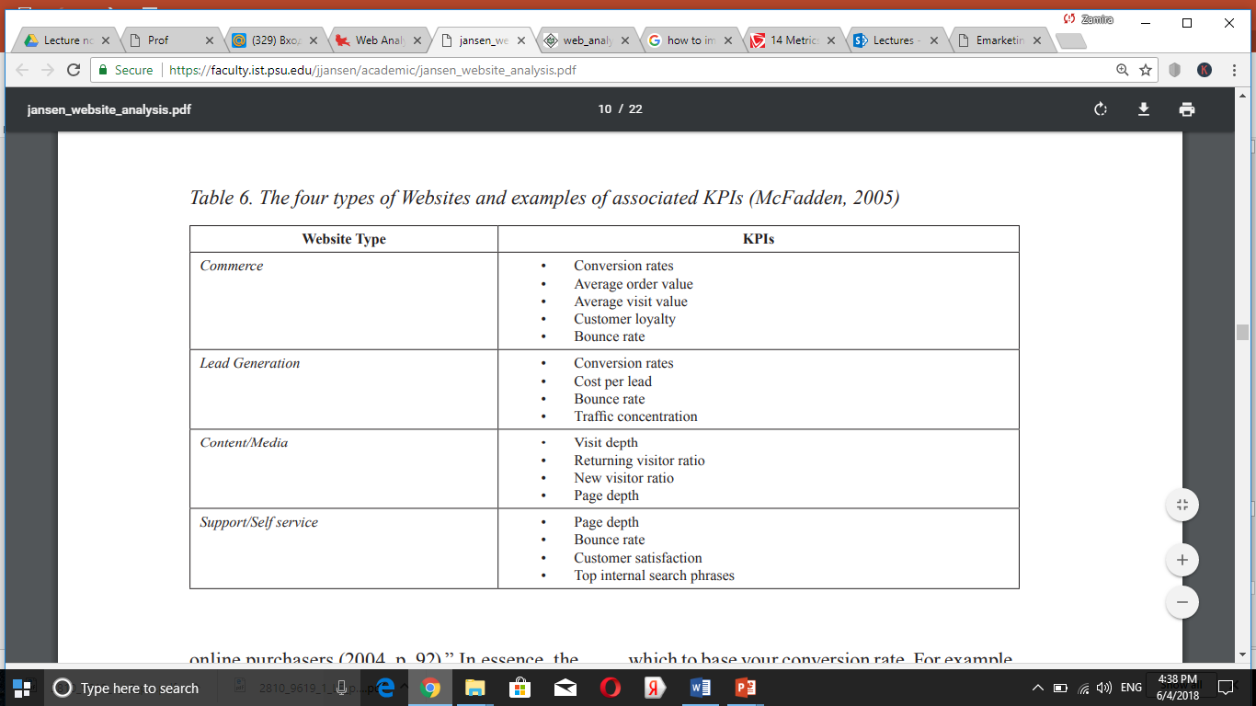
KPIs by website types

Slide 13
Tools for web analysis
Google analytics is a freemium analytic tool that provides a detailed statistics of the web traffic. Used by more than 60% of website owners.
Google analytics helps to track, measure visitors, traffic sources, goals, conversion, and other metrics. It basically generates reports on:
  Audience analysis
  Acquisition analysis
  Behavioral analysis
  Conversion analysis

Slide 14
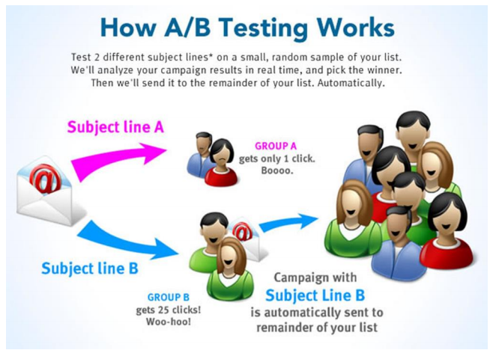
Tools for web analysis
Optimizely is a optimization platform to test and validate changes and the present look of your website. It also determines which layout to finally go with.
Can do: `
  A/B testing
  Multipage
  Multivariate testing

Slide 15
Tools for web analysis
Kissmetrics is a powerful web analytics tool that delivers key insights and user interaction on your website. It defines a clear picture of users’ activities on your website and collects acquisition data of every visitor
Kissmetrics services are free for 1 month.
Kissmetrics helps to identify the following:
  Cart size
  Landing page conversion rate
  Customer activity on your portal
  Customer bounce points
  Cart abandoned products
  Customer occurrence before making a purchase
  Customer lifetime value

Slide 16
Tools for web analysis
Crazy egg is an online analytics application that provides eye-tracking tools. It generates heatmaps based on where people clicked on your website.

Slide 17
Recommended reading
Recommended readings:
Web analytics available at https://www.tutorialspoint.com/web_analytics/web_analytics_tutorial.pdf

Slide 18
Digital marketing module summary
How offline and online world interacts with each other
Frictions
How marketing mix is impacted by digital environment
E-models
E-customers
Social media marketing
Site design
SEO strategy and research
SEO tactics
E-CRM
Content Marketing
Web analytics

Slide 19
Thank you!
Our contact details:
Zamira Ataniyazova – zataniyazova@wiut.uz
Umidjon Akhunjonov – uakhunjonov@wiut.uz
Dilmurod Khodiev – d.khodiev@wiut.uz

