Slide 1

The 7 Habits of Highly Effective Students
Mamurjon Rahimov

Slide 2


Slide 3


Slide 4


Slide 5

Notes:
In 2011, Time magazine listed 7 Habits as one of "The 25 Most Influential Business Management Books".

Slide 6


Slide 7
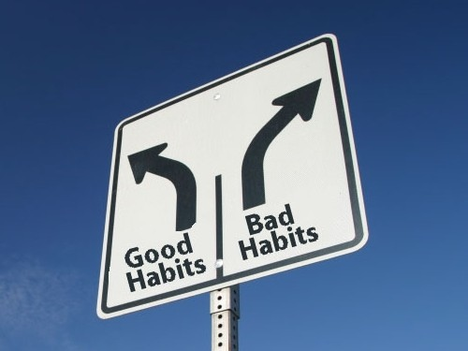

Slide 8

Good Habits
Notes:
Reading regularly

Slide 9
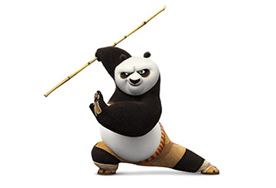
Notes:
Exercising regularly

Slide 10

Notes:
Planning ahead

Slide 11

Notes:
Thinking negatively

Slide 12

Notes:
Feeling inferior

Slide 13

Notes:
Blaming others

Slide 14

Notes:
Habits. Depending on what they are, our habits will either make us or break us. We become what we repeatedly do.

Slide 15
Samuel Smiles Quote
Sow a thought, and reap an act;
Sow an act, and you reap a habit;
Sow a habit, and reap a character;
Sow a character, and you reap a destiny.
What does this mean?

Slide 16
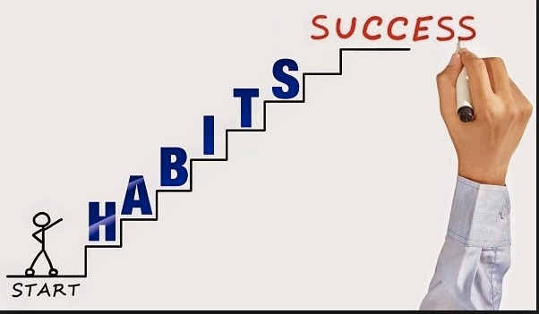
Notes:
You are stronger than your habits. Therefore, you can change them.

Slide 17

Notes:
The 7 Habits can help you:
Get control of your life
Improve your relationships with your friends
Make smarter decisions.
Get along with people around you.
Overcome addiction (food, soft drinks, etc)
Define your values and what matters most to you.
Get more done in less time.
Increase your self-confidence.
Be happy
Find balance between, university, friends, and everything else.

Slide 18

Notes:
Habit #1
Be Proactive
Take responsibility for your life.
A Reactive student: blames all of their problems on others, their teachers, lousy neighborhood

Slide 19

Notes:
We Can Control Only One Thing

Slide 20

Notes:
Proactive People
Are not easily offended
Take responsibility for their choices
Think before they act
Bounce back when something bad happens
Always find a way to make it happen
Focus on things they can do something about, and don’t worry about things they can’t

Slide 21

Notes:
Proactive or Reactive
The Choice is Yours
Reactive people make choices based on impulse. They are cans of soda pop. If life shakes them up a bit, the pressure builds and they suddenly explode.
Reactive people
Are easily offended
Blame others
Get angry and say things they later regret
Whine and complain
Wait for things to happen to them
Change only when they have to.

Slide 22

Notes:
Proactive people make choices based on values. They think before they act. They recognize they can’t control everything that happens to them, but they can control what they do about it. They are calm, cool, and in control.

Slide 23

Notes:
Your Language
Listen to what you say are you reactive or proactive.
Do you blame circumstances for your situation?
Do you make the best of your situation?

Slide 24
Language
Reactive Language | Proactive Language
I’ll try | I’ll do it
That’s just the way I am | I can do better than that
There’s nothing I can do | Let’s look at all our options.
I have to | I choose to
I can’t | There’s gotta be a way
You ruined my day | I’m not going to let your bad mood rub off on me.

Slide 25
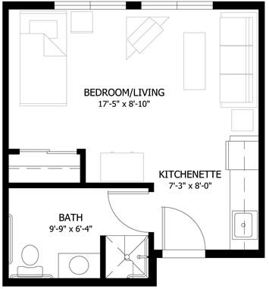
Notes:
Habit #2
Begin With the End in Mind

Slide 26
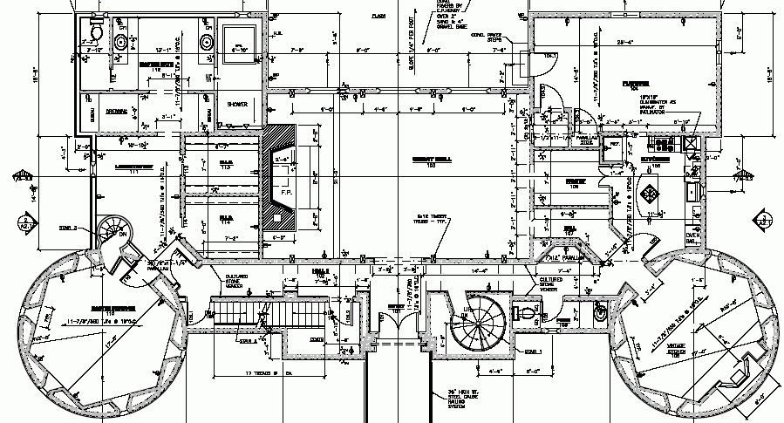

Slide 27
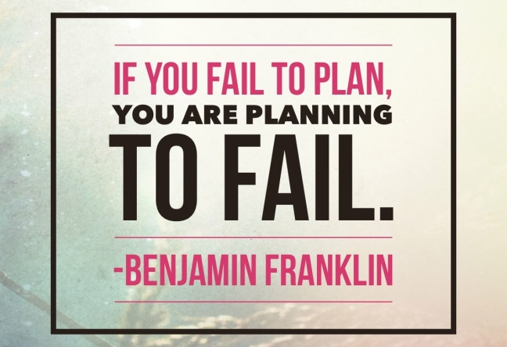
Notes:
If students aren’t clear about where they want to end up in life, about their values, goals, what they stand for, they will wander and waste time.
Create a personal mission statement which will act as a road map and direct and guide your decision-making process.

Slide 28
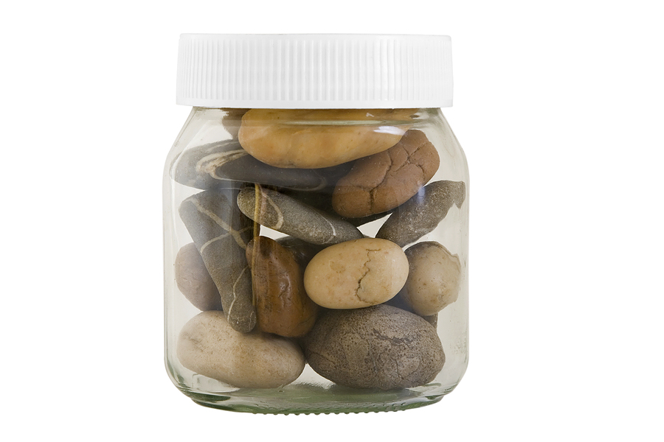
Notes:
Habit #3
Put First Things
First
This habit helps students prioritize and manage their time so that they focus on and complete the most important things in their lives.
Putting first things first also means leaning to overcome fears and being strong during difficult times. It’s living life according to what matters most.

Slide 29
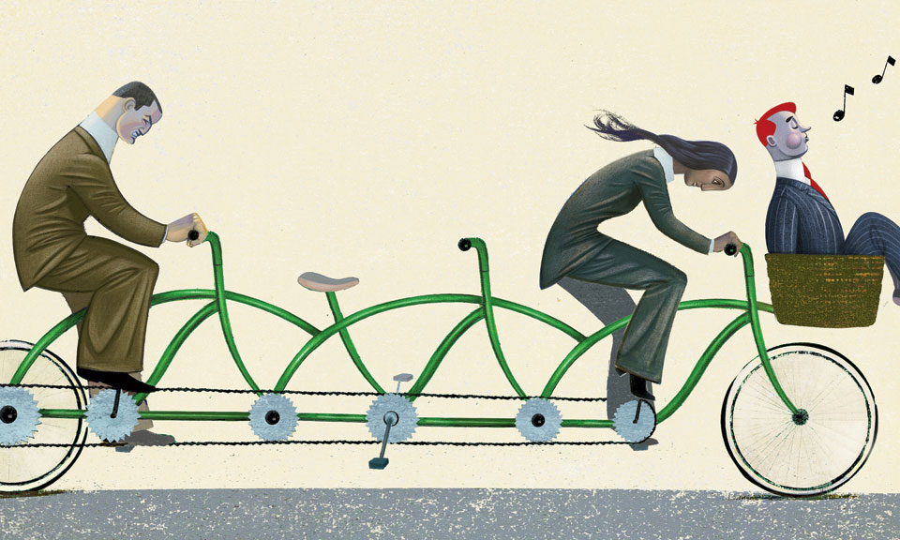
Notes:
Habit #4
Think Win-Win
Students can learn to foster the belief that it is possible to create an atmosphere of win-win in every relationship.
This habit encourages the idea that in any given discussion or situation both parties can arrive at a mutually beneficial solution.
Learn to celebrate the accomplishments of others instead of being threatened by the them

Slide 30
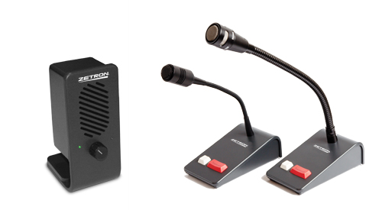
Notes:
Habit #5
Seek First to Understand
Then Be Understood
Because most people don’t listen very well, one of the great frustrations in life is that many don’t feel understood.

Slide 31

Notes:
This habit ensures you learn the most important communication skill there is: active listening

Slide 32

Notes:
A Chinese proverb:
When you are washing a cup, think about the cup.

Slide 33

Notes:
Habit #6
Synergize
Synergy is achieved when two or more people work together to create something better than either could alone.
Synergy allows students to value differences and better appreciate others.

Slide 34

Notes:
Through this habit, learn that it doesn’t have to be “your way” or “my way” but rather a better way.

Slide 35
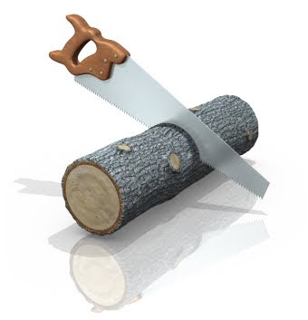
Notes:
Habit #7
Sharpen the Saw
Sharpening the saw means regularly renewing and strengthen the four key dimensions of life – body, brain, heart, and soul.

Slide 36
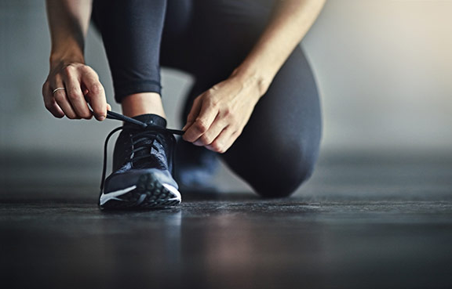
Notes:
Students should never get too busy with studying to take time to renew themselves.

Slide 37

Notes:
When a student “sharpens the saw” he or she is keeping their personal self sharp so that he/she can better deal with life.

Slide 38
7 HABITS OF HIGHLY EFFECTIVE STUDENTS
A Quick Review

Slide 39
7 Habits of Highly Effective Students
Habit #1 – Be Proactive
Habit #2 – Begin With the End in Mind
Habit #3 – Put First things First
Habit #4 – Think Win-Win
Habit #5 - Seek First to Understand, Then Be Understood
Habit #6 – Synergize
Habit #7 – Sharpen the Saw

Slide 40


