Slide 1

Aspects of International Marketing Management
Mamurjon Rahimov
mrahimov@wiut.uz
mamurjon@gmail.com

Slide 2

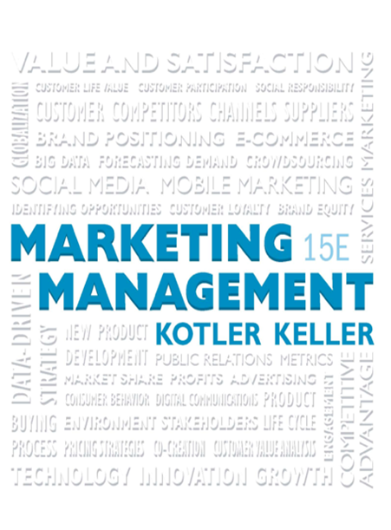
Conducting Marketing Research

Slide 3
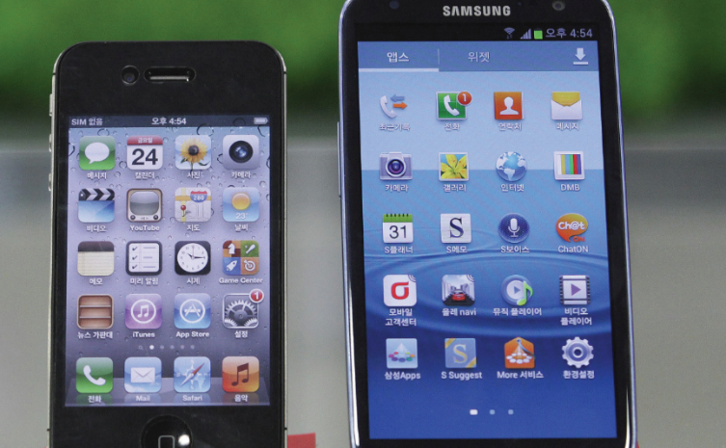
Learning Objectives
- What is the scope of marketing research?
- What steps are involved in conducting good marketing research?
- What are the best metrics for measuring marketing productivity?

Slide 4
The Scope of Marketing Research (1 of 4)
American Marketing Association
  Marketing research is the function that links the consumer, customer, and public to the marketer through information—information used to identify and define marketing opportunities and problems; generate, refine, and evaluate marketing actions; monitor marketing performance; and improve understanding of marketing as a process.
Notes:
AMA: Marketing research specifies the information required to address these issues, designs the method for collecting information, manages and implements the data collection process, analyzes the results, and communicates the findings and their implications.

Slide 5

The Scope of Marketing Research (2 of 4)
Importance of marketing insights
  Generating insights (how and why we observe certain effects in the marketplace)
Notes:
Good marketing insights often form the basis of successful marketing programs.

Slide 6
The Scope of Marketing Research (3 of 4)
Who Does Marketing Research?
  Marketing departments in big firms
  Everyone at small firms
  Syndicated-service research firms
  Custom marketing research firms
  Specialty-line marketing research firms
Notes:
Spending on marketing research topped $40.2 billion globally in 2013, according to ESOMAR, the world association of opinion and market research professionals. Most companies use a combination of resources to study their industries, competitors, audiences, and channel strategies. They normally budget marketing research at 1 percent to 2 percent of company sales and spend a large percentage of that on the services of outside firms.
Syndicated-service research firms—These firms gather consumer and trade information, which they sell for a fee. Examples include the Nielsen Company, Kantar Group, Westat, and IRI.
Custom marketing research firms—These firms are hired to carry out specific projects. They design the study and report the findings.
Specialty-line marketing research firms—These firms provide specialized research services. The best example is the field-service firm, which sells field interviewing services to other firms.

Slide 7
Research Conducted at Small Companies
Engage students/professors
Tap employee creativity
Use Internet
Tap partner expertise
Check out rivals
Notes:
Often at much smaller companies, everyone carries out marketing research—including the customers.
Small companies can also hire the services of a marketing research firm or conduct research in creative and affordable ways.

Slide 8

The Scope of Marketing Research (4 of 4)
Overcoming Barriers to the Use of Marketing Research
  Many companies still fail to use it sufficiently or correctly
Notes:
Companies may not understand what it is capable of or provide the researcher the right problem definition and information from which to work. They may also have unrealistic expectations about what researchers can offer. Failure to use marketing research properly has led to numerous gaffes, including the historic one involving Star Wars (as mentioned in the text).

Slide 9
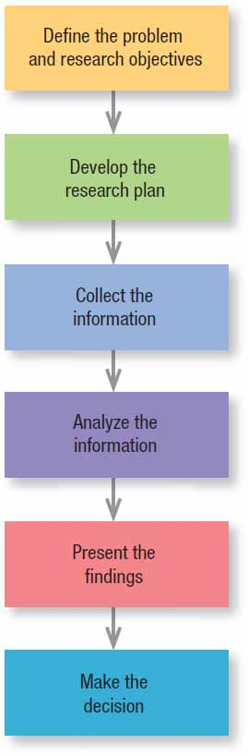
Figure 4.1 The Marketing Research Process

Slide 10

Step 1: Define the Problem, Define the Decision Alternatives, Define the Research Objectives
Notes:
Marketing managers must be careful not to define the problem too broadly or too narrowly for the marketing researcher. To help design the research, management should first spell out the decisions it might face and then work backward. Now management and marketing researchers are ready to set specific research objectives. Some research is exploratory—its goal is to identify the problem and to suggest possible solutions. Some is descriptive—it seeks to quantify demand, such as how many first-class passengers would purchase ultra high-speed Wi-Fi service at $25. Some research is causal—its purpose is to test a cause-and-effect relationship.

Slide 11

Step 2: Develop the Research Plan (1 of 6)
Data sources
  Secondary data vs. primary data
Notes:
Secondary data are data that were collected for another purpose and already exist somewhere. Primary data are data freshly gathered for a specific purpose or project. Researchers usually start their investigation by examining some of the rich variety of low-cost and readily available secondary data to see whether they can partly or wholly solve the problem without collecting costly primary data. When the needed data don’t exist or are dated or unreliable, the researcher will need to collect primary data. Most marketing research projects do include some primary-data collection.

Slide 12
Step 2: Develop the Research Plan (2 of 6)
Research approaches
  Observational research
  Focus group research
  Survey research
  Behavioral research
Notes:
Observational Research Researchers can gather fresh data by observing unobtrusively as customers shop or consume products. Sometimes they equip consumers with pagers and instruct them to write down or text what they’re doing whenever prompted, or they hold informal interview sessions at a café or bar. Ethnographic research uses concepts and tools from anthropology and other social science disciplines to provide deep cultural understanding of how people live and work. The goal is to immerse the researcher into consumers’ lives to uncover unarticulated desires that might not surface in any other form of research.
Focus Group Research A focus group is a gathering of 6 to 10 people carefully selected for demographic, psychographic, or other considerations and convened to discuss various topics at length for a small payment. A professional moderator asks questions and probes based on the marketing managers’ agenda; the goal is to uncover consumers’ real motivations and the reasons they say and do certain things. Sessions are typically recorded, and marketing managers often observe from behind two-way mirrors. To allow more in-depth discussion, focus groups are trending smaller in size.
Survey Research Companies undertake surveys to assess people’s knowledge, beliefs, preferences, and satisfaction and to measure these magnitudes in the general population.
Behavioral Research Customers leave traces of their purchasing behavior in store scanning data, catalog purchases, and customer databases. Marketers can learn much by analyzing these data. Actual purchases reflect consumers’ preferences and often are more reliable than statements they offer to market researchers. The most scientifically valid research is experimental research, designed to capture cause-and-effect relationships by eliminating competing explanations of the findings. If the experiment is well designed and executed, research and marketing managers can have confidence in the conclusions.

Slide 13
Step 2: Develop the Research Plan (3 of 6)
Research instruments
  Questionnaires
  Qualitative measures
  Technological devices
Notes:
Marketing researchers have a choice of three main research instruments in collecting primary data: questionnaires, qualitative measures, and technological devices.

Slide 14
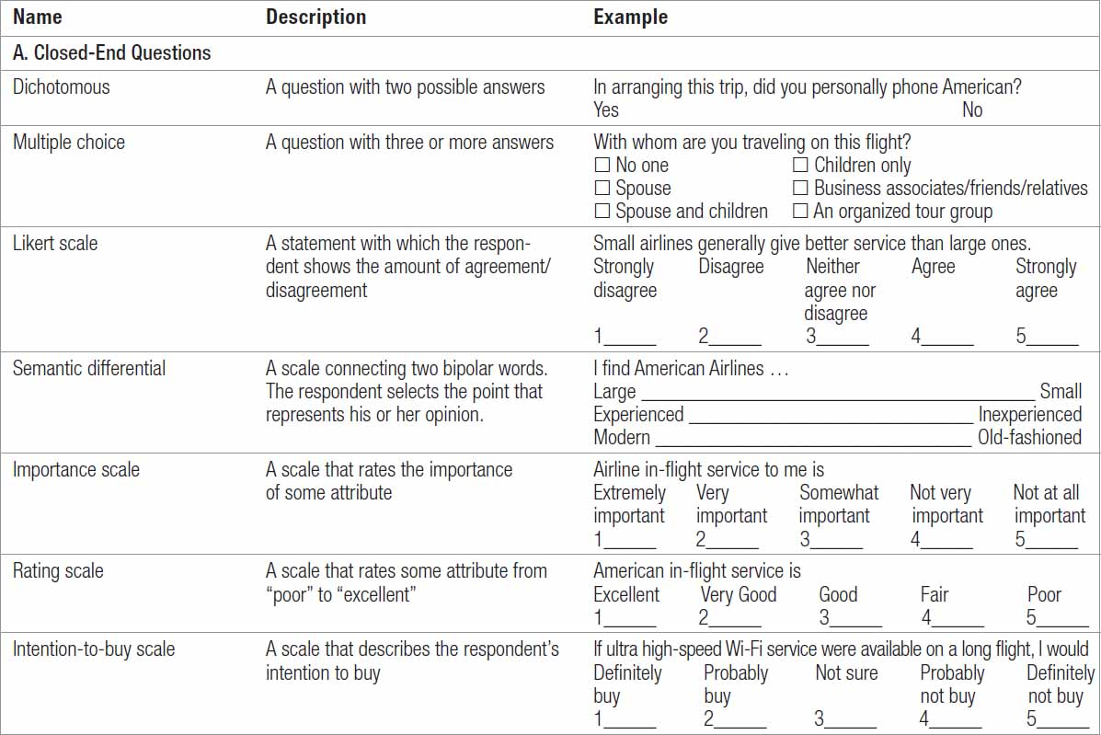
Questionnaire (1 of 2)
Table 4.1 Types of Questions
Notes:
Questionnaires A questionnaire consists of a set of questions presented to respondents. Because of its flexibility, it is by far the most common instrument used to collect primary data. The form, wording, and sequence of the questions can all influence the responses, so testing and de-bugging are necessary. Closed-end questions specify all the possible answers, and the responses are easier to interpret and tabulate.

Slide 15
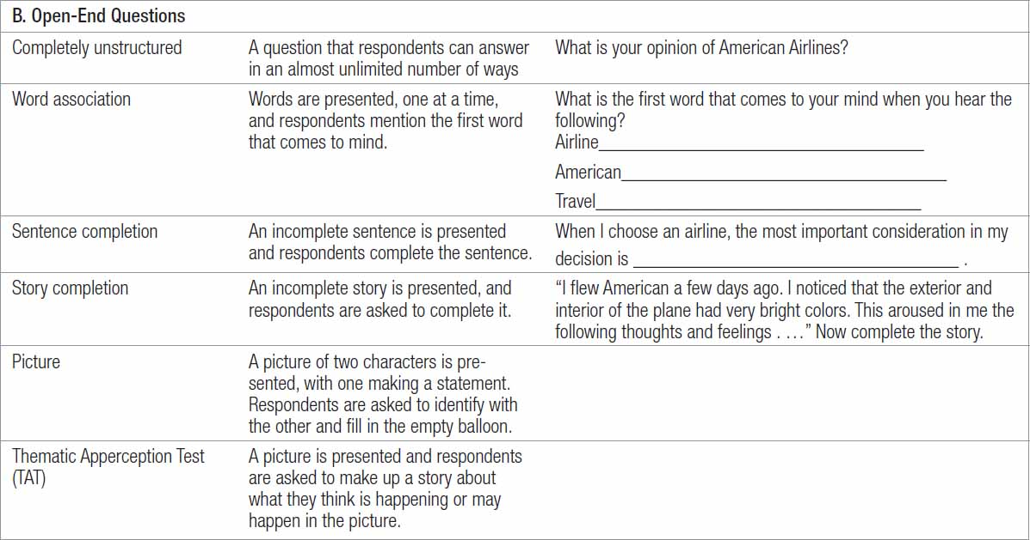
Questionnaire (2 of 2)
[Table 4.1 continued]
Notes:
Open-end questions allow respondents to answer in their own words. They are especially useful in exploratory research, where the researcher is looking for insight into how people think rather than measuring how many think a certain way. Table 4.1 provides examples of both types of questions; also see “Marketing Memo: Questionnaire Dos and Don’ts.”

Slide 16
Qualitative Measures
ZMET approach
Word association
Laddering
Projective techniques
Brand personification
Visualization
Notes:
Qualitative research techniques are relatively indirect and unstructured measurement approaches, limited only by the marketing researcher’s creativity, that permit a range of responses. They can be an especially useful first step in exploring consumers’ perceptions because respondents may be less guarded and reveal more about themselves in the process.
The basic assumption behind the Zaltman Metaphor Elicitation Technique (ZMET) is that most thoughts and feelings are unconscious and shaped by a set of universal deep metaphors , basic orientations toward the world that shape everything consumers think, hear, say, or do.
Word associations. To identify the range of possible brand associations, ask subjects what words come to mind when they hear the brand’s name.
Projective techniques. Give people an incomplete or ambiguous stimulus and ask them to complete or explain it.
Visualization. Visualization requires people to create a collage from magazine photos or drawings to depict their perceptions.
Brand personification. Ask “If the brand were to come alive as a person, what would it be like, what would it do, where would it live, what would it wear, who would it talk to if it went to a party (and what would it talk about)?”
Laddering. A series of increasingly specific “why” questions can reveal consumer motivation and deeper goals.

Slide 17
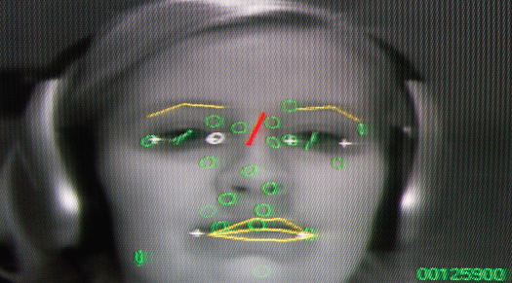
Step 2: Develop the Research Plan (4 of 6)
Technological devices
  Galvanometer
  Tachistoscope
  Eye-tracking
  Facial detection
  Skin sensors
  Brain wave scanners
  Audiometer
  GPS
Notes:
Many advances in visual technology techniques studying the eyes and face have benefited marketing researchers and managers alike. Technology now lets marketers use skin sensors, brain wave scanners, and full-body scanners to get consumer responses. Technology has replaced the diaries that participants in media surveys used to keep.

Slide 18
Step 2: Develop the Research Plan (5 of 6)
Sampling plan
  Sampling unit: Whom should we survey?
  Sample size: How many people should we survey?
  Sampling procedure: How should we choose the respondents?
Notes:
With the sampling unit chosen, marketers must next develop a sampling frame so everyone in the target population has an equal or known chance of being sampled. Large samples give more reliable results, but it’s not necessary to sample the entire target population to achieve reliable results. Samples of less than 1 percent of a population can often provide good reliability, with a credible sampling procedure. Probability sampling allows marketers to calculate confidence limits for sampling error and makes the sample more representative.

Slide 19
Step 2: Develop the Research Plan (6 of 6)
Contact methods
  Mail
  Telephone
  Personal
  Online
Notes:
Now the marketing researcher must decide how to contact the subjects: by mail, by telephone, in person, or online.
Mail Contacts The mail questionnaire is one way to reach people who would not give personal interviews or whose responses might be biased or distorted by the interviewers. Mail questionnaires require simple and clearly worded questions. Unfortunately, responses are usually few or slow.
Telephone Contacts Telephone interviewing is a good method for gathering information quickly; the interviewer is also able to clarify questions if respondents do not understand them. Interviews must be brief and not too personal. Although the response rate has typically been higher than for mailed questionnaires, telephone interviewing in the United States is getting more difficult because of consumers’ growing antipathy toward telemarketers.
Personal Contacts Personal interviewing is the most versatile method. The interviewer can ask more questions and record additional observations about the respondent, such as dress and body language. Personal interviewing is also the most expensive method, is subject to interviewer bias, and requires more planning and supervision.
Online Contacts The Internet offers many ways to do research. A company can embed a questionnaire on its Web site and offer an incentive for answering, or it can place a banner on a frequently visited site, inviting people to answer questions and possibly win a prize. Online product testing can provide information much faster than traditional new-product marketing research techniques.

Slide 20
Online Research
Advantages
  Inexpensive
  Expansive
  Fast
  Honest
  Thoughtful
  Versatile
Disadvantages
  Small
  Skewed
  Excessive turnover
  Technological problems
  Technological inconsistencies
Notes:
As popular as online research methods are, smart companies use them to augment rather than replace more traditional methods. Like any method, online research has pros and cons.

Slide 21
Step 3 to Step 6
Step 3: Collect the Information
Step 4: Analyze the Information
Step 5: Present the Findings
Step 6: Make the Decision
Notes:
The data collection phase of marketing research is generally the most expensive and error-prone. Some respondents will be away from home, offline, or otherwise inaccessible; they must be contacted again or replaced. Others will refuse to cooperate or will give biased or dishonest answers.
The fourth step in the process is to extract findings by tabulating the data and developing summary measures. The researchers now compute averages and measures of dispersion for the major variables and apply some advanced statistical techniques and decision models in the hope of discovering additional findings. They may test different hypotheses and theories, applying sensitivity analysis to test assumptions and the strength of the conclusions.
Then, the researcher presents the findings. Researchers are increasingly asked to play a proactive, consulting role in translating data and information into insights and recommendations for management.
Finally, the firm who commissioned the research need to weigh the evidence. If their confidence in the findings is low, they may decide against implementing the recommendations/conclusions. If they are predisposed to launching it, the findings may support their inclination. They may even decide to study the issue further and do more research. The decision is theirs, but rigorously done research provides them with insight into the problem

Slide 22
Good Marketing Research (1 of 2)
Table 4.2 The Seven Characteristics of good Marketing Research
1. Scientific method | Effective marketing research uses the principles of the scientific method: careful observation, formulation of hypotheses, prediction, and testing.
2. Research creativity | In an award-winning research study to reposition cheetos snacks, researchers dressed up in a brand mascot Chester Cheetah suit and walked around the streets of San Francisco. The response the Character encountered led to the realization that even adults loved the fun and playfulness of Cheetos. The resulting repositioning led to a double-digit sales increase despite a tough business environment.
3. Multiple methods | Marketing researchers shy away from overreliance on any one method. They also recognize the value of using two or three methods to increase confidence in the results.
4. Interdependence of models and data | Marketing researchers recognize that data are interpreted from underlying models that guide the type of information sought.

Slide 23
Good Marketing Research (2 of 2)
[Table 4.2 continued]
5. Value and cost of information | Marketing researchers shoe concern for estimating the value of information against its cost. Costs are typically easy to determine, but the value of research is harder to quantify. It depends on the reliability and validity of the findings and management’s willingness to accept and act on those findings.
6. Healthy scepticism | Marketing researchers show a healthy skepticism toward glib assumptions made by managers about how a market works. They are alert to the problems caused by “marketing myths.”
7. Ethical marketing | Marketing research benefits both the sponsoring company and its customers. The misuse of marketing research can harm or annoy consumers, increasing resentment at what consumers regard as an invasion of their privacy or a disguised sales pitch.

Slide 24
Measuring Marketing Productivity
Marketing metrics
Marketing-mix modeling
Marketing dashboards
Notes:
marketing research must assess the efficiency and effectiveness of marketing activities. Two complementary approaches to measuring marketing productivity are: (1) marketing metrics to assess marketing effects and (2) marketing-mix modeling to estimate causal relationships and measure how marketing activity affects outcomes. Marketing dashboards are a structured way to disseminate the insights gleaned from these two approaches.

Slide 25
Marketing Metrics
Measures that help marketers quantify, compare, and interpret performance
Table 4.3 Sample Marketing Metrics
I. External | II. Internal
Awareness | Awareness of goals
Market share (volume or value) | Commitment of goals
Relative price (market share value/volume) | Active innovation support
Number of complaints (level of dissatisfaction) | Resource adequacy
Consumer satisfaction | Staffing/skill levels
Distribution/availability | Desire to learn
Total number of customers | Willingness to change
Perceived quality/esteem | Freedom to fail
Loyalty/retention | Autonomy
Relative perceived quality | Relative employee satisfaction
Notes:
Marketers choose one or more measures based on the particular issues or problems they face. London Business School’s Tim Ambler believes firms can split evaluation of marketing performance into two parts: (1) short-term results and (2) changes in brand equity.50 Short-term results often reflect profit-and-loss
concerns as shown by sales turnover, shareholder value, or some combination of the two. Brand-equity measures could include customer awareness, attitudes, and behaviors; market share; relative price premium; number of complaints; distribution and availability; total number of customers; perceived quality, and loyalty and retention.

Slide 26
Marketing-Mix Modeling
Analyzes data from a variety of sources, such as retailer scanner data, company shipment data, pricing, media, and promotion spending data, to understand more precisely the effects of specific marketing activities
Notes:
To deepen understanding, marketers can conduct multivariate analyses, such as regression analysis, to sort through how each marketing element influences marketing outcomes such as brand sales or market share.

Slide 27
Marketing Dashboards
“A concise set of interconnected performance drivers to be viewed in common throughout the organization.”
  Customer-performance scorecard
  Stakeholder-performance scorecard
Notes:
Management can assemble a summary set of relevant internal and external measures in a marketing dashboard for synthesis and interpretation. Marketing dashboards are like the instrument panel in a car or plane, visually displaying real-time indicators to ensure proper functioning.
As input to the marketing dashboard, companies should include two key market-based scorecards that reflect performance and provide possible early warning signals.
A customer-performance scorecard records how well the company is doing year after year on such customer-based measures as those shown in Table 4.4. Management should set target goals for each measure and take action when results get out of bounds.
A stakeholder-performance scorecard tracks the satisfaction of various constituencies who have a critical interest in and impact on the company’s performance: employees, suppliers, banks, distributors, retailers, and stockholders. Again, management should take action when one or more groups register increased or above norm levels of dissatisfaction.

Slide 28
Sample Customer-Performance Scorecard Measures
Table 4.4 Sample Customer-Performance Scorecard Measures
Percentage of new customers to average number of customers
Percentage of lost customers to average number of customers
Percentage of Win-back customers to average number of customers
Percentage of customers falling into very dissatisfied, natural, satisfied, and very satisfied categories
Percentage of customers who say they would repurchase the product
Percentage of customers who say they would recommend the product to others
Percentage of target market customers who have brand awareness or recall
Percentage of customers who say that the company’s product is the most preferred in its category
Percentage of customers who correctly identify the brand’s intended positioning and differentiation
Average perception of company’s product quality relative to chief competitor
Average perception of company’s service quality relative to chief competitor
Notes:
A customer-performance scorecard records how well the company is doing year after year on such customer-based measures as those shown in Table 4.4. Management should set target goals for each measure and take action when results get out of bounds.

Slide 29
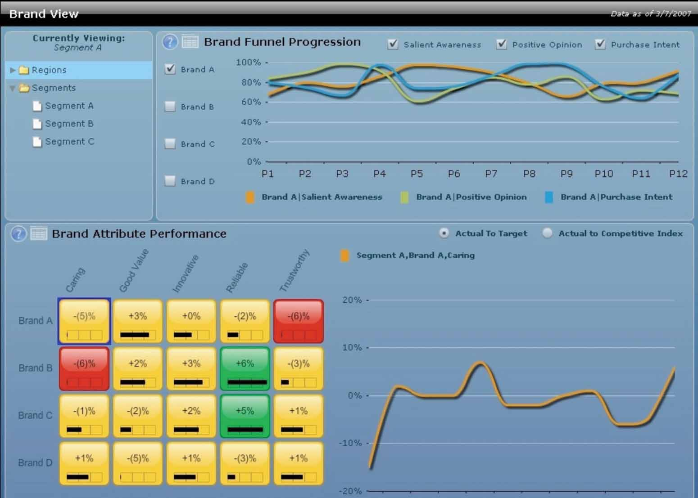
Figure 4.3 Example of a Marketing Dashboard
Notes:
Some executives worry that they’ll miss the big picture if they focus too much on a set of numbers on a dashboard. Some critics are concerned about privacy and the pressure the technique places on employees. But most experts feel the rewards offset the risks. “Marketing Memo: Designing Effective Marketing Dashboards” provides practical advice about the development of these marketing tools.

Slide 30

THANK YOU FOR YOUR ATTENTION!

Slide 31

Notes:
No wonder, Marketing is the most popular area at our University!

