Slide 1

Aspects of International Marketing Management
Mamurjon Rahimov
mrahimov@wiut.uz
mamurjon@gmail.com

Slide 2

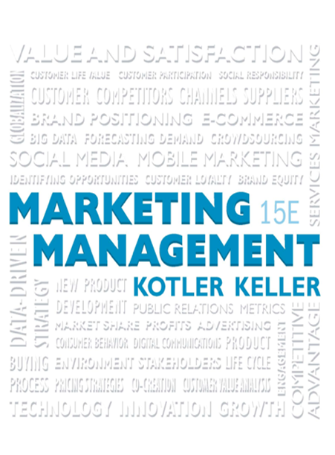
Identifying Market Segments and Targets

Slide 3

Learning Objectives
9.1 In what ways can a company divide the consumer market into segments?
9.2 How should business markets be segmented?
9.3 How should a company choose the most attractive target markets?
9.4 What are the requirements for effective segmentation?
9.5 What are the different levels of market segmentation?

Slide 4
Bases for Segmenting Consumer Markets
Market segment
  A group of customers who share a similar set of needs and wants
    Geographic segmentation
    Demographic segmentation
    Psychographic segmentation
    Behavioral segmentation
Notes:
Market segmentation divides a market into well-defined slices. A market segment consists of a group of customers who share a similar set of needs and wants. The marketer’s task is to identify the appropriate number and nature of market segments and decide which one(s) to target. The major segmentation variables—geographic, demographic, psychographic, and behavioral segmentation—are summarized in Table 9.1 (see Table 9.1 on slides 4-6).

Slide 5
Major Segmentation Variables for Consumer Markets (1 of 3)
Table 9.1 Major Segmentation Variables for Consumer Markets
Geographic region | Pacific Mountain, West North Central, West South Central, East North Central, East South Central, South Atlantic, Middle Atlantic, New England
City or metro size | Under 5,000; 5,000–20,000; 20,000–50,000; 50,000–100,000; 100,000–250,000; 250,000–500,000; 500,000–1,000,000; 1,000,000–4,000,000; 4,000,000+
Density | Urban, suburban, rural
Climate | Northern, southern
Demographic age | Under 6, 6–11, 12–17, 18–34, 35–49, 50–64, 64+
Family size | 1–2, 3–4, 5+
Family life cycle | Young, single; young, married, no children; young, married, youngest child under 6; young; married, youngest child 6 or older; older, married, with children; older, married, no children under 18; older, single; other
Gender | Male, female
Income | Under $10,000; $10,000–$15,000; $15,000–$20,000; $20,000–$30,000; $30,000–$50,000; $50,000–$100,000; $100,000+

Slide 6
Major Segmentation Variables for Consumer Markets (2 of 3)
[Table 9.1 continued]
Occupation | Professional and technical; managers, officials, and proprietors; clerical sales; craftspeople; forepersons; operatives; farmers; retired; students; homemakers; unemployed
Education | Grade school or less; some high school; high school graduate; some college; college graduate; post college
Religion | Catholic, Protestant, Jewish, Muslim, Hindu, Other
Race | White, Black, Asian, Hispanic, Other
Generation | Silent Generation, Baby Boomers, Gen X, Millennials (Gen Y)
Nationality | North American, Latin American, British, French, German, Italian, Chinese, Indian, Japanese
Social class | Lower lowers, upper lowers, working class, middle class, upper middles, lower uppers, upper uppers
Psychographic lifestyle | Culture-oriented, sports-oriented, outdoor-oriented
Personality | Compulsive, gregarious, authoritarian, ambitious

Slide 7
Major Segmentation Variables for Consumer Markets (3 of 3)
[Table 9.1 continued]
Behavioral occasions | Regular occasion, special occasion
Benefits | Quality, service, economy, speed
User status | Nonuser, ex-user, potential user, first-time user, regular user
Usage rate | Light user, medium user, heavy user
Loyalty status | None, medium, strong, absolute
Readiness stage | Unaware, aware, informed interested, desirous, intending to buy
Attitude toward product | Enthusiastic, positive, indifferent, negative, hostile

Slide 8
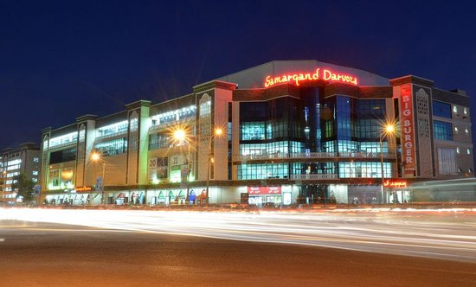
Geographic Segmentation (1 of 2)
Geographical units
  Nations, states, regions, counties, cities, or neighborhoods
Nielsen Claritas’ PRIZM
  Education and affluence
  Family life cycle
  Urbanization
  Race and ethnicity
  Mobility
Notes:
The company can operate in one or a few areas, or it can operate in all but pay attention to local variations. In that way it can tailor marketing programs to the needs and wants of local customer groups in trading areas, neighborhoods, even individual stores. In a growing trend called grassroots marketing, marketers concentrate on making such activities as personally relevant to individual customers as possible.
More and more, regional marketing means marketing right down to a specific zip code. Nielsen Claritas has developed a geoclustering approach called PRIZM (Potential Rating Index by Zip Markets) NE that classifies more than half a million U.S. residential neighborhoods into 14 distinct groups and 66 distinct lifestyle segments called PRIZM Clusters. The groupings take into consideration 39 factors in five broad categories. The clusters have descriptive titles such as Blue Blood Estates, Winner’s Circle, Hometown Retired, Shotguns and Pickups, and Back Country Folks. The inhabitants in a cluster tend to lead similar lives, drive similar cars, have similar jobs, and read similar magazines. Table 9.2 has examples of three PRIZM clusters.

Slide 9
Geographic Segmentation (2 of 2)
Table 9.2 Examples of PRIZM Clusters
Young Digerati. Young Digerati are the nation’s tech-savvy singles and couples living in fashionable neighbor-hoods on the urban fringe. Affluent, highly educated, and ethnically mixed, they live in areas typically filled with trendy apartments and condos, fitness clubs and clothing boutiques, casual restaurants, and all types of bars—from juice to coffee to microbrew.
Beltway Boomers. One segment of the huge baby boomer cohort—college-educated, upper-middle-class, and home-owning—is Beltway Boomers. Like many of their peers who married late, these boomers are still raising children in comfortable suburban subdivisions and pursuing kid-centered lifestyles.
The Cosmopolitans. Educated, midscale, and multiethnic, the Cosmopolitans are urbane couples in America’s fast-growing cities. Concentrated in a handful of metros—such as Las Vegas, Miami, and Albuquerque—these households feature older homeowners, empty nesters, and college graduates. A vibrant social scene surrounds their older homes and apartments, and residents love the nightlife and enjoy leisure-intensive lifestyles.
Notes:
Geoclustering captures the increasing diversity of the U.S. population. PRIZM has been used to answer questions such as: Which neighborhoods or zip codes contain our most valuable customers? How deeply have we already penetrated these segments? Which distribution channels and promotional media work best in reaching our target clusters in each area?

Slide 10
Demographic Segmentation (1 of 5)
Age and life-cycle stage
Life stage
Race and culture
Gender
Generation
Income
Notes:
One reason demographic variables such as age, family size, family life cycle, gender, income, occupation, education, religion, race, generation, nationality, and social class are so popular with marketers is that they’re often associated with consumer needs and wants. Another is that they’re easy to measure.

Slide 11

Demographic Segmentation (2 of 5)
Age and life-cycle stage
  Our wants and abilities change with age
Life stage
  A person’s major concern (e.g., frequent road trips)
Notes:
Age and life cycle can be tricky variables. The target market for some products may be the psychologically young.
People in the same part of the life cycle may still differ in their life stage. Life stage defines a person’s major concern, such as going through a divorce, going into a second marriage, taking care of an older parent, deciding to cohabit with another person, buying a new home, and so on.

Slide 12

Demographic Segmentation (3 of 5)
Gender
  Men and women have different attitudes and behave differently
Income
  Income segmentation is a long-standing practice
Notes:
Research shows that women have traditionally tended to be more communal-minded and men more self-expressive and goal-directed; women have tended to take in more of the data in their immediate environment and men to focus on the part of the environment that helps them achieve a goal. Gender differences are shrinking in some other areas as men and women expand their roles.
Income does not always predict the best customers for a given product. Blue-collar workers were among the first purchasers of color television sets; it was cheaper for them to buy a television than to go to movies and restaurants. Many marketers are deliberately going after lower income groups, in some cases discovering fewer competitive pressures or greater consumer loyalty. Increasingly, companies are finding their markets are hourglass-shaped, as middle-market U.S. consumers migrate toward both discount and premium products.

Slide 13
Demographic Segmentation (4 of 5)
Generation
  Millennials (Gen Y)
  Gen X
  Baby Boomers
  Silent Generation
Notes:
Each generation or cohort is profoundly influenced by the times in which it grows up—the music, movies, politics, and defining events of that period. Members share the same major cultural, political, and economic experiences and often have similar outlooks and values. Marketers may choose to advertise to a cohort by using the icons and images prominent in its experiences. They can also try to develop products and services that uniquely meet the particular interests or needs of a generational target.
Although different age splits are used to define Millennials, or Gen Y, the term usually means people born between 1977 and 1994. Also known as the Echo Boomers, “digital native” Millennials have been wired almost from birth—playing computer games, navigating the Internet, downloading music, and connecting with friends via texting and social media. Although they may have a sense of entitlement and abundance from growing up during the economic boom and being pampered by their boomer parents, Millennials are also often highly socially conscious, concerned about environmental issues, and receptive to cause marketing efforts.
Often lost in the demographic shuffle, the 50 million or so Gen X consumers, named for a 1991 novel by Douglas Coupland, were born between 1964 and 1978. Gen Xers prize self-sufficiency and the ability to handle any circumstance. Technology is an enabler for them, not a barrier. Unlike the more optimistic, team-oriented Gen Yers, Gen Xers are more pragmatic and individualistic. As consumers, they are wary of hype and pitches that seem inauthentic.
Baby boomers are the approximately 76 million U.S. consumers born between 1946 and 1964. Though they represent a wealthy target, possessing $1.2 trillion in annual spending power and controlling three-quarters of the country’s wealth, marketers often overlook them. With many baby boomers approaching their 70s and even the last and youngest wave cresting 50, demand has exploded for products to turn back the hands of time.
Those born between 1925 and 1945—the “Silent Generation”—are redefining what old age means. To start with, many people whose chronological age puts them in this category don’t see themselves as old. Advertisers have learned that older consumers don’t mind seeing other older consumers in ads targeting them, as long as they appear to be leading vibrant lives. But marketers have learned to avoid clichés like happy older couples riding bikes or strolling hand in hand on a beach at sunset.

Slide 14
Demographic Segmentation (5 of 5)
Race and culture
  Hispanic Americans
  Asian Americans
  African Americans
Notes:
Multicultural marketing is an approach recognizing that different ethnic and cultural segments have sufficiently different needs and wants to require targeted marketing activities and that a mass market approach is not refined enough for the diversity of the marketplace. The Hispanic American, African American, and Asian American markets are all growing at two to three times the rate of nonmulticultural populations, with numerous submarkets, and their buying power is expanding.
Accounting for more than half the growth in the U.S. population from 2000 to 2010, Hispanic Americans have become the largest minority in the country. It’s projected that by 2020, 17 percent of U.S. residents will be of Hispanic origin. With annual purchasing power of more than $1 trillion in 2010—and expected to rise to $1.5 trillion by 2015—Hispanic Americans would be the world’s ninth-largest market if they were a separate nation. Hispanic Americans often share strong family values—several generations may reside in one household—and strong ties to their country of origin.
According to the U.S. Census Bureau, “Asian” refers to people having origins in any of the original peoples of the Far East, Southeast Asia, or the Indian subcontinent. Six countries represent 79 percent of the Asian American population: China (21 percent), the Philippines (18 percent), India (11 percent), Vietnam (10 percent), Korea (10 percent), and Japan (9 percent). Telecommunications and financial services are a few of the industries more actively targeting Asian Americans. Asian Americans tend to be more brand-conscious than other minority groups yet are the least loyal to particular brands. They also tend to care more about what others think (for instance, whether their neighbors will approve of them) and share core values of safety and education.
African Americans are projected to have a combined spending power of $1.1 trillion by 2015. Like many cultural segments, they are deeply rooted in the U.S. landscape while also proud of their heritage and respectful of family ties. African Americans are the most fashion-conscious of all racial and ethnic groups but are strongly motivated by quality and selection. They’re also more likely to be influenced by their children when selecting a product and less likely to buy unfamiliar brands. African Americans watch television and listen to the radio more than other groups and are heavy users of mobile data. Nearly three-fourths have a profile on more than one social network, with Twitter being extremely popular.
The lesbian, gay, bisexual, and transgender (LGBT) market is estimated to make up 5 percent to 10 percent of the population and have approximately $700 billion in buying power. Many firms have recently created initiatives to target this market. Some firms worry about backlash from organizations that will criticize or even boycott firms supporting gay and lesbian causes. Although Pepsi, Campbell’s, and Wells Fargo all experienced such boycotts in the past, they continue to advertise to the gay community.

Slide 15
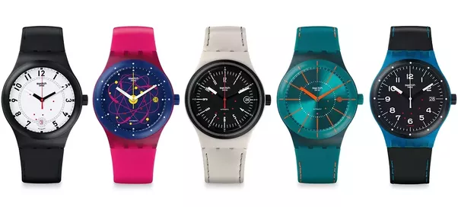
Psychographic Segmentation
Buyers are divided into groups on the basis of psychological/personality traits, lifestyle, or values
Notes:
Psychographics is the science of using psychology and demographics to better understand consumers. People within the same demographic group can exhibit very different psychographic profiles.

Slide 16
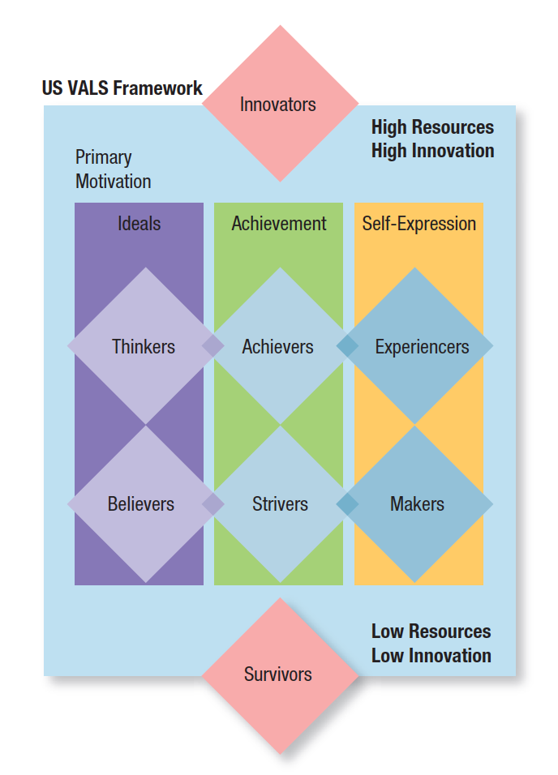
Figure 9.1 VALS Segmentation System
Notes:
One of the most popular commercially available classification systems based on psychographic measurements is Strategic Business Insight’s (SBI) VALS™ framework. VALS is based on psychological traits for people and classifies U.S. adults into eight primary groups based on responses to a questionnaire featuring four demographic and 35 attitudinal questions. The VALS system is continually updated with new data from more than 80,000 surveys per year (see Figure 9.1).
The main dimensions of the VALS segmentation framework are consumer motivation (the horizontal dimension) and consumer resources (the vertical dimension). Consumers are inspired by one of three primary motivations: ideals, achievement, and self-expression. Those primarily motivated by ideals are guided by knowledge and
principles. Those motivated by achievement look for products and services that demonstrate success to their peers. Consumers whose motivation is self-expression desire social or physical activity, variety, and risk. Personality traits such as energy, self-confidence, intellectualism, novelty seeking, innovativeness, impulsiveness, leadership, and vanity—in conjunction with key demographics—determine an individual’s resources. Different levels of resources enhance or constrain a person’s expression of his or her primary motivation.

Slide 17
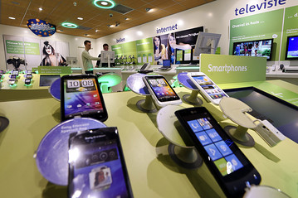
Behavioral Segmentation (1 of 2)
Marketers divide buyers into groups on the basis of their knowledge of, attitude toward, use of, or response to a product
Notes:
Although psychographic segmentation can provide a richer understanding of consumers, some marketers fault it for being somewhat removed from actual consumer behavior.

Slide 18
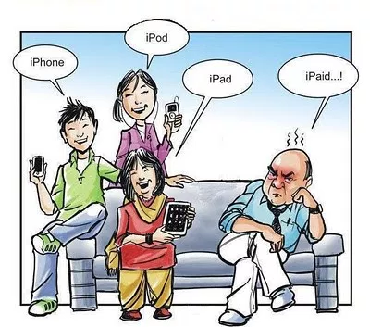
Behavioral Segmentation (2 of 2)
Needs and benefits
Decision roles
  Initiator
  Influencer
  Decider
  Buyer
  User
Notes:
Needs-based or benefit-based segmentation identifies distinct market segments with clear marketing implications.
People play five roles in a buying decision: Initiator, Influencer, Decider, Buyer, and User. For example, assume a wife initiates a purchase by requesting a new treadmill for her birthday. The husband may then seek information from many sources, including his best friend who has a treadmill and is a key influencer in what models to consider. After presenting the alternative choices to his wife, he purchases her preferred model, which ends up being used by the entire family. Different people are playing different roles, but all are crucial in the decision process and ultimate consumer satisfaction.

Slide 19
User and Usage-Related Variables
Occasions
User status
Attitude
Usage rate
Loyalty status
Buyer-readiness stage
Notes:
Many marketers believe variables related to users or their usage—occasions, user status, usage rate, buyer-readiness stage, and loyalty status—are good starting points for constructing market segments.
Occasions mark a time of day, week, month, year, or other well-defined temporal aspects of a consumer’s life. We can distinguish buyers according to the occasions when they develop a need, purchase a product, or use a product.
Every product has its nonusers, ex-users, potential users, first-time users, and regular users. Included in the potential-user group are consumers who will become users in connection with some life stage or event.
We can segment markets into light, medium, and heavy product users. Heavy users are often a small slice but account for a high percentage of total consumption.
Some people are unaware of the product, some are aware, some are informed, some are interested, some desire the product, and some intend to buy. To help characterize how many people are at different stages and how well they have converted people from one stage to another, recall from Chapter 5 that marketers can employ a marketing funnel to break the market into buyer-readiness stages.
Loyalty Status Marketers usually envision four groups based on brand loyalty status:
1. Hard-core loyals—Consumers who buy only one brand all the time
2. Split loyals—Consumers who are loyal to two or three brands
3. Shifting loyals—Consumers who shift loyalty from one brand to another
4. Switchers—Consumers who show no loyalty to any brand
Five consumer attitudes about products are enthusiastic, positive, indifferent, negative, and hostile.

Slide 20
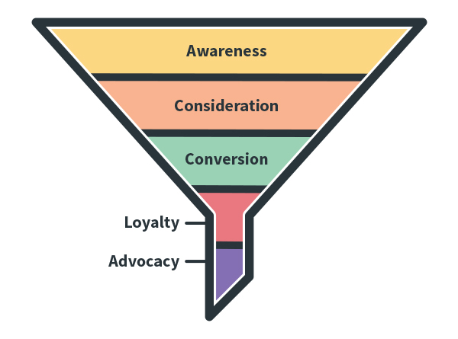
Figure 9.2 Marketing Funnel
Notes:
Figure 9.2 displays a funnel for two hypothetical brands. Compared with Brand B, Brand A performs poorly at converting one-time users to more recent users (only 46 percent convert for Brand A compared with 61 percent for Brand B). Depending on the reasons consumers didn’t use again, a marketing campaign could introduce more
relevant products, find more accessible retail outlets, or dispel rumors or incorrect beliefs consumers hold.

Slide 21
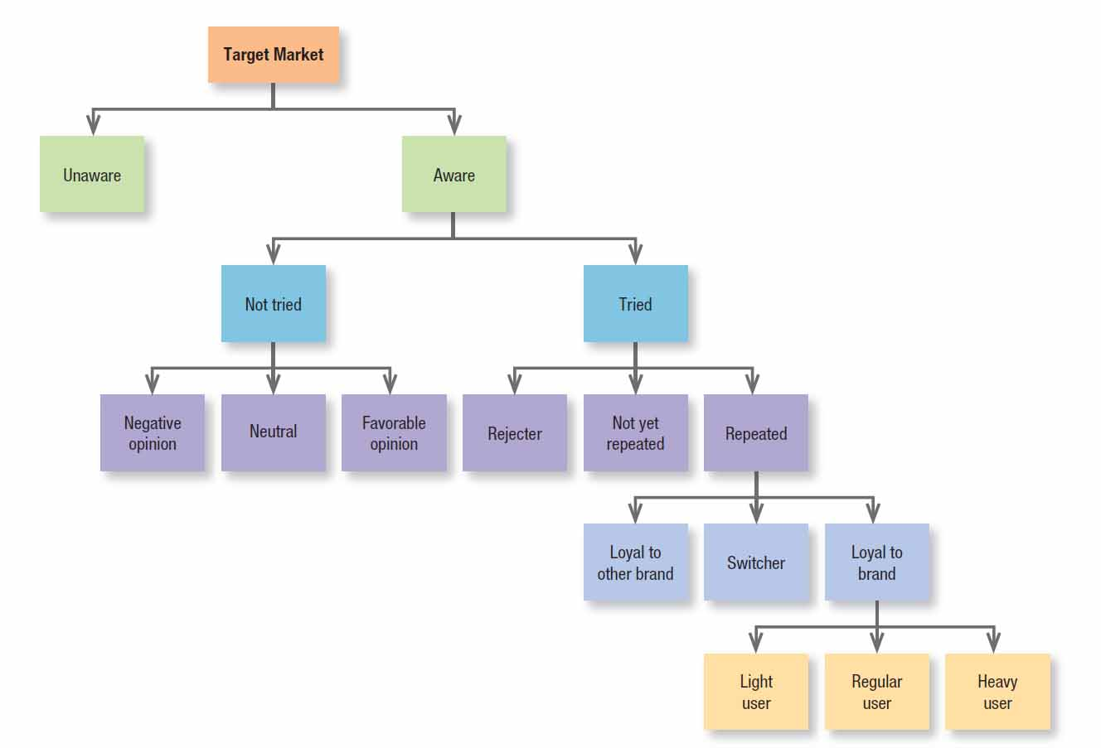
Figure 9.3 Behavioral Segmentation Breakdown
Notes:
Combining different behavioral bases can provide a more comprehensive and cohesive view of a market and its segments. Figure 9.3 depicts one possible way to break down a target market by various behavioral segmentation bases.

Slide 22
How Should Business Markets Be Segmented?
  Demographic
  Operating variables
  Purchasing approaches
  Purchasing approaches
  Situational factors
  Personal characteristics
Notes:
We can segment business markets with some of the same variables we use in consumer markets, such as geography, benefits sought, and usage rate, but business marketers also use other variables. Table 9.5 (see Table 9.5 on slides 22-23) shows one set of these. The demographic variables are the most important, followed by the operating variables—down to the personal characteristics of the buyer. Business marketers generally identify segments through a sequential process.

Slide 23
Major Segmentation Variables for Business Markets (1 of 2)
Table 9.5 Major Segmentation Variables for Business Markets
Demographic 1. Industry: Which industries should we serve? 2. Company size: What size companies should we serve? 3. Location: What geographical areas should we serve?
Operating Variables 4. Technology: What customer technologies should we focus on? 5. User or nonuser status: Should we serve heavy users, medium users, light users, or nonusers? 6. Customer capabilities: Should we serve customers needing many or few services?
Purchasing Approaches 7. Purchasing-function organization: Should we serve companies with a highly centralized or decentralized purchasing organization? 8. Power structure: Should we serve companies that are engineering dominated, financially dominated, and so on? 9. Nature of existing relationship: Should we serve companies with which we have strong relationships or simply go after the most desirable companies? 10. General purchasing policies: Should we serve companies that prefer leasing? Service contract? Systems purchases? Sealed bidding? 11. Purchasing criteria: Should we serve companies that are seeking quality? Service? Price?

Slide 24
Major Segmentation Variables for Business Markets (2 of 2)
[Table 9.5 continued]
Situational Factors 12. Urgency: Should we serve companies that need quick and sudden delivery or service? 13. Specific application: Should we focus on a certain application of our product rather than all applications? 14. Size or order: Should we focus on large or small orders?
Personal Characteristics 15. Buyer-seller similarity: Should we serve companies whose people and values are similar to ours? 16. Attitude toward risk: Should we serve risk-taking or risk-avoiding customers? 17. Loyalty: Should we serve companies that show high loyalty to their suppliers?

Slide 25
Market Targeting
  Table 9.6 Steps in the Segmentation Process
blank | Description
1. Needs-Based Segmentation | Group customers into segments based on similar needs and benefits sought by customers in solving a particular consumption problem.
2. Segment Identification | For each needs-based segment, determine which demographics, lifestyles, and usage behaviors make the segment distinct and identifiable (actionable).
3. Segment Attractiveness | Using predetermined segment attractiveness criteria (such as market growth, competitive intensity, and market access), determine the overall attractiveness of each segment.
4. Segment Profitability | Determine segment profitability.
5. Segment Positioning | For each segment, create a “value proposition” and product-price positioning strategy based on that segment’s unique customer needs and characteristics.
6. Segment “Acid Test” | Create “segment storyboard” to test the attractiveness of each segment’s positioning strategy.
7. Marketing-Mix Strategy | Expand segment positioning strategy to include all aspects of the marketing mix: product, price, promotion, and place.
Notes:
There are many statistical techniques for developing market segments. Once the firm has identified its market-segment opportunities, it must decide how many and which ones to target. Marketers are increasingly combining several variables in an effort to identify smaller, better-defined target groups. Thus, a bank may not only identify a group of wealthy retired adults but within that group distinguish several segments depending on current income, assets, savings, and risk preferences. This has led some market researchers to advocate a needs-based market segmentation approach. Roger Best proposed the seven-step approach shown in Table 9.6.

Slide 26
Effective Segmentation Criteria
  Measurable
  Substantial
  Accessible
  Differentiable
  Actionable
Notes:
To be useful, market segments must rate favorably on five key criteria:
Measurable. The size, purchasing power, and characteristics of the segments can be measured.
Substantial. The segments are large and profitable enough to serve. A segment should be the largest possible homogeneous group worth going after with a tailored marketing program. It would not pay, for example, for an automobile manufacturer to develop cars for people who are under four feet tall.
Accessible. The segments can be effectively reached and served.
Differentiable. The segments are conceptually distinguishable and respond differently to different marketing mix elements and programs. If married and single women respond similarly to a sale on perfume, they do not constitute separate segments.
Actionable. Effective programs can be formulated for attracting and serving the segments.

Slide 27
Porter’s Five Forces
Threat of Rivalry
Threat of New Entrants
Threat of Substitutes
Threat of Buyer Bargaining Power
Threat of Supplier Bargaining Power
Notes:
Michael Porter has identified five forces that determine the intrinsic long-run attractiveness of a market or market segment: industry competitors, potential entrants, substitutes, buyers, and suppliers.
Threat of intense segment rivalry—A segment is unattractive if it already contains numerous, strong, or aggressive competitors. These conditions will lead to frequent price wars, advertising battles, and new-product introductions and will make it expensive to compete.
Threat of new entrants—The most attractive segment is one in which entry barriers are high and exit barriers are low. Few new firms can enter the industry, and poorly performing firms can easily exit. When both entry and exit barriers are high, profit potential is high, but firms face more risk because poorer-performing firms stay in and fight it out. When both entry and exit barriers are low, firms easily enter and leave the industry, and returns are stable but low. The worst case occurs when entry barriers are low and exit barriers are high: Here firms enter during good times but find it hard to leave during bad times.
Threat of substitute products—A segment is unattractive when there are actual or potential substitutes for the product. Substitutes place a limit on prices and on profits. If technology advances or competition increases in these substitute industries, prices and profits are likely to fall.
Threat of buyers’ growing bargaining power—A segment is unattractive if buyers possess strong or growing bargaining power. Buyers’ bargaining power grows when
they become more concentrated or organized, when the product represents a significant fraction of their costs, when the product is undifferentiated, when buyers’ switching costs are low, or when they can integrate upstream. To protect themselves, sellers might select buyers who have the least power to negotiate or switch
suppliers. A better defense is developing superior offers that strong buyers cannot refuse.
Threat of suppliers’ growing bargaining power—A segment is unattractive if the company’s suppliers are able to raise prices or reduce quantity supplied. Suppliers tend to be powerful when they are concentrated or organized, when they can integrate downstream, when there are few substitutes, when the supplied product is an important input, and when the costs of switching suppliers are high. The best defenses are to build win-win relationships with suppliers or use multiple supply sources.

Slide 28
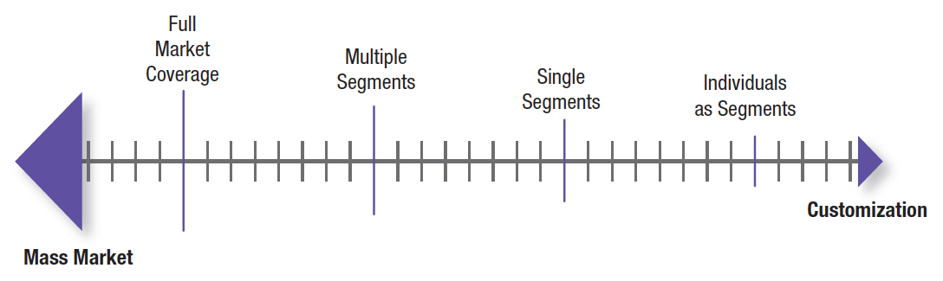
Figure 9.4 Evaluating and Selecting the Market Segments
Possible Levels of Segmentation
Notes:
Marketers have a range or continuum of possible levels of segmentation that can guide their target market decisions. As Figure 9.4 shows, at one end is a mass market of essentially one segment; at the other are individuals or segments of one person each. Between lie multiple segments and single segments.
With full market coverage, a firm attempts to serve all customer groups with all the products they might need. Only very large firms such as Microsoft (software market), General Motors (vehicle market), and Coca-Cola (nonalcoholic beverage market) can undertake a full market coverage strategy. Large firms can cover a whole market in two broad ways: through differentiated or undifferentiated marketing.
Multiple Segment Specialization With selective specialization, a firm selects a subset of all the possible segments, each objectively attractive and appropriate. There may be little or no synergy among the segments, but each promises to be a moneymaker. Keeping synergies in mind, companies can try to operate in supersegments rather than in isolated segments. A supersegment is a set of segments sharing some exploitable similarity. With product specialization, the firm sells a certain product to several different market segments. With market specialization, the firm concentrates on serving many needs of a particular customer group, such as by selling an assortment of products only to university laboratories.
With single-segment concentration, the firm markets to only one particular segment. Through concentrated marketing, the firm gains deep knowledge of the segment’s needs and achieves a strong market presence. It also enjoys operating economies by specializing its production, distribution, and promotion. If it captures segment
leadership, the firm can earn a high return on its investment. A niche is a more narrowly defined customer group seeking a distinctive mix of benefits within a segment. Marketers usually identify niches by dividing a segment into subsegments.
Individual Marketing The ultimate level of segmentation leads to “segments of one,” “customized marketing,” or “one-to-one marketing.” As companies have grown proficient at gathering information about individual customers and business partners (suppliers, distributors, retailers), and as their factories are being designed more flexibly, they have increased their ability to individualize market offerings, messages, and media. Mass customization is the ability of a company to meet each customer’s requirements—to prepare on a mass basis individually designed products, services, programs, and communications.

Slide 29
One-To-One Marketing
Identify your prospects and customers
Differentiate customers in terms of their needs and value to your company
Interact to improve your knowledge about customers’ needs and to build relationships
Customize products, services, and messages to each customer
Notes:
Early pioneers in individual marketing Don Peppers and Martha Rogers outlined a four-step framework for what they called one-to-one marketing. One-to-one marketing is not for every company. It works best for firms that normally collect a great deal of individual customer information and carry a lot of products that can be cross-sold, need periodic replacement or upgrading, and offer high value. For others, the required investment in information collection, hardware, and software may exceed the payout. The cost of goods is raised beyond what the customer is willing to pay.

Slide 30
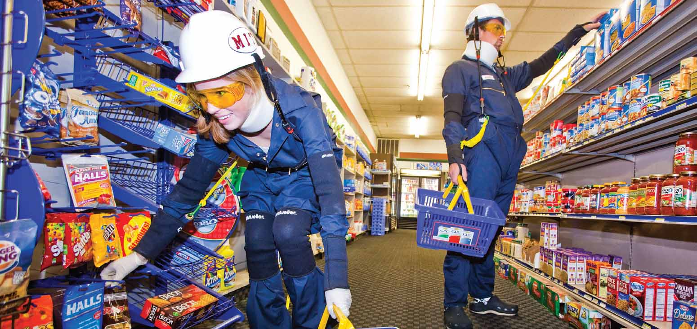
Legal and Ethical Issues
Marketers must avoid consumer backlash
  Labeling consumers
  Vulnerable groups
  Disadvantaged groups
  Potentially harmful products
Notes:
Some consumers resist being labeled. Singles may reject single-serve food packaging if they don’t want to be reminded they are eating alone. Elderly consumers who don’t feel their age may not appreciate products that label them “old.” Market targeting also can generate public controversy when marketers take unfair advantage of vulnerable groups (such as children) or disadvantaged groups (such as inner-city residents) or promote potentially harmful products. The cereal industry has been criticized through the years for marketing efforts directed toward children.

Slide 31

THANK YOU FOR YOUR ATTENTION!

Slide 32

Notes:
No wonder, Marketing is the most popular area at our University!

