Slide 1

Aspects of International Marketing Management
Mamurjon Rahimov
mrahimov@wiut.uz
mamurjon@gmail.com

Slide 2

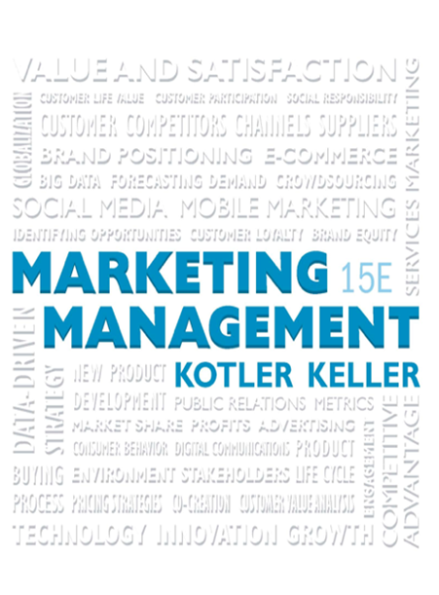
Setting Product Strategy

Slide 3
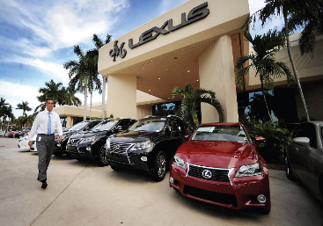
Learning Objectives (1 of 2)
13.1 What are the characteristics of products, and how do marketers classify product?
13.2 How can companies differentiate products?
13.3 Why is product design important, and what are the different approaches taken?
13.4 How can marketers best manage luxury brands?
13.5 What environmental issues must marketers consider in their product strategies?
13.6 How can a company build and manage its product mix and product lines?

Slide 4
Learning Objectives (2 of 2)
13.7 How can companies combine products to create strong co-brands or ingredient brands?
13.8 How can companies use packaging, labeling, warranties, and guarantees as marketing tools?

Slide 5
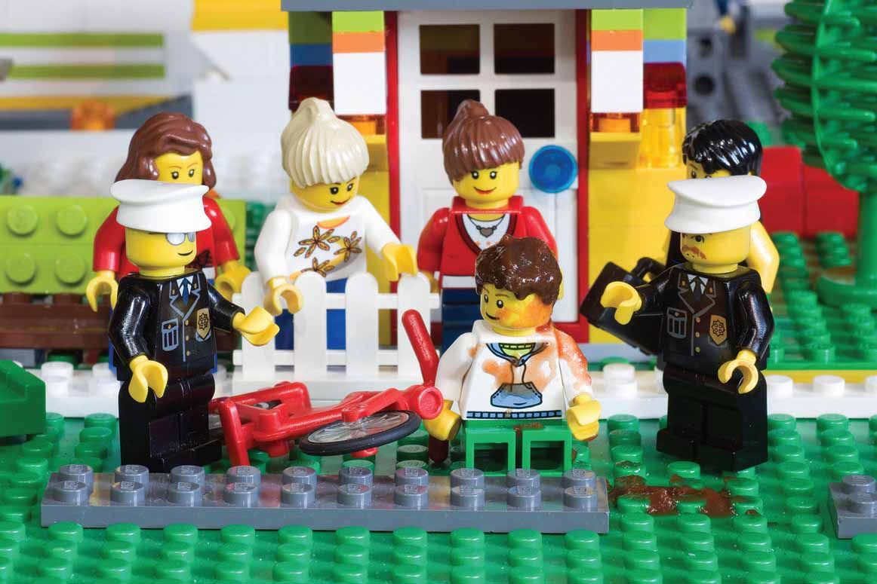
Product Characteristics and Classifications
Product
  Anything that can be offered to a market to satisfy a want or need, including physical goods, services, experiences, events, persons, places, properties, organizations, information, and ideas
Notes:
Many people think a product is tangible, but this definition suggests otherwise.

Slide 6
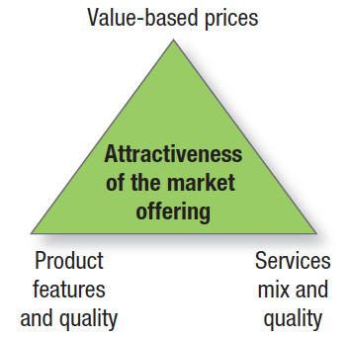
Figure 13.1 Components of the Market Offering
Notes:
Marketing planning begins with formulating an offering to meet target customers’ needs or wants. The customer will judge the offering on three basic elements: product features and quality, service mix and quality, and price (see Figure 13.1).

Slide 7
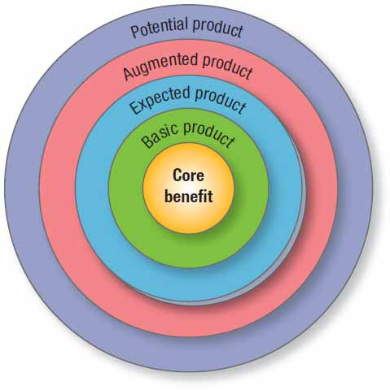
Product Levels: The Customer-Value Hierarchy
Figure 13.2 Five Product Levels
Notes:
In planning its market offering, the marketer needs to address five product levels (see Figure 13.2).2 Each level adds more customer value, and together the five constitute a customer-value hierarchy.
• The fundamental level is the core benefit: the service or benefit the customer is really buying. A hotel guest is buying rest and sleep.
• At the second level, the marketer must turn the core benefit into a basic product. Thus a hotel room includes a bed, bathroom, towels, desk, dresser, and closet.
• At the third level, the marketer prepares an expected product, a set of attributes and conditions buyers normally expect when they purchase this product. Hotel guests minimally expect a clean bed, fresh towels, working lamps, and a relative degree of quiet.
• At the fourth level, the marketer prepares an augmented product that exceeds customer expectations. In developed countries, brand positioning and competition take place at this level.
• At the fifth level stands the potential product, which encompasses all the possible augmentations and transformations the product or offering might undergo in the future. Here companies search for new ways to satisfy customers and distinguish their offering.

Slide 8
Product Classifications
Durability
Tangibility
Use
Notes:
Marketers classify products on the basis of durability, tangibility, and use (consumer or industrial). Each type has an appropriate marketing-mix strategy.

Slide 9
Durability and Tangibility
Nondurable goods
Durable goods
Services
Notes:
Products fall into three groups according to durability and tangibility:
1. Nondurable goods are tangible goods normally consumed in one or a few uses, such as beer and shampoo. Because these goods are purchased frequently, the appropriate strategy is to make them available in many locations, charge only a small markup, and advertise heavily to induce trial and build preference.
2. Durable goods are tangible goods that normally survive many uses: refrigerators, machine tools, and clothing. They normally require more personal selling and service, command a higher margin, and require more seller guarantees.
3. Services are intangible, inseparable, variable, and perishable products that normally require more quality control, supplier credibility, and adaptability. Examples include haircuts, legal advice, and appliance repairs.

Slide 10
Consumer-Goods Classification
Convenience
Shopping
Specialty
Unsought
Notes:
When we classify the vast array of consumer goods on the basis of shopping habits, we distinguish among convenience, shopping, specialty, and unsought goods.
The consumer usually purchases convenience goods frequently, immediately, and with minimal effort. Examples include soft drinks, soaps, and newspapers. Staples are convenience goods consumers purchase on a regular basis. A buyer might routinely purchase Heinz ketchup, Crest toothpaste, and Ritz crackers. Impulse goods are purchased without any planning or search effort, like candy bars and magazines. Emergency goods are purchased when a need is urgent—umbrellas during a rainstorm, boots and shovels during the first winter snow.
Shopping goods are those the consumer characteristically compares on such bases as suitability, quality, price, and style. Examples include furniture, clothing, and major appliances. Homogeneous shopping goods are similar in quality but different enough in price to justify shopping comparisons. Heterogeneous shopping goods differ in product features and services that may be more important than price.
Specialty goods have unique characteristics or brand identification for which enough buyers are willing to make a special purchasing effort. Examples include cars, audio-video components, and men’s suits.
Unsought goods are those the consumer does not know about or normally think of buying, such as smoke detectors. Other classic examples are life insurance, cemetery plots, and gravestones.

Slide 11
Industrial-Goods Classification
Materials and parts
Capital items
Supplies and business services
Notes:
We classify industrial goods in terms of their relative cost and the way they enter the production process: materials and parts, capital items, and supplies and business services. Materials and parts are goods that enter the manufacturer’s product completely. They fall into two classes: raw materials and manufactured materials and parts. Raw materials in turn fall into two major groups: farm products (wheat, cotton, livestock, fruits, and vegetables) and natural products (fish, lumber, crude petroleum, iron ore). Manufactured materials and parts fall into two categories: component materials (iron, yarn, cement, wires) and component parts (small motors, tires, castings). Component materials are usually fabricated further—pig iron is made into steel, and yarn is woven into cloth. The standardized nature of component materials usually makes price and supplier reliability key purchase factors. Component parts enter the finished product with no further change in form, as when small motors are put into vacuum cleaners and tires are put on automobiles.
Capital items are long-lasting goods that facilitate developing or managing the finished product. They fall into two groups: installations and equipment. Installations consist of buildings (factories, offices) and heavy equipment (generators, drill presses, mainframe computers, elevators). Equipment includes portable factory equipment and tools (hand tools, lift trucks) and office equipment (desktop computers, desks). These types of equipment don’t become part of a finished product.
Supplies and business services are short-term goods and services that facilitate developing or managing the finished product. Supplies are of two kinds: maintenance and repair items (paint, nails, brooms) and operating supplies (lubricants, coal, writing paper, pencils). Together, they go under the name of MRO goods. Business services include maintenance and repair services (window cleaning, copier repair) and business advisory services (legal, management consulting, advertising).

Slide 12

Product Differentiation
Form
Features
Performance quality
Conformance quality
Durability
Reliability
Repairability
Style
Customization
Notes:
Form Many products can be differentiated in form—the size, shape, or physical structure of a product.
Features Most products can be offered with varying features that supplement their basic function.
Performance Quality Most products occupy one of four performance levels: low, average, high, or superior. Performance quality is the level at which the product’s primary characteristics operate.
Conformance Quality Buyers expect a high conformance quality, the degree to which all produced units are identical and meet promised specifications.
Durability Durability, a measure of the product’s expected operating life under natural or stressful conditions, is a valued attribute for vehicles, kitchen appliances, and other durable goods.
Reliability Buyers normally will pay a premium for more reliable products. Reliability is a measure of the probability that a product will not malfunction or fail within a specified time period.
Repairability Repairability measures the ease of fixing a product when it malfunctions or fails. Ideal repairability would exist if users could fix the product themselves with little cost in money or time.
Style Style describes the product’s look and feel to the buyer and creates distinctiveness that is hard to copy.
Customization As Chapter 9 described, customized products and marketing allow firms to be highly relevant and differentiating by finding out exactly what a person wants—and doesn’t want—and delivering on that.

Slide 13
Services Differentiation
  Ordering ease
  Delivery
Installation
Customer training
Customer consulting
Maintenance and repair
Returns
Notes:
The main service differentiators are ordering ease, delivery, installation, customer training, customer consulting, maintenance and repair, and returns.
Ordering ease describes how easy it is for the customer to place an order with the company.
Delivery refers to how well the product or service is brought to the customer, including speed, accuracy, and care throughout the process.
Installation refers to the work done to make a product operational in its planned location.
Customer Training Customer training helps the customer’s employees use the vendor’s equipment
properly and efficiently.
Customer consulting includes data, information systems, and advice services the seller offers to buyers.
Maintenance and repair programs help customers keep purchased products in good working order. These services are critical in business-to-business settings.
Returns A nuisance to customers, manufacturers, retailers, and distributors alike, product returns are also an
unavoidable reality of doing business, especially in online purchases. Free shipping, growing more popular, makes it easier for customers to try out an item, but it also increases the likelihood of returns. Controllable returns result from problems or errors made by the seller or customer and can mostly be eliminated
with improved handling or storage, better packaging, and improved transportation and forward logistics by the seller or its supply chain partners. Uncontrollable returns result from the need for customers to actually see, try, or experience products in person to determine suitability and can’t be eliminated by the company in the short run.

Slide 14

Design (1 of 2)
Design
  The totality of features that affect the way a product looks, feels, and functions to a consumer
Notes:
As competition intensifies, design offers a potent way to differentiate and position a company’s products and services.

Slide 15
Design (2 of 2)
  Is emotionally powerful
  Transmits brand meaning/positioning
Is important with durable goods
Makes brand experiences rewarding
Can transform an entire enterprise
Facilitates manufacturing/distribution
Can take on various approaches
Notes:
Design offers functional and aesthetic benefits and appeals to both our rational and emotional sides.

Slide 16

Luxury brands
Quality
Uniqueness
Craftsmanship
Heritage
Authenticity
History
Notes:
Design is often an important aspect of luxury products, though these products also face some unique issues.
They are perhaps one of the purest examples of the role of branding because the brand and its image are often key competitive advantages that create enormous value and wealth. A luxury shopper must feel he or she is getting something truly special. Thus the common denominators of luxury brands are quality and uniqueness. A winning formula for many is craftsmanship, heritage, authenticity, and history, often critical to justifying a sometimes extravagant price.

Slide 17
Marketing Luxury Brands
Table 13.1 Guidelines for Marketing Luxury Brands
1 | Maintaining a premium image for luxury brands is crucial; controlling that image is thus a priority.
2 | Luxury branding typically includes the creation of many intangible brand associations and an aspirational image.
3 | All aspects of the marketing program for luxury brands must be aligned to ensure high-quality products and services and pleasurable purchase and consumption experiences.
4 | Besides brand names, other brand elements—logos, symbols, packaging, signage—can be important drivers of brand equity for luxury products.
5 | Secondary associations from linked personalities, events, countries, and other entities can boost luxury-brand equity as well.
6 | Luxury brands must carefully control distribution via a selective channel strategy.
7 | Luxury brands must employ a premium pricing strategy, with strong quality cues and few discounts and markdowns.
8 | Brand architecture for luxury brands must be managed carefully.
9 | Competition for luxury brands must be defined broadly because it often comes from other categories.
10 | Luxury brands must legally protect all trademarks and aggressively combat counterfeits.

Slide 18
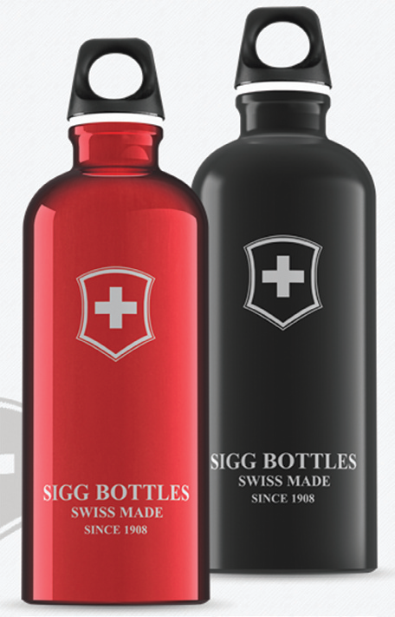
Environmental Issues
Environmental issues are also playing an increasingly important role in product design and manufacturing
Notes:
Many firms are considering ways to reduce the negative environmental consequences of conducting business, and some are changing the manufacture of their products or the ingredients that go into them.

Slide 19
The Product Hierarchy
Need family
Product family
Product class
Product line
Product type
Item
Notes:
The product hierarchy stretches from basic needs to particular items that satisfy those needs. We can identify six levels of the product hierarchy, using life insurance as an example:
1. Need family—The core need that underlies the existence of a product family. Example: security.
2. Product family—All the product classes that can satisfy a core need with reasonable effectiveness. Example: savings and income.
3. Product class—A group of products within the product family recognized as having a certain functional coherence, also known as a product category. Example: financial instruments.
4. Product line—A group of products within a product class that are closely related because they perform a similar function, are sold to the same customer groups, are marketed through the same outlets or channels, or fall within given price ranges. A product line may consist of different brands, a single family brand, or an individual brand that has been line extended. Example: life insurance.
5. Product type—A group of items within a product line that share one of several possible forms of the product. Example: term life insurance.
6. Item (also called stock-keeping unit or product variant)—A distinct unit within a brand or product line distinguishable by size, price, appearance, or some other attribute. Example: Prudential renewable term life insurance.

Slide 20
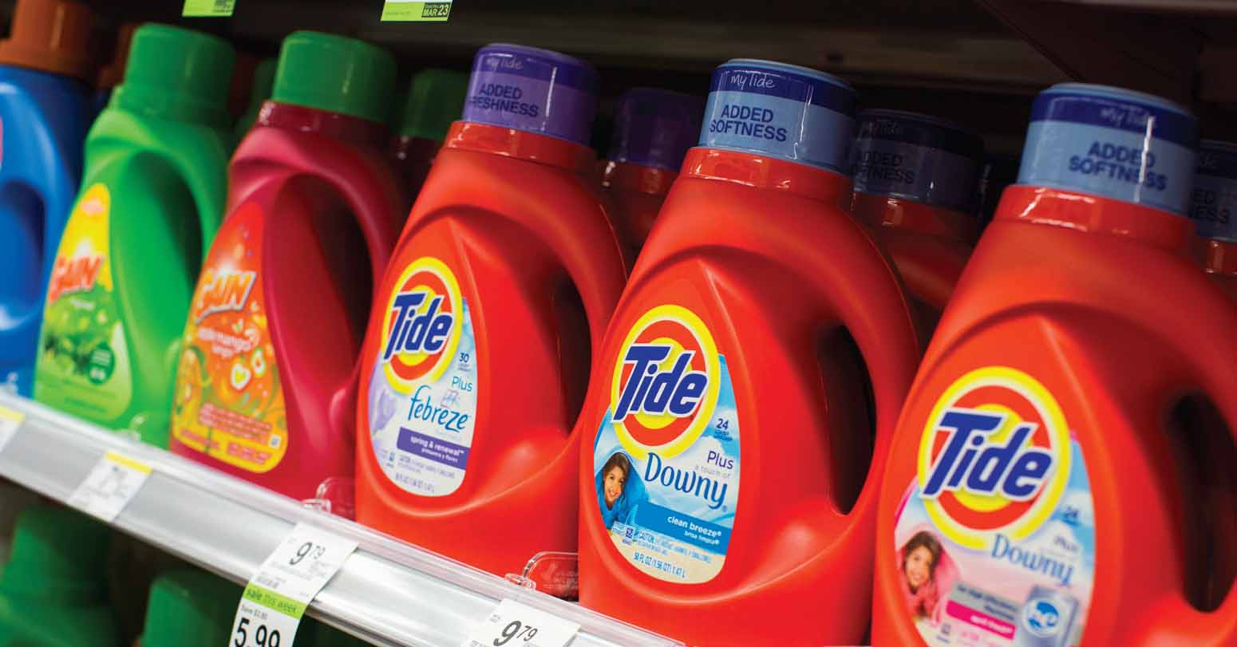
Product Systems and Mixes
Product system
Product mix/assortment
  Width
  Length
  Depth
  Consistency
Notes:
A product system is a group of diverse but related items that function in a compatible manner. A product mix (also called a product assortment) is the set of all products and items a particular seller offers for sale. A product mix consists of various product lines.
A company’s product mix has a certain width, length, depth, and consistency.
The width of a product mix refers to how many different product lines the company carries. The length of a product mix refers to the total number of items in the mix. The depth of a product mix refers to how many variants are offered of each product in the line. The consistency of the product mix describes how closely related the various product lines are in end use, production requirements, distribution channels, or some other way.

Slide 21
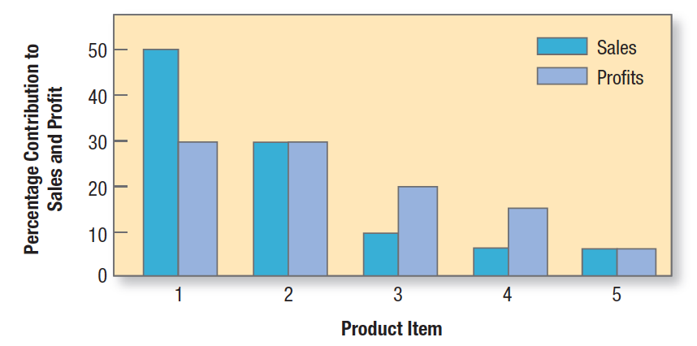
Product Line Analysis (1 of 2)
Sales and profits
Figure 13.3 Product-Item Contributions to a Product Line’s Total Sales and Profits
Notes:
In offering a product line, companies normally develop a basic platform and modules that can be added to meet different customer requirements and lower production costs. Product line managers need to know the sales and profits of each item in their line to determine which items to build, maintain, harvest, or divest. They also need to understand each product line’s market profile and image.
Figure 13.3 shows a sales and profit report for a five-item product line. The first item accounts for 50 percent of total sales and 30 percent of total profits. The first two items account for 80 percent of total sales and 60 percent of total profits. If these two items were suddenly hurt by a competitor, the line’s sales and profitability could collapse. These items must be carefully monitored and protected. At the other end, the last item delivers only 5 percent of the product line’s sales and profits. The product line manager may consider dropping this item unless it has strong growth potential.

Slide 22
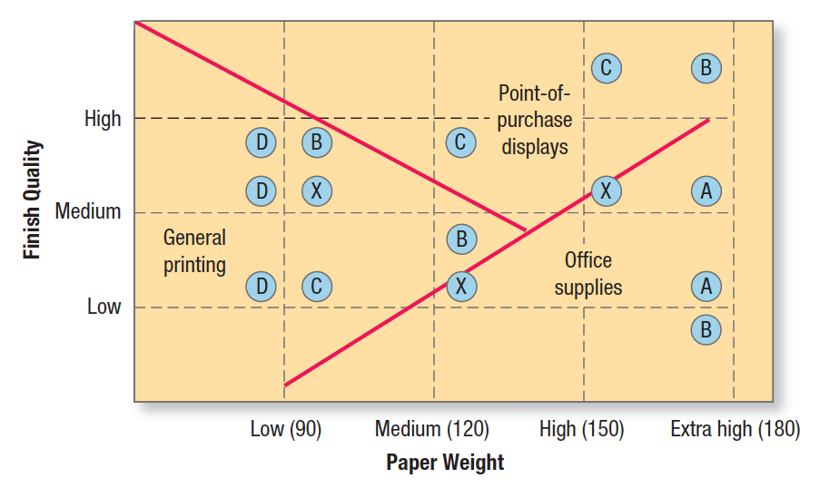
Product Line Analysis (2 of 2)
Market profile and image
Figure 13.4 Product Map for a Paper-Product Line
Source: Benson P. Shapiro, Industrial Product Policy: Managing the Existing Product Line (Cambridge, MA: Marketing Science Institute Report No. 77–110). Copyright © 2003. Reprinted by permission of Marketing Science Institute and Benson P. Shapiro.
Notes:
The product line manager must review how the line is positioned against competitors’ lines. Consider paper company X with a paperboard product line.54 Two paperboard attributes are weight and finish quality. Paper is usually offered at standard levels of 90, 120, 150, and 180 weights. Finish quality is offered at low, medium, and high levels.
The product map in Figure 13.4 shows the location of the various product line items of company X and four competitors, A, B, C, and D. Competitor A sells two product items in the extra-high weight class ranging from medium to low finish quality. Competitor B sells four items that vary in weight and finish quality. Competitor C
sells three items in which the greater the weight, the greater the finish quality. Competitor D sells three items, all lightweight but varying in finish quality. Company X offers three items that vary in weight and finish quality. The product map also shows which competitors’ items are competing against company X’s items. Another benefit of product mapping is that it identifies market segments. Figure 13.4 shows the types of paper, by weight and quality, preferred by the general printing industry, the point-of-purchase display industry, and the office supply industry.

Slide 23
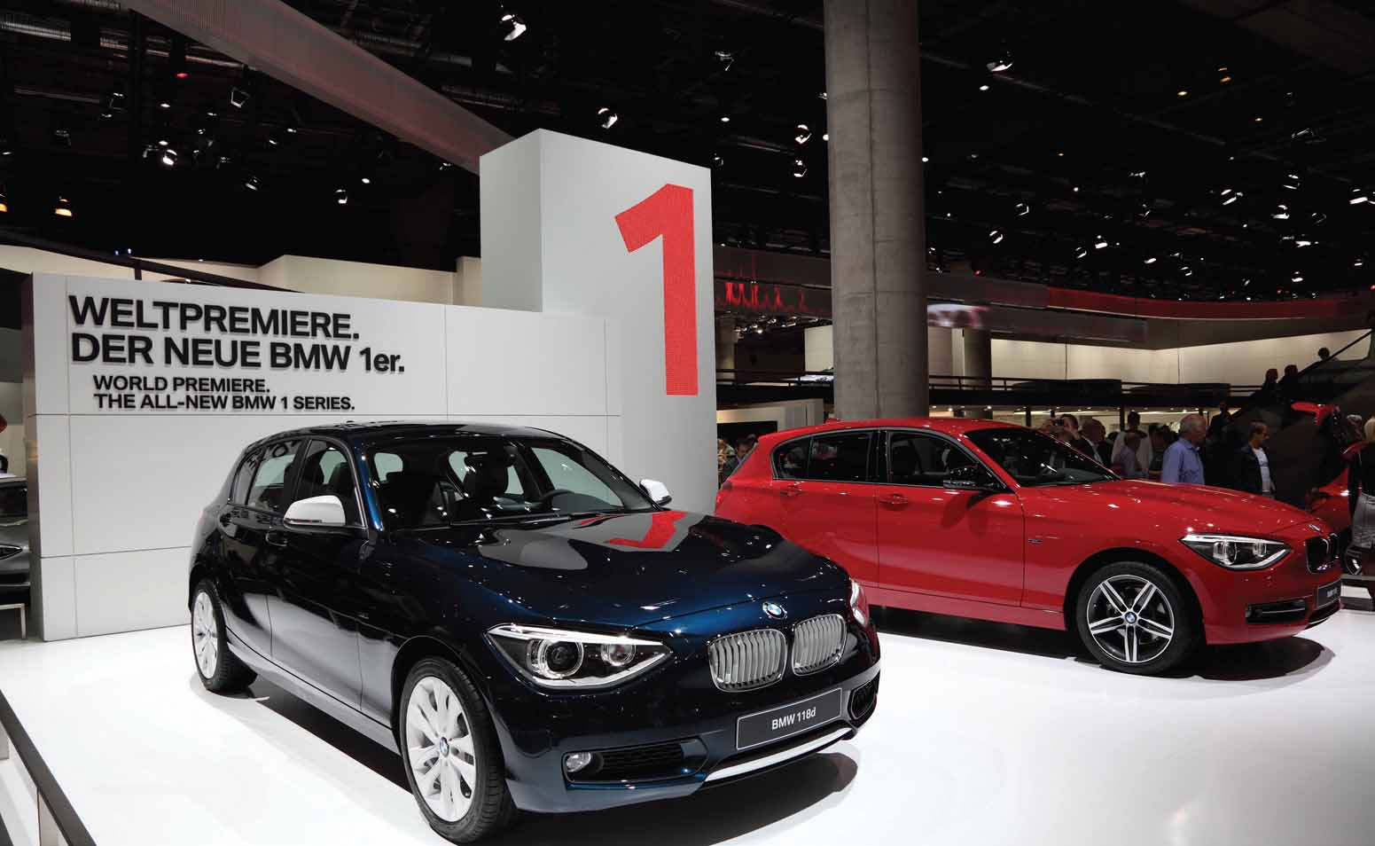
Product Line Length
Line stretching
  Down-market stretch
  Up-market stretch
  Two-way stretch
Line filling
Line modernization
Line featuring
Line pruning
Notes:
Product lines tend to lengthen over time. Excess manufacturing capacity puts pressure on the product line manager to develop new items. A company lengthens its product line in two ways: line stretching and line filling. Line stretching occurs when a company lengthens its product line beyond its current range, whether down-market, up-market, or both ways.
Down-Market Stretch A company positioned in the middle market may want to introduce a lower-priced line.
Up-Market Stretch Companies may wish to enter the high end of the market to achieve more growth, realize higher margins, or simply position themselves as full-line manufacturers.
Two-Way Stretch Companies serving the middle market might stretch their line in both directions.
Line Filling A firm can also lengthen its product line by adding more items within the present range. Motives for line filling include reaching for incremental profits, satisfying dealers who complain about lost sales because of items missing from the line, utilizing excess capacity, trying to become the leading full-line company, and plugging holes to keep out competitors.
Line Modernization, Featuring, and Pruning Product lines regularly need to be modernized. The product line manager typically selects one or a few items in the line to feature. Using sales and cost analysis, product line managers must periodically review the line for deadwood that depresses profits.

Slide 24
Product Mix Pricing
The firm searches for a set of prices that maximizes profits on the total mix
  Product line pricing
  Optional-feature pricing
  Product-bundling pricing
  Captive-product pricing
  By-product pricing
  Two-part pricing
Notes:
We can distinguish six situations calling for product-mix pricing: product line pricing, optional- feature pricing, captive-product pricing, two-part pricing, by-product pricing, and product-bundling pricing. Product Line Pricing Companies normally develop product lines rather than single products, so they introduce price steps. Optional-Feature Pricing Many companies offer optional products, features, and services with their main product. Captive-Product Pricing Some products require the use of ancillary or captive products. Two-Part Pricing Service firms engage in two-part pricing, consisting of a fixed fee plus a variable usage fee. By-Product Pricing The production of certain goods—meats, petroleum products, and other chemicals—often yields by-products that should be priced on their value. Product-Bundling Pricing Sellers often bundle products and features. Pure bundling occurs when a firm offers its products only as a bundle. In mixed bundling, the seller offers goods both individually and in bundles, normally charging less for the bundle than if the items were purchased separately.

Slide 25
Co-Branding
Two or more well-known brands are combined into a joint product or marketed together in some fashion
  Same-company
  Joint-venture
  Multiple-sponsor
  Retail
Notes:
Marketers often combine their products with products from other companies in various ways. In co-branding—also called dual branding or brand bundling—two or more well-known brands are combined into a joint product or marketed together in some fashion.
One form of co-branding is same-company co-branding, as when General Mills advertises Trix cereal and Yoplait yogurt. Another form is joint-venture co-branding, such as General Electric and Hitachi lightbulbs in Japan or the Citi Platinum Select AAdvantage Visa Signature credit card in which three different parties are involved. There is multiple-sponsor co-branding, such as Taligent, a one-time technological alliance of Apple, IBM, and Motorola. Finally, there is retail co-branding in which two retail establishments use the same location to optimize space and profits, such as jointly owned Pizza Hut, KFC, and Taco Bell restaurants.

Slide 26

Ingredient Branding
Co-branding that creates brand equity for parts that are necessarily contained within other branded products
Notes:
For host products whose brands are not that strong, ingredient brands can provide differentiation and important signals of quality. An interesting take on ingredient branding is self-branded ingredients that companies advertise and even trademark. Westin Hotels advertises its own “Heavenly Bed”—a critically important ingredient to a guest’s good night’s sleep. The brand has been so successful that Westin now sells the bed, pillows, sheets, and blankets via an online catalog, along with other “Heavenly” gifts, bath products, and even pet items. Ingredient brands try to create enough awareness and preference for their product so consumers will not buy a host product that doesn’t contain it.

Slide 27

Packaging (1 of 3)
All the activities of designing and producing the container for a product
Notes:
Packaging is important because it is the buyer’s first encounter with the product. A good package draws the consumer in and encourages product choice. In effect, it can act as a “five-second commercial” for the product.
It also affects consumers’ later product experiences when they open it and use what’s inside. Some packages can even be attractively displayed at home. Distinctive packaging like that for Kiwi shoe polish, Altoids mints, and Absolut vodka is an important part of a brand’s equity.

Slide 28
Packaging (2 of 3)
Used as a marketing tool
Self-service
Consumer affluence
Company and brand image
Innovation opportunity
Packaging objectives
Identify the brand
Convey descriptive and persuasive information
Facilitate product transportation and protection
Assist at-home storage
Aid product consumption
Notes:
Several factors contribute to the growing use of packaging as a marketing tool.
Self-service. In an average supermarket, which may stock 15,000 items, the typical shopper passes some 300 products per minute. Given that 50 percent to 70 percent of all purchases are made in the store, the effective package must perform many sales tasks: attract attention, describe the product’s features, create consumer confidence, and make a favorable overall impression.
Consumer affluence. Rising affluence means consumers are willing to pay a little more for the convenience, appearance, dependability, and prestige of better packages.
Company and brand image. Packages contribute to instant recognition of the company or brand. In the store, they can create a billboard effect, as Garnier Fructis does with its bright green packaging in the hair care aisle.
Innovation opportunity. Unique or innovative packaging can bring big benefits to consumers and profits to producers. Companies are always looking for a way to make their products more convenient and easier to use—often charging a premium when they do so.
Formally, packaging must achieve a number of objectives that are listed on this slide. To achieve these objectives and satisfy consumers’ desires, marketers must choose the functional and aesthetic components of packaging correctly.

Slide 29
Packaging (3 of 3)
Table 13.3 The Color Wheel of Branding and Packaging
Red symbolizes excitement, energy, passion, courage, and being bold.
Orange connotes friendliness and fun. It combines the energy of red and the warmth of yellow.
Yellow, as the color of the sun, is equated with warmth, joy, and happiness.
Green, as the color of nature, connotes health, growth, freshness, and renewal.
Blue, as the color of the sky and sea, is associated with dependability, trust, competence, and integrity.
Purple has symbolized nobility, wealth, and wisdom. It combines the stability of blue and the energy of red.
Pink is considered to have soft, peaceful, comforting qualities.
Brown, as the color of the earth, connotes honesty and dependability.
Black is seen as classic, strong, and balanced.
White connotes purity, innocence, and cleanliness.
Notes:
Color is a particularly important aspect of packaging and carries different meanings in different cultures and market segments. Color can define a brand, from Tiffany’s blue box to Cadbury’s purple wrapping and UPS’s brown trucks. Orange, the telecom mobile operator, uses color as both its name and its look. Table 13.3 summarizes the beliefs of some visual marketing experts about the role of color in Western culture.

Slide 30
Labeling, Warranties, and Guarantees
Labeling
  Identifies, grades, describes, and promotes the product
Warranties
  Formal statements of expected product performance by the manufacturer
Guarantees
  Promise of general or complete satisfaction
Notes:
A label performs several functions. First, it identifies the product or brand—for instance, the name Sunkist stamped on oranges. It might also grade the product; canned peaches are grade-labeled A, B, and C. The label might describe the product: who made it, where and when, what it contains, how it is to be used, and how to use it safely. Finally, the label might promote the product through attractive graphics.
All sellers are legally responsible for fulfilling a buyer’s normal or reasonable expectations. Products under warranty can be returned to the manufacturer or designated repair center for repair, replacement, or refund. Whether expressed or implied, warranties are legally enforceable.
Many sellers offer either general or specific guarantees. Guarantees reduce the buyer’s perceived risk. They suggest that the product is of high quality and the company and its service performance are dependable. They can be especially helpful when the company or product is not well known or when the product’s quality is superior to that of competitors.

Slide 31

THANK YOU FOR YOUR ATTENTION!

Slide 32

Notes:
No wonder, Marketing is the most popular area at our University!

