Slide 1

Aspects of International Marketing Management
Mamurjon Rahimov
mrahimov@wiut.uz
mamurjon@gmail.com

Slide 2

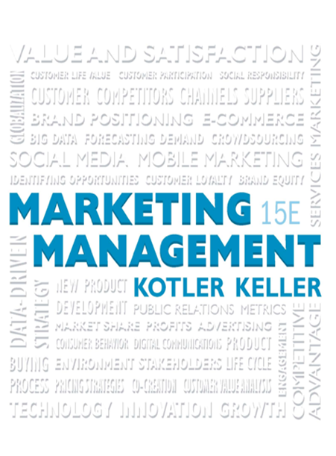
Designing and Managing Services

Slide 3

Learning Objectives
14.1 How can services be defined and classified, and how do they differ from goods?
14.2 What are the new services realities?
14.3 How can companies achieve excellence in services marketing?
14.4 How can companies improve service quality?
14.5 How can goods marketers improve customer-support services?

Slide 4
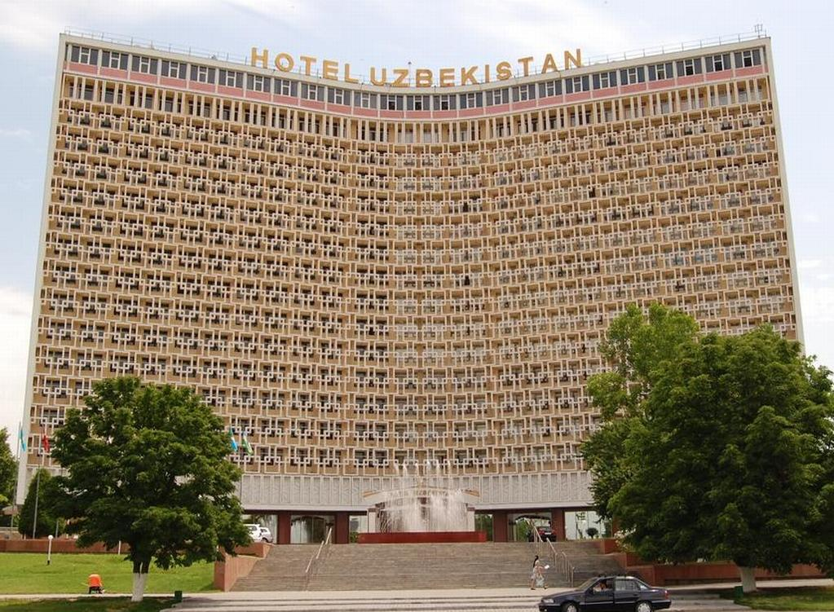
The Nature of Services
Service
  Any act or performance one party can offer to another that is essentially intangible and does not result in the ownership of anything
Notes:
Its production may or may not be tied to a physical product.
The government sector, with its courts, employment services, hospitals, loan agencies, military services, police and fire departments, postal service, regulatory agencies, and schools, is in the service business. The private nonprofit sector—museums, charities, churches, colleges, foundations, and hospitals—is in the service business. A good part of the business sector, with its airlines, banks, hotels, insurance companies, law firms, management consulting firms, medical practices, motion picture companies, plumbing repair companies, and real estate firms, is in the service business. Many workers in the manufacturing sector, such as computer operators, accountants, and legal staff, are really service providers.

Slide 5

Categories of Service Mix
A pure tangible good
A tangible good with accompanying services
A hybrid
A major service with accompanying minor goods/services
A pure service
Notes:
The service component can be a minor or a major part of the total offering. We distinguish five categories of offerings on this slide. Restaurants are good examples of hybrid offerings combining products and services. One of the more successful restaurant brands is Panera Bread.

Slide 6

Service Distinctions
  Equipment- or people-based
  Different processes of delivery
  Some need client’s presence
  Meets personal or business need
  Differs in objectives and ownership
Notes:
Services are equipment-based (automated car washes, vending machines) or people-based (window washing, accounting services). People-based services vary by whether unskilled, skilled, or professional workers provide them.
• Service companies can choose among different processes to deliver their service. Restaurants offer cafeteria-style, fast-food, buffet, and candlelight service formats.
• Some services need the client’s presence. Brain surgery requires the client’s presence; a car repair does not. If the client must be present, the service provider must be considerate of his or her needs. Thus beauty salon operators will invest in décor, play background music, and engage in light conversation with the client.
• Services may meet a personal need (personal services) or a business need (business services). Service providers typically develop different marketing programs for these markets.
• Service providers differ in their objectives (profit or nonprofit) and ownership (private or public). These two characteristics, when crossed, produce four quite different types of organizations. The marketing programs of a private investor hospital will differ from those of a private charity hospital or a Veterans Administration hospital.

Slide 7
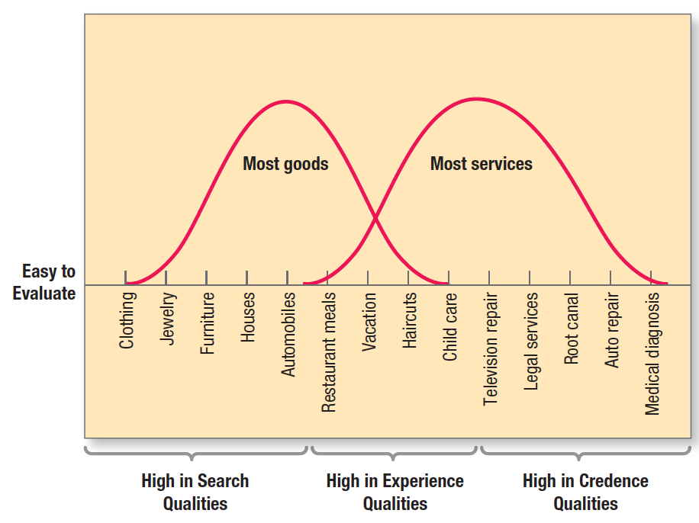
Figure 14.1 Evaluation Continuum for Product Types
Notes:
Customers typically cannot judge the technical quality of some services even after they have received them. Figure 14.1 shows various products and services according to difficulty of evaluation.6 At the left are goods high in search qualities—that is, characteristics the buyer can evaluate before purchase. In the middle are goods and services high in experience qualities—characteristics the buyer can evaluate after purchase. At the right are goods and services high in credence qualities—characteristics the buyer normally finds hard to evaluate even after consumption.

Slide 8
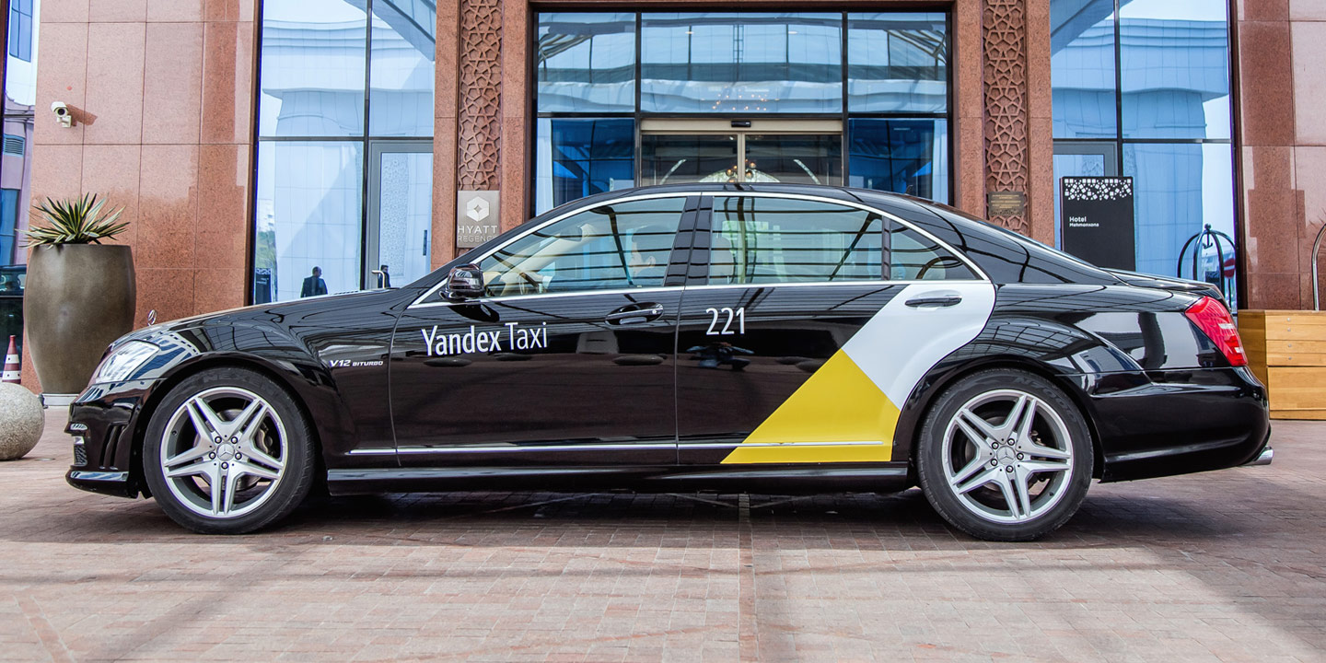
Characteristics of Services
  Intangibility
  Inseparability
  Variability
  Perishability
Notes:
Four distinctive service characteristics greatly affect the design of marketing programs: intangibility, inseparability, variability, and perishability.

Slide 9

Intangibility (1 of 2)
  Services cannot be seen, tasted, felt, heard, or smelled
  Physical evidence and presentation tools:
    Place
    People
    Equipment
    Communication material
    Symbols
    Price
Notes:
Unlike physical products, services cannot be seen, tasted, felt, heard, or smelled before they are bought. A person getting cosmetic surgery cannot see the results before the purchase, and the patient in the psychiatrist’s office cannot know the exact outcome of treatment. To reduce uncertainty, buyers will look for evidence of quality by drawing inferences from the place, people, equipment, communication material, symbols, and price. Service companies can try to demonstrate their service quality through physical evidence and presentation.

Slide 10
Intangibility (2 of 2)
  Table 14.1 Dimensions of Brand Experience
Sensory This brand makes a strong impression on my visual sense or other senses. I find this brand interesting in a sensory way. This brand does not appeal to my senses.
Affective This brand induces feelings and sentiments. I do not have strong emotions for this brand. This brand is an emotional brand.
Behavioral I engage in physical actions and behaviors when I use this brand. This brand results in bodily experiences. This brand is not action-oriented.
Intellectual I engage in a lot of thinking when I encounter this brand. This brand does not make me think. This brand stimulates my curiosity and problem solving.
Notes:
Disney is a master at “tangibilizing the intangible” and creating magical fantasies in its theme parks; so are retailers such as Toys “R” Us and Bass Pro Shops.
Table 14.1 measures brand experiences along sensory, affective, behavioral, and intellectual dimensions. Applications to services are clear.

Slide 11

Inseparability
  Services are typically produced and consumed simultaneously
Notes:
Whereas physical goods are manufactured, then inventoried, then distributed, and later consumed, services are typically produced and consumed simultaneously. A haircut can’t be stored— or produced without the barber. Several strategies exist for getting around the limitations of inseparability. The service provider can work with larger groups. The service organization can train more service providers and build up client confidence, as H&R Block has done with its national network of trained tax consultants.

Slide 12
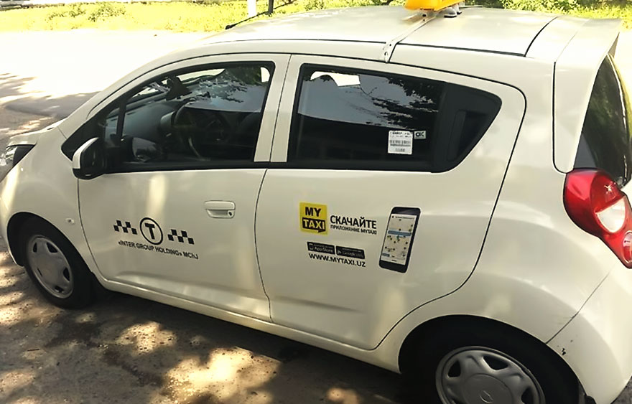
Variability
The quality of services depends on who provides them, when and where, and to whom
  As such, services are highly variable
Notes:
Some doctors have an excellent bedside manner; others are less empathetic. Service firms know that variability in their performance puts them at risk. Hilton initiated a major program to create more uniformity in guest experiences. Here are three steps service firms can take to increase quality control.
Invest in good hiring and training procedures.
Standardize the service-performance process throughout the organization.
Monitor customer satisfaction.

Slide 13
Perishability
Services cannot be stored
Strategies to match demand & supply
On demand side
Differential pricing
Nonpeak demand
Complementary services
Reservation services
On supply side
Part-time employees
Peak-time efficiency routines
Increased consumer participation
Shared services
Facilities for future expansion
Notes:
Services cannot be stored, so their perishability can be a problem when demand fluctuates. Demand or yield management is critical—the right services must be available to the right customers at the right places at the right times and right prices to maximize profitability. Several strategies can produce a better match between service demand and supply.20 On the demand (customer) side:
• Differential pricing will shift some demand from peak to off-peak periods. Examples include low matinee movie prices and weekend discounts for car rentals.
• Nonpeak demand can be cultivated. McDonald’s pushes breakfast service, and hotels promote mini-vacation weekends.
• Complementary services can provide alternatives to waiting customers, such as cocktail lounges in restaurants and automated teller machines in banks.
• Reservation systems are a way to manage the demand level. Airlines, hotels, and physicians employ them extensively.
On the supply side:
• Part-time employees can serve peak demand. Colleges add part-time teachers when enrollment goes up; stores hire extra clerks during holiday periods.
• Peak-time efficiency routines can allow employees to perform only essential tasks during peak periods.
Paramedics assist physicians during busy periods.
• Increased consumer participation frees service providers’ time. Consumers fill out their own medical records or bag their own groceries.
• Shared services can improve offerings. Several hospitals can share medical-equipment purchases.
• Facilities for future expansion can be a good investment. An amusement park might buy surrounding land for later development.

Slide 14
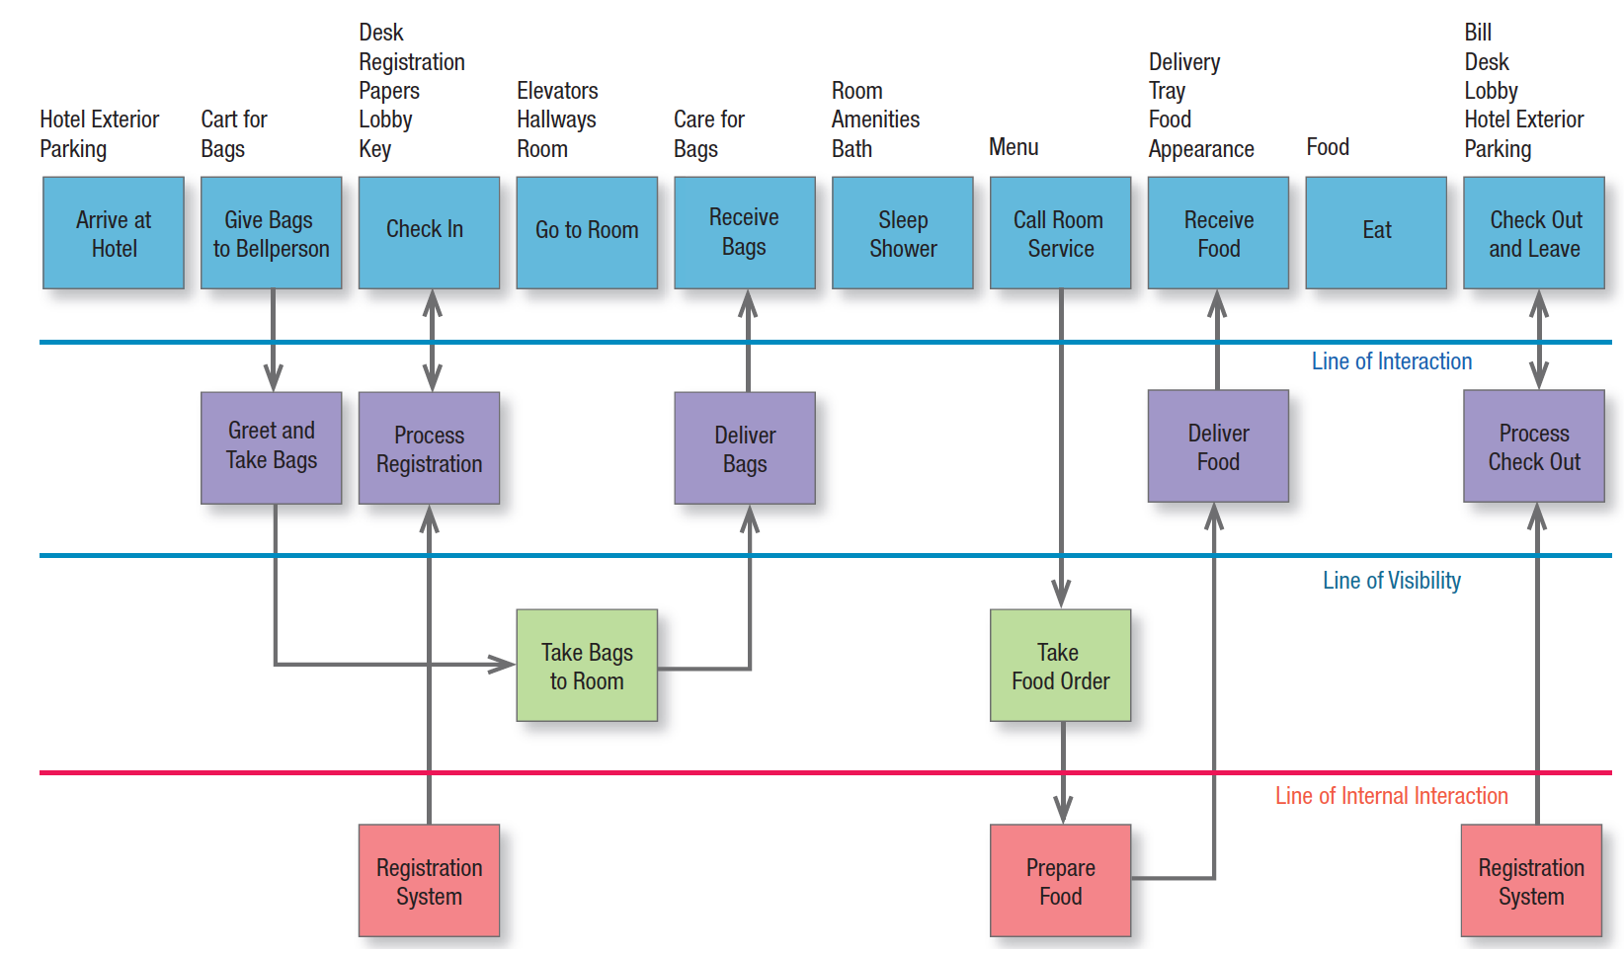
Figure 14.2 Blueprint for Overnight Hotel Stay
Notes:
A service blueprint can map out the service process, the points of customer contact, and the evidence of service from the customer’s point of view. Figure 14.2 shows a service blueprint for an overnight guest at a hotel. Behind the scenes, the hotel must skillfully help the guest move from one step to the next. Service blueprints can be helpful in identifying potential “pain points” for customers, developing new services, supporting a zero-defects culture, and devising service recovery strategies.

Slide 15
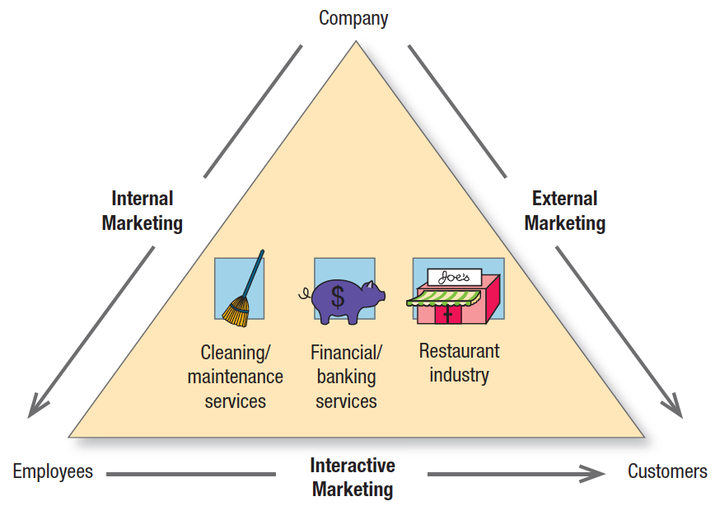
Achieving Excellence In Services Marketing (1 of 2)
Marketing excellence
Figure 14.3 Three Types of Marketing in Service Industries
Notes:
Marketing excellence in services requires excellence in three broad areas: external, internal, and interactive marketing (see Figure 14.3). External marketing describes the normal work of preparing, pricing, distributing, and promoting the service to customers. Internal marketing describes training and motivating employees to serve customers well. Interactive marketing describes the employees’ skill in serving the client. Clients judge service not only by its technical quality (Was the surgery successful?), but also by its functional quality (Did the surgeon show concern and inspire confidence?).

Slide 16

Achieving Excellence In Services Marketing (2 of 2)
Technology and service delivery
  The Internet allows for true interactivity, customer-specific and situational personalization, and real-time adjustments of the firm’s offerings
Notes:
Technology is changing the rules of the game for services in a very fundamental way. But as companies collect, store, and use more information about customers, they have also raised concerns about security and privacy. Companies must incorporate the proper safeguards and reassure customers about their efforts.

Slide 17
Best Practices of Top Service Companies
Strategic concept
Top-management commitment
Satisfying customer complaints
High standards
Monitoring systems
Profit tiers
Notes:
Well-managed service companies that achieve marketing excellence have in common a strategic concept, a history of top-management commitment to quality, high standards, profit tiers, and systems for monitoring service performance and customer complaints.
Strategic Concept Top service companies are “customer obsessed.” They have a clear sense of their target customers and their needs and have developed a distinctive strategy for satisfying them.
Top-Management Commitment Companies such as Marriott, Disney, and Ace Hardware have a thorough commitment to service quality. Their managers look monthly not only at financial performance, but also at service performance.
High Standards The best service providers set high quality standards.
Profit Tiers Firms have decided to coddle big spenders to retain their patronage as long as possible.
Customers in high-profit tiers get special discounts, promotional offers, and lots of special service; those in lower profit tiers who barely pay their way may get more fees, stripped-down service, and voice messages to process their inquiries.
Monitoring Systems Top firms audit service performance, both their own and competitors’, on a regular
basis. They collect voice of the customer (VOC) measurements to probe customer satisfiers and dissatisfiers and use comparison shopping, mystery or ghost shopping, customer surveys, suggestion and complaint forms, service audit teams, and customers’ letters.
Satisfying Customer Complaints On average, 40 percent of customers who suffer through a bad service experience stop doing business with the company.58 But if those customers are willing to complain first,
they actually offer the company a gift if the complaint is handled well. Companies that encourage disappointed customers to complain—and also empower employees to remedy the situation on the spot—have been shown to achieve higher revenues and greater profits than companies without a systematic approach for addressing service failures.

Slide 18
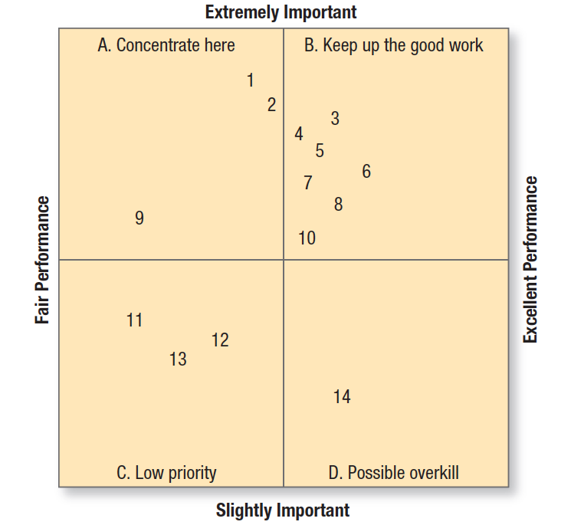
Figure 14.4 Importance-Performance Analysis
Notes:
We can judge services on customer importance and company performance. Importance-performance analysis rates the various elements of the service bundle and identifies required actions. (Table 14.2 – see slides 19-20) shows how customers rated 14 service elements or attributes of an automobile dealer’s service department on importance and performance.
• Quadrant A in the figure shows important service elements that are not being performed at the desired levels; they include elements 1, 2, and 9. The dealer should concentrate on improving the service department’s performance on these elements.
• Quadrant B shows important service elements that are being performed well; the company needs to maintain this high performance.
• Quadrant C shows minor service elements that are being delivered in a mediocre way but do not need any
attention.
• Quadrant D shows that a minor service element, “Send out maintenance notices,” is being performed in an
excellent manner.

Slide 19
Customer Importance and Performance Ratings for an Auto Dealership (1 of 2)
Table 14.2 Customer Importance and Performance Ratings for an Auto Dealership
Number Attribute | Attribute Description | Mean Importance Rating a | Mean Performance Rating b
1 | Job done right the first time | 3.83 | 2.63
2 | Fast action on complaints | 3.63 | 2.73
3 | Prompt warranty work | 3.60 | 3.15
4 | Able to do any job needed | 3.56 | 3.00
5 | Service available when needed | 3.41 | 3.05
6 | Courteous and friendly service | 3.41 | 3.29
7 | Car ready when promised | 3.38 | 3.03
8 | Perform only necessary work | 3.37 | 3.11

Slide 20
Customer Importance and Performance Ratings for an Auto Dealership (2 of 2)
[Table 14.2 continued]
Number Attribute | Attribute Description | Mean Importance Rating a | Mean Performance Rating b
9 | Low prices on service | 3.29 | 2.00
10 | Clean up after service work | 3.27 | 3.02
11 | Convenient to home | 2.52 | 2.25
12 | Convenient to work | 2.43 | 2.49
13 | Courtesy buses and cars | 2.37 | 2.35
14 | Send out maintenance notices | 2.05 | 3.33
a Ratings obtained from a four-point scale of “extremely important” (4), “important” (3), “slightly important” (2), and “not important” (1).
b Ratings obtained from a four-point scale of “excellent” (4), “good” (3), “fair” (2), and “poor” (1). A “no basis for judgment” category was also provided.

Slide 21

Differentiating Services
Primary and secondary service options
Innovation with services
Notes:
customers who view a service as fairly homogeneous care less about the provider than about the price. Marketing excellence requires service marketers to continually differentiate their brands so they are not seen as a commodity. Marketers can differentiate their service offerings in many ways, through people and processes that add value. What the customer expects is called the primary service package. The provider can also add secondary service features to the package. In the hotel industry, various chains have introduced such secondary service features as merchandise for sale, free breakfast buffets, and loyalty programs. The service company that regularly introduces innovations can intrigue customers and stay a step ahead of any competitors. Sometimes it can even reinvent a service category, as Cirque du Soleil did. Innovation is as vital in services as in any industry. New service categories are constantly being introduced to satisfy unmet needs and wants.

Slide 22
Managing Service Quality
Customer switching behavior factors
  Pricing
  Inconvenience
  Core service failure
  Service encounter failures
  Response to service failure
  Competition
  Ethical problems
  Involuntary switching
Notes:
The service quality of a firm is tested at each service encounter. If employees are bored, cannot answer simple questions, or are visiting each other while customers are waiting, customers will think twice about doing business there again. Flawless service delivery is the ideal output for any service organization.

Slide 23
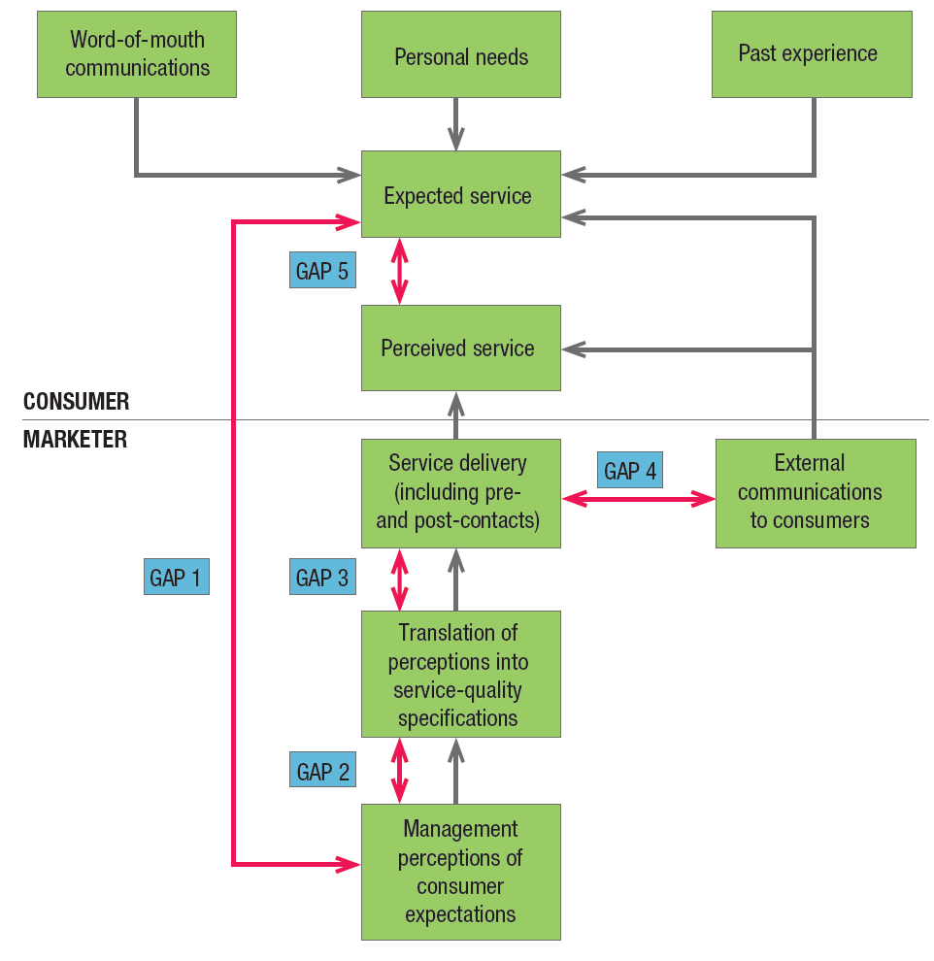
Figure 14.5 Service-Quality Model
Notes:
The service-quality model in Figure 14.5 highlights the main requirements for delivering high service quality.
It identifies five gaps that prevent successful delivery:
1. Gap between consumer expectation and management perception—Management does not always correctly perceive what customers want.
2. Gap between management perception and service-quality specification—Management might correctly perceive customers’ wants but not set a performance standard.
3. Gap between service-quality specifications and service delivery—Employees might be poorly trained or incapable of or unwilling to meet the standard; they may be held to conflicting standards, such as taking time to listen to customers and serving them fast.
4. Gap between service delivery and external communications—Consumer expectations are affected by statements made by company representatives and ads.
5. Gap between perceived and expected service—The consumer may misperceive the service quality.

Slide 24
Improving Service Quality
Listening
Reliability
Basic service
Service design
Recovery
Surprising customers
Fair play
Teamwork
Employee research
Servant leadership
Notes:
“Marketing Memo: Recommendations for Improving Service Quality” offers a comprehensive set of guidelines to which top service marketing organizations can adhere.

Slide 25
Servqual Scale
Table 14.4 Servqual Attributes
Reliability Providing service as promised Dependability in handing customers’ service problems Performing services at the promised time Maintaining error-free records Employees who have the knowledge to answer customer questions | Empathy Giving customers individual attention Employees who deal with customers in a fashion Having the customer’s best interests at heart Employees who understand the needs of their customers Convenient business hours
Responsiveness Keeping customer informed as to when service will be performed Prompt service to customers Willingness to help customers Readiness to respond to customers’ requests | Tangibles Modern equipment Visually appealing facilities Employees who have a neat, professional appearance Visually appealing materials associated with the service
Assurance Employees who instill confidence in customers Making customers feel safe in their transactions Employees who are consistently courteous | blank
Notes:
Researchers identified five determinants of service quality, in descending order of importance:
1. Reliability—The ability to perform the promised service dependably and accurately.
2. Responsiveness—The willingness to help customers and provide prompt service.
3. Assurance—The knowledge and courtesy of employees and their ability to convey trust and confidence.
4. Empathy—The provision of caring, individualized attention to customers.
5. Tangibles—The appearance of physical facilities, equipment, staff, and communication materials.
Based on these five factors, the researchers developed the 21-item SERVQUAL scale (see Table 14.4). They also note there is a zone of tolerance, or a range in which a service dimension would be deemed satisfactory, anchored by the minimum level consumers are willing to accept and the level they believe can and should be delivered.

Slide 26
Extending the Service-Quality Model
Dynamic process model of improved service quality perceptions
  Increasing customer expectations of what the firm will deliver
  Decreasing customer expectations of what the firm should deliver
Notes:
Subsequent research has extended the service-quality model. One dynamic process model of service quality was based on the premise that customer perceptions and expectations of service quality change over time, but at any one point they are a function of prior expectations about what will and what should happen during the service encounter, as well as the actual service delivered during the last contact.

Slide 27
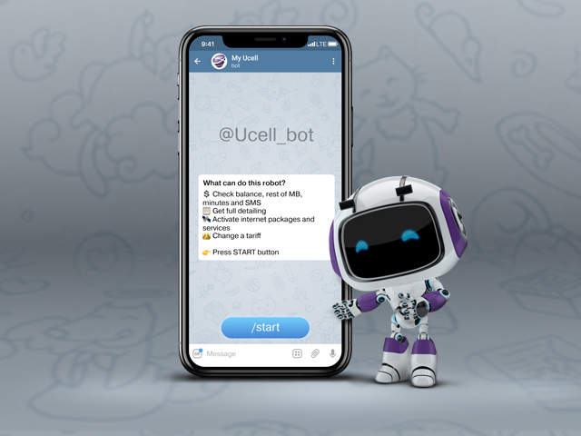
Incorporating Self-Service Technologies
SSTs can:
  Make transactions more accurate
  Make transactions more convenient
  Make transactions faster
  Reduce costs
Notes:
Consumers value convenience in services, and many person-to-person service interactions are being replaced by self-service technologies (SSTs) intended to provide that convenience. To traditional vending machines we can add automated teller machines (ATMs), self-pumping at gas stations, self-checkout at hotels, and a variety of activities on the Internet, such as ticket purchasing, investment trading, and customization of products.

Slide 28
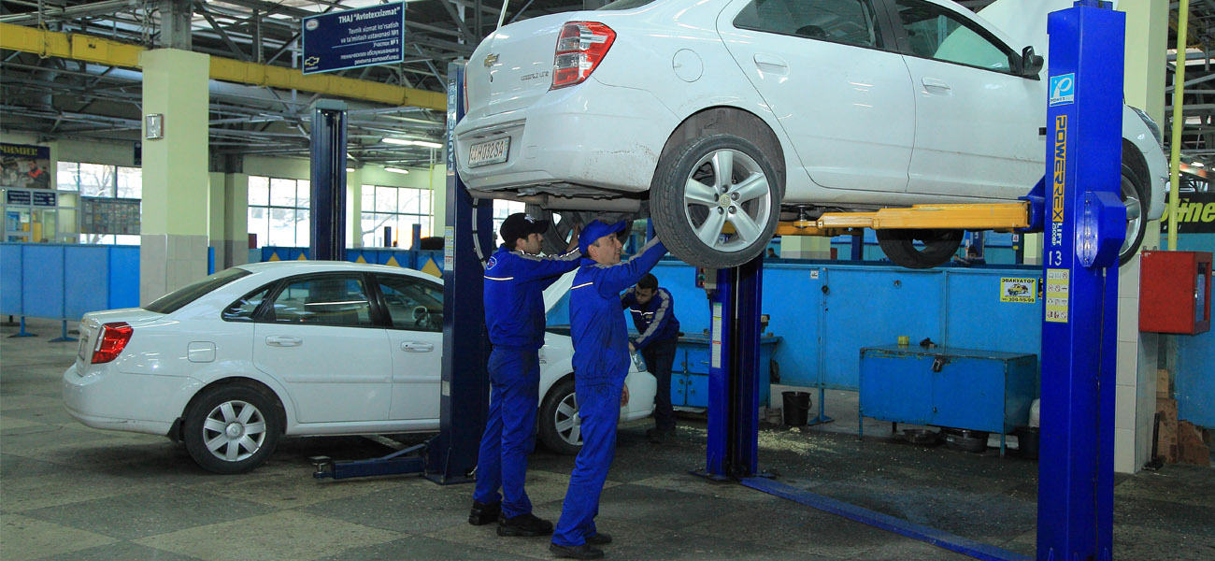
Managing Product-Support Services
Three types of customer worries
  Failure frequency
  Downtime
  Out-of-pocket costs
Notes:
Traditionally, customers have had three specific worries about product service:
• They worry about reliability and failure frequency. A farmer may tolerate a combine that will break down once a year, but not one that goes down two or three times a year.
• They worry about downtime. The longer the downtime, the higher the cost. The customer counts on the
seller’s service dependability—the ability to fix the machine quickly or at least provide a loaner.
• They worry about out-of-pocket costs. How much does the customer have to spend on regular maintenance
and repair costs?
A buyer takes all these factors into consideration and tries to estimate the life-cycle cost, which is the product’s purchase cost plus the discounted cost of maintenance and repair less the discounted salvage value.

Slide 29

THANK YOU FOR YOUR ATTENTION!

Slide 30

Notes:
No wonder, Marketing is the most popular area at our University!

