Slide 1

Aspects of International Marketing Management
Mamurjon Rahimov
mrahimov@wiut.uz
mamurjon@gmail.com

Slide 2

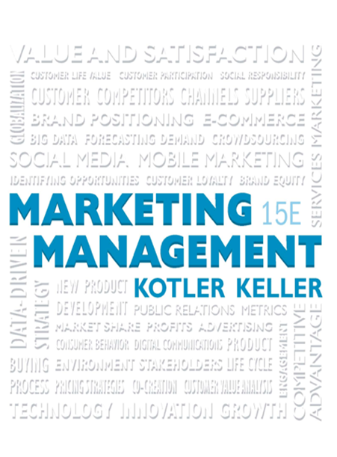
Managing a Holistic Marketing Organization for the Long Run

Slide 3

Learning Objectives
23.1 What are important trends in marketing practices?
23.2 What are the keys to effective internal marketing?
23.3 How can companies be socially responsible marketers?
23.4 What tools are available to help companies monitor and improve their marketing activities?
23.5 What do marketers need to do to succeed in the future?

Slide 4
Trends in Marketing Practices
Reengineering
Outsourcing
Benchmarking
Supplier partnering
Customer partnering
Merging
Globalizing
Flattening
Focusing
Justifying
Accelerating
Empowering
Broadening
Monitoring
Uncovering
Notes:
With globalization, deregulation, market fragmentation, consumer empowerment, environmental concerns, and all the remarkable developments in communication technology, the world has unquestionably become a very different place for marketers. Table 23.1 summarizes some important shifts in marketing realities.
Reengineering. Appointing teams to manage customer-value-building processes and break down walls between departments.
Outsourcing. Buying more goods and services from outside domestic or foreign vendors.
Benchmarking. Studying “best practice companies” to improve performance.
Supplier partnering. Partnering with fewer but better value-adding suppliers.
Customer partnering. Working more closely with customers to add value to their operations.
Merging. Acquiring or merging with firms in the same or complementary industries to gain economies of scale and scope.
Globalizing. Increasing efforts to “think global” and “act local.”
Flattening. Reducing the number of organizational levels to get closer to the customer.
Focusing. Determining the most profitable businesses and customers and focusing on them.
Justifying. Becoming more accountable by measuring, analyzing, and documenting the effects of marketing actions.
Accelerating. Designing the organization and setting up processes to respond more quickly to changes in the environment.
Empowering. Encouraging and empowering personnel to produce more ideas and take more initiative.
Broadening. Factoring the interests of customers, employees, shareholders, and other stakeholders into the activities of the enterprise.
Monitoring. Tracking what is said online and elsewhere and studying customers, competitors, and others to improve business practices.
Uncovering. Using data mining and other analytical methods to develop deep insights into customers and how they behave.

Slide 5
Important Shifts in Marketing and Business Practices (1 of 3)
Table 23.1 Important Shifts in Marketing and Business Practices
Reengineering. Appointing teams to manage customer-value-building processes and break down walls between departments
Outsourcing. Buying more goods and services from outside domestic or foreign vendors
Benchmarking. Studying “best practice companies” to improve performance
Supplier partnering. Partnering with fewer but better value-adding suppliers
Customer partnering. Working more closely with customers to add value to their operations
Merging. Acquiring or merging with firms in the same or complementary industries to gain economies of scale and scope

Slide 6
Important Shifts in Marketing and Business Practices (2 of 3)
[Table 23.1 continued]
Globalizing. Increasing efforts to “think global” and “act local”
Flattening. Reducing the number of organizational levels to get closer to the customer
Focusing. Determining the most profitable businesses and customers and focusing on them
Justifying. Becoming more accountable by measuring, analyzing, and documenting the effects of marketing actions
Accelerating. Designing the organization and setting up processes to respond more quickly to changes in the environment
Empowering. Encouraging and empowering personnel to produce more ideas and take more initiative

Slide 7
Important Shifts in Marketing and Business Practices (3 of 3)
[Table 23.1 continued]
Broadening. Factoring the interests of customers, employees, shareholders, and other stakeholders into the activities of the enterprise
Monitoring. Tracking what is said online and elsewhere and studying customers, competitors, and others to improve business practices
Uncovering. Using data mining and other analytical methods to develop deep insights into customers and how they behave

Slide 8

Internal Marketing
Internal marketing requires that everyone in the organization accept the concepts and goals of marketing and engage in identifying, providing, and communicating customer value
Notes:
in a networked enterprise, every functional area can interact directly with customers. Marketing no longer has sole ownership of customer interactions; it now must integrate all the customer-facing processes so customers see a single face and hear a single voice when they interact with the firm.

Slide 9

Organizing the Marketing Department
Functional organization
Geographic organization
Product- or brand-management organization
Market-management Organization
Matrix-management Organization
Notes:
Modern marketing departments can be organized in a number of different, sometimes overlapping ways: functionally, geographically, by product or brand, by market, or in a matrix.
Functional Organization In the most common form of marketing organization, functional specialists report to a marketing vice president who coordinates their activities.
Geographic Organization A company selling in a national market often organizes its sales force (and sometimes its marketing) along geographic lines. The national sales manager may supervise four regional sales managers, who each supervise six zone managers, who in turn supervise eight district sales managers, who each supervise 10 salespeople. Some companies are adding area market specialists (regional or local marketing managers) to support sales efforts in high-volume markets.
Product- or Brand-Management Organization Companies producing a variety of products and brands often establish a product- (or brand-) management organization. This does not replace the functional organization but serves as another layer of management. A group product manager supervises product category managers, who in turn supervise specific product and brand managers.
Market-Management Organization When customers fall into different user groups with distinct buying preferences and practices, a market-management organization is desirable. Market managers supervise several market-development managers, market specialists, or industry specialists and draw on functional services as needed. Market managers of important markets might even have functional specialists reporting to them.
Matrix-Management Organization Companies that produce many products for many markets may adopt a matrix organization employing both product and market managers.

Slide 10
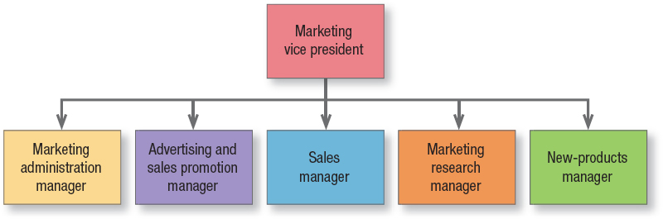
Functional Organization
Figure 23.1 Functional Organization
Notes:
Figure 23.1 shows five specialists. Others might include a customer service manager, a marketing planning manager, a market logistics manager, a direct marketing manager, and a digital marketing manager.

Slide 11
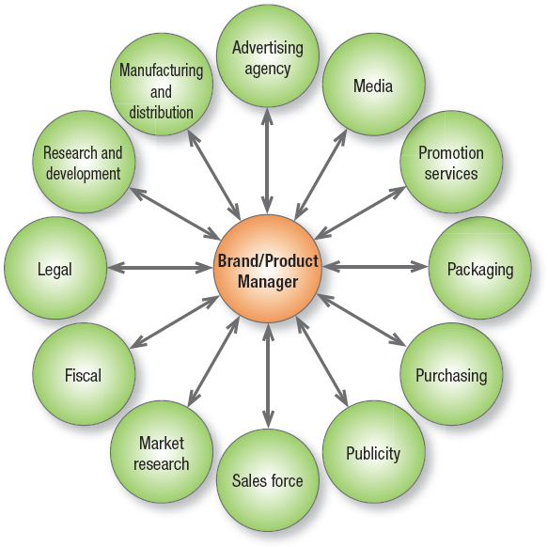
Hub-and-Spoke System
Figure 23.2 The Product Manager’s Interactions
Notes:
A product-management organization makes sense if the company’s products are quite different or there are more than a functional organization can handle. This form is sometimes characterized as a hub-and-spoke system. The brand or product manager is figuratively at the center, with spokes leading to various departments representing working relationships (see Figure 23.2).

Slide 12
Brand/Product Manager Tasks
  Develop long-range/competitive
  strategy
  Prepare marketing plan/sales forecast
Work with agencies
Increase support among sales force
Gather intelligence
Initiate product improvements
Notes:
The product-management organization lets the product manager concentrate on developing a cost-effective marketing program and react more quickly to new products in the marketplace; it also gives the company’s smaller brands a product advocate.

Slide 13
Product-/Brand-Management Organization (1 of 2)
Product-Management organization disadvantages
  Managers may lack authority to carry out responsibilities
  Managers rarely achieve functional expertise
  The system often proves costly
  Managers normally manage brand for a short time
  Market fragmentation makes it harder to develop national strategy
  Managers focus company away from customer relationships

Slide 14
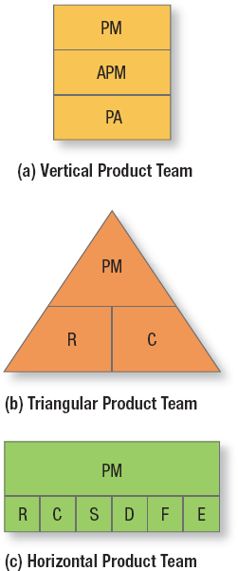
Product-/Brand-Management Organization (2 of 2)
Product teams
  Brand-asset management team (BAMT)
Eliminate product manager positions for minor products
Category management
Figure 23.3 Three Types of Product Teams
Notes:
A second alternative in a product-management organization is product teams. There are three types: vertical, triangular, and horizontal (see Figure 23.3). The triangular and horizontal product-team approaches let each major brand be run by a brand-asset management team (BAMT) consisting of key representatives from functions that affect the brand’s performance. The company consists of several BAMTs that periodically report to a BAMT directors committee, which itself reports to a chief branding officer. This is quite different from the way brands have traditionally been handled.
A third alternative is to eliminate product manager positions for minor products and assign two or more products to each remaining manager. This is feasible when two or more products appeal to a similar set of needs. A cosmetics company doesn’t need product managers for each product because cosmetics serve one major need—beauty. A toiletries company needs different managers for headache remedies, toothpaste, soap, and shampoo because these products differ in use and appeal.
In a fourth alternative, category management, a company focuses on product categories to manage its brands. Procter & Gamble (P&G), a pioneer of the brand-management system, and other top packaged- goods firms have made a major shift to category management, as have firms outside the grocery channel. Diageo’s shift to category management was seen as a means to better manage the development of premium brands. It also helped the firm address the plight of under-performing brands.

Slide 15

Market-Management Organization
Market-centered organizations
Customer-management organization
Notes:
Market managers are staff (not line) people, with duties like those of product managers. They develop long-range and annual plans for their markets and are judged by their market’s growth and profitability. Because this system organizes marketing activity to meet the needs of distinct customer groups, it shares many advantages and disadvantages of product-management systems. Many companies are reorganizing along market lines and becoming market-centered organizations. Xerox converted from geographic selling to selling
by industry, as did IBM and Hewlett-Packard.
When a close relationship is advantageous, such as when customers have diverse and complex requirements and buy an integrated bundle of products and services, a customer-management organization, which deals with individual customers rather than the mass market or even market segments, should prevail.

Slide 16
A Creative Marketing Organization
Shift to customer-focus
Appoint marketing officer & task force
Get outside help
Change reward system
Hire marketing talent
Develop in-house marketing training
Install marketing planning system
Establish annual recognition program
Shift to a process-outcome focus
Empower employees
Notes:
Many companies realize they’re not yet really market and customer driven—they are product and sales driven. Transforming into a true market-driven company requires, among other actions: (1) developing a company-wide passion for customers; (2) organizing around customer segments instead of products; and (3) understanding customers through qualitative and quantitative research. The task is not easy, but the payoffs can be considerable. See “Marketing Insight: The Marketing CEO” for concrete actions a CEO can take to improve marketing capabilities.

Slide 17
Socially Responsible Marketing
Figure 23.4 Rationale for Investing in Corporate Social Responsibility
Rationale for Investing in Corporate Social Responsibility
Companies need to differentiate themselves. Companies with civic virtues will be preferred.
Companies need a decision framework for facing daily requests for sponsorships, improved health coverage, injury prevention, environmental protection, and community contributions.
Corporate heads and boards need to understand the social pressures and opportunities facing their companies.
Companies need to build a bank of public goodwill to offset potential criticisms.
Employees, investors, and partners will be more motivated and loyal.
Notes:
Effective internal marketing must be matched by a strong sense of ethics, values, and social responsibility. Taking a more active, strategic role in corporate social responsibility is thought to benefit not just customers, employees, community, and the environment but also shareholders. Firms feel they also benefit in different ways, as Figure 23.4 illustrates.

Slide 18
Corporate Social Responsibility (1 of 2)
Table 23.2 Top Firms of Endearment
Best Buy | BMW | CarMax | Caterpillar
Commerce Bank | Container Store | Costco | eBay
Google | Harley-Davidson | Honda | IDEO
IKEA | JetBlue | Johnson & Johnson | Jordan’s Furniture
L.L.Bean | New Balance | Patagonia | Progressive Insurance
REI | Southwest | Starbucks | Timberland
Toyota | Trader Joe’s | UPS | Wegmans
Whole Foods | Blank | Blank | Blank
Notes:
Researchers Raj Sisodia, David Wolfe, and Jag Sheth believe humanistic companies make great companies. They see “Firms of Endearment” as those with a culture of caring that serve the interests of their stakeholders, who are defined by the acronym SPICE: Society, Partners, Investors, Customers, and Employees. Sisodia and colleagues believe Firms of Endearment create a love affair with stakeholders. The authors see the 21st-century marketing paradigm as creating value for all stakeholders and becoming a beloved firm. Table 23.2 lists firms receiving top marks as Firms of Endearment from a sample of thousands of customers, employees, and suppliers.

Slide 19

Corporate Social Responsibility (2 of 2)
Legal behavior
Ethical behavior
Social responsibility behavior and socially responsible business models
Sustainability and greenwashing
Notes:
Legal Behavior Organizations must ensure every employee knows and observes relevant laws. For example, it’s illegal for salespeople to lie to consumers or mislead them about the advantages of buying a product.
Ethical Behavior Business practices come under attack because business situations routinely pose ethical dilemmas: It’s not easy to draw a clear line between normal marketing practice and unethical behavior. Some issues can generate controversy or sharply divide critics, such as acceptable marketing to children.
Social Responsibility Behavior Marketers must exercise their social conscience in specific dealings with customers and stakeholders. Some top-rated companies for corporate social responsibility are Whole Foods, Walt Disney, Coca- Cola, Johnson & Johnson, and Google. Companies that innovate solutions and values in a socially responsible way are most likely to succeed. Companies such as The Body Shop, Working Assets, and Smith & Hawken are also giving social responsibility a more prominent role, as has Newman’s Own. More firms are coming to believe corporate social responsibility in the form of cause marketing and employee volunteerism programs is not just the “right thing” but also the “smart thing to do.
Sustainability Sustainability—the ability to meet humanity’s needs without harming future generations—now tops many corporate agendas. Major corporations outline in great detail how they are trying to improve the long-term impact of their actions on communities and the environment. Coca-Cola, AT&T, and DuPont have even installed Chief Sustainability Officers. Heightened interest in sustainability has also unfortunately resulted in greenwashing, which gives products the appearance of being environmentally friendly without living up to that promise.

Slide 20

Cause-Related Marketing (1 of 3)
Links the firm’s contributions toward a designated cause to customers’ engaging directly or indirectly in revenue-producing transactions with the firm
  Is part of corporate societal marketing (CSM)
Notes:
Many firms blend corporate social responsibility initiatives with marketing activities. Minette Drumwright and Patrick Murphy define CSM as marketing efforts “that have at least one noneconomic objective related to social welfare and use the resources of the company and/or of its partners.” Drumwright and Murphy also include traditional and strategic philanthropy and volunteerism in CSM.

Slide 21

Cause-Related Marketing (2 of 3)
Builds brand awareness
Enhances brand image
Elicits brand engagement
Establishes brand credibility
Creates brand community
Evokes brand feelings
Notes:
A successful cause-marketing program can improve social welfare, create differentiated brand positioning, build strong consumer bonds, enhance the company’s public image, create a reservoir of goodwill, boost internal morale and galvanize employees, drive sales, and increase the firm’s market value. Consumers may develop a strong, unique bond with the firm that transcends normal marketplace transactions.

Slide 22
Cause-Related Marketing (3 of 3)
Align focus area with your mission
Evaluate institutional “will” and resources
Analyze competitors’ cause positioning
Choose partners carefully
Don’t underestimate program name
Develop cross-functional strategy team
Leverage your assets with partner(s)
Communicate through every channel
Go local
Innovate
Notes:
Designing a Cause Program Firms must make a number of decisions in designing and implementing a cause-marketing program, such as how many and which cause(s) to choose and how to brand the cause program. “Marketing Memo: Making a Difference: Top 10 Tips for Cause Branding” provides some tips from a top cause-marketing firm.

Slide 23

Social Marketing (1 of 3)
Social marketing by nonprofits or government organizations furthers a cause
Notes:
Cause-related marketing supports a cause. Social marketing by nonprofit or government organizations furthers a cause, such as “say no to drugs” or “exercise more and eat better.

Slide 24
Social Marketing (2 of 3)
Table 23.3 Some Possible Social Marketing Program Objectives
Cognitive Campaigns Explain the nutritional values of different foods. Demonstrate the importance of conservation. | Behavioral Campaigns Demotivate cigarette smoking. Demotivate use of hard drugs. Demotivate excessive alcohol consumption.
Action Campaigns Attract people for mass immunization. Motivate people to vote “yes” on a certain issue. Inspire people to donate blood. Motivate women to receive a Pap test. | Value Campaigns Alter ideas about abortion. Change attitudes of bigoted people.
Notes:
Choosing the right goal or objective for a social marketing program is critical. Should a family-planning campaign focus on abstinence or birth control? Should a campaign to fight air pollution focus on ride sharing or mass transit? Table 23.3 illustrates the range of possible objectives.

Slide 25
Social Marketing (3 of 3)
  Choose target markets ready to respond
  Promote doable behavior in simple terms
Explain the benefits in compelling terms
Make it easy to adopt the behavior
Develop attention-grabbing messages
Use education-entertainment approach
Notes:
While social marketing uses a number of different tactics to achieve its goals, the planning process follows many of the same steps as for traditional products and services (see Table 23.4).

Slide 26
The Social Marketing Planning Process
Table 23.4 The Social Marketing Planning Process
Where Are We? Choose program focus Identify campaign purpose Conduct an analysis of strengths, weaknesses, opportunities, and threats (SWOT) Review past and similar efforts
Where Do We Want to Go? Select target audiences Set objectives and goals Analyze target audiences and the competition
How Will We Get There? Product: Design the market offering Price: Manage costs of behavior change Distribution: Make the product available Communications: Create messages and choose media
How Will We Stay on Course? Develop a plan for evaluation and monitoring Establish budgets and find funding sources Complete an implementation plan

Slide 27
Marketing Implementation/Control (1 of 3)
Table 23.5 Characteristics of a Great Marketing Company
The company selects target markets in which it enjoys superior advantages and exits or avoids markets where it is intrinsically weak.
Virtually all the company’s employees and departments are customer- and market-minded.
There is a good working relationship between marketing, R&D, and manufacturing.
There is a good working relationship between marketing, sales, and customer service.
The company has installed incentives designed to lead to the right behaviors.
The company continuously builds and tracks customer satisfaction and loyalty.
The company manages a value delivery system in partnership with strong suppliers and distributors.
The company is skilled in building its brand name(s) and image.
The company is flexible in meeting customers’ varying requirements.
Notes:
Table 23.5 summarizes the characteristics of a great marketing company, great not for what it is but for what it does. Great marketing companies know the best marketers thoughtfully and creatively devise marketing plans and then bring them to life. Marketing implementation and control are critical to making sure marketing plans have their intended results year after year.

Slide 28

Marketing Implementation/Control (2 of 3)
Marketing implementation
  The process that turns marketing plans into action assignments and ensures they accomplish the plan’s stated objectives
  Marketing resource management (MRM) software
Notes:
A brilliant strategic marketing plan counts for little if not implemented properly. Strategy addresses the what and why of marketing activities; implementation addresses the who, where, when, and how. They are closely related: One layer of strategy implies certain tactical implementation assignments at a lower level. For example, top management’s strategic decision to “harvest” a product must be translated into specific actions and assignments.
Marketing resource management (MRM) software provides a set of Web-based applications that automate and integrate project management, campaign management, budget management, asset management, brand management, customer relationship management, and knowledge management. The knowledge management component consists of process templates, how-to wizards, and best practices. Software packages can provide what some have called desktop marketing, giving marketers information and decision structures on computer dashboards. MRM software lets marketers improve spending and investment decisions, bring new products to market more quickly, and reduce decision time and costs.

Slide 29
Marketing Implementation/Control (3 of 3)
Marketing control
  The process by which firms assess the effects of their marketing activities and programs and make necessary changes and adjustments
    Annual Plan Control
    Efficiency Control
    Profitability Control
    Strategic Control
Notes:
Table 23.6 lists four types of needed marketing control: annual-plan control, profitability control, efficiency control, and strategic control.
Annual-Plan Control Annual-plan control ensures the company achieves the sales, profits, and other goals established in its annual plan.
Profitability Control Companies should measure the profitability of their products, territories, customer groups, segments, trade channels, and order sizes to help determine whether to expand, reduce, or eliminate any products or marketing activities.
Efficiency Control. Some companies have established a marketing controller position to work out of the controller’s office but specialize in improving marketing efficiency. These marketing controllers examine adherence to profit plans, help prepare brand managers’ budgets, measure the efficiency of promotions, analyze media production costs, evaluate customer and geographic profitability, and educate marketing staff on the financial implications of marketing decisions.
Strategic Control Each company should periodically reassess its strategic approach to the marketplace with a good marketing audit. Companies can also perform marketing excellence reviews and ethical/social responsibility reviews.

Slide 30
Types of Marketing Control (1 of 2)
Table 23.6 Types of Marketing Control
Type of Control | Prime Responsibility | Purpose of Control | Approaches
I. Annual-plan control | Top management Middle management | To examine whether the planned results are being achieved | • Sales analysis • Market share analysis • Sales-to-expense ratios • Financial analysis • Market-based scorecard analysis
II. Profitability control | Marketing controller | To examine where the company is making and losing money | Profitability by: • product • territory • customer • segment • trade channel • order size

Slide 31
Types of Marketing Control (2 of 2)
[Table 23.6 continued]
Type of Control | Prime Responsibility | Purpose of Control | Approaches
III. Efficiency control | Line and staff management Marketing controller | To evaluate and improve the spending efficiency and impact of marketing expenditures | Efficiency of: • sales force • advertising • sales promotion • distribution
IV. Strategic control | Top management Marketing auditor | To examine whether the company Is pursuing its best opportunities With respect to markets, products, And channels | • Marketing effectiveness rating instrument • Marketing audit • Marketing excellence review • Company ethical and social responsibility review

Slide 32
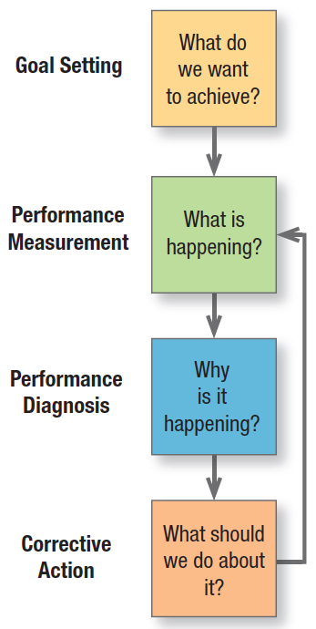
Annual Plan Control
Marketing metrics
  Sales metrics
  Customer readiness to buy metrics
  Customer metrics
  Distribution metrics
  Communication metrics
Figure 23.5 The Control Process
Notes:
At its heart is management by objectives (see Figure 23.5). First, management sets monthly or quarterly goals. Second, it monitors performance in the marketplace. Third, management determines the causes of serious performance deviations. Fourth, it takes corrective action to close gaps between goals and performance.
Marketers today have better marketing metrics for measuring the performance of marketing plans (see Table 23.7 for some samples).73 Four tools for the purpose are sales analysis, market share analysis, marketing expense-to-sales analysis, and financial analysis. The chapter appendix outlines them in detail.

Slide 33
Strategic Control (1 of 2)
Marketing audit
  A comprehensive, systematic, independent, and periodic examination of a company’s or business unit’s marketing environment, objectives, strategies, and activities, with a view to determining problem areas and opportunities and recommending a plan of action to improve the company’s marketing performance

Slide 34
Strategic Control (2 of 2)
Marketing audit’s characteristics
  Comprehensive
  Systematic
  Independent
  Periodic
Notes:
Let’s examine the marketing audit’s four characteristics:
1. Comprehensive—The marketing audit covers all the major marketing activities of a business, not just a few trouble spots as in a functional audit.
2. Systematic—The marketing audit is an orderly examination of the organization’s macro- and micromarketing environments, marketing objectives and strategies, marketing systems, and specific activities.
3. Independent—Self-audits, in which managers rate their own operations, lack objectivity and independence. Usually, however, outside consultants bring the necessary objectivity, broad experience in a number of industries, familiarity with the industry being audited, and undivided time and attention.
4. Periodic—Firms typically initiate marketing audits only after failing to review their marketing operations during good times, with resulting problems. A periodic marketing audit can benefit companies in good health as well as those in trouble.

Slide 35
Marketing Audit Components
Marketing environment
Marketing strategy
Marketing function
Marketing organization
Marketing productivity
Marketing systems
Notes:
The marketing audit examines six major components of the company’s marketing situation. Table 23.8 lists the major questions.

Slide 36
Components of a Marketing Audit (1 of 7)
Table 23.8 Components of a Marketing Audit
Part I. Marketing Environment Audit Macroenvironment | Blank
A. Demographic | What major demographic developments and trends pose opportunities or threats to this company? What actions has the company taken in response to these developments and trends?
B. Economic | What major developments in income, prices, savings, and credit will affect the company? What actions has the company been taking in response to these developments and trends?
C. Environmental | What is the outlook for the cost and availability of natural resources and energy needed by the company? What concerns have been expressed about the company’s role in pollution and conservation, and what steps has the company taken?
D. Technological | What major changes are occurring in product and process technology? What is the company’s position in these technologies? What major generic substitutes might replace this product? What are the digital implications of how the company conducts its business and its marketing?
E. Political | What changes in laws and regulations might affect marketing strategy and tactics? What is happening in the areas of sustainability, equal employment opportunity, product safety, advertising, price control, and so forth, that affects marketing strategy?

Slide 37
Components of a Marketing Audit (2 of 7)
[Table 23.8 continued]
F. Cultural | What is the public’s attitude toward business and toward the company’s products? What changes in customer lifestyles and values might affect the company?
Task Environment | Blank
A. Markets | What is happening to market size, growth, geographical distribution, and profits? What are the major market segments?
B. Customers | What are the customers’ needs and buying processes? How do customers and prospects rate the company and its competitors on reputation, product quality, service, sales force, and price? How do different customer segments make their buying decisions?
C. Competitors | Who are the major competitors? What are their objectives, strategies, strengths, weaknesses, sizes, and market shares? What trends will affect future competition and substitutes for the company’s products?
D. Distribution and Dealers | What are the main trade channels for bringing products to customers? What are the efficiency levels and growth potentials of the different trade channels?
E. Suppliers | What is the outlook for the availability of key resources used in production? What trends are occurring among suppliers?

Slide 38
Components of a Marketing Audit (3 of 7)
[Table 23.8 continued]
F. Facilitators and Marketing Firms | What is the cost and availability outlook for transportation services, warehousing facilities, and financial resources? How effective are the company’s advertising agencies and marketing research firms?
G. Publics | Which publics represent particular opportunities or problems for the company? What steps has the company taken to deal effectively with each public?
Part II. Marketing Strategy Audit | Blank
A. Business Mission | Is the business mission clearly stated in market-oriented terms? Is it feasible?
B. Marketing Objectives and Goals | Are the company and marketing objectives and goals stated clearly enough to guide marketing planning and performance measurement? Are the marketing objectives appropriate, given the company’s competitive position, resources, and opportunities?
C. Strategy | Has the management articulated a clear marketing strategy for achieving its marketing objectives? Is the strategy convincing? Is the strategy appropriate to the stage of the product life cycle, competitors’ strategies, and the state of the economy? Is the company using the best basis for market segmentation? Does it have clear criteria for rating the segments and choosing the best ones? Has it developed accurate profiles of each target segment? Has the company developed an effective positioning and marketing mix for each target segment? Are marketing resources allocated optimally to the major elements of the marketing mix? Are enough resources or too many resources budgeted to Accomplish the marketing objectives?

Slide 39
Components of a Marketing Audit (4 of 7)
[Table 23.8 continued]
Part III. Marketing Organization Audit | Blank
A. Formal Structure | Does the marketing vice president or CMO have adequate authority and responsibility for company activities that affect customers’ satisfaction? Are the marketing activities optimally structured along functional, product, segment, end user, and geographical lines?
B. Functional Efficiency | Are there good communication and working relations between marketing and sales? Is the product-management system working effectively? Are product managers able to plan profits or only sales volume? Are there any groups in marketing that need more training, motivation, supervision, or evaluation?
C. Interface Efficiency | Are there any problems between marketing and manufacturing, R&D, IT, purchasing, finance, accounting, and/or legal that need attention?
Part IV. Marketing Systems Audit | Blank
A. Marketing Information System | Is the marketing information system producing accurate, sufficient, and timely information about marketplace developments with respect to customers, prospects, distributors and dealers, competitors, suppliers, and various publics? Are company decision makers asking for enough marketing research, and are they using the results? Is the company Employing the best methods for market measurement and sales forecasting?

Slide 40
Components of a Marketing Audit (5 of 7)
[Table 23.8 continued]
B. Marketing Planning System | Is the marketing planning system well conceived and effectively used? Do marketers have decision support systems available? Does the planning system result in acceptable sales targets and quotas?
C. Marketing Control System | Are the control procedures adequate to ensure that the annual-plan objectives are being achieved? Does management periodically analyze the profitability of products, markets, territories, and channels of distribution? Are marketing costs and productivity periodically examined?
D. New-Product Development System | Is the company well organized to gather, generate, and screen new-product ideas? Does the company do adequate Concept research and business analysis before investing in new ideas? Does the company carry out adequate product and market testing before launching new products?
Part V. Marketing Productivity Audit | Blank
A. Profitability Analysis | What is the profitability of the company’s different products, markets, territories, and channels of distribution? Should the company enter, expand, contract, or withdraw from any business segments?
B. Cost-Effectiveness Analysis | Do any marketing activities seem to have excessive costs? Can cost-reducing steps be taken?

Slide 41
Components of a Marketing Audit (6 of 7)
[Table 23.8 continued]
Part VI. Marketing Function Audits | Blank
A. Products | What are the company’s product line objectives? Are they sound? Is the current product line meeting the objectives? Should the product line be stretched or contracted upward, downward, or both ways? Which products should be phased out? Which products should be added? What are the buyers’ knowledge and attitudes toward the company’s and competitors’ product quality, features, styling, brand names, and so on? What areas of product and brand strategy need improvement?
B. Price | What are the company’s pricing objectives, policies, strategies, and procedures? To what extent are prices set on cost, demand, and competitive criteria? Do the customers see the company’s prices as being in line with the value of its offer? What does management know about the price elasticity of demand, experience-curve effects, and competitors’ prices and pricing policies? To what extent are price policies compatible with the needs of distributors and dealers, suppliers, and government regulation?
C. Distribution | What are the company’s distribution objectives and strategies? Is there adequate market coverage and service? How effective are distributors, dealers, manufacturers’ representatives, brokers, agents, and others? Should the company consider changing its distribution channels?

Slide 42
Components of a Marketing Audit (7 of 7)
[Table 23.8 continued]
D. Marketing Communications | Is the company making enough use of mass, digital, and personal communications? What are the organization’s communication objectives? Are they sound? Is the right amount being spent on communications? What do customers and the public think about the communications? Are media well chosen? Is the internal communications staff adequate? Is the communication budget adequate?
E. Sales Force | What are the sales force’s objectives? Is the sales force large enough to accomplish the company’s objectives? Is the sales force organized along the proper principles of specialization (territory, market, product)? Are there enough (or too many) sales managers to guide the field sales representatives? Do the sales compensation level and structure provide adequate incentive and reward? Does the sales force show high morale, ability, and effort? Are the procedures Adequate for setting quotas and evaluating performance? How does the company’s sales force compare to competitors’ sales forces?

Slide 43
The Marketing Excellence Review
Table 23.9 The Marketing Excellence Review: Best Practices
Poor | Good | Excellent
Product driven | Market driven | Market driving
Mass-market oriented | Segment-oriented | Niche-oriented and customer-oriented
Product offer | Augmented product offer | Customer solutions offer
Average product quality | Better than average | Legendary
Average service quality | Better than average | Legendary
End-product oriented | Core-product oriented | Core-competency oriented
Function oriented | Process oriented | Outcome oriented
Reacting to competitors | Benchmarking competitors | Leapfrogging competitors
Notes:
The three columns in Table 23.9 distinguish among poor, good, and excellent business and marketing practices. The profile management creates from indicating where it thinks the business stands on each line can highlight where changes could help the firm become a truly outstanding player in the marketplace.

Slide 44
The Future of Marketing
The coming years will see:
  The demise of the marketing department and the rise of holistic marketing
  The demise of free-spending marketing and the rise of ROI marketing
  The demise of marketing intuition and the rise of marketing science
  The demise of manual marketing and the rise of both automated and creative marketing
  The demise of mass marketing and the rise of precision marketing
Notes:
To succeed in the future, marketing must be more holistic and less departmental. Marketers must achieve wider influence in the company, continuously create new ideas, and strive for customer insight by treating customers differently but appropriately. They must build their brands more through performance than promotion. They must go electronic and win through building superior information and communication systems.

Slide 45
Holistic Marketing
CRM
PRM
Database marketing & data mining
Contact center management & telemarketing
Digital marketing & social media
PR marketing
Brand-building & brand-asset management
Experiential marketing
Integrated marketing communications
Profitability analysis
Notes:
To accomplish these changes and become truly holistic, marketers need a new set of skills and competencies listed on this slide.

Slide 46

THANK YOU FOR YOUR ATTENTION!

Slide 47

Notes:
No wonder, Marketing is the most popular area at our University!

