Slide 1
I
Introduction to Innovation
Dr. Jens Weinmann

Slide 2
What is innovation?
Innovation is the art of turning ideas into money, whereas R&D is the art of turning money into ideas.

Slide 3
Agenda
1
Innovation Radar
2
Corporate Entrepreneurship Matrix

Slide 4
The innovation radar provides a framework on 4 dimensions: What, Who, How and Where
Offering
(WHAT)
Platform
Solution
Presence
(WHERE)
Customer Need
(WHO)
Incre-
mental
Substantial
Radical
Process
(HOW)
Source: Sawhney, Wolcott, Arroniz, MIT Sloan Management Review, Spring 2006

Slide 5
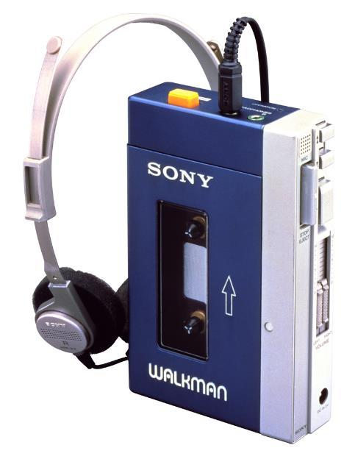
»WHAT?«
1979

Slide 6
»WHAT?« Would you enter the French budget hotel industry?
Competitive differentiation¹⁾
Product/service elements
Performance level
low
high
Price
1-star hotel
2-star hotel
Rooms
Quietness of rooms
Industry situation
Quality of beds
Excess capacity
Many competitors
Best locations taken
Stagnant growth
Low profitability
Hygiene
Reception
Lounges
Eating facilities
Architecture
1) In 1995; Source: Kim/Mauborgne, 1997

Slide 7
»WHAT?« The business model of the French hotel group Accor changed the rules of the game: better sleeping with less service – “Formule 1”
Competitive differentiation¹⁾
Product/service elements
Performance level
low
high
Results
Price
1-star hotel
Formule 1
2-star hotel
Bigger than the next
five players combined
Capturing the mass
of customers from both
segments
Expanding the customer
base
Huge economic success
Rooms
Quietness of rooms
Quality of beds
Hygiene
Reception
Lounges
Eating facilities
Architecture
1) In 1995; Source: Kim/Mauborgne, 1997

Slide 8
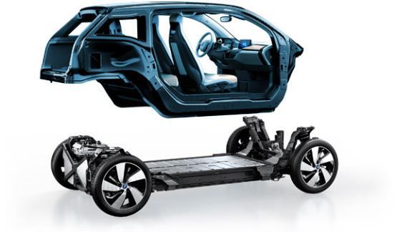
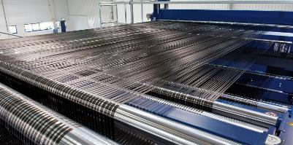

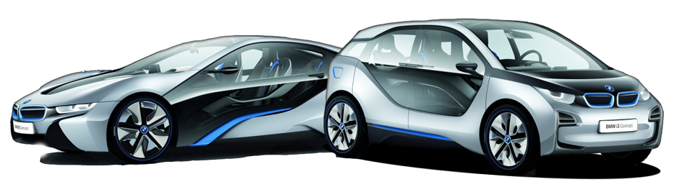
»WHAT?« Breakthrough Ideas, inventing radical products, services and markets the case of BMW i3 and i8 – the first carbon-fiber electric cars
Source: http://www.gatesnotes.com/Development/Omniprocessor-From-Poop-to-Potable, retrieved 28.01.15

Slide 9

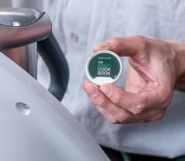
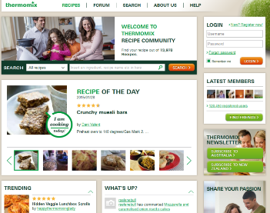
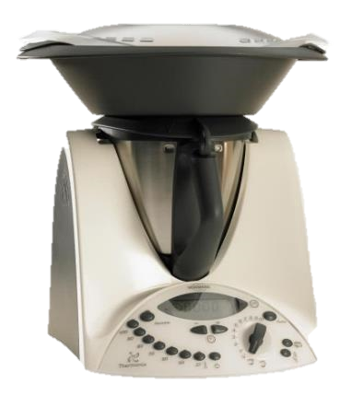
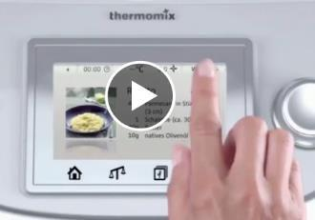
»WHAT?« Breakthrough Ideas, inventing radical products, services and markets the case of Vorwerk Thermomix – automated high end, natural cooking
€1000
Thermomix 6:
Guided cooking
Cooking for everybody
Own ingredients
Meeting trends: mistrust against food industry, kitchen as status symbol
A Thermomix is sold every
38 seconds worldwide!
Source: Vorwerk, FAZ 09.11.2014

Slide 10

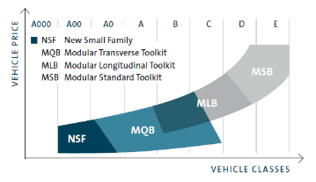
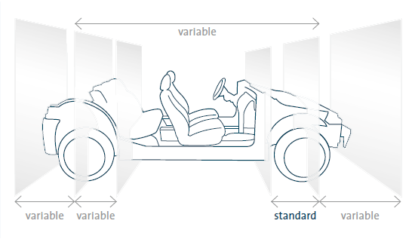
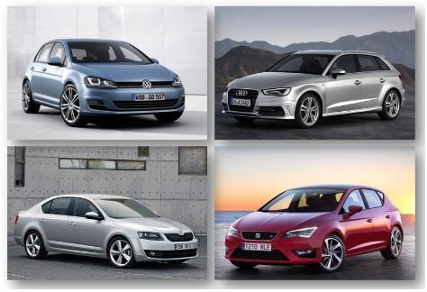
»WHAT?« Platform: Revolution from the toolkit – Volkswagen launches the Modular Transverse Toolkit (Modularer Querbaukasten)
Source: Volkswagen (2012)

Slide 11

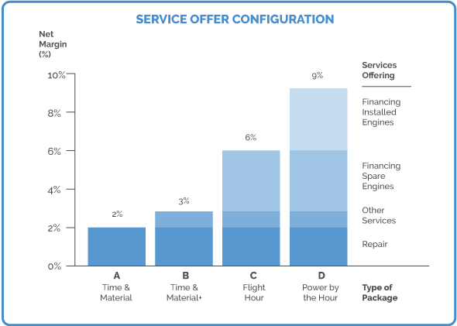
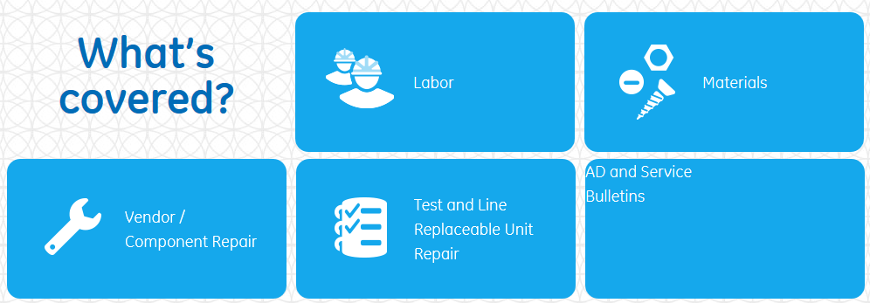
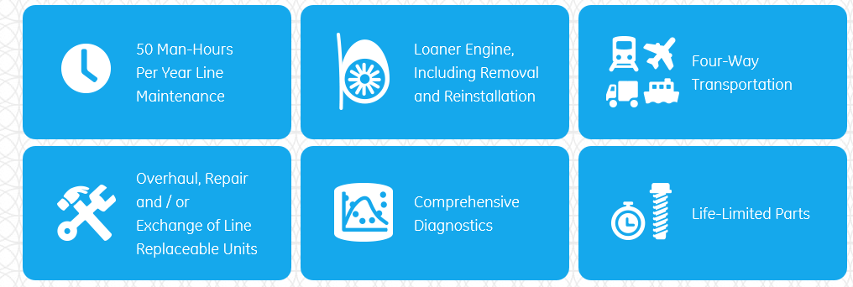

»WHAT?« Solution: GE’s model “OnPoint – Power by the Hour,” selling its engines much as a utility company
Net Margin %
Services Offering
Financing installed engines
Financing spare engines
Other services
Repair
Time & Material
Time & Material+
Flight hour
Power by the hour
Type pf package
Source: GE Aiiation (2015)

Slide 12
The innovation radar provides a framework on 4 dimensions: What, Who, How and Where
Offering
(WHAT)
Platform
Solution
Customer Need
(WHO)
Incre-
mental
Substantial
Customer Experience
Radical
Communication
Source: Sawhney, Wolcott, Arroniz, MIT Sloan Management Review, Spring 2006

Slide 13

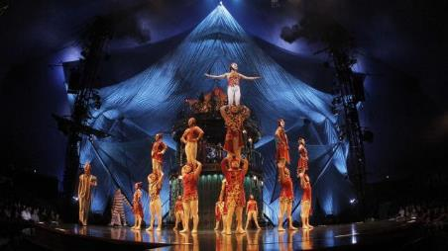


»WHO?« Acquiring new customer groups: Cirque du Soleil
1984

Slide 14
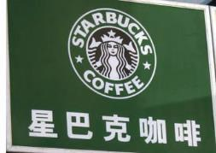

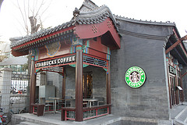
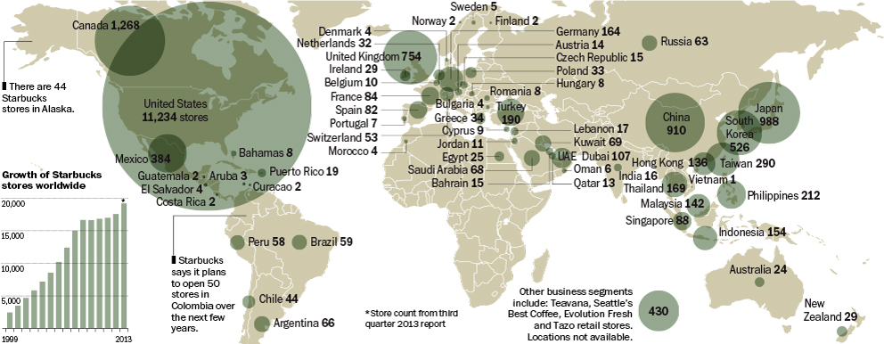
»WHO?« Customer experience: Starbucks does not only sell coffee, but a specific lifestyle

Slide 15
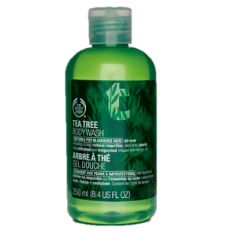


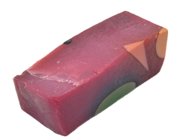
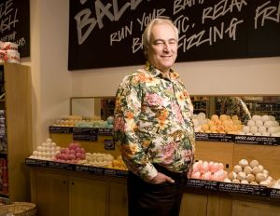

»WHO?« Communication: How to attract new customers with an ethical agenda – Lush and Body Shop
Mark Constantine
Anita Roddick

Slide 16
The innovation radar provides a framework on 4 dimensions: What, Who, How and Where
Offering
(WHAT)
Platform
Solution
Customer Need
(WHO)
Incre-
mental
Supply Chain
Substantial
Customer Experience
Radical
Value Capture
Communication
Process
(HOW)
Source: Sawhney, Wolcott, Arroniz, MIT Sloan Management Review, Spring 2006

Slide 17
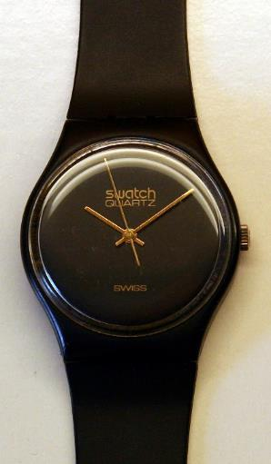
»HOW?« Changing the customer experience with a watch made from synthetic material, shock-proof, accurate, perfect for mass production – and affordable for everyone
1983
Source: Swatch (2015)

Slide 18
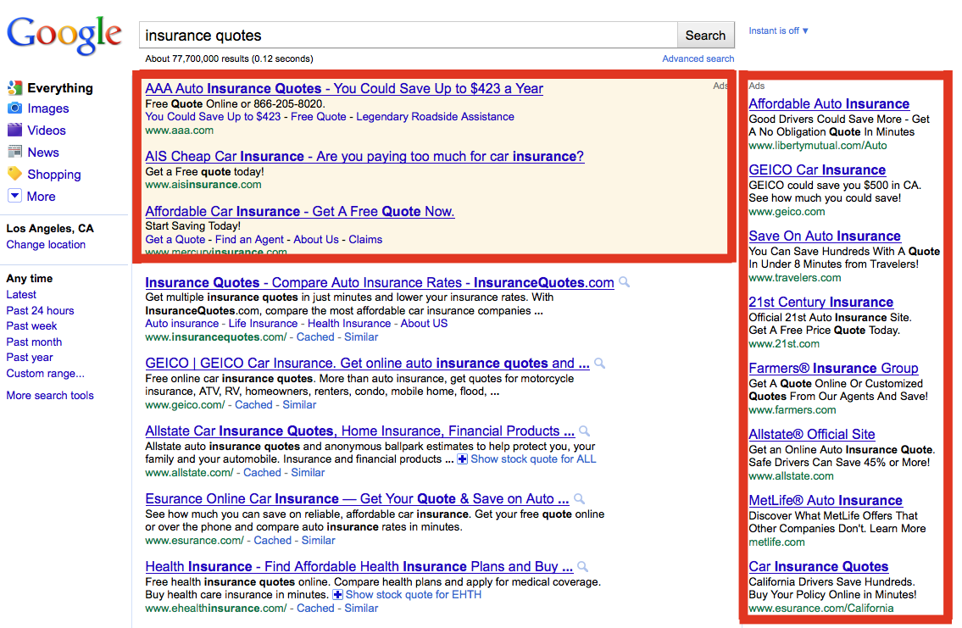

»HOW?« Value capture: How to make money in the internet?

Slide 19
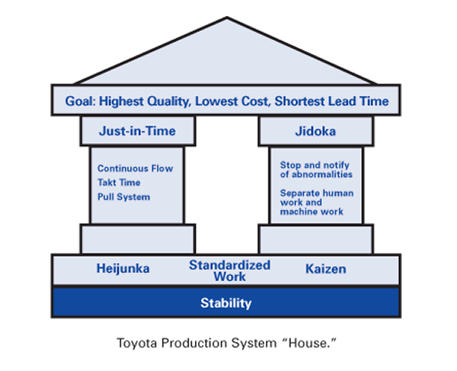
»HOW?« Supply Chain: Lean Management in Toyota’s Production System
Goal: Highest Quality, Lowest Cost, Shortest Lead Time
Just-in-Time
Jidoka
Autonomation
Continuous Flow
Takt Time
Pull System
Stop and notify of abnormalities
Separate human work and machine work
Level
Scheduling (manufacturing in much smaller batches by sequencing (mixing) product variants)
Standardized work
Continuous Improvement
Heijunka
Kaizen
Stability
Toyota Production System “House”

Slide 20
The innovation radar provides a framework on 4 dimensions: What, Who, How and Where
Offering
(WHAT)
Brand
Platform
Networking
Solution
Presence
(WHERE)
Customer Need
(WHO)
Incre-
mental
Supply Chain
Substantial
Customer Experience
Radical
Value Capture
Communication
Process
(HOW)
Source: Sawhney, Wolcott, Arroniz, MIT Sloan Management Review, Spring 2006

Slide 21
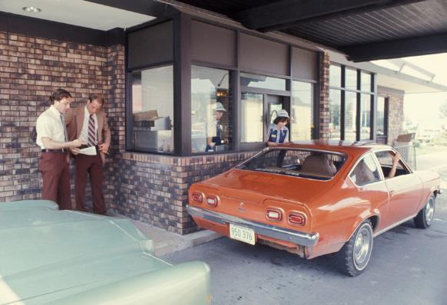
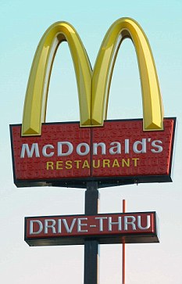
»Where?«– Changing where, when and how customers access your firm: McDonald’s “Drive In”
Arizona,
1975

Slide 22



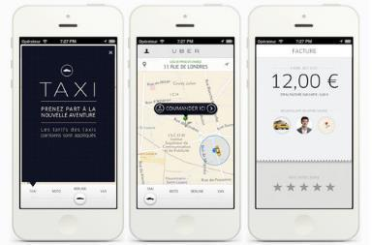

»Where?«– Networking: The difference between the offering as a standalone offering versus an offering that benefits from connectivity to a network

Slide 23


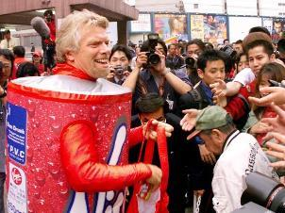



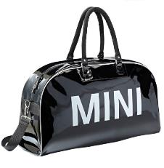


»Where?« – Brand: an identifying symbol, word, mark or other source identifier that distinguishes a product

Slide 24

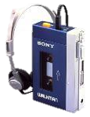
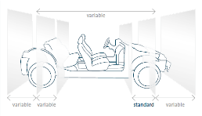







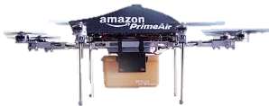







The Innovation Radar: Examples
Modular Transverse Toolkit
(Modularer Querbaukasten)
Offering
(WHAT)
Brand
Platform
Networking
Solution
Presence
(WHERE)
Customer Need
(WHO)
Incre-
mental
Supply Chain
Substantial
Customer Experience
Radical
Value Capture
Communication
Process
(HOW)
Source: Sawhney, Wolcott, Arroniz, MIT Sloan Management Review, Spring 2006

Slide 25
Agenda
1
Innovation Radar
2
Corporate Entrepreneurship Matrix

Slide 26
Corporate Entrepreneurship Matrix (adapted from Christoph Räthke, GTEC)
Max. internal
Status Quo
Max. targeted
Max. disruptive
Max. external
Copyright Christoph Räthke, www.christophraethke.de

Slide 27
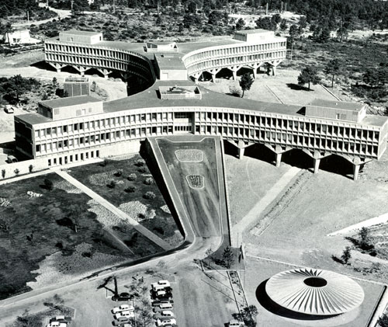
IBM France Research Center, La Gaude, France, 1958-62

Slide 28
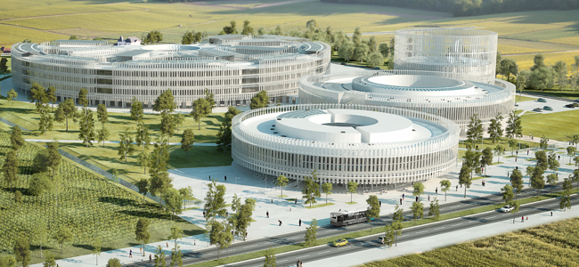
The future EDF R&D centre in Saclay (near Paris) for €400 million

Slide 29
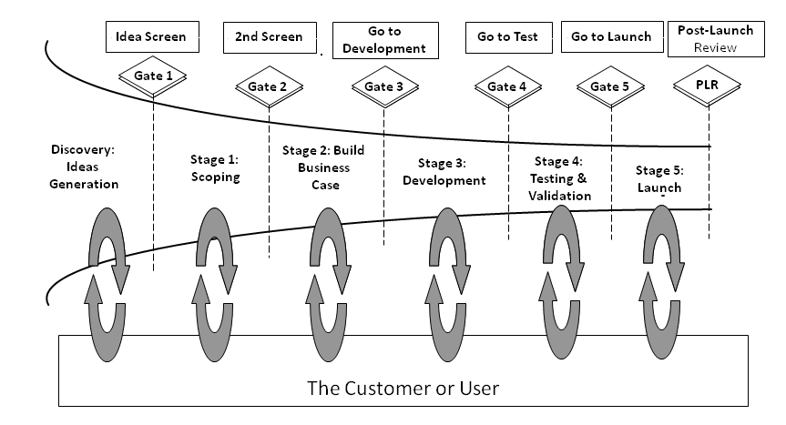
A typical 5 stage idea-to-launch Stage-Gate System, according to Robert G. Cooper
Idea Screen
2nd Screen
Go to development
Go to test
Go to launch
Post Launch Review
Gate 1
Gate 2
PLR
Gate 3
Gate 4
Gate 4
Discovery:
Ideas Generation
Stage 1:
Scoping
Stage 2: Build business case
Stage 3: Development
Stage 4: Testing and validation
Stage 5: Launch
The Customer of User

Slide 30






Example: Innovation with a gate process at a large German chemical company (I)
Three conditions:
must be related to chemistry
does not yet exist in the company's current portfolio
should be a proper business unit with a revenue potential of €500m and 20% profitability within 10 years
First market assessment,
Test for plausibility
Rough quantification:
Is the idea relevant and
demand large enough?
3-4 Gate 2 decisions
per year
6-12
months
Idea
Gate 1
Gate 2
Market push (old): New chemicals
Market pull (new): Customer demand (“solution“)
Formal budget
Developing roadmap and business plan
Multi-client studies
Consultations with internal and external experts to validate the idea
Calculations and market assessment

Slide 31



Example: Innovation with a gate process at a large German chemical company (II)
Incubation group:
technology or economic background
marketing and sales
Management Board defining a new growth field
Annual budget: €3-5m
Incubation
3-4 years
Business build-up
Gate 3
concrete business plan and option for business model, ranging from classical activities (producing chemical products and selling them in large quantities) to more service-oriented solutions.
The business plan is based on discounted cash flows (DCF), typically with a time horizon of 15 years

Slide 32
The classic innovation funnel (“managed“ or “targeted“ innovation)
Choosing the gate keepers
Choosing the Gate Keepers
Scaling
Idea
generation
Scope
Business case
& strategy
Testing &
validation
Launch
Crossing the chasm
Organizational
implementation
Funneling: product development vs. R&D
Early
Adopters

Slide 33
To allow for protecting traditional business while participating in new markets, the ambidextrous organization achieves the best results, according to O’Reilly and Tushman
4 organizational designs to develop and deliver innovations
The scope of the ambidextrous organization
Alignment of: | Exploitative Business | Exploratory Business
Strategic intent | cost, profit | innovation, growth
Critical tasks | operations, efficiency, incremental innovation | adaptability, new products, breakthrough innovation
Competencies | operational | entrepreneurial
Structure | formal, mechanistic | adaptive, loose
Controls, rewards | margins, productivity | milestones, growth
Culture | efficiency, low risk, quality, customers | risk taking, speed, flexibility, experimentation
Leadership role | authoritative, top down | visionary, involved
Functional designs
Unsupported teams
General
Manager
General
Manager
MfG
Sales
R&D
MfG
Sales
R&D
Emerging
Business
Cross-functional teams
Ambidextrous organizations
General
Manager
General
Manager
MfG
Sales
R&D
Existing Business
Emerging Business
Emerging Business
MfG
Sales
R&D
MfG
Sales
R&D
Source: O'Reilly III / Tushmann, HBR April 2004

Slide 34
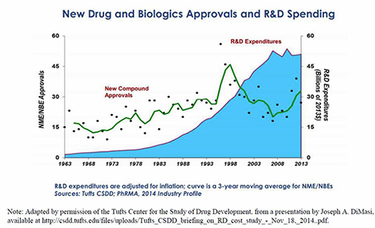
Example: Productivity in pharmaceutical research and development
New Drug and Biologics Approvals and R&D Spending
R&D Expenditure
New compound approvals
Source: Graham (2015), http://www.ncpa.org/pub/ib158

Slide 35
Corporate Entrepreneurship Matrix (adapted from Christoph Räthke, GTEC)
Max. internal
Innovation funnel
Intrapreneurship
Max. targeted
Max. disruptive
Max. external
Copyright Christoph Räthke, www.christophraethke.de

Slide 36

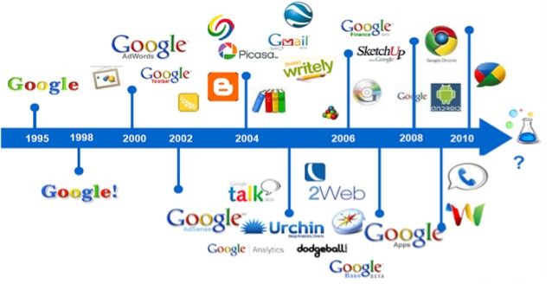
Example I: Google’s Intrapreneurship Program
“We encourage our employees, in addition to their regular projects, to spend 20% of their time working on what they think will most benefit Google. This empowers them to be more creative and innovative. Many of our significant advances have happened in this manner.”

Slide 37


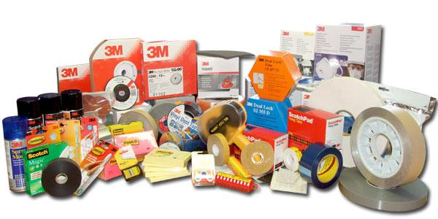
Example II: Intrapreneurship at 3M
“A 15% time for employees to develop own projects called the bootlegging”
1979

Slide 38
Corporate Entrepreneurship Matrix (adapted from Christoph Räthke, GTEC)
Max. internal
Innovation funnel
Intrapreneurship
Max. targeted
Trend scouts
Max. disruptive
Acquisitions
Max. external
Copyright Christoph Räthke, www.christophraethke.de

Slide 39
Corporate Entrepreneurship Matrix (adapted from Christoph Räthke, GTEC)
Max. internal
Innovation funnel
Intrapreneurship
Max. targeted
Trend scouts
Max. disruptive
Acquisitions
Open innovation
Max. external
Copyright Christoph Räthke, www.christophraethke.de

Slide 40
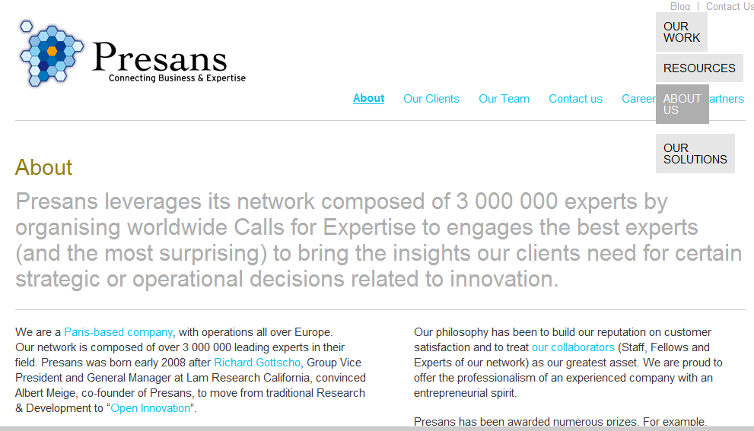
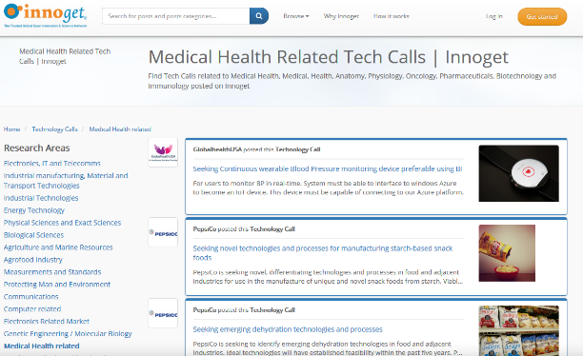
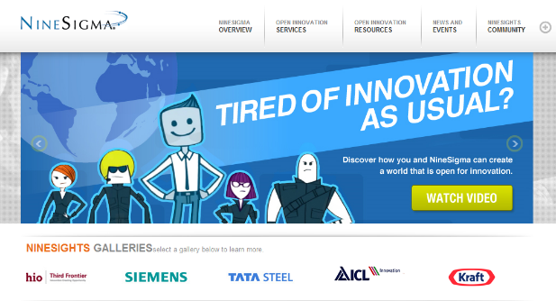
Global networks of seekers and providers give Open Innovation a boost in the Web 2.0 – wisdom of the crowds combined with wisdom of the experts

Slide 41
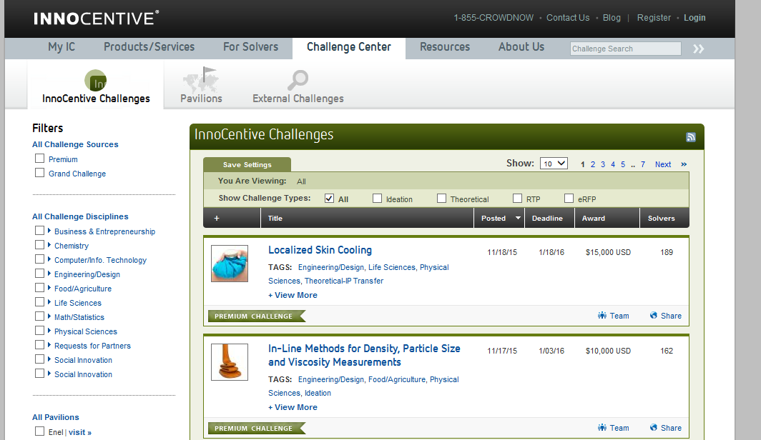

Slide 42
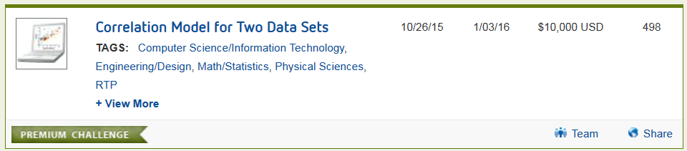
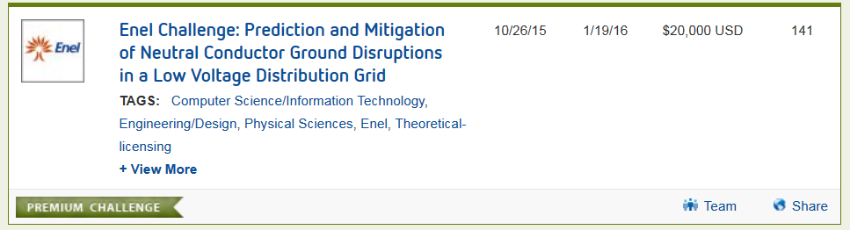

Slide 43
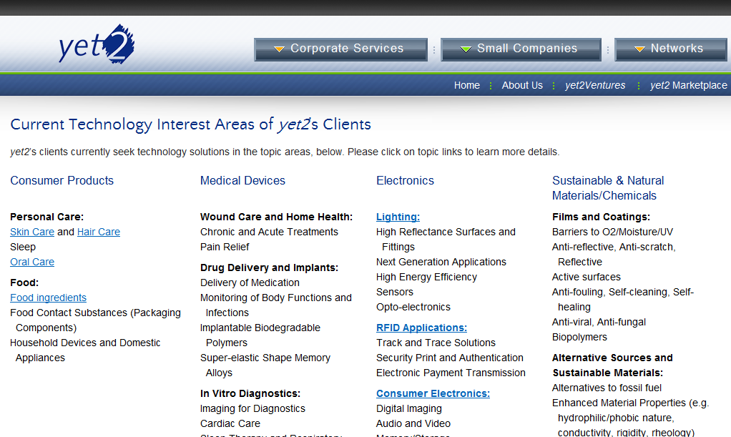
Yet2.com

Slide 44
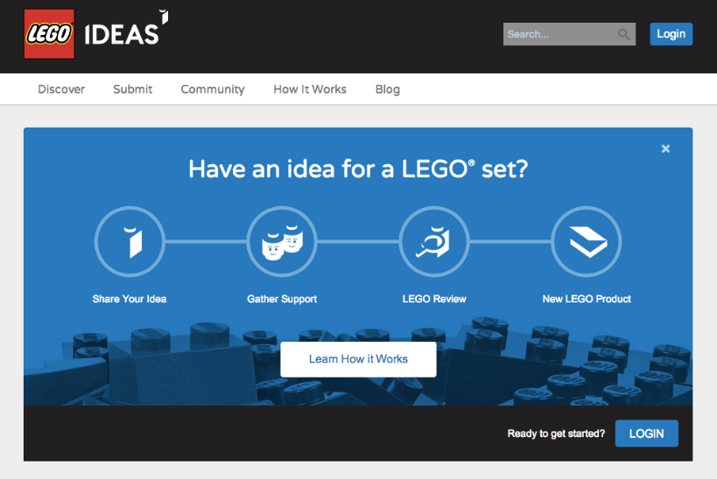
LEGO

Slide 45
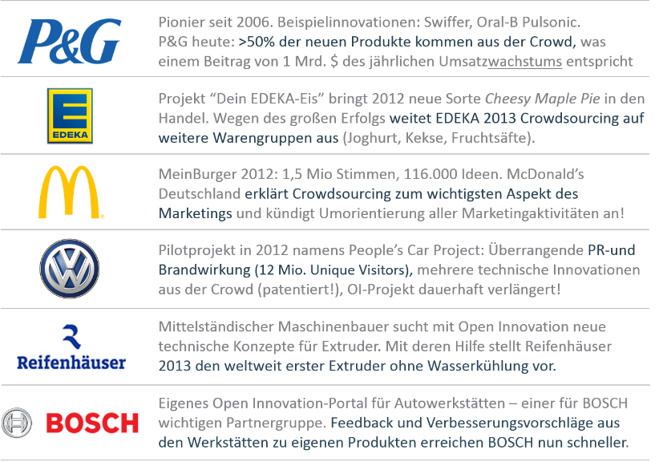
Notes:
LEGO, Samsung, GE, coca cola, Samsung

Slide 46
Corporate Entrepreneurship Matrix (adapted from Christoph Räthke, GTEC)
Max. internal
Innovation funnel
Intrapreneurship
Max. targeted
Trend scouts
Max. disruptive
Acquisitions
Hackathons
Open innovation
Max. external
Copyright Christoph Räthke, www.christophraethke.de

Slide 47
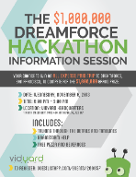
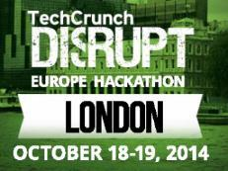
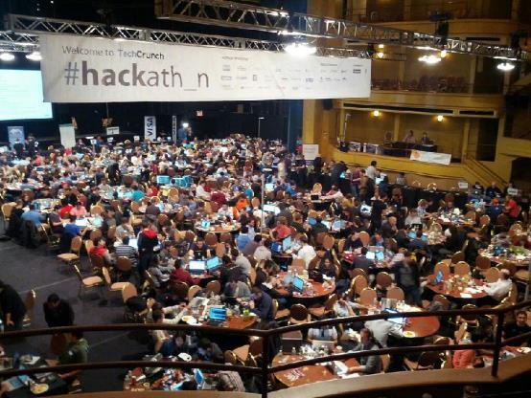




“Hackathons“ focus on a particular platform such as mobile apps and have become a popular tool for corporations

Slide 48
Increasing the variance: From managed to diverse innovation
“Targeted innovation“
“Diverse innovation“
☹
☺
Quality
(commercial viability, technical feasibility, originality, etc.)
Source: Barnett (2014)

Slide 49
Corporate Entrepreneurship Matrix (adapted from Christoph Räthke, GTEC)
Max. internal
Innovation funnel
Corporate incubator
Intrapreneurship
Max. targeted
Trend scouts
Max. disruptive
Acquisitions
Hackathons
Open innovation
Max. external
Copyright Christoph Räthke, www.christophraethke.de

Slide 50


UQBATE is an internal new business program (incubator) at Deutsche Telekom
We are looking for colleagues with ideas for new business – apart from today‘s core business.
We are looking for colleagues who do not have ideas themselves but have a serious interest in joining another team of intrapreneurs to make their ideas come true.
We are looking for external partners to support our teams with their know how and experience.
Villano (2013), What Corporate Incubators and Accelerators Mean for Your Business

Slide 51
Corporate Entrepreneurship Matrix (adapted from Christoph Räthke, GTEC)
Max. internal
Innovation funnel
Corporate incubator
Intrapreneurship
Max. targeted
Trend scouts
Max. disruptive
Corporate accelerator
Acquisitions
Hackathons
Open innovation
Max. external
Copyright Christoph Räthke, www.christophraethke.de

Slide 52

Kärcher
“Our goal is and has been: We want to be present in every country in the world. We enter up to ten additional countries each year, operating sales by ourselves.”
Kärcher
Notes:
Kärcher: Besetzung Nische nicht genug, Innovation; in 2014 58 new patents; 12,72 Mio sold products ;
Weltmarktführer im Handel mit Befestigungsmaterial
Die Würth-Gruppe ist Weltmarktführer in ihrem Kerngeschäft, dem Handel mit Montage- und Befestigungsmaterial. Sie besteht aktuell aus über 400 Gesellschaften in mehr als 80 Ländern und beschäftigt über 65.000 Mitarbeiter. Davon sind über 32.000 fest angestellte Verkäufer im Außendienst. In den ersten 6 Monaten des Geschäftsjahrs 2012 erzielte die Würth-Gruppe einen Umsatz von 5 Milliarden Euro.
Im Kerngeschäft, der Würth-Linie, umfasst das Verkaufsprogramm für Handwerks- und Industriebetriebe über 100.000 Produkte: Von Schrauben, Schraubenzubehör und Dübeln über Werkzeuge bis hin zu chemisch-technischen Produkten und Arbeitsschutz. Die Allied Companies – Gesellschaften des Konzerns, die an das Kerngeschäft angrenzen oder diversifizierte Geschäftsbereiche bearbeiten – ergänzen das Angebot um Produkte für Bau- und Heimwerkermärkte, Elektroinstallationsmaterial, elektronische Bauteile (z.B. Leiterplatten) sowie Finanzdienstleistungen.

Slide 53

Notes:
Specializes also in cleaning; cleaning of UNESCO heritage monuments, like facade of catedral in Aachen

Slide 54


Slide 55











TechStars organizes accelerators for large corporations

Slide 56

Accelerators mushroom all across the world

Slide 57

After intense mentoring, an accelerator typically ends with Demo Day

Slide 58




Axel Springer Plug & Play – how it works
100 days
Place to work
Access to global network
Daily opportunities
25,000€ funding
5% from the start-up
Alumni network
Notes:
We run 100 day acceleration programs. When we partner with you, we provide you with a place to work, access to our global network, daily opportunities and 25,000 Euro funding. In return we ask to hold 5% of your company. Our support doesn't end after the 100 days. Our team, our alumni network and everyone we know are here to support you throughout your entrepreneurial

Slide 59
Diverse innovation needs an ecosystem: Map of central Berlin

Slide 60
Corporate Entrepreneurship Matrix (adapted from Christoph Räthke, GTEC)
Max. internal
Innovation funnel
Corporate incubator
Intrapreneurship
Max. targeted
Trend scouts
Max. disruptive
Corporate accelerator
Acquisitions
Hackathons
Open innovation
Venture capital
Max. external
Copyright Christoph Räthke, www.christophraethke.de

Slide 61











European electric utilities experiment with new types of innovation
VC fund €80m
2008
2011
VC fund €60m
May 2012
2012
May 2013
Jun 2013
VC fund €180m
Autumn 2013
Jan 2014
VC fund €100m
May 2014
Oct 2014
RWE Israel Innovation Center
Jan 2015
2008 2009 2010 2011 2012 2013 2014 2015
Source: Burger, Weinmann;
Innovation Index 2014 (2015)

Slide 62
Corporate Entrepreneurship Matrix (adapted from Christoph Räthke, GTEC)
+
create products or services that are very close to your company and may be easy to integrate
–
this way, you don‘t find game changers
Max. targeted
Max. disruptive
+
a chance to discover and build true game changers that may reach beyond industry boundaries
–
they may be far from what your core organisation is about or good at
Copyright Christoph Räthke, www.christophraethke.de

Slide 63
Corporate Entrepreneurship Matrix (adapted from Christoph Räthke, GTEC)
Max. internal
+
may trigger cultural change and adoption of entrepreneurial skills inside an organisation
–
often an HR management tool with very low output of truly innovative or market-ready product ideas
+
very few employees of the mother company involved; normally faster results
–
this approach leaves the mother organisation mostly untouched
Max. external
Copyright Christoph Räthke, www.christophraethke.de

Slide 64
Corporate Entrepreneurship Matrix
Max. internal
Innovation funnel
Corporate incubator
Intrapreneurship
Max. targeted
Trend scouts
Max. disruptive
Corporate accelerator
Acquisitions
Hackathons
Open innovation
Venture capital
Max. external
Copyright Christoph Räthke, www.christophraethke.de

Slide 65

0
1099
  info@esmt.org
Dr. Jens Weinmann
Program Director
Jens.weinmann@esmt.org
8052

