Slide 1


Chapter 9
Reaching Global Markets
Course Instructor:
Mamurjon Rahimov

Slide 2


Learning Objectives
© zayats-and-zayats
LO 9-1 Define international marketing
LO 9-2 Differentiate between the six environmental forces that affect international marketing efforts
LO 9-3 List six important international trade agreements
LO 9-4 Identify methods of international market entry
LO 9-5 Summarize the three forms of global organizational structure
LO 9-6 Describe the use of the marketing mix internationally

Slide 3
International Marketing
© zayats-and-zayats
Developing and performing marketing activities across national boundaries
  International markets provide growth opportunities
  Many countries offer assistance and research to encourage international business
    Export.gov, managed by the U.S. Department of Commerce’s International Trade Administration, collects a variety of resources to help businesses who want to export to other countries
LO 9-1

Slide 4
International Marketing
© zayats-and-zayats
Most companies have entered the global marketplace incrementally as they gained knowledge about various markets and opportunities
  McDonald’s and KFC
Born globals – Firms that are international from their inception
  Often small technology-based firms
  Earn most of their sales outside the domestic home market
  eBay, Google, and Logitech
LO 9-1

Slide 5

Environmental Forces in
Global Markets
© zayats-and-zayats
Sociocultural
Technological
Economic
Environmental Forces
Political, Legal,
and Regulatory
Competitive
Ethical and Social Responsibility
LO 9-2

Slide 6
Environmental Forces
© zayats-and-zayats
Environmental forces may be dramatically different in international markets than in domestic markets
  Research to understand the needs/desires of international customers is crucial to global marketing success
Proper environmental analysis of international markets can:
  Generate financial rewards
  Increase market share
  Heighten customer awareness of products
LO 9-2

Slide 7
Sociocultural Forces
© zayats-and-zayats
Social
Influences
Family
Religion
Education
Health
Recreation
Language
Country of
Origin
LO 9-2

Slide 8
Sociocultural Forces
© zayats-and-zayats
Marketing activities are influenced by beliefs and values regarding family, religion, education, health, and recreation
Can be difficult to:
  Adapt marketing efforts to different preferences, tastes, and idioms
  Transfer marketing symbols, trademarks, logos, and even products to international markets
LO 9-2

Slide 9


Slide 10
Sociocultural Forces
© zayats-and-zayats
Consumer preferences for products depends on their impression of the country of origin
Faster acceptance of a product or service through:
  Sensitivity to and understanding of cultural differences
  Cultural similarities
LO 9-2

Slide 11
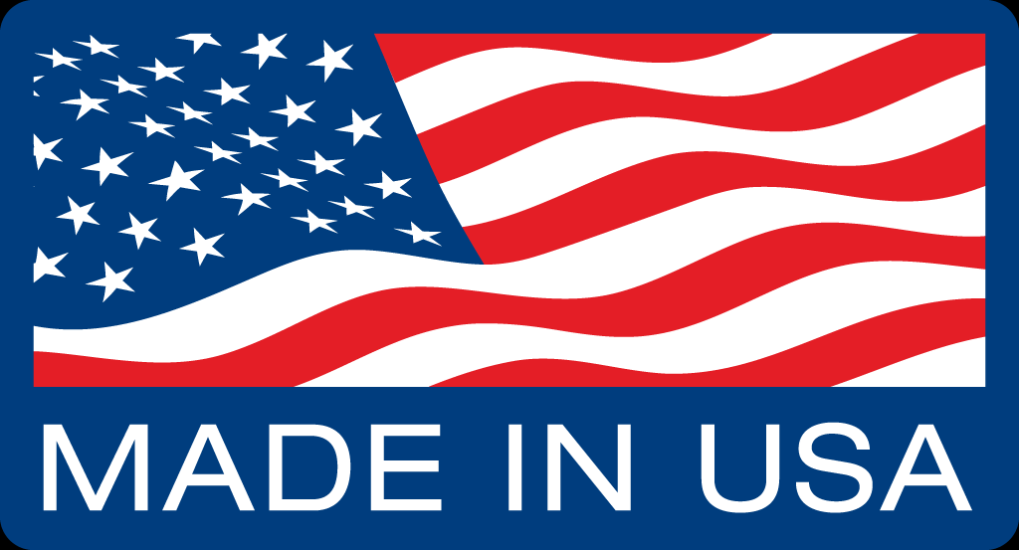

Slide 12
Economic Forces
© zayats-and-zayats
Global marketers must understand:
  International trade systems
  Economic stability/instability of nations
  Trade barriers
  Economic disparities between nations
Instability is a guaranteed constant in the global business environment
Developing nations, while poorer, offer much market potential
LO 9-2

Slide 13
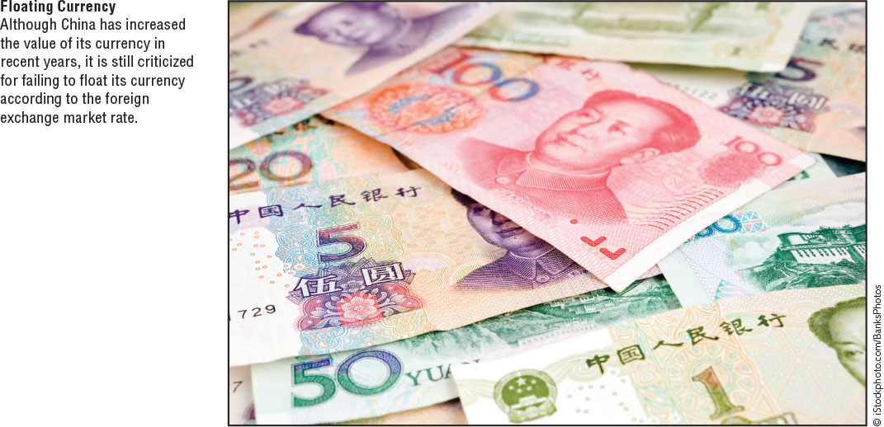
Economic Forces
© zayats-and-zayats
Many differences between nations exist:
Standards of living | Availability of credit
Buying power | Income distribution
National resources | Exchange rates
LO 9-2

Slide 14
Economic Forces
© zayats-and-zayats
Gross domestic product (GDP) – The market value of a nation’s total output of goods and services for a given period; an overall measure of economic standing
  Gives insights into a nation’s wealth and market potential
LO 9-2

Slide 15
Political, Legal, and Regulatory Forces
© zayats-and-zayats
Political, legal, and regulatory forces are often intertwined
  A nation’s legal and regulatory infrastructure reflect its political situation
  Import tariff – A duty levied by a nation on goods bought outside its borders and brought into the country
  Quota – A limit on the amount of goods an importing country will accept for certain product categories in a specific period of time
LO 9-2

Slide 16
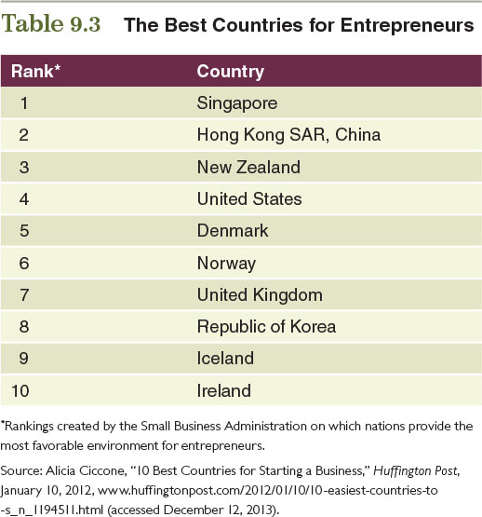
Table 9.3 – The Best Countries for Entrepreneurs
© zayats-and-zayats
LO 9-2

Slide 17
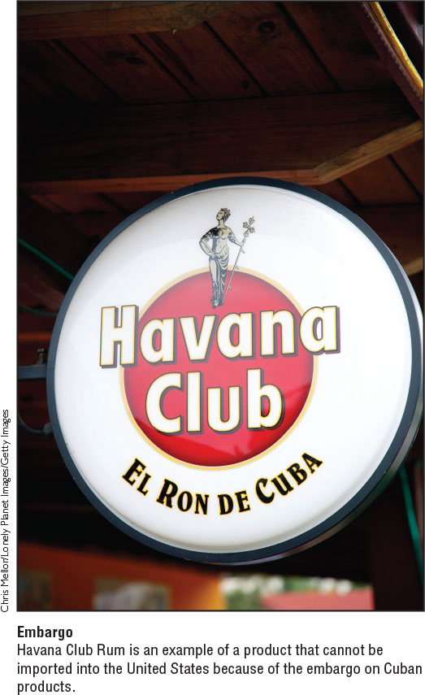
Political, Legal, and Regulatory Forces
© zayats-and-zayats
Embargo – A government’s suspension of trade in a particular product or with a given country
  Did you know that the United States has multiple embargos in place?
LO 9-2

Slide 18
Trade Controls
© zayats-and-zayats
Exchange controls – Government restrictions on the amount of a particular currency that can be bought or sold
Some countries promote international trade through free trade zones, which are multinational economic communities that eliminate trade barriers
LO 9-2

Slide 19
Trade Controls
© zayats-and-zayats
Balance of trade – The difference in value between a nation’s exports and its imports
Non-regulatory barriers, like stringent health or safety requirements, can also inhibit trade
LO 9-2

Slide 20
Ethical and Social Responsibility Forces
© zayats-and-zayats
Accepted business practices vary from country to country
  Differences exist in ethical standards:
    Bribery
    Intellectual property protection
  Different modes of operation
Bribes are an entrenched part of the business culture in many nations
  Illegal for U.S. firms, although small gifts are allowed
  Foreign Corrupt Practices Act of 1977
LO 9-2

Slide 21
Different Cultural Practices
© zayats-and-zayats
Self-reference criterion (SRC) – The unconscious reference to one’s own cultural values, experiences, and knowledge
  Usually includes the sense that your culture is best
  Formed over a lifetime; worse in those who have little international travel exposure
LO 9-2

Slide 22
Different Cultural Practices
© zayats-and-zayats
Cultural relativism
  The concept that morality varies from one culture to another and that business practices are therefore differentially defined as right or wrong by particular cultures
  “When in Rome, do as the Romans do”
  Most large international businesses will counteract this urge with international ethics and compliance programs
LO 9-2

Slide 23
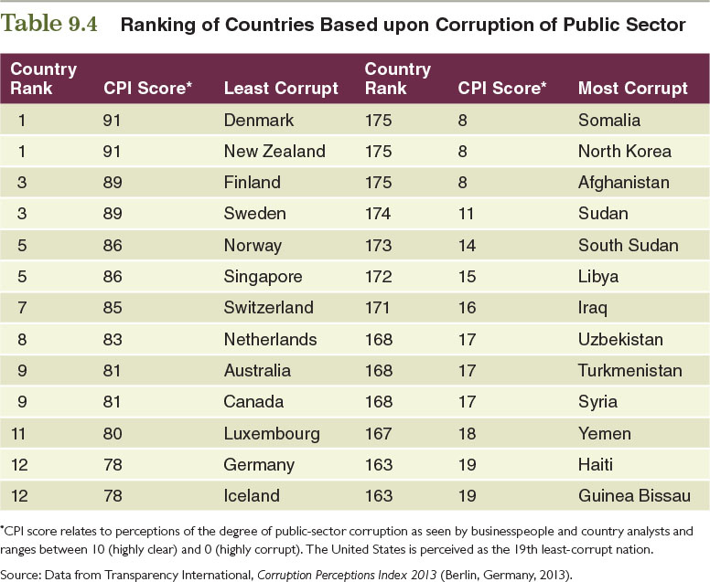
Table 9.4 – Ranking of Countries Based upon Corruption of Public Sector
© zayats-and-zayats
LO 9-2

Slide 24
Competitive Forces
© zayats-and-zayats
Competition is a staple of the global marketplace
Technology and interconnectedness have created unique competitive forces in the international marketplace
LO 9-2

Slide 25
Competitive Forces
© zayats-and-zayats
Firms that operate internationally should:
  Be aware of the competitive forces in the countries they target
  Identify the interdependence of countries and the global competitors in those markets
  Be mindful of a new breed of customers: The global customer
LO 9-2

Slide 26
Competitive Forces
© zayats-and-zayats
Each country has unique competitive aspects
  Shaped by the environmental forces that act upon it
  Nations establish the infrastructure and rules for the types of competition that can take place
The global consumer is changing international competition
  Increased ability to compare products and prices around the globe
LO 9-2

Slide 27
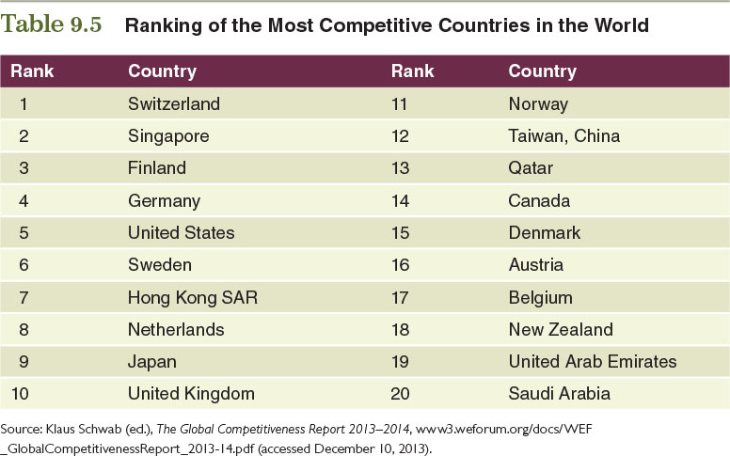
Table 9.5 – Ranking of the Most Competitive Countries in the World
© zayats-and-zayats
LO 9-2

Slide 28
Technological Forces
© zayats-and-zayats
Technological advances have made international marketing easier, faster, and more affordable
Technological infrastructure varies by country
  Many developing nations are beginning to capitalize on opportunities to leapfrog existing technology
LO 9-2

Slide 29

Discussion Point – Proctor & Gamble in Asia
Look at the examples below and describe which barrier(s) P&G faced with expansion into these two countries:
  In China, parents use cloth diapers on their babies and toilet train them early. P&G therefore marketed studies to show that babies wearing Pampers fall asleep faster.
  Chinese and Indian consumers cannot afford P&G’s products. P&G found a way to lower the prices of their products by offering single-serve, no-frills packaging.
  P&G faces a stiff rivalry with Hindustan Unilever in India, which is the market leader in consumer goods.
  Since most Indian men go to the barber to get a shave, P&G promoted the convenience of its Gillette razors and emphasized that women prefer clean shaves.
Procter & Gamble plans to raise its number of global customers to 5 billion. Two countries integral to P&G’s success is China and India.
LO 9-2
Notes:
Answers:
Sociocultural—it involves changes cultural practices and perceptions
Economic—P&G had to adjust to make their products affordable
Competitive—P&G must compete against an established leader
Sociocultural—it involved having to change cultural practices and perceptions

Slide 30
Regional Trade Alliances, Markets, and Agreements
© zayats-and-zayats
Regional trade alliances create opportunities and impose constraints on international trade
  North American Free Trade Agreement (NAFTA)
  European Union (EU)
  Southern Common Market (MERCOSUR)
  Asia-Pacific Economic Cooperation (APEC)
  Association of Southeast Asian Nations (ASEAN)
  World Trade Organization (WTO)
LO 9-3

Slide 31
North American Free Trade Agreement (NAFTA)
© zayats-and-zayats
An alliance that merges Canada, Mexico, and the United States into a single market
Eliminates most tariffs and trade restrictions on agricultural and manufactured products to encourage trade
Controversial but has created new business opportunities with fewer barriers than before
LO 9-3

Slide 32
European Union (EU)
© zayats-and-zayats
An alliance that promotes trade among its member countries in Europe
  Makes up 7% of the population, but nearly 22% of the world’s GDP
Consumers in the EU may become more homogeneous in their needs and wants
  Cultural difference among the nations may require modifications in the marketing mix for customers in each nation
LO 9-3

Slide 33
Southern Common Market (MERCOSUR)
© zayats-and-zayats
An alliance that promotes the free circulation of goods, services, and production factors, and has a common external tariff and commercial policy among member nations in South America
  South America and Latin America are catching the attention of many international businesses
  Estimated growth rate of 4-5%
  Experiencing more stable democracies
LO 9-3

Slide 34
Asia-Pacific Economic Cooperation (APEC)
© zayats-and-zayats
An alliance that promotes open trade and economic and technical cooperation among member nations throughout the world
  21-member alliance
  Approximately 41% of the world’s population, 54% of world GDP, and nearly 44% of global trade
  Most important emerging economic power is China, which has become one of the most productive manufacturing nations
LO 9-3

Slide 35
Association of Southeast Asian Nations (ASEAN)
© zayats-and-zayats
An alliance that promotes trade and economic integration among member nations in Southeast Asia
  Economies of ASEAN countries are expanding at an average of 5%
  Political systems of countries in ASEAN are vastly different
  Have been conflicts between members
  Unlike EU, no common currency or fully free labor flows between members
LO 9-3

Slide 36
Discussion Point – Mistine
Mistine was launched as a direct-selling cosmetics firm in Thailand in 1991. It became the first direct selling firm in the world to engage in mass media advertising. Mistine has expanded beyond Thailand into other Asian countries. ASEAN is a crucial trade agreement paving the way for Mistine’s distribution and expansion into Southeast Asian countries.
  Explain some ways that ASEAN is beneficial for companies such as Mistine.
LO 9-3
Notes:
Answer:
ASEAN is eliminating tariffs among Southeast Asian countries, making it less expensive for Thai companies like Mistine to export to other countries. The purpose of ASEAN is to increase trade between these countries. This gives countries in Southeast Asia a competitive advantage because it reduces trade barrier that other countries may have when trading with Southeast Asia.

Slide 37
The World Trade Organization (WTO)
© zayats-and-zayats
An entity that promotes free trade among member nations by eliminating trade barriers and educating individuals, companies, and governments about trade rules around the world
  Successor to General Agreement on Tariffs and Trade (GATT) – An agreement among nations to reduce worldwide tariffs and increase international trade
  Dumping – Selling products at unfairly low prices
LO 9-3

Slide 38
Modes of Entry into International Markets
© zayats-and-zayats
Stage 1 – No regular export activities
Stage 2 – Export via independent representatives (agents)
Stage 3 – Establishment of one or more sales subsidiaries internationally
Stage 4 – Establishment of international production/manufacturing facilities
LO 9-4

Slide 39
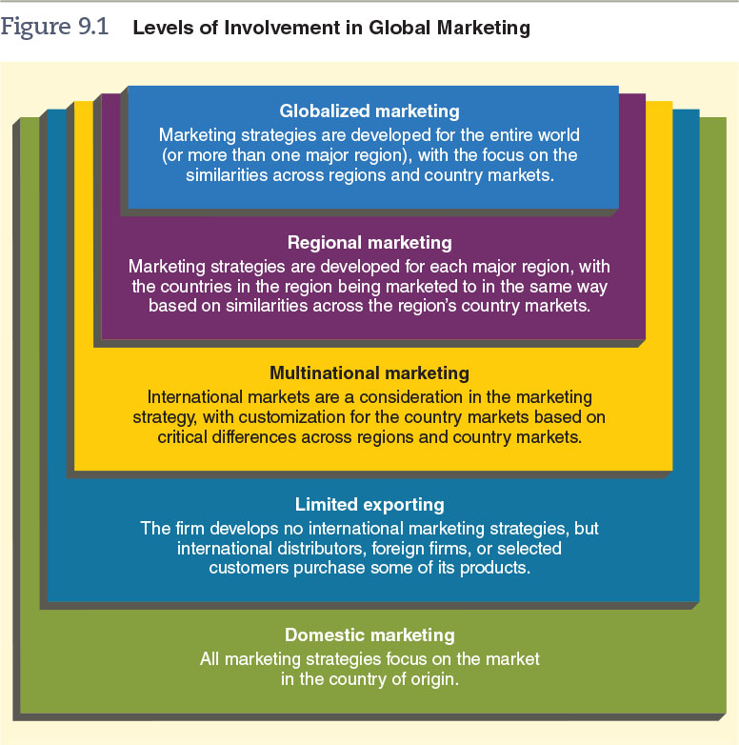
Figure 9.1 – Levels of Involvement in Global Marketing
© zayats-and-zayats
LO 9-4

Slide 40
Discussion Point – Logitech
Logitech is a Swiss provider of computer peripherals such as mouse products and speakers. Founded in 1981, the company did not appear to belong to any particular country. Rather, research and development was performed in two separate countries. By 1989 the company had global market share of computer mouse products. Logitech is an early example of a “born global” firm.
  What are some of the advantages Logitech had by becoming a born global firm?
  What might be some disadvantages to immediately adopting a born global approach?
LO 9-4
Notes:
Answers:
Advantages: can export product almost immediately after introduction; can compete with larger, more established firms on a global scale
Possible disadvantages: can represent an initial investment and many new firms do not have appropriate funding or infrastructure; taking a smaller approach by focusing on one country or area allows it to build up reputation before expansion

Slide 41
Importing and Exporting
© zayats-and-zayats
Importing
  The purchase of products from a foreign source
Exporting
  The sale of products to foreign markets
    Exporting intermediaries can perform most marketing functions for minimal effort and cost
    Export agents unite buyers and sellers and collect a commission for arranging sales
    Export houses and export merchants purchase products from different companies and then sell them abroad
LO 9-4

Slide 42
Trading Company
© zayats-and-zayats
A company that links buyers and sellers in different countries
  Is not involved in manufacturing and does not own assets related to manufacturing
  Acts like a wholesaler; purchases products in one country for a low price and sells them to buyers in another country
    Reduces risk to the company wanting to trade internationally
LO 9-4

Slide 43
Licensing
© zayats-and-zayats
An alternative to direct investment that requires a licensee to pay commissions or royalties on sales or supplies used in manufacturing
  An attractive alternative when:
    Resources for direct investment are not available
    Product sold is outside the core competency of a company
    A foreign country is politically unstable
LO 9-4

Slide 44
Franchising
© zayats-and-zayats
A form of licensing in which a franchiser, in exchange for a financial commitment, grants a franchisee the right to market its product in accordance with the franchiser’s standards
  The franchisee must:
    Pay an initial fee and royalties to the franchiser
    Adhere to all franchise standards
LO 9-4

Slide 45
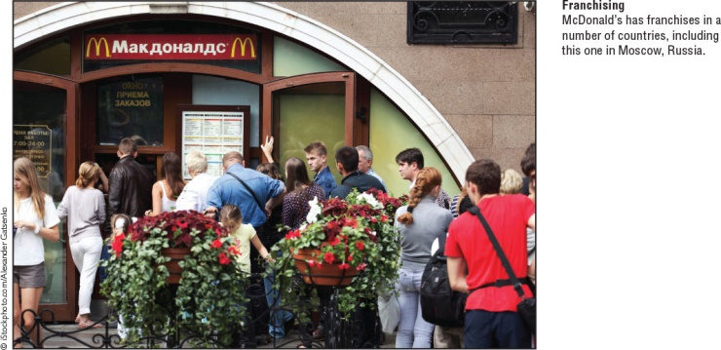
Franchising
© zayats-and-zayats
LO 9-4

Slide 46
Benefits of International Franchising
© zayats-and-zayats
Minimizes risks to franchiser:
  Does not have to put up a large capital investment
  Revenue stream is fairly consistent because franchisees pay a fixed fee and royalties
  Retains control of its name and increases global penetration
  Franchise agreements ensure a standard of conduct and protect the franchise name
LO 9-4

Slide 47
Contract Manufacturing
© zayats-and-zayats
The practice of hiring a foreign firm to produce a designated volume of the domestic firm’s product or a component of it to specification
The final product carries the domestic firm’s name
Marketing may be handled by the contract manufacturer or by the contracting company
LO 9-4

Slide 48
Forms of Contract Manufacturing
© zayats-and-zayats
Outsourcing
  The practice of contracting noncore operations with an organization that specializes in that operation
Offshoring
  The practice of moving a business process that was done domestically at the local factory to a foreign country, regardless of whether the production accomplished in the foreign country is performed by the local company (in a wholly owned subsidiary) or a third party (subcontractor)
LO 9-4

Slide 49
Forms of Contract Manufacturing
© zayats-and-zayats
Offshore outsourcing
  The practice of contracting with an organization to perform some or all business functions in a country other than the country in which the product or service will be sold
LO 9-4

Slide 50
Joint Ventures
© zayats-and-zayats
Joint venture – A partnership between a domestic firm and a foreign firm or government
  Popular in industries requiring large investments
  May be a political necessity because of laws and regulations
LO 9-4

Slide 51
Joint Ventures
© zayats-and-zayats
Strategic alliances – A partnership that is formed to create a competitive advantage on a worldwide basis
  Firms may be traditional rivals competing for the same market
  Firms may compete in some markets while collaborating in others
LO 9-4

Slide 52
Direct Ownership
© zayats-and-zayats
A situation in which a company owns subsidiaries or other facilities overseas
  Owning facilities may be too expensive for many firms
Multinational enterprise (multinational corporation)
  A firm that has operations or subsidiaries in many countries
    Subsidiaries may be semi-autonomous or part of a network led by headquarters
LO 9-4

Slide 53
Discussion Point – Modes of Entry
A water purification plant works with WTSC Industrial Group to connect it with buyers throughout the world.
Apple uses factories in China to manufacture its iPad and iPhone components.
Siemens has partnered with Nokia to create Nokia Siemens Networks U.S. This entity is gaining large inroads into telecom manufacturing equipment.
An Australian lunchbox manufacturer makes a deal with Disney to use Marvel comic book characters and names on its lunchboxes.
Jaguar Land Rover opened up a new car plant in China and is planning to open up an engine factory there as well.
Look at the examples below. Identify which mode of entry applies to each situation.
LO 9-4
Notes:
Answers:
Trading company
Contract manufacturing
Joint venture
Licensing
Direct ownership

Slide 54
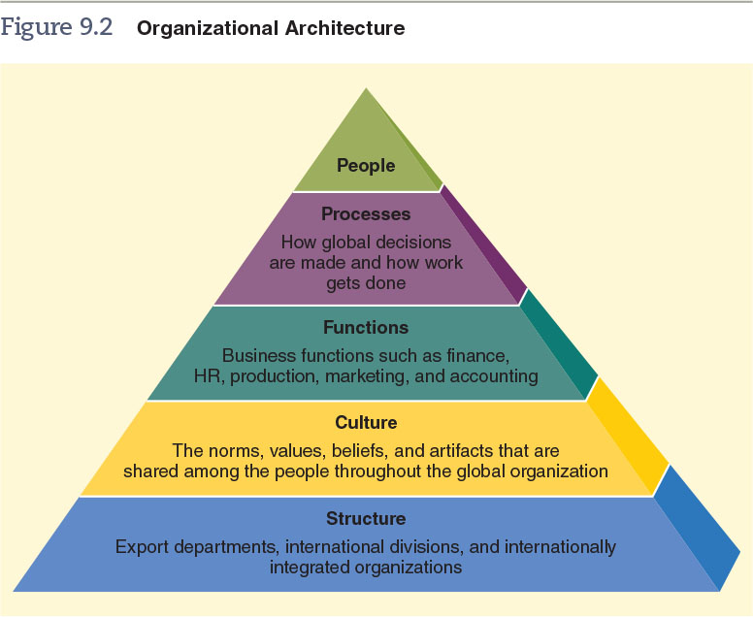
Figure 9.2 – Organizational Architecture
© zayats-and-zayats
LO 9-5

Slide 55
Global Organizational Structures
© zayats-and-zayats
An organizational structure should best leverage a firm’s resources and core competencies
  Export departments – A subunit of the marketing department
    Not present in all firms
  International divisions – Centralizes all of the responsibility and communications related to international operations
LO 9-5

Slide 56
International Integrated Structures
© zayats-and-zayats
Internationally integrated structures – Firms with internationally integrated structures are most likely to engage in direct ownership internationally
  Three most common structures:
    Product division structure
    The geographic area structure
    The global matrix structure
LO 9-5

Slide 57
International Integrated Structures
© zayats-and-zayats
Product division structure
  The form used by most multinational enterprises
  Good for firms that are diversified, yet driven by domestic operations
  Each unit is self-contained
LO 9-5

Slide 58
International Integrated Structures
© zayats-and-zayats
Geographic area structure
  Good for firms with low diversification
  Divides the world into logistical areas based on operations and customers’ characteristics
Global matrix structure
  Designed to achieve global integration, cost, efficiencies, knowledge transfers, and local responsiveness
  Most firms do not use this structure
LO 9-5

Slide 59
Customization vs. Globalization of International Marketing Mixes
© zayats-and-zayats
Marketers must realize that similarities and differences exist across all countries
Customization: Adapting marketing strategy and marketing mixes according to cultural, regional, and national differences
  The traditional approach to marketing
LO 9-6

Slide 60
Customization vs. Globalization of International Marketing Mixes
© zayats-and-zayats
Globalization – The development of marketing strategies that treat the entire world (or its major regions) as a single entity
  Entails producing standardized products, promotion campaigns, prices, and distribution channels for all markets
LO 9-6

Slide 61
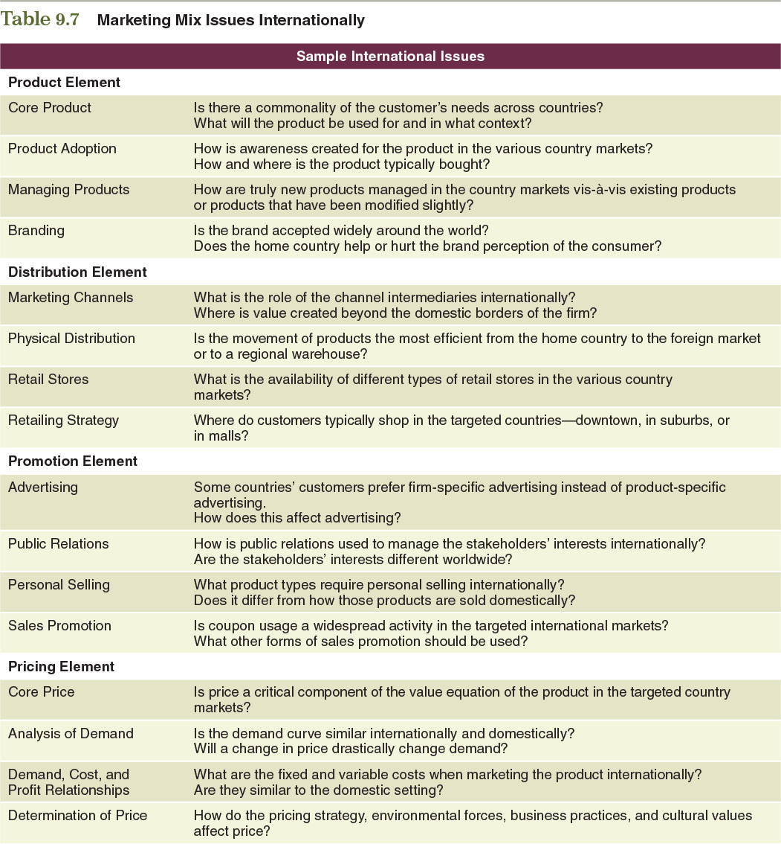
Table 9.7 – Marketing Mix Issues Internationally
© zayats-and-zayats
LO 9-6

Slide 62
Table 9.7 – Marketing Mix Issues Internationally (cont.)
© zayats-and-zayats
LO 9-6

Slide 63
A Global Presence
© zayats-and-zayats
Maintaining a global presence creates five opportunities for creating value:
  Adapt to local market differences
  Exploit economies of global scale
  Exploit economies of global scope
  Mine optimal locations for activities and resources
  Maximize the transfer of knowledge across locations
LO 9-6

Slide 64
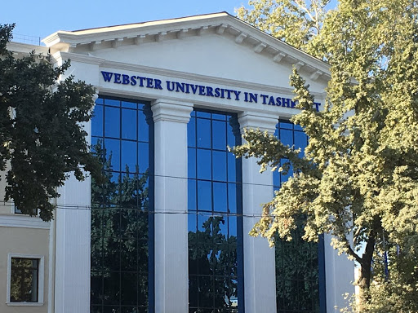
Thank you for your attention!

