Slide 1


Chapter 8
Business Markets and Buying Behavior
Course Instructor:
Mamurjon Rahimov

Slide 2


Learning Objectives
© zayats-and-zayats
LO 8-1 Distinguish among the four types of business markets
LO 8-2 Identify the major characteristics of business customers and transactions
LO 8-3 Identify the attributes of demand for business products
LO 8-4 Describe the buying center, stages of the business buying decision process, and the factors that affect this process
LO 8-5 Describe industrial classification systems and how they can be used to identify and analyze business markets

Slide 3
Business Markets
© zayats-and-zayats
Business (B2B) markets consists of individuals, organizations or groups that purchase a specific kind of product for one of three purposes:
  Resale
  Direct use in producing other products
  Use in general daily operations
  The four categories of business markets are:
Producer | Reseller
Government | Institutional
LO 8-1

Slide 4
Product Markets
© zayats-and-zayats
Producer Markets
  Individuals and business organizations that purchase products to make profits by using them to produce other products or using them in their operations
    Include buyers of raw materials
    Purchasers of semi-finished and finished items, used to produce other products
    Producer markets include a wide array of industries
LO 8-1

Slide 5
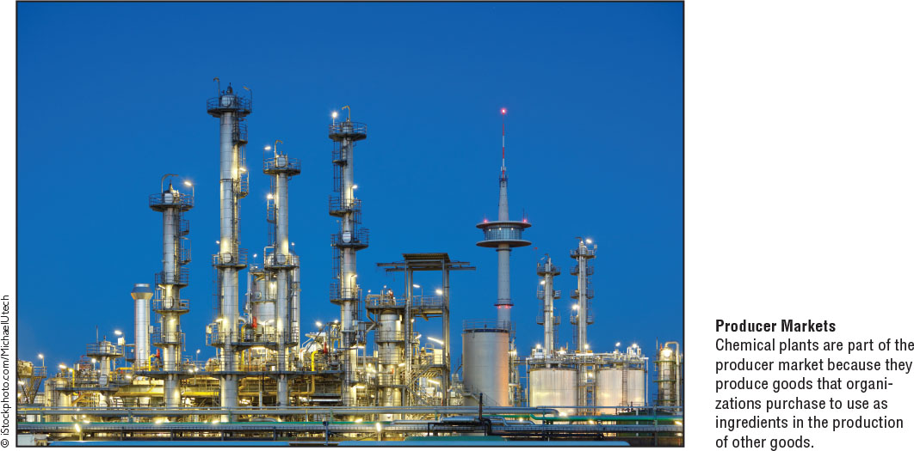
Product Markets
© zayats-and-zayats
LO 8-1

Slide 6
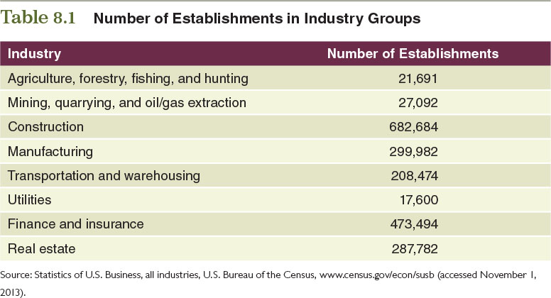
Table 8.1 – Number of Establishments in Industry Groups
© zayats-and-zayats
LO 8-1

Slide 7
Reseller Markets
© zayats-and-zayats
Reseller markets
  Intermediaries, such as wholesalers and retailers, which buy finished goods and resell them for a profit
  Resellers consider many factors, such as:
    Level of demand
    Resale price
    Space required – sales per square foot
    Supplier’s ability to provide adequate quantities when and where needed
    Ease of placing orders
LO 8-1

Slide 8
Government Markets
© zayats-and-zayats
Government Markets
  Federal, state, county and local governments that buy goods and services to support their internal operations and provide products to their constituencies
    Total government spending accounts for around 39 percent of the U.S.’ total gross domestic product
    Although government markets can impose intimidating requirements, they can also be very lucrative
LO 8-1

Slide 9
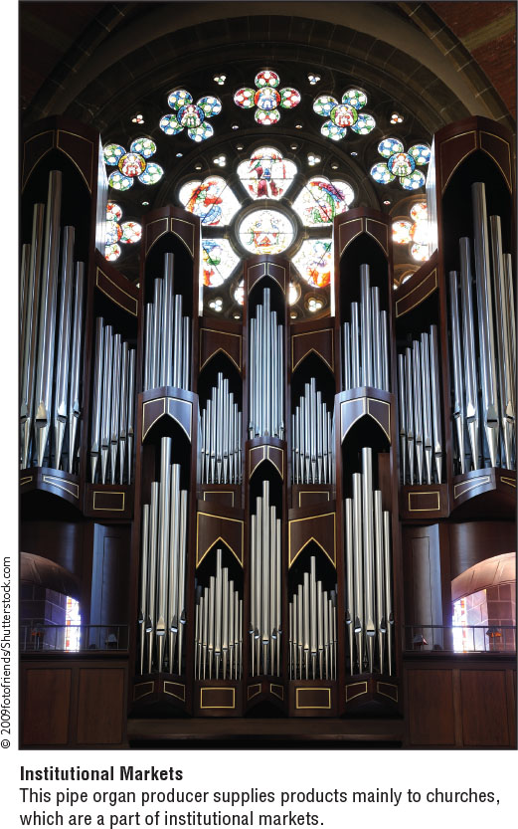
Institutional Markets
© zayats-and-zayats
Institutional markets consist of organizations with charitable, educational, community or other non-business goals
LO 8-1

Slide 10
Institutional Markets
© zayats-and-zayats
Institutions have different goals and fewer resources than other types of organizations
This pipe organ producer supplies products mainly to churches
Can you think of other products used mainly by institutional markets?
LO 8-1

Slide 11

Discussion Point – Bombardier
Bombardier specializes in planes and trains. This Canadian company’s primary markets are governments and businesses that purchase railroad and airplane related products. Bombardier also markets corporate jets under the names of Learjet, Challenger, and Global. Bombardier markets their products’ fuel efficiency, low operating costs, and other benefits.
  Which business markets does Bombardier seem to focus on? There may be more than one answer.
  What do you think is the most important concern of Bombardier’s customers: price, quality, service, or supplier relationships?
LO 8-1
Notes:
Answers:
Bombardier sells to government and producer markets.
Students might be able to argue for a few of these answers, but probably the best one is quality. Because of the industry, it is important to have a product that works well and is durable. Price might also be a major consideration, but probably trails quality in importance. Bombardier does emphasize the low operating costs of its products.

Slide 12
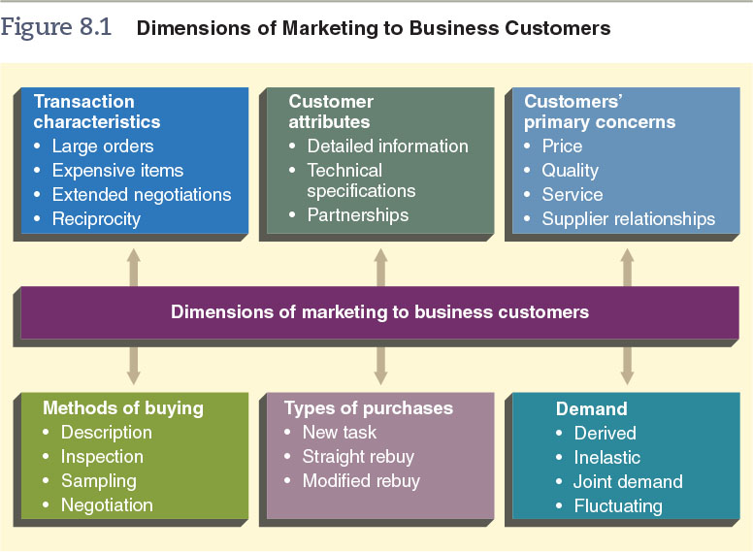
Figure 8.1 – Dimensions of Marketing to Business Customers
© zayats-and-zayats
LO 8-2

Slide 13
Transaction Characteristics
© zayats-and-zayats
Transactions between businesses differ from consumer sales in several ways
  Business orders tend to be much larger
  Purchases tend to be made by committee
  Discussions and negotiations can require considerable marketing time and selling effort
  Reciprocity is an arrangement unique to business markets in which two organizations agree to buy from each other
    Agreements that threaten competition are illegal but a certain amount still occurs
LO 8-2

Slide 14
Business Customer Attributes
© zayats-and-zayats
Business customers differ from consumers
  Better informed
  Demand more detailed product information
  Goals of a purchasing agent may include advancement or financial awards
  Some suppliers and business customers build and maintain mutually beneficial relationships or partnerships
LO 8-2

Slide 15
Business Customer Concerns
© zayats-and-zayats
Concerns of business customers:
  Price – Influences operating costs, which in turn affect selling price, profit margin and the ability to compete
  Product quality – most firms have standards or specifications they must meet and not exceed
  Service – typically business customers desire market information, inventory maintenance, on-time delivery and repair services
  Supplier relationships – with a strong relationship, buyers can reduce their search efforts and their price uncertainty
LO 8-2

Slide 16
Business Buying Methods
© zayats-and-zayats
Most business purchasers use one of the following purchase methods:
  Description – used when products are standardized such as agriculture products
  Inspection – used when products have unique characteristics such as buildings or vehicles
  Sampling – used for homogeneous products when examining the entire lot is not feasible such as grain
  Negotiation – used commonly for onetime projects such as buildings or capital equipment
LO 8-2

Slide 17
Types of Business Purchases
© zayats-and-zayats
Most business purchases are one of three types, each requiring modified selling approaches
  New-task purchase
    Initial purchase of an item for use in performing a new job or solving a new problem
  Straight rebuy purchase
    Routine purchases of the same products under approximately the same terms of sale
  Modified rebuy purchase
    When new-task purchases are changed on repeat orders or straight rebuy purchases are modified
LO 8-2

Slide 18
Discussion Point – Government Buyers
Apple products are appreciated for their quality and longevity. Assume that you are a city of San Francisco employee in charge of ordering more Apple computers for your facility. Look at the different situations below and determine the type of business purchase.
  Your facility has decided to upgrade to the newest model of Apple computers. You fill out an order to replace all your older models with new ones.
  You got the go-ahead to hire new employees. You need to purchase more computers for them to use.
  Apple is pulling its products from a green-registry. This does not fit with San Francisco’s emphasis on sustainability. You are told that the city will no longer do business with Apple and will use PCs from now on. When you need new computers, you contact Dell.
LO 8-2
Notes:
Answers:
Modified-rebuy purchase—you are still buying from Apple but are modifying your order
Straight-rebuy purchase—you are simply purchasing additional computers of the same type
New-task purchase—this is a completely new order with a different company

Slide 19
Demand for Business Products
© zayats-and-zayats
Demand for business products, also called industrial demand, can be:
  Derived demand – the demand for business products derives from demand for consumer products
  Inelastic demand – price increases and decreases will not significantly alter industrial demand
  Joint demand – occurs when two or more items are used in combination to produce a product
    Because demand for business products is derived from consumer demand, it may fluctuate enormously
LO 8-3

Slide 20
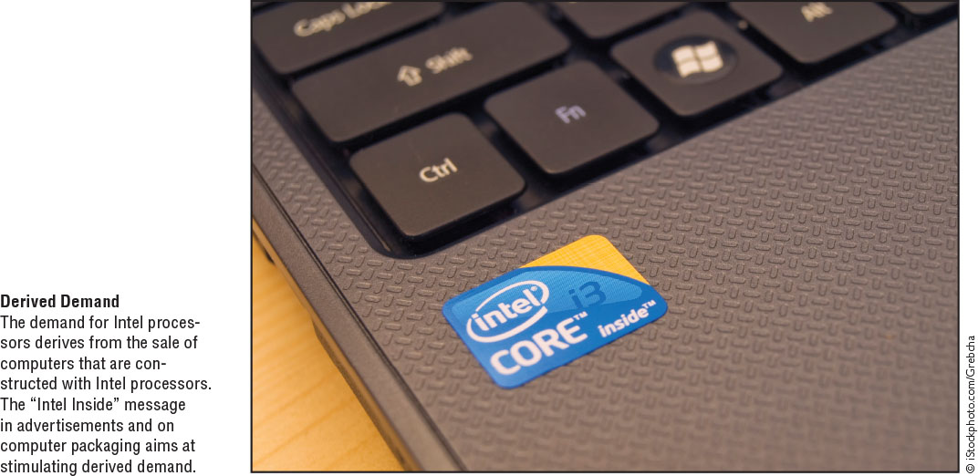
Derived Demand
© zayats-and-zayats
LO 8-3

Slide 21
Discussion Point – Type of Demand
A manufacturer of snow tires provides a discount on its products during the summer months. What type of demand is this?
A grocery store is running low on hamburger buns. They must order more to keep up with demand. Hamburger buns illustrate what type of demand for businesses?
Fleetwood, an RV manufacturer, is constructing its newest model of RV. The windshield wipers for the RV has risen in price. What type of demand applies to this product?
Sales of computers are increasing. Intel markets its computer chips to computer manufacturers worldwide. Describe the type of demand for its computer chips.
There are four types of demand for business products: derived, inelastic, joint, and fluctuating. Look at the following situations. Categorize each according to its demand:
LO 8-3
Notes:
Answers:
Fluctuating—snow tires are in low demand in the summer, high demand in the winter
Joint—hamburger buns go with purchases of hamburgers
Inelastic—the rising price of windshield wipers probably won’t have much of an effect on the construction of RVs
Derived—as end consumers buy more computers, there is a greater demand for computer chips like what Intel sells to make the computers

Slide 22
Business Buying Decisions
© zayats-and-zayats
Business (organizational) buying behavior refers to the purchase behavior of producers, government units, institutions and resellers
  Some purchasing factors are the same as the consumer market but some are unique to business markets
  We will first look at the buying center which is a group of people within an organization who make business purchase decisions
  Then we will focus on the stages of the buying decision process and the factors that affect it
LO 8-4

Slide 23
The Buying Center
© zayats-and-zayats
The people within an organization who make business purchase decisions are called the buying center and includes the following roles:
  Users – members who frequently initiate the purchase, use the product and evaluate the product
  Influencers – technical personnel who develop the specifications and evaluate alternative products
LO 8-4

Slide 24
The Buying Center
© zayats-and-zayats
Buyers – select suppliers and negotiate terms
Deciders – actually choose the products
Gatekeepers – control the flow of information to and among people who occupy other roles in the buying center
LO 8-4

Slide 25
Discussion Point – The Buying Center
You are a salesperson in charge of securing a contract with a construction company. You know that there are a lot of people in the company that will influence whether it will choose to do business with your firm. Identify the following people according to their roles.
  Because the company gets a lot of bids, Martha screens salespeople before they can talk to the purchasing department.
  Sam is a trusted manager who has vast knowledge of construction. He gives the purchasing department advice about what to look for.
  After receiving final approval, Dana places the order and approves the transfer of payment.
LO 8-4
Notes:
Answers:
Gatekeeper
Influencer
Buyer

Slide 26
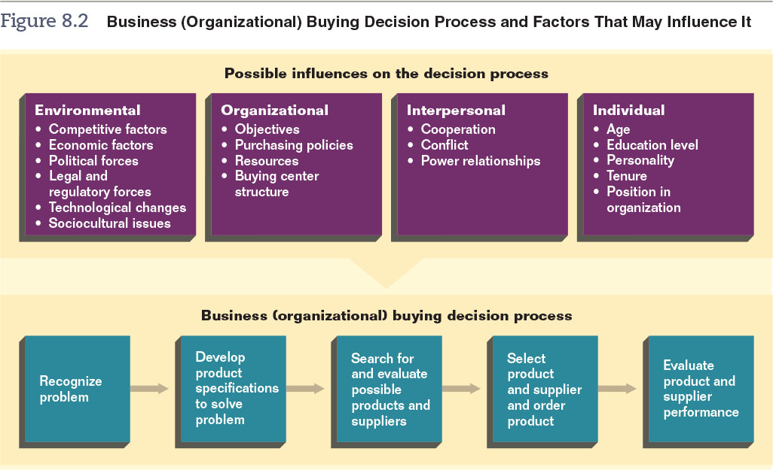
Figure 8.2 – Business Buying Decision Process and Factors that May Influence It
© zayats-and-zayats
LO 8-4

Slide 27
Stage 1: Problem Recognition
© zayats-and-zayats
One or more individuals recognize a problem or need exists
  Could be individuals in the buying center such as users, influencers or buyers who recognize the need or problem
  Problems or needs could be identified by external sources such as sales representatives or advertisements
LO 8-4

Slide 28
Stage 1: Problem Recognition
© zayats-and-zayats
May arise under a variety of circumstances
  When machines malfunction
  When an existing product is modified
  When introducing new products
LO 8-4

Slide 29
Stage 2: Specifications
© zayats-and-zayats
The development of product specifications requires the buying center participants assess the problem or need and determine what is necessary to resolve or satisfy it
Users and influencers often provide information and advice
By assessing and describing needs, the organization should be able to establish product specifications
LO 8-4

Slide 30
Stage 3: Potential Products
© zayats-and-zayats
Searching for and evaluating potential products and suppliers is the third stage
Searching may include contacting suppliers for information, soliciting proposals and examining websites, catalogs and trade publications
LO 8-4

Slide 31
Stage 3: Potential Products
© zayats-and-zayats
Value analysis is an evaluation of each component of the potential purchase
  Examines quality, design, materials etc.
Vendor analysis is a formal, systematic evaluation of current and potential vendors
  Examines price, product quality, delivery service, product availability and overall reliability
LO 8-4

Slide 32
Stage 4: Selection
© zayats-and-zayats
The fourth stage is to select the product to be purchased and the supplier or suppliers
  Multiple Sourcing – when the buyer selects and uses several suppliers
  Sole Sourcing – when only one supplier is selected
LO 8-4

Slide 33
Stage 4: Selection
© zayats-and-zayats
This stage is where the actual purchase takes place and the following details finalized
  Terms and credit arrangements
  Delivery dates and methods
  Technical assistance arrangements
LO 8-4

Slide 34
Stage 5: Evaluation
© zayats-and-zayats
During the fifth stage the product’s performance is evaluated by comparing it with the specifications
  If the product meets specifications but does not work – specifications need adjusted
  Supplier’s performance is also evaluated
These 5 steps are used primarily for new-task purchases
  Several stages, but not all, would be used for straight and modified rebuy
LO 8-4

Slide 35
Figure 8.2 – Business Buying Decision Process and Factors that May Influence It
© zayats-and-zayats
LO 8-4

Slide 36
Environmental Influences
© zayats-and-zayats
Environmental factors that influence buying decisions can be:
  Competitive and economic factors
  Political forces
  Legal and regulatory forces
  Technological changes
  Socio-cultural issues
LO 8-4

Slide 37
Organizational Influences
© zayats-and-zayats
Organizational factors that influence the buying decision process include
  The company’s objectives
  Purchasing policies
  Resources
  Size and composition of the buying center
LO 8-4

Slide 38
Interpersonal Influences
© zayats-and-zayats
Interpersonal factors are the relationships among people in the buying center
  Trust is crucial, especially with customized products
  Trust and clear communication ensures the satisfaction of all parties
  These interpersonal dynamics are often hidden, making it difficult for marketers to assess
LO 8-4

Slide 39
Individual Influences
© zayats-and-zayats
Individual factors are personal characteristics of participants in the buying center, such as:
Age | Personality
Education level | Position in the organization
LO 8-4

Slide 40
Individual Influences
© zayats-and-zayats
How influential these factors are depends on:
  The buying situation
  The type of product being purchased
  Whether the purchase is new-task, modified or straight rebuy
Effective marketers must know customers well
LO 8-4

Slide 41
Industrial Classification Systems
© zayats-and-zayats
Information about business customers is based on industrial classification systems
  Standard Industrial Classification (SIC) System was developed by the federal government International Standard Industrial Classification (ISIC) is used mainly in Europe
  North American Industry Classification System (NAICS) An industry classification system that generates comparable statistics among the United States, Canada and Mexico
LO 8-5

Slide 42
Industrial Classification Uses
© zayats-and-zayats
Useful for segmentation, most appropriate when used with other types of data
Marketers must locate potential purchasers and estimate their purchase potential by finding a relationship between the potential purchases and a variable from the industrial classification data
LO 8-5

Slide 43
Industrial Classification Uses
© zayats-and-zayats
Problems with the data include:
  Some industries do not have a specific designation
  Double counting of shipments could occur
  Some data may be understated
  Currency of data suffers due to lag time
LO 8-5

Slide 44

Thank you for your attention!

