Slide 1


Chapter 7
Consumer Buying Behavior
Course Instructor:
Mamurjon Rahimov

Slide 2


Learning Objectives
© zayats-and-zayats
LO 7-1 Recognize the stages of the consumer buying decision process
LO 7-2 Describe the types of consumer decision making and the level of involvement
LO 7-3 Explain how situational influences may affect the consumer buying decision process
LO 7-4 Identify the psychological influences that may affect the consumer buying decision process
LO 7-5 Describe the social influences that may affect the consumer buying decision process
LO 7-6 Discuss consumer misbehavior

Slide 3
Buying Behavior
© zayats-and-zayats
Buying Behavior
  The decision processes and actions of people involved in buying and using products
Consumer Buying Behavior
  The decision processes and purchasing activities of people who purchase products for personal or household use and not for business purposes
LO 7-1

Slide 4
Understanding Buying Behavior
© zayats-and-zayats
Customers’ overall opinions and attitudes toward a firm’s products have a great impact on the firm’s success
  To find out what satisfies buyers, marketers must examine the main influences on what, where, when, and how consumers buy
  By gaining a deeper understanding of the factors that affect buying behavior, marketers are in a better position to predict how consumers will respond to marketing strategies
LO 7-1

Slide 5
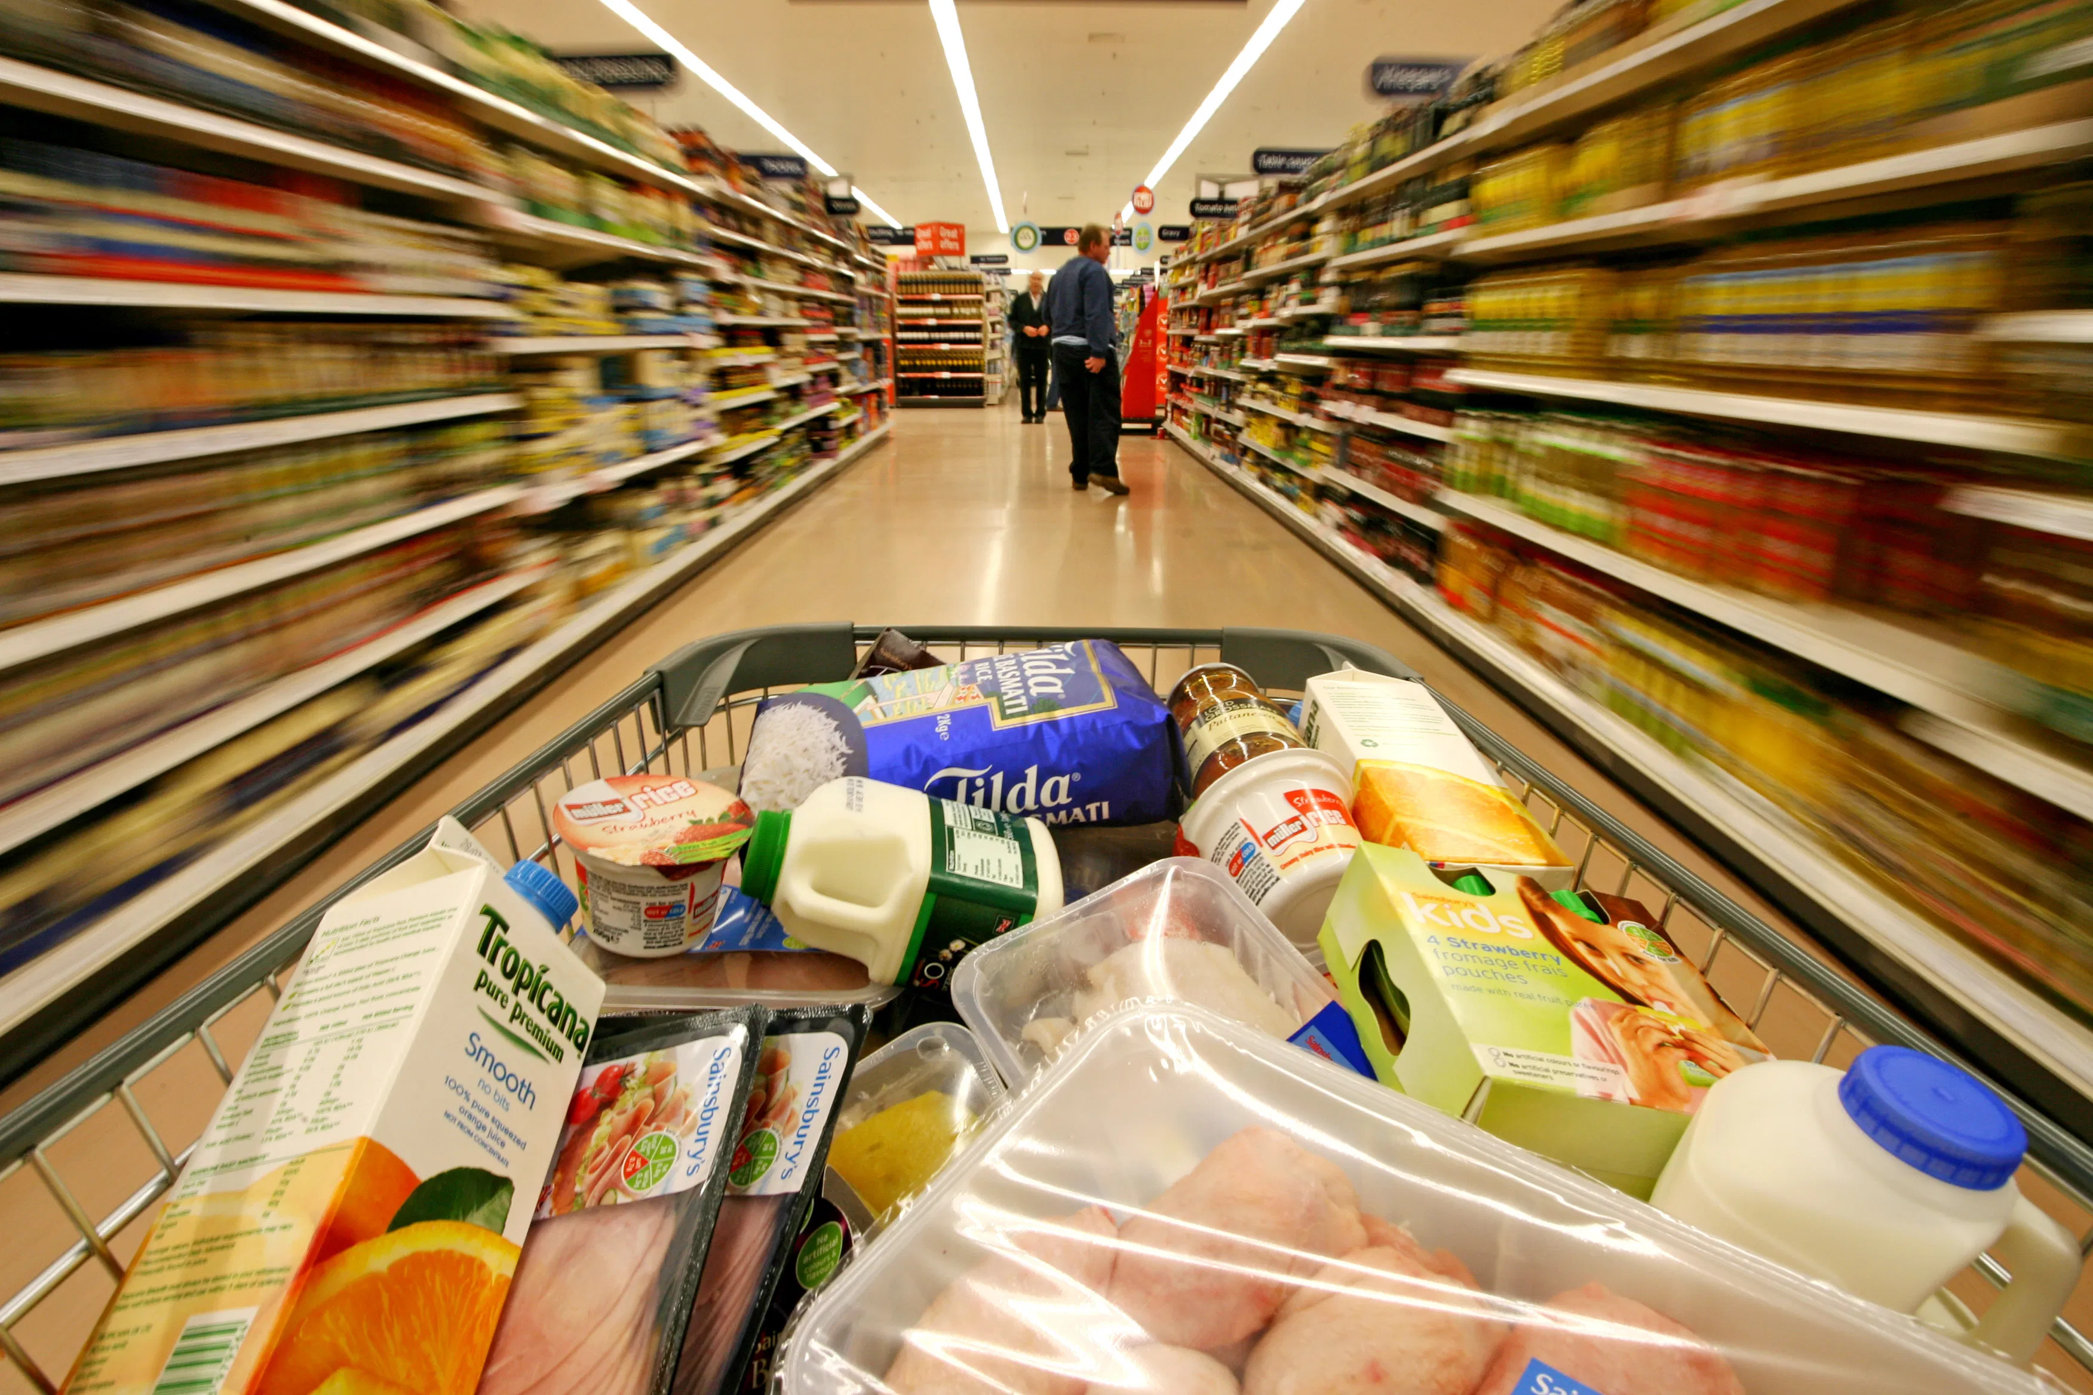

Slide 6
Consumer Buying Decision Process
© zayats-and-zayats
Five stages:
  Problem recognition
  Information search
  Evaluation of alternatives
  Purchase
  Postpurchase evaluation
LO 7-1

Slide 7
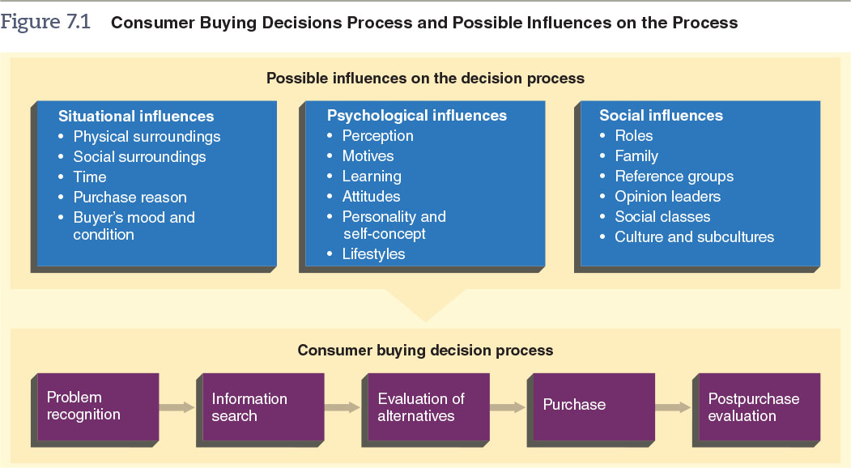
Figure 7.1 – Consumer Buying Decisions Process and Possible Influences on the Process
© zayats-and-zayats
LO 7-1

Slide 8
Problem Recognition Stage
© zayats-and-zayats
Occurs when a buyer becomes aware of a difference between a desired state and an actual condition
  Speed of consumer problem recognition can be rapid or slow
  Some consumers are unaware of their problems or needs
  Marketers use sales personnel, advertising, and packaging to help trigger recognition of such needs or problems
LO 7-1

Slide 9
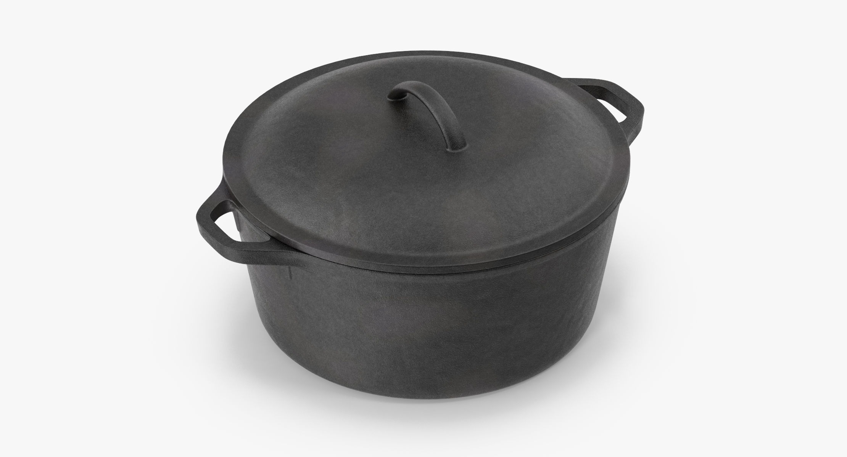

Slide 10
Information Search Stage
© zayats-and-zayats
After recognizing the problem, consumers seek to satisfy their need
Consumers seek out product information
Internal search
  An information search in which buyers search their memories for information about products that might solve their problem
LO 7-1

Slide 11
Information Search Stage
© zayats-and-zayats
External search
  An information search in which buyers seek information from sources other than their memories
    Personal contacts are often influential sources of information
    The Internet has become a major information source during the consumer buying decision process
    Buyers obtain information from independent sources such as government reports, news presentations, and reports from product-testing organizations
LO 7-1

Slide 12
Evaluation of Alternatives
© zayats-and-zayats
Consideration Set
  A group of brands within a product category that a buyer views as alternatives for possible purchase
Evaluative Criteria
  Objective and subjective product characteristics that are important to a buyer
  Marketers can influence customers by framing the alternatives in a certain way
    Framing probably influences the decision processes of inexperienced buyers more than those of experienced ones
LO 7-1

Slide 13
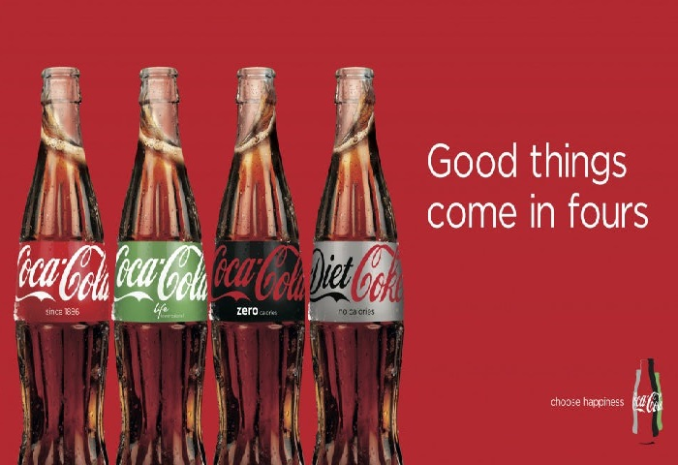

Slide 14
Purchase Stage
© zayats-and-zayats
The buyer:
  Chooses the product or brand to be bought
    Product availability may influence the decision
  Chooses the seller
  Negotiates the terms of the transaction
  Makes the actual purchase or terminates the process
LO 7-1
© 2016 Cengage Learning. All Rights Reserved. May not be copied, scanned, or duplicated, in whole or in part, except for use as permitted in a license distributed with a certain product or service or otherwise on a password-protected website for classroom use.

Slide 15
Postpurchase Evaluation Stage
© zayats-and-zayats
After purchase, the buyer evaluates the product
Does its actual performance meet expected levels?
  Is either satisfied or dissatisfied
Cognitive Dissonance
  A buyer’s doubts shortly after a purchase about whether the decision was the right one
  Often occurs after expensive, high-involvement purchases
LO 7-1

Slide 16
Level of Involvement with Products
© zayats-and-zayats
High-involvement products – Products that are visible to others and/or are expensive
  Healthcare, a home
  Associated with high levels of involvement
Low-involvement products – Products that tend to be less expensive and have less associated social risk
  Grocery items, a T-shirt
LO 7-2

Slide 17
Level of Involvement
© zayats-and-zayats
An individual’s degree of interest in a product and the importance of the product for that person
  Enduring involvement – Ongoing and long-term involvement with a product or product category
  Situational involvement – Temporary or dynamic involvement resulting from a particular set of circumstances
LO 7-2

Slide 18

Discussion Point – Buying Coach
You have decided to buy a coach bag for somebody special. Coach is a luxury leather goods company that specializes in handbags, wallets, briefcases, and luggage. You want this present to be special but cannot purchase anything more than $600. The person you are buying for has very specific tastes in accessories.
  What level of involvement would be appropriate for this shopping experience?
  What influences will be important in determining which handbag you will buy? There can be more than one answer.
  What motive would a consumer have to purchase a Coach bag in particular, using Maslow’s hierarchy?
LO 7-2
Notes:
Answers:
Extended
Psychological—perceptions and attitudes toward this brand are very important to whether it succeeds, as well as personality and self-concept. Social influences could also be important as the Coach brand is seen to be higher status.
Most likely the motive would be for social or esteem purposes since a Coach bag is thought to convey higher status and portrays a certain image about the person.

Slide 19
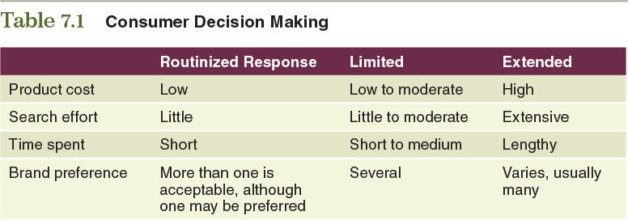
Table 7.1 – Consumer Decision Making
© zayats-and-zayats
LO 7-2

Slide 20


Consumer Decision Making Strategies
© zayats-and-zayats
Consumer
Buying
Behaviors
Routinized
Response
Limited
Problem
Solving
Extended
Problem
Solving
Impulse
Buying
LO 7-2

Slide 21
Consumer Decision Making Strategies
© zayats-and-zayats
Routinized response behavior – A consumer decision-making process used when buying frequently purchased, low-cost items that require very little search-and-decision effort
  Selecting soft drinks or cereals
LO 7-2

Slide 22
Consumer Decision Making Strategies
© zayats-and-zayats
Limited decision making – A consumer decision-making process used when purchasing products occasionally or needing information about an unfamiliar brand in a familiar product category
  Requires a moderate amount of time for information gathering and deliberation
LO 7-2

Slide 23
Consumer Decision Making Strategies
© zayats-and-zayats
Extended decision making – A consumer decision-making process employed when purchasing unfamiliar, expensive, or infrequently bought products
  A car, home, or college education
LO 7-2

Slide 24
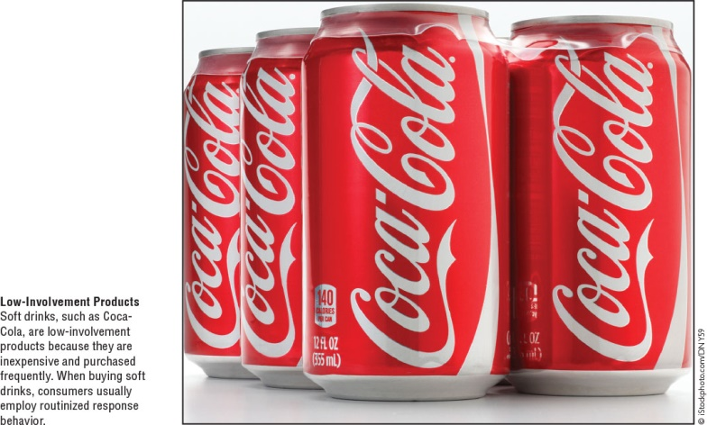
Consumer Decision Making Strategies
© zayats-and-zayats
LO 7-2

Slide 25
Consumer Decision Making Strategies
© zayats-and-zayats
Impulse buying – An unplanned buying behavior resulting from a powerful urge to buy something immediately
  When have you made a purchase solely on impulse?
  Were you satisfied or dissatisfied with the purchase?
LO 7-2

Slide 26
Figure 7.1 – Consumer Buying Decisions Process and Possible Influences on the Process
© zayats-and-zayats
LO 7-3

Slide 27
Situational Influences on the Buying Decision Process
© zayats-and-zayats
Situational
Influences
Physical
Surroundings
Social
Surroundings
Time
Dimension
Purchase
Reason
Mood of
Consumer
LO 7-3

Slide 28
Situational Influences
© zayats-and-zayats
Influences that result from circumstances, time, and location that affect the consumer buying decision process
  Can influence the decision making process at any stage
LO 7-3

Slide 29
Situational Influences
© zayats-and-zayats
Five categories of situational influences:
  Physical surroundings
  Social surroundings
  Time perspective
  Reason for purchase
  Buyer’s momentary mood and condition
LO 7-3

Slide 30
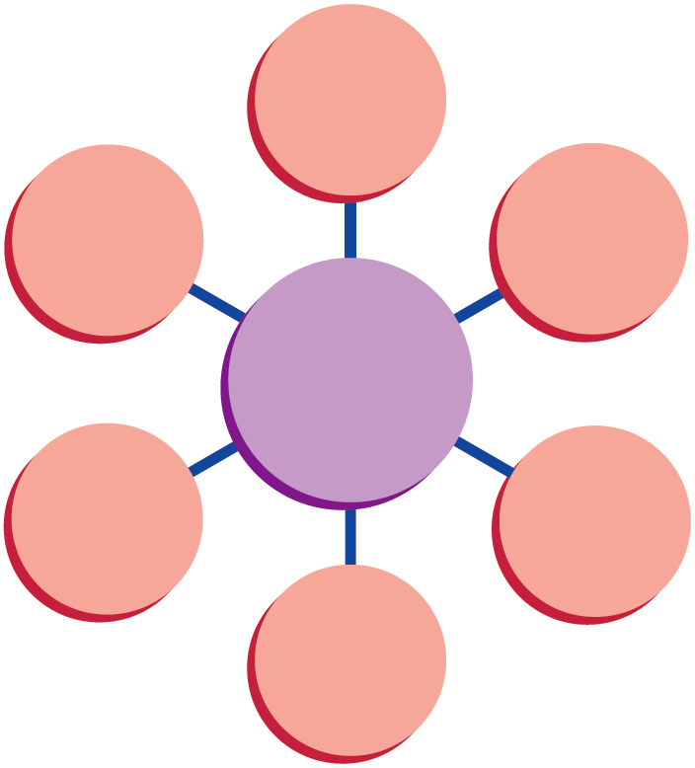
Psychological Influences on the Buying Decision Process
© zayats-and-zayats
Perception
Lifestyle
Motives
Psychological Influences
Personality and Self-Concept
Learning
Attitudes
LO 7-4

Slide 31
Psychological Influences
© zayats-and-zayats
Factors that in part determine people’s general behavior, thus influencing their behavior as consumers
  Operate on buyers internally, but are acted on by outside forces
Six categories of psychological influences:
Perception | Motives
Learning | Attitudes
Personality & self-concept | Lifestyles
LO 7-4

Slide 32
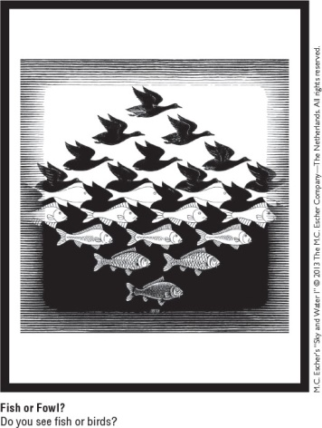
Perception
© zayats-and-zayats
The process of selecting, organizing, and interpreting information inputs to produce meaning
Information inputs
  Sensations received through sight, taste, hearing, smell, and touch
LO 7-4

Slide 33
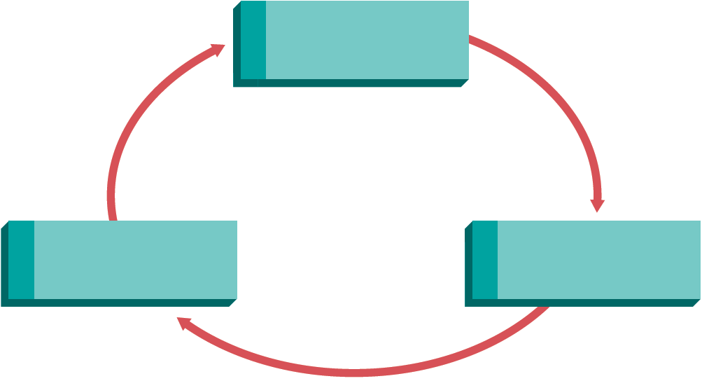
The Perception Process
© zayats-and-zayats
1
Selective Exposure
3
Selective
Retention
2
Selective Distortion
LO 7-4

Slide 34
The Perception Process
© zayats-and-zayats
Selective exposure
  The process by which some inputs are selected to reach awareness and others are not
Selective distortion
  An individual’s changing or twisting of information that is inconsistent with personal feelings or beliefs
Selective retention
  Remembering information inputs that support personal feelings and beliefs and forgetting inputs that do not
LO 7-4

Slide 35
Motives
© zayats-and-zayats
Motive
  An internal energizing force that directs a person’s behavior toward satisfying needs or achieving goals
Maslow’s Hierarchy of Needs
  The five levels of needs that humans seek to satisfy, from most to least important
Patronage Motives
  Motives that influence where a person purchases products on a regular basis
LO 7-4

Slide 36
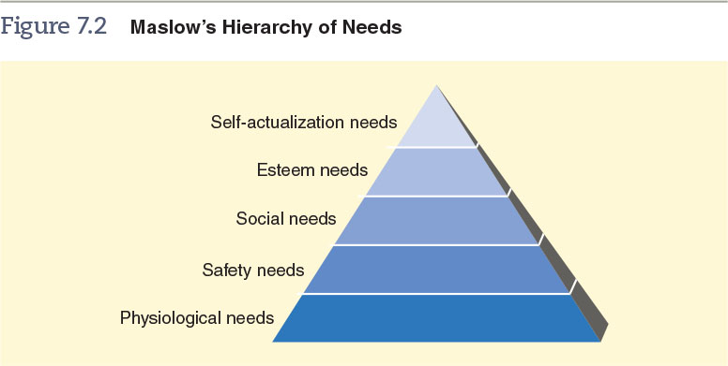
Figure 7.2 – Maslow’s Hierarchy of Needs
© zayats-and-zayats
LO 7-4

Slide 37
Learning
© zayats-and-zayats
Changes in an individual’s thought processes and behavior caused by information and experience
Sources of learning:
  Behavioral consequences
  Information processing
  Experience
LO 7-4

Slide 38
Attitudes
© zayats-and-zayats
An individual’s enduring evaluation of feelings about and behavioral tendencies toward an object or idea
Can be positive or negative
Three major components:
  Cognitive – Knowledge and information
  Affective – Feelings and emotions
  Behavioral – Actions regarding the object or idea
LO 7-4

Slide 39
Role of Attitudes in Decision Making
© zayats-and-zayats
Seeking to understand attitudes has resulted in two major academic models:
  Attitude toward the object (the Fishbein model)
    Can be used to understand, and possibly predict, a consumer’s attitude
  Behavioral intentions model (the Theory of Reasoned Action)
    Rather than focusing on attributes, focuses on intentions to act or purchase
    Considers consumer perceptions of what other people, such as peers, believe is the best choice among a set of alternatives
LO 7-4

Slide 40
Attitude Scales
© zayats-and-zayats
Marketers evaluate attitudes through attitude scales – A means of measuring consumer attitudes by gauging the intensity of individuals’ reactions to adjectives, phrases, or sentences about an object
  Respondents indicate the intensity of their feelings toward the object by reacting to the adjectives, phrases, or sentences in a certain way
  Why are marketers concerned about consumer attitudes?
LO 7-4

Slide 41
Personality
© zayats-and-zayats
A set of internal traits and distinct behavioral tendencies that result in consistent patterns of behavior in certain situations
  There is a weak association between personality and buying behavior
  However, a number of marketers are convinced that consumers’ personalities do influence types and brands of products purchased
  Marketers take aim at personality types in their campaigns
LO 7-4

Slide 42
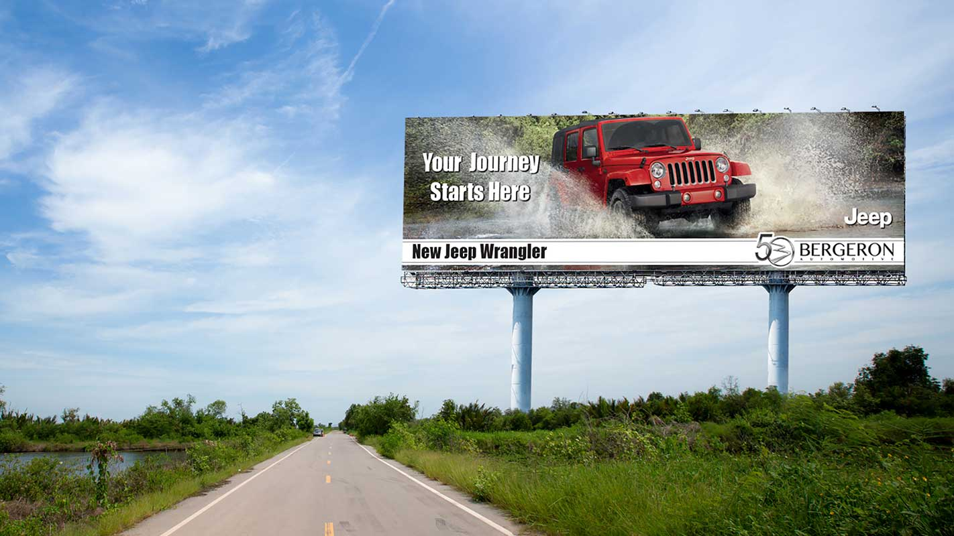

Slide 43
Self-Concept
© zayats-and-zayats
A perception or view of oneself
  Closely linked to personality
  Individuals develop and alter their self-concepts based on an interaction between psychological and social dimensions
Research shows that:
  Buyers purchase products that reflect and enhance their self-concepts
  Purchase decisions are important to the development and maintenance of a stable self-concept
LO 7-4

Slide 44
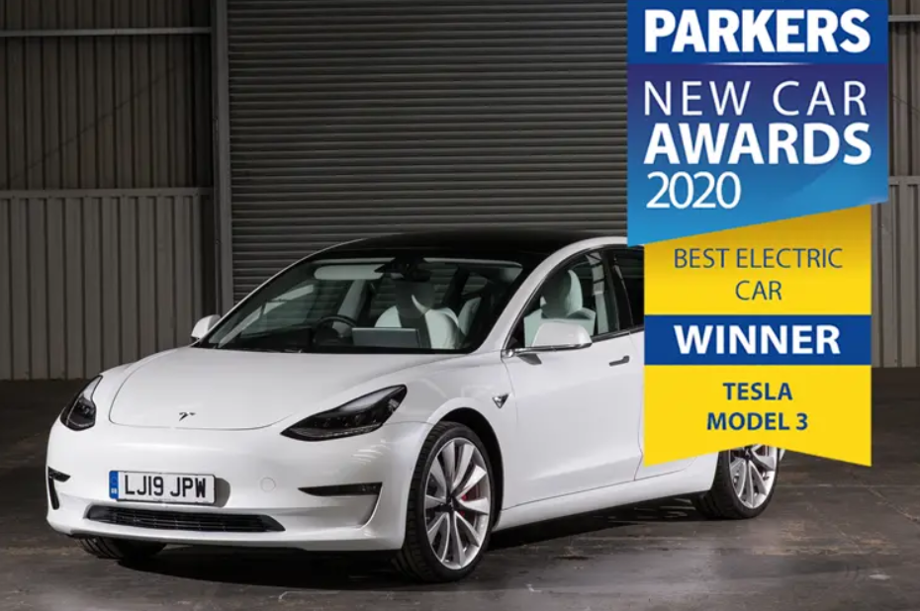

Slide 45
Lifestyles
© zayats-and-zayats
An individual’s pattern of living expressed through activities, interests, and opinions
  Strongly influences the buying decision process
  Many marketers segment markets by lifestyle
  Lifestyles influence consumers’ product needs, brand preferences, types of media used, and how and where they shop
LO 7-4

Slide 46
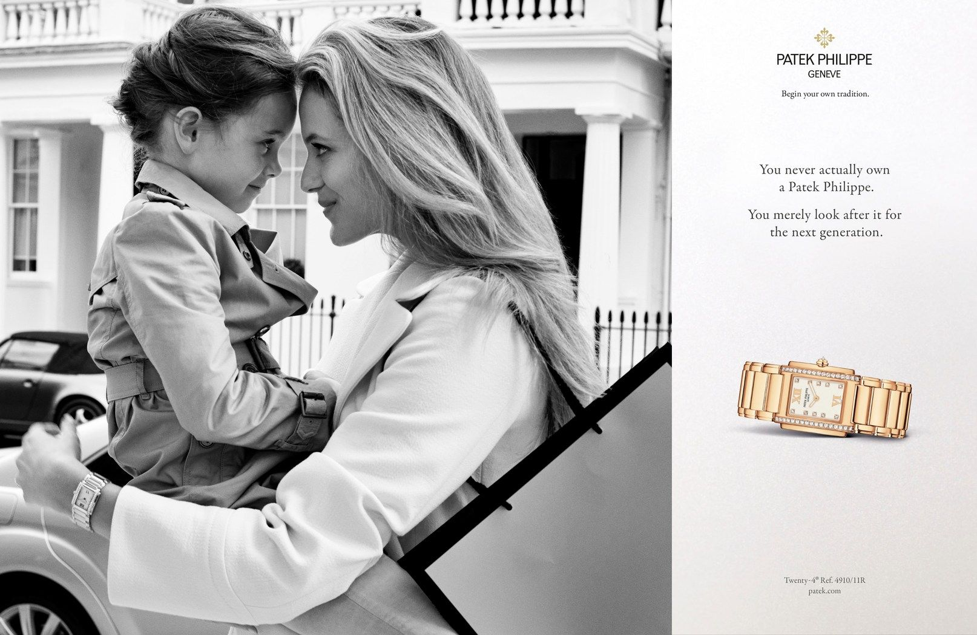

Slide 47
Discussion Point – Apple Products
Apple products are admired for their sleek design and longevity (they tend to last longer than PCs). Look at the different situations below. Determine whether the psychological influence involves learning, self-concept, or attitude.
  Although Martha grew up with PCs, she used Apple computers in the college computer lab and gained an appreciation for the brand’s high quality. She now wants a Mac of her own.
  Fred has strong feels about Apple products, viewing the brand as high-quality. Even negative criticism from his friends about Apple’s newest product does not dissuade him.
  Jenny cares more about what the Apple product says about her than in how it functions.
LO 7-4
Notes:
Answers:
Learning
Attitude
Self-concept

Slide 48
Social Influences on the Buying Decision Process
© zayats-and-zayats
Social
Influences
Roles
Family
Influences
Reference
Groups
Opinion
Leaders
Digital
Networks
Social
Classes
Culture
and
Subcultures
LO 7-5

Slide 49
Social Influences
© zayats-and-zayats
The forces other people exert on one’s buying behavior
  Roles – Actions and activities that a person in a particular position is supposed to perform based on expectations of the individual and surrounding persons
  Family influences have a direct impact on the buying decision process
LO 7-5

Slide 50
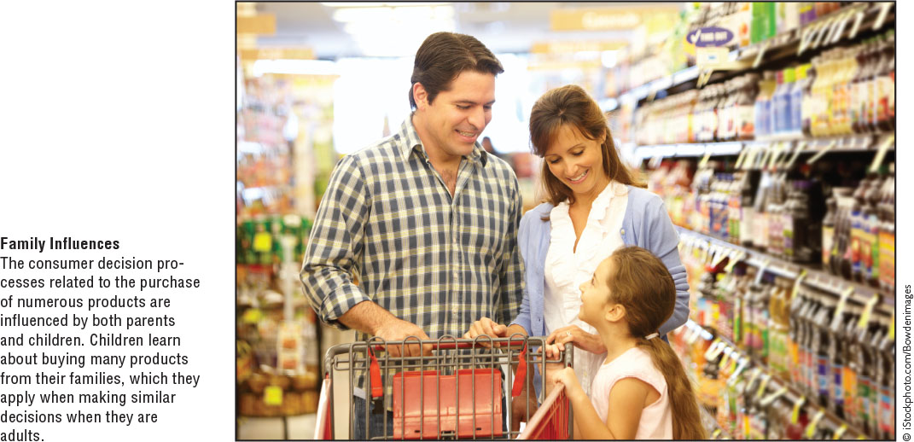
Social Influences
© zayats-and-zayats
Consumer socialization – The process through which a person acquires the knowledge and skills to function as a consumer
LO 7-5

Slide 51
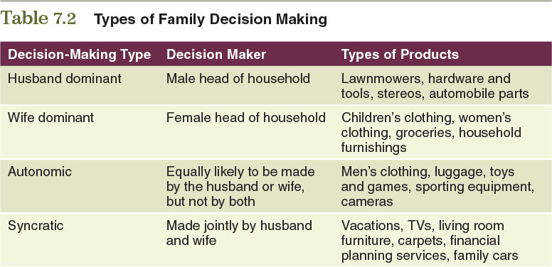
Table 7.2 – Types of Family Decision Making
© zayats-and-zayats
LO 7-5

Slide 52
Social Influences
© zayats-and-zayats
Reference group
  A group that a person identifies with so strongly that he or she adopts the values, attitudes, and behavior of group members
  Types of reference groups:
    Membership – A group to which an individual belongs
    Aspirational – A group to which an individual wants to belong
    Disassociative – A group to which an individual does not want to belong
LO 7-5

Slide 53


Slide 54
Social Influences
© zayats-and-zayats
Opinion leader
  A member of an informal group who provides information about a specific topic to other group members
  Likely to be most influential when:
    consumers have high product involvement but low product knowledge
    They share the opinion leader’s values and attitudes
    The product details are numerous or complicated
LO 7-5

Slide 55
Social Influences
© zayats-and-zayats
Social class
  An open group of individuals with similar social rank:
    Interact most often with those of the same class
    People can move in and out of different groups
    Individuals within social classes develop and assume common behavioral patterns
    Class affects shopping patterns and types of stores frequented
LO 7-5

Slide 56
Culture
© zayats-and-zayats
The accumulation of values, knowledge, beliefs, customs, objects, and concepts that a society uses to cope with its environment and passes on to future generations
  Influences buying behavior because it permeates our daily lives
    Cultural changes affect product development, promotion, distribution, and pricing
    People in other regions of the world have different attitudes, values, and needs, which call for different methods of doing business/types of marketing mixes
LO 7-5

Slide 57
Discussion Point – Targeting Millennials
Millennials are those born between the early 1980s and the turn of the century. Millennials tend to be more collaborative, more into establishing an enjoyable career, appreciate new and exciting things, love quirkiness, embrace change, and are generally characterized as “do-ers.” Which of the following brands would be more likely to appeal to Millennials, based on this description?
  Chevrolet
  Whole Foods
  Apple
  McDonald’s
  Old Navy
  Walmart
LO 7-5
Notes:
Answers:
Reject—Car ownership is actually decreasing among younger people, and there tends to be more favorability toward foreign cars
Accept—Millennials like the organic and local movements
Accept—Apple symbolizes change and technology
Reject—McDonald’s is struggling to re-orient itself to target Millennials
Accept—a very popular brand among Millennials
Probably reject—Again, Walmart is trying to change its image to appeal to Millennials

Slide 58
Ethnic U.S. Subculture
© zayats-and-zayats
  African American – Consumers spend much of their money on depreciable products such as phone services, children’s clothing, and shoes
  Hispanics – Spend more of their income on groceries, phone services, clothing, and shoes, while they spend less than average on health care, entertainment, and education
  Asian Americans – Spend more of their income on housing, clothing, education, and personal insurance, while they spend less than average on vehicles, entertainment, alcohol, and tobacco
LO 7-5

Slide 59
Consumer Misbehavior
© zayats-and-zayats
Behavior that violates generally accepted norms of a particular society
  Shoplifting
  Organized retail crime
  Consumer fraud
  Pirating
  Abusive consumers
LO 7-6

Slide 60


Slide 61
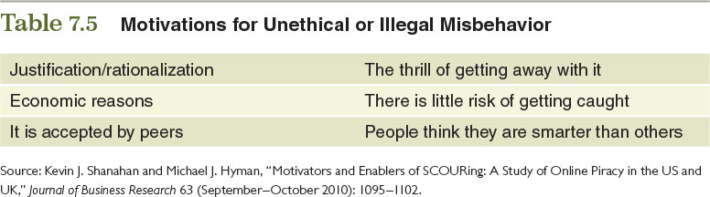
Table 7.5 – Motivations for Unethical or Illegal Misbehavior
© zayats-and-zayats
LO 7-6

Slide 62
Discussion Point – VALS^{PM}
Look at the different descriptions of people below and classify them based on these five categories:
  Jean loves amusement parks because of the thrills involved.
  Shannon purchases TOMS shoes because she strongly supports its mission of providing a pairs of shoes to those in need for every pair sold.
  Donald is always looking for the newest product. He bought Google Glass and the Samsung smart watch as soon as they became available on the market.
  Dana loves to shop at arts-and-craft shows and places like Michaels for products she can use to develop her own artistic creations.
  Phil chose to purchase a Mercedes-Benz because of its reputation as a high-status symbol.
VALS^{PM} is a program developed by the Strategic Business Insights. Five of these categories include innovators, believers, achievers, experiencers, and makers.
LO 7-6
Notes:
Answers:
Experiencer
Believer
Innovator
Maker
Achiever

Slide 63
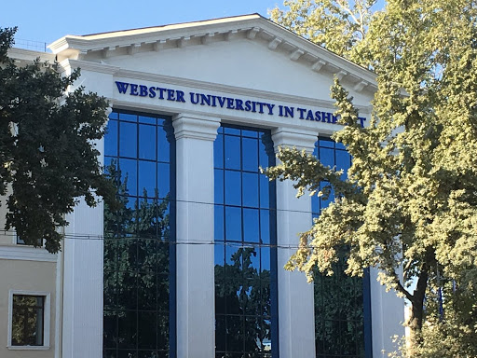
Thank you for your attention!

