Slide 1


Chapter 6
Target Markets: Segmentation and Evaluation
Course Instructor:
Mamurjon Rahimov

Slide 2


Learning Objectives
© zayats-and-zayats
LO 6-1 Explain what markets are and how they are generally classified
LO 6-2 Identify the five steps of the target market selection process
LO 6-3 Describe the differences among three targeting strategies
LO 6-4 Identify the major segmentation variables

Slide 3
Learning Objectives
© zayats-and-zayats
LO 6-5 Explain what market segment profiles are and how they are used
LO 6-6 Explain how to evaluate market segments
LO 6-7 Identify the factors that influence the selection of specific market segments for use as target markets
LO 6-8 Discuss sales forecasting methods

Slide 4
What Are Markets?
© zayats-and-zayats
A market is a group of people, individuals or organizations, who
  Have needs for products in a product class and
  Have the ability, willingness, and authority to purchase such products
A group of people that lacks any of the four requirements does not constitute a market
  Teenagers may have the desire, the money and the willingness to buy alcohol but the law prevents them from having the authority to purchase alcohol
LO 6-1

Slide 5
Two Types of Markets
© zayats-and-zayats
Consumer Market
  Purchasers and household members who intend to consume or benefit from the purchased products and do not buy products to make profits
Business Market
  Individuals, organizations or groups that purchase a specific kind of product for resale, direct use in producing other products or use in general daily operations
LO 6-1

Slide 6
Consumer Markets
© zayats-and-zayats
Also referred to as business-to-consumer (B2C) markets
Each of us belongs to numerous consumer markets
LO 6-1

Slide 7
Business Markets
© zayats-and-zayats
Also referred to as business-to-business (B2B), industrial, or organizational markets
Business markets can be classified into:
  Producer
  Reseller
  Government
  Institutional
LO 6-1

Slide 8
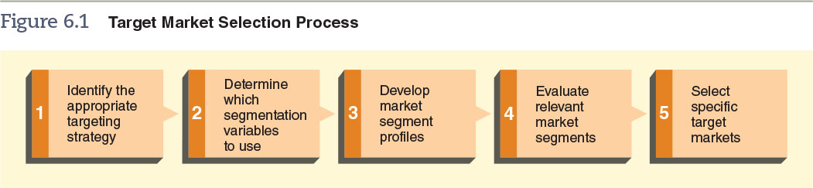
Figure 6.1 – Target Market Selection Process
© zayats-and-zayats
LO 6-2

Slide 9
Step 1: Identify Appropriate Targeting Strategy
© zayats-and-zayats
Target Market
  A group of people or organizations for which a business creates and maintains a marketing mix specifically designed to satisfy the needs of group members
  The strategy used to select a target market is affected by:
    Target market characteristics
    Product attributes
    The organization’s objectives and resources
LO 6-3

Slide 10
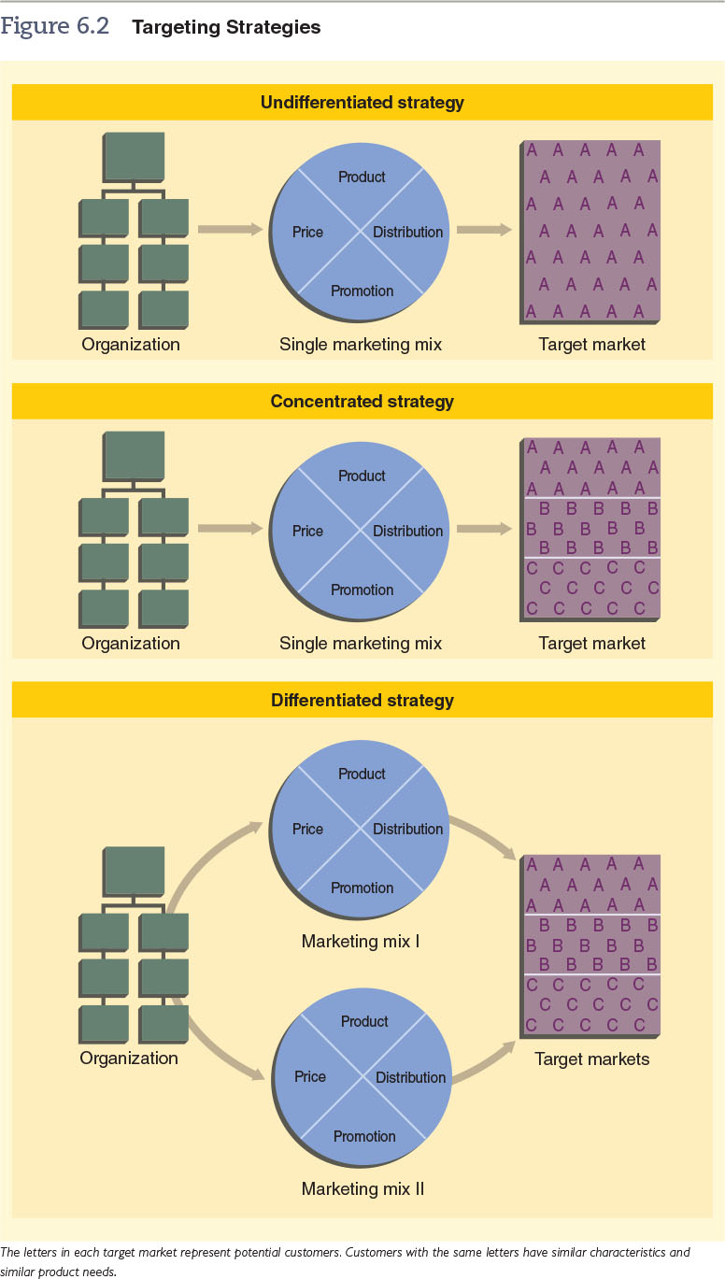
Figure 6.2 – Targeting Strategies
© zayats-and-zayats
LO 6-3

Slide 11
Figure 6.2 – Targeting Strategies (cont.)
© zayats-and-zayats
LO 6-3

Slide 12
Undifferentiated Strategy
© zayats-and-zayats
Undifferentiated targeting strategy means a company designs a single marketing mix and directs it at the entire market
  Effective for homogeneous markets where a large proportion of people in a target market have similar needs for a product
This strategy consists of:
One type of product | One price
One promotional program | One distribution channel
LO 6-3

Slide 13
Market Segmentation
© zayats-and-zayats
Market Segmentation is the process of dividing a total market into groups of customers with similar product needs and designing a marketing mix to meet those needs
  Used for heterogeneous markets made up of individuals or organizations with diverse needs for products in a specific product class
LO 6-3

Slide 14
Market Segmentation
© zayats-and-zayats
Market segments consist of customers that share one or more similar characteristics causing them to have similar product needs
  Smaller groups allow a tailored marketing mix
LO 6-3

Slide 15
Market Segmentation
© zayats-and-zayats
For market segmentation to succeed, five conditions must exist:
  Customer’s needs must be heterogeneous
  Segments must be identifiable and divisible
  Segments must be comparable to one another with respect to estimated sales potential, costs and profits
  One segment must show enough profit potential to justify developing a special marketing mix
  The firm must be able to reach the chosen segment with a particular marketing mix
LO 6-3

Slide 16
Concentrated Strategy
© zayats-and-zayats
A concentrated targeting strategy means a company targets a single market segment using one marketing mix
Advantages | Disadvantages
Allows specialization | Profits fall with demand
A small firm can compete | Difficult to diversify
LO 6-3

Slide 17
Differentiated Strategy
© zayats-and-zayats
With a differentiated targeting strategy, an organization directs its marketing efforts at two or more segments, developing a marketing mix for each segment
Advantages | Disadvantages
Could mean increased sales | Production costs are higher
Uses excess production capacity
LO 6-3

Slide 18

Discussion Point – Identify the Targeting Strategy
Look at the six types of products below. Identify whether each product would require an undifferentiated, concentrated, or differentiation targeting strategy.
  Baking soda
  Mont Blanc pens
  iPhones
  Lululemon yoga gear
  Tesla automobiles
  Black pepper
LO 6-3
Notes:
Answers:
Undifferentiated
Concentrated
Differentiated
Differentiated
Concentrated
Undifferentiated

Slide 19
Step 2: Segmentation Variables
© zayats-and-zayats
Segmentation variables are the characteristics of individuals, groups or organizations used to divide a market into segments
  Several variables are often used in combination
  When selecting a segmentation variable, several factors are considered:
    Variable should relate to the customers’ needs for, uses of or behavior toward the product
    Variable must be measurable
    Company resources and capabilities
    Product type and variations in customer needs
LO 6-4

Slide 20
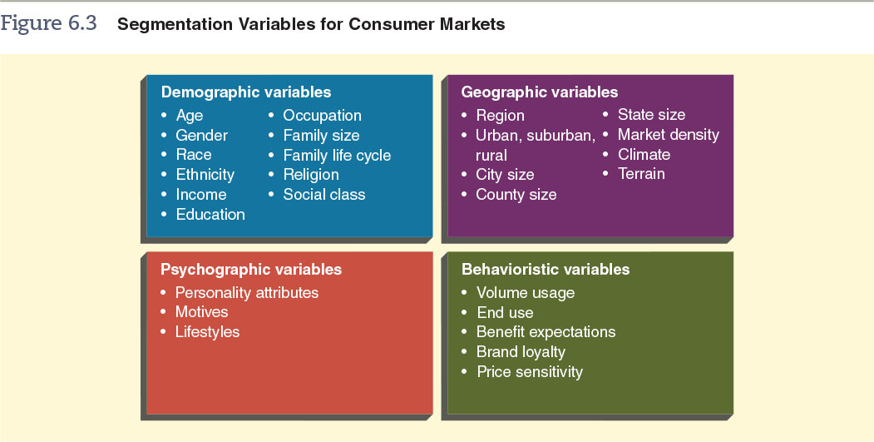
Figure 6.3 – Segmentation Variables for Consumer Markets
© zayats-and-zayats
LO 6-4

Slide 21
Demographic Variables: Age
© zayats-and-zayats
By 2025
  Age groups under 55 expected to decrease
  Age groups 55 and older expected to increase
LO 6-4

Slide 22
Demographic Variables: Gender
© zayats-and-zayats
The magazine market is a market segmented by gender
Can you think of other examples?
LO 6-4

Slide 23
Demographic Variables
© zayats-and-zayats
  Marketers use race and ethnicity to target segments for products such as:
  Income is a variable affecting a person’s ability to purchase and affecting their desires for certain lifestyles, products affected include:
Food | Music | Clothing
Cosmetics | Banking | Insurance
Sporting goods | Housing | Furniture
Cosmetics | Clothing | Jewelry
Home appliances | Automobiles | Electronics
LO 6-4

Slide 24
Demographic Variables: Family Life Cycle
© zayats-and-zayats
Characteristics
  Marital status
  Number and age of children
Factors affecting the family life cycle:
  Single parent families are on the rise
  The median marrying age is increasing
LO 6-4

Slide 25
Discussion Point – American Eagle Outfitters
American Eagle Outfitters sells jeans, polo shirts, T-shirts, swimsuits, and more. The company has become very popular among teenagers and young adults of both genders. The target market for the retailer is between the ages of 15 to 25. It is frequently located in malls and sells apparel at prices generally considered to be affordable.
  What appears to be the key variable in segmenting American Eagle’s target market?
  American Eagle wants to open a store in a medium-sized city, but it needs to assess the competition before making a final decision. Which stores are likely to compete against American Eagle?
LO 6-4
Notes:
Answers:
Demographic due to age
Some answers are Abercrombie & Fitch, Hollister, Aeropostale Inc., or the Gap.

Slide 26
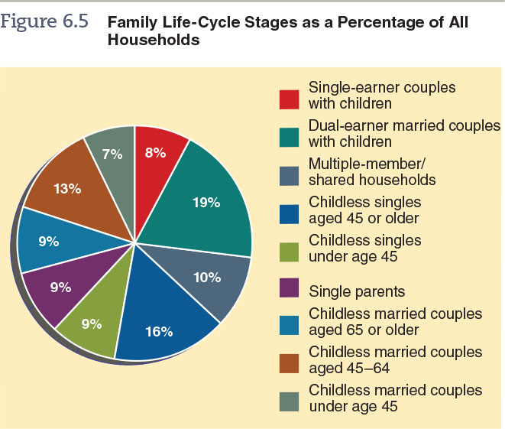
Figure 6.5 – Family Life-Cycle Stages as a Percentage of All Households
© zayats-and-zayats
LO 6-4

Slide 27
Geographic Variables
© zayats-and-zayats
Markets may be divided by any of these geographic variables:
Market density refers to the number of potential customers within a unit of land area
  Not the same as population density
Climate | Regions of the U.S.
City size | Zip code area
Terrain | Population density
LO 6-4

Slide 28
Geodemographic Segmentation
© zayats-and-zayats
Clusters people in zip code areas and even smaller neighborhood units based on lifestyle and demographic information
Micromarketing focuses precise marketing efforts on very small geographic markets
  Can be as small as communities or neighborhoods
  Some retailers tailor the merchandise by each store using micromarketing
LO 6-4

Slide 29
Psychographic Variables
© zayats-and-zayats
Psychographic variables, such as personality characteristics, motives and lifestyles, are sometimes used to segment markets
  Marketers choose a positive trait and assume most people either have the trait or desire to have
  Examples of motivational consuming include personal appearance, status, safety and health
  Lifestyle segments group people according to their activities, interests and opinions
LO 6-4

Slide 30
Psychographic Variables: Lifestyle
© zayats-and-zayats
Lifestyle segmentation groups people by:
  How they spend their time
  The importance of things in their surroundings
  Beliefs about themselves and broad issues
LO 6-4

Slide 31
Psychographic Variables: VALS
© zayats-and-zayats
One of the most popular lifestyle frameworks is VALSTM
  VALS classifies consumers based on psychological characteristics correlated with purchase behavior and key demographics
  VALS can be used to determine lifestyle choices
  VALS research is used to create new products as well as segment existing markets
LO 6-4

Slide 32
Behavioristic Variables
© zayats-and-zayats
Markets can be divided according to some feature of consumer behavior toward a product, usually some aspect of product use
  Such as heavy, moderate or light use and nonusers
  Benefit segmentation is the division of a market according to benefits consumers want from the product
    If used, the segment must be identifiable, recognizable and accessible to marketing efforts
LO 6-4

Slide 33
Discussion Point – Skullcandy
Skullcandy founder Rick Alden got the idea to develop trendy, functional headphones for music lovers who enjoy active sports and want to look fashionable. Age is a consideration as customers tend to be younger, but Skullcandy products are geared more toward sports enthusiasts. Skullcandy earbuds are brightly colored to appeal to sport-lovers who care about fashion. They come in different styles and designs for both genders.
  From the description above, which type of variable is most important in segmenting Skullcandy’s target market: demographic, geographic, psychographic, or behavioristic?
  Do you think Skullcandy has an undifferentiated, concentrated, or differentiated target strategy?
LO 6-4
Notes:
Answers:
Psychographic because it involves lifestyle and personality attributes; age (demographic) is a variable, but not as important as lifestyle
Most likely a differentiated target strategy due to the different varieties available

Slide 34
Segmenting Business Markets
© zayats-and-zayats
Like consumer markets, business markets are frequently segmented, often by multiple variables in combination
Marketers segment business markets according to
  Geographic location
  Type of organization
  Customer size
  Product use
LO 6-4

Slide 35
Step 3: Market Segment Profile
© zayats-and-zayats
A market segment profile
  Describes the similarities of potential customers within a segment
  Explains the differences among people and organizations in different segments
Profiles benefits marketers in several ways
  Information included in the profiles can be highly useful in making marketing decision
  Used to assess the degree to which the firm’s products can match potential customers’ product needs
LO 6-5

Slide 36
Step 4: Evaluate Market Segments
© zayats-and-zayats
After analyzing the segment profiles, a marketer has identified several relevant market segments which require further analysis
Several factors should be analyzed, including:
  Sales estimates
  Competition
  Estimated costs
LO 6-6

Slide 37
Sales Estimate
© zayats-and-zayats
Sales estimates can be measured along several dimensions including:
  Product level
  Geographic area
  Time
  Level of competition
LO 6-6

Slide 38
Market Potential
© zayats-and-zayats
Market potential is the total amount of a product customers will purchase within a specified period at a specific level of industry wide marketing activity
  Affected by economic, soiciocultural and other environmental forces
  Marketers must assume a certain level of marketing effort in the industry
  Marketers must also consider whether and to what extent industry marketing efforts will change
LO 6-6

Slide 39
Company Sales Potential
© zayats-and-zayats
Company sales potential is the maximum percentage of market potential a firm can expect for a specific product
  Influencing factors:
    Market potential places absolute limits on sales potential
    Industrywide marketing indirectly impacts sales potential
    Intensity and effectiveness of marketing activities compared to competitors marketing activities
LO 6-6

Slide 40
Company Sales Potential
© zayats-and-zayats
Two general approaches that measure company sales potential are:
  Breakdown approach – measuring company sales potential based on a general economic forecast for a specific period and the market potential derived from it
  Buildup approach – measuring company sales potential by estimating how much of a product a potential buyer in a specific geographic area will purchase in a given period, multiplying the estimate by the number of potential buyers, and adding the totals of all the geographic areas considered
LO 6-6

Slide 41
Competitive Assessment
© zayats-and-zayats
Without competitive assessment, sales estimates can be misleading
  The following questions need answered for a competitive assessment:
    How many competitors exist?
    What are their strengths and weaknesses?
    Do several competitors have a major market share?
    Can we create a competitive marketing mix?
    Will new competitors enter this segment?
    If so, can we still compete successfully?
LO 6-6

Slide 42
Cost Estimates
© zayats-and-zayats
Developing and maintaining a marketing mix that fulfills the needs of the a target segment, is expensive
Factors affecting costs include:
  Distinctive product features
  Attractive package design
  Generous product warranties
  Extensive advertising
  Attractive promotional offers
  Competitive prices
  High quality personal service
LO 6-6

Slide 43
Step 5: Select Target Markets
© zayats-and-zayats
In selecting a target market, it must be determined if the customers’ needs differ enough to warrant use of market segmentation
Segmentation analysis will show if the customers’ needs are homogeneous and would benefit from an undifferentiated targeting strategy
LO 6-7

Slide 44
Step 5: Select Target Markets
© zayats-and-zayats
Or, if the customers’ needs are heterogeneous, one or more target markets must be selected
Assuming one or more segments offer significant opportunities, marketers must decide in which segments to participate
LO 6-7

Slide 45
Step 5: Select Target Markets
© zayats-and-zayats
After identifying the target market, the company needs a sales forecast which differs from sales potential
  Sales forecast is the amount of a product a company expects to sell during a specific period at a specific level of marketing activities
  There are a number of forecasting methods falling into five categories:
Executive Judgment | Surveys
Time Series Analysis | Market Tests
Regression Analysis
LO 6-7

Slide 46
Executive Judgment
© zayats-and-zayats
Executive judgment is a sales forecasting method based on the intuition of one or more executives
  This approach is unscientific but fast and cheap
  May work when product demand is stable and the forecaster has years of market-related experience
  Such forecasts may be too optimistic or pessimistic
  The forecaster is using past experience to predict the future
LO 6-8

Slide 47
Forecasting Survey
© zayats-and-zayats
Customer forecasting survey is a survey of customers regarding the types and quantities of products they intend to buy during a specific period
  Useful to a business with few customers
Sales force forecasting survey is a survey of a firm’s sales force regarding anticipated sales in their territories for a specified period
  Salespeople are closer to customers and know more about their needs
LO 6-8

Slide 48
Forecasting Surveys
© zayats-and-zayats
Expert forecasting survey is sales forecasts prepared by experts outside the firm, such as economists, management consultants, advertising executives or college professors
  Expedient and relatively inexpensive but outsiders may be less motivated to do a effective job
LO 6-8

Slide 49
Forecasting Surveys
© zayats-and-zayats
The Delphi technique is a procedure in which experts create initial forecasts, submit them to the company for averaging, and then refine the forecasts
  The ultimate goal in using this technique is to develop a highly accurate sales forecast
LO 6-8

Slide 50
Time Series Analysis
© zayats-and-zayats
Time series analysis is a forecasting method that uses historical sales data to discover patterns in the firm’s sales over time and generally involves trend, cycle, seasonal and random factor analyses
LO 6-8

Slide 51
Time Series Analysis
© zayats-and-zayats
  Trend analysis - Focuses on aggregate sales date over a period of many years to determine general trends in annual sales
  Cycle analysis - Analysis of sales figures for a three to five year period to ascertain whether sales fluctuate in a consistent, periodic manner
LO 6-8

Slide 52
Time Series Analysis
© zayats-and-zayats
Seasonal analysis - Analysis of daily, weekly or monthly sales figures to evaluate the degree to which seasonal factors influence sales
Random factor analysis - An analysis attempting to attribute erratic sales variations to random, nonrecurring events
LO 6-8

Slide 53
Regression Analysis
© zayats-and-zayats
Regression analysis is a method of predicting sales based on finding a relationship between past sales and one or more independent variables, such as population or income
  Simple regression analysis uses one of the independent variables
  Multiple regression analysis uses two or more independent variables
LO 6-8

Slide 54
Discussion Point – Spicy Salsa
The Southwestern United States loves spicy food, particularly in New Mexico. New Mexicans take their salsa seriously, so seriously that the state vegetable is the chile pepper. Hot salsa is popular among New Mexico residents of all demographics. For this reason, a salsa manufacturing company decided to introduce a new super-hot product in the surrounding New Mexico area.
  What is the key variable in segmenting the market for this new product?
  For this new product, which would likely make the best sales forecast: time series analysis, regression analysis, or market test?
LO 6-8
Notes:
Answers:
Geographic variable
Market test most likely, because time series analysis and regression analysis depends on historical sales data. Since this is a new product, there won’t be historical sales data available.

Slide 55
Market Tests
© zayats-and-zayats
A market test makes a product available to buyers in one or more areas and measures purchases and consumer responses to distribution, promotion and price
LO 6-8

Slide 56
Market Tests
© zayats-and-zayats
  Advantages
    Effective for new products
    Also effective for introducing existing products in a new geographic area
  Disadvantages
    Time consuming and expensive
    Not guaranteed replication from the test market to the national market
LO 6-8

Slide 57
Multiple Forecasting Methods
© zayats-and-zayats
Most firms use several forecasting techniques for a variety of reasons:
  Use multiple methods when marketing diverse product lines
  May use multiple methods for a single product line when sold in different market segments
  Variation in the length of needed forecasts may call for using several methods
  Sometimes a marketer verifies results of one method by using one or more other methods and comparing outcomes
LO 6-8

Slide 58

Thank you for your attention!

