Slide 1


Chapter 5
Marketing Research and
Information Systems
Course Instructor:
Mamurjon Rahimov

Slide 2


Learning Objectives
© zayats-and-zayats
LO 5-1 Define marketing research and its importance to decision makers
LO 5-2 Distinguish between exploratory and conclusive research
LO 5-3 Name the five basic steps in conducting marketing research, including the two types of data and four survey methods
LO 5-4 Describe the tools, such as databases, big data, decision support systems, and the Internet, useful to marketing decision making
LO 5-5 Identify ethical and international issues in marketing research

Slide 3
Marketing Research
© zayats-and-zayats
The systematic design, collection, interpretation, and reporting of information to help marketers solve specific marketing problems or take advantage of marketing opportunities
  It is a process for gathering information that is not currently available to decision makers
  Purpose is to inform an organization about:
    Customers’ needs and desires
    Marketing opportunities for particular goods and services
    Changing attitudes and purchase patterns of customers
LO 5-1

Slide 4
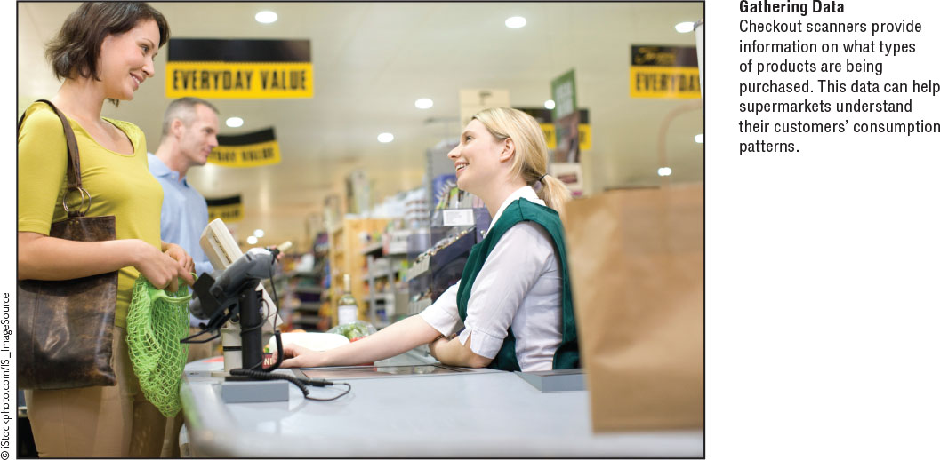
Marketing Research
© zayats-and-zayats
LO 5-1

Slide 5
Benefits of Marketing Research
© zayats-and-zayats
Facilitates strategic planning
Assesses opportunities/threats
Ascertains potential for success
Helps determine feasibility of a strategy
Improves marketer’s ability to make decisions
LO 5-1

Slide 6
Types of Research
© zayats-and-zayats
Marketing research can involve two forms of data:
  Qualitative data yields descriptive non-numerical information
  Quantitative data yields empirical information that can be communicated through numbers
Marketers conduct either exploratory research or conclusive research
LO 5-2

Slide 7
Exploratory Research
© zayats-and-zayats
Research conducted to gather more information about a problem or to make a tentative hypothesis more specific
  How are consumers’ car buying habits changing?
To better understand a problem or situation and/or to help identify additional data needs or decision alternatives
LO 5-2

Slide 8
Exploratory Research
© zayats-and-zayats
Customer advisory boards
  Small groups of actual customers who serve as sounding boards for new-product ideas and offer insights into their feelings and attitudes toward a firm’s products and other elements of its marketing strategy
Focus group
  A study in which a small group of 8-12 people are interviewed often informally, without a structured questionnaire, to observe interaction when members are exposed to an idea or a concept
LO 5-2

Slide 9

Exploratory Research
© zayats-and-zayats
LO 5-2

Slide 10
Conclusive Research
© zayats-and-zayats
Research designed to verify insights through objective procedures and to help marketers in making decisions
  What percentage of consumers will consider an electric car purchase?
Used when the marketer has one or more alternatives in mind and needs assistance in the final stages of decision making
LO 5-2

Slide 11
Conclusive Research
© zayats-and-zayats
Descriptive Research – Research conducted to clarify the characteristics of certain phenomena to solve a particular problem
  Demands prior knowledge
  Assumes problem is clearly defined
  May require statistical analysis
LO 5-2

Slide 12
Conclusive Research
© zayats-and-zayats
Experimental Research – Research that allows marketers to make causal inferences about relationships
  Provides strong evidence of cause and effect
  Need a dependent variable and independent variable(s) in order to set-up research project
LO 5-2

Slide 13
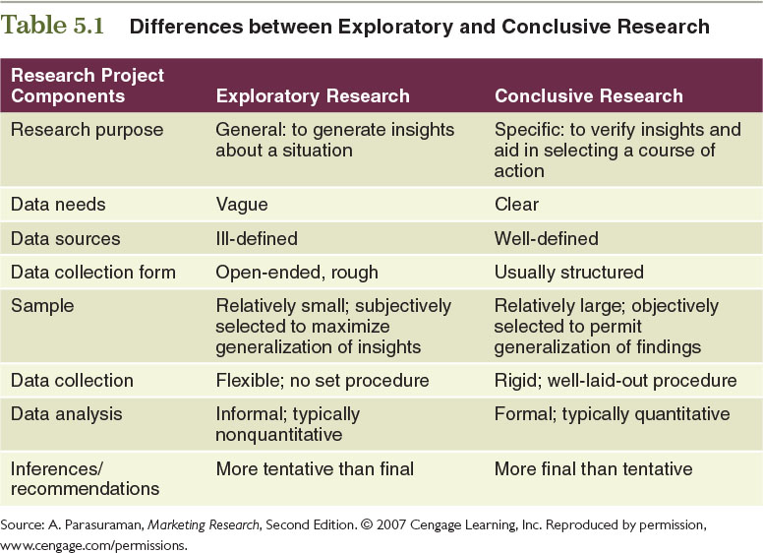
Table 5.1 – Differences between Exploratory and Conclusive Research
© zayats-and-zayats
LO 5-2

Slide 14
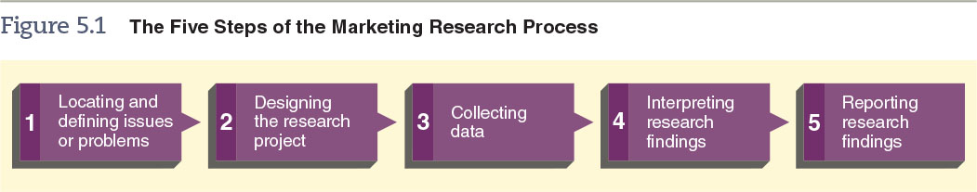
Figure 5.1 – The Five Steps of the Marketing Research Process
© zayats-and-zayats
LO 5-3

Slide 15
Step 1: Locating and Defining Problems of Research Issues
© zayats-and-zayats
Focus on uncovering the nature and boundaries of a situation
  The first sign of a problem is a departure from normal or expected results
Define the problem
Research will often be in-depth
LO 5-3

Slide 16
Defining the Problem
© zayats-and-zayats
Marketers must define the nature and scope of the situation in order to pin down the problem
  Determine precisely what is the aim of research
  Researchers and decision makers should remain in the problem or issue definition stage until they have determined precisely what they want from marketing research and how they will use it
LO 5-3

Slide 17
Step 2: Designing the Research Project
© zayats-and-zayats
Research Design
  An overall plan for obtaining the information needed to address a research problem or issue
Hypothesis
  An informed guess or assumption about a certain problem or set of circumstances
  Accepted or rejected hypotheses act as conclusions for the research effort
LO 5-3

Slide 18
Reliability and Validity
© zayats-and-zayats
Reliability
  A condition that exists when a research technique produces almost identical results in repeated trials
Validity
  A condition that exists when a research method measures what it is supposed to measure
LO 5-3

Slide 19
Step 3: Collecting Data
© zayats-and-zayats
Primary Data
  Data observed and recorded or collected directly from respondents
  Is collected to address a specific problem that cannot be answered by secondary data alone
Secondary Data
  Data compiled both inside and outside the organization for some purpose other than the current investigation
LO 5-3

Slide 20
Methods of Collecting
Primary Data
© zayats-and-zayats
Population
  All the elements, units, or individuals of interest to researchers for a specific study
Sample
  A limited number of units chosen to represent the characteristics of a total population
Sampling
  The process of selecting representative units from a total population
LO 5-3

Slide 21



How Types of Sampling Align
© zayats-and-zayats
Sampling
Probability
Nonprobability
Random Sampling
Stratified Sampling
Quota
LO 5-3

Slide 22
Probability Sampling
© zayats-and-zayats
A type of sampling in which every element in the population being studied has a known chance of being selected for study
  Random Sampling – All units in a population have an equal chance of appearing in the sample, and the various events that occur have an equal or known chance of taking place
  Stratified Sampling – The population is divided into groups with a common attribute and a random sample is chosen within each group
LO 5-3

Slide 23
Nonprobability Sampling
© zayats-and-zayats
A sampling technique in which there is no way to calculate the likelihood that a specific element of the population being studied will be chosen
  Quota Sampling – A nonprobability sampling technique in which researchers divide the population into groups and then arbitrarily choose participants from each group
LO 5-3

Slide 24
Survey Methods
© zayats-and-zayats
Mail survey – A research method in which respondents answer a questionnaire sent through the mail
Telephone survey – A research method in which respondents’ answers to a questionnaire are recorded by an interviewer on the phone
  Telephone depth interview – An interview that combines the traditional focus group’s ability to probe with the confidentiality provided by telephone surveys
LO 5-3

Slide 25
Survey Methods
© zayats-and-zayats
Personal interview survey – A research method in which participants respond to survey questions face-to-face
  In-home (door-to-door) interview – A personal interview that takes place in the respondent’s home
LO 5-3

Slide 26
Survey Methods
© zayats-and-zayats
Shopping mall intercept interview – A research method that involves interviewing a percentage of individuals passing by “intercept” points in a mall
  On-site computer interview – A variation in which respondents complete a self-administered questionnaire displayed on a computer monitor
LO 5-3

Slide 27
Benefits of a Personal Interview
© zayats-and-zayats
Establishes rapport
More in-depth interviewing:
  Probes
  Follow-up questions
  Psychological tests
Longer in duration
LO 5-3

Slide 28
Benefits of a Personal Interview
© zayats-and-zayats
Yields more information
Respondents can be carefully selected, reasons for nonresponse explored
Gives the interviewer greater flexibility
LO 5-4

Slide 29
Survey Methods
© zayats-and-zayats
Online survey – A research method in which respondents answer a questionnaire via e-mail or on a website
  Marketers can use digital media forums such as chat rooms, blogs, newsgroups, social networks, and research communities to identify trends in interests and consumption patterns
  What are the advantages and disadvantages of using these forums for conducting surveys?
LO 5-4

Slide 30
Survey Methods
© zayats-and-zayats
Crowdsourcing – Combines the words crowd and outsourcing and calls for taking tasks usually performed by a marketer or researcher and outsourcing them to a crowd, or potential market, through an open call
  A way for marketers to gather input straight from willing consumers and to actively listen to people’s ideas and evaluations on products
LO 5-5

Slide 31
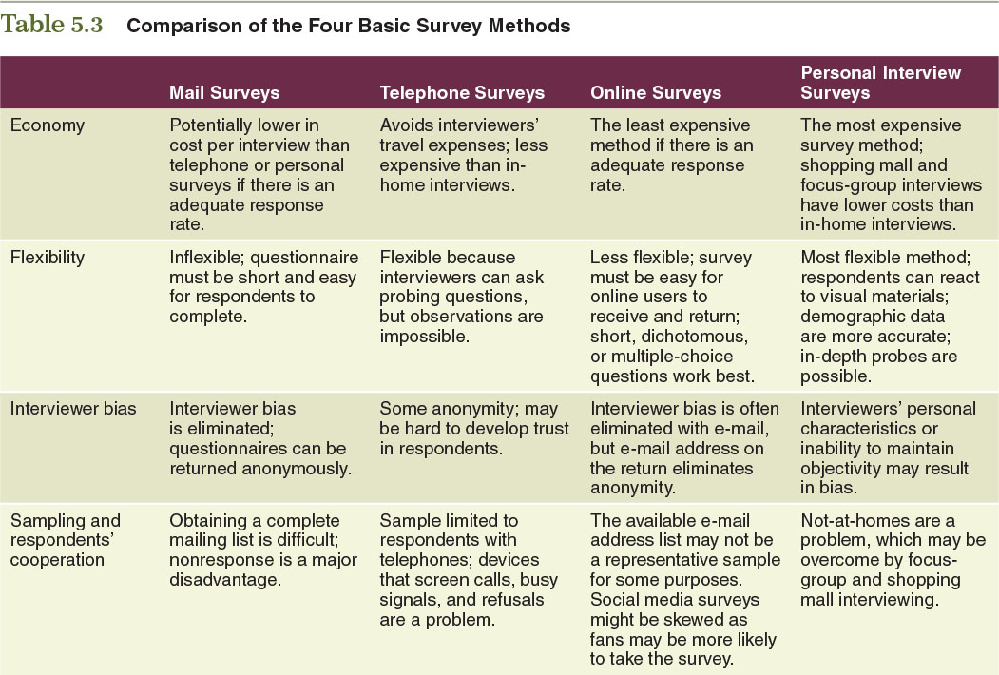
Table 5.3 – Comparison of the Four Basic Survey Methods
© zayats-and-zayats
LO 5-3

Slide 32
Questionnaire Construction
© zayats-and-zayats
Questions must be clear, easy to understand, and directed toward a specific objective
  Designed to elicit information that meets the study’s data requirements
  Maintain impartiality
  Avoid or reword questions that a respondent might consider too personal or that might require an admission of activities that other people are likely to condemn
LO 5-3

Slide 33
Observation Methods
© zayats-and-zayats
Avoid direct contact with subject to reduce possible awareness of observation process
Note physical conditions, subject’s actions and demographics
LO 5-3

Slide 34
Observation Methods
© zayats-and-zayats
Observation may include the use of ethnographic techniques, such as watching customers interact with a product in a real-world environment
Observation may be combined with interviews
Data gathered may be influenced by observer bias
LO 5-3

Slide 35
Step 4: Interpreting Research Findings
© zayats-and-zayats
The first step in drawing conclusions from most research is displaying the data in table format
The data must be analyzed next:
  Statistical interpretation – Analysis of what is typical and what deviates from the average
LO 5-3

Slide 36
Step 4: Interpreting Research Findings
© zayats-and-zayats
Data requires careful interpretation
Managers must understand the research results and relate them to a context that permits effective decision making
LO 5-3

Slide 37
Step 5: Reporting Research Findings
© zayats-and-zayats
Prepare a formal, written document
Determine level of detail
Clear and objective presentation
Consider the intended audience
Point out deficiencies in the data
Researchers often give their summary and recommendations first
  For decision makers who do not have time to study how the result were obtained
LO 5-3

Slide 38
Using Technology to Improve Marketing Information Gathering and Analysis
© zayats-and-zayats
Increasingly accessible
Customer relationship management enhanced
Permits internal research and quick information gathering
Access array of valuable information sources
LO 5-4

Slide 39
Marketing Information Systems
© zayats-and-zayats
Marketing Information Systems (MIS)
  A framework for managing and structuring information gathered regularly from sources inside and outside the organization
  Important asset for developing effective marketing strategies
  Provides a continuous flow of information about prices, advertising expenditures, sales, competition, and distribution expenses
LO 5-4

Slide 40
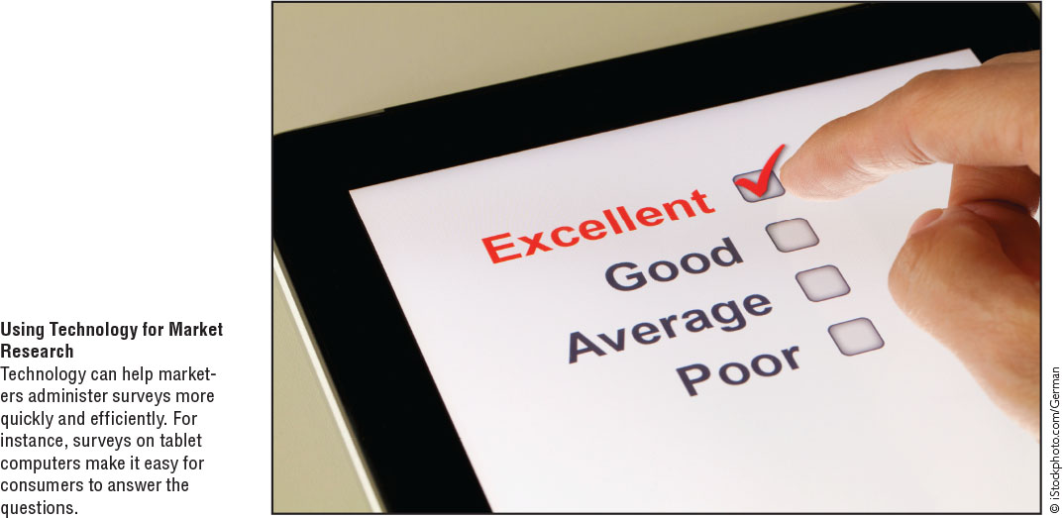
Using Technology for
Market Research
© zayats-and-zayats
LO 5-4

Slide 41
Databases
© zayats-and-zayats
Database
  A collection of information arranged for easy access and retrieval
  Allow marketers to tap into an abundance of information useful in making marketing decisions
  Marketing researchers can use commercial databases to obtain useful information for marketing decisions
Single-source data
  Information provided by a single marketing research firm
LO 5-4

Slide 42
Customer Relationship Management (CRM)
© zayats-and-zayats
Employs database marketing techniques to identify different types of customers and develop specific strategies for interacting with each customer:
    Identifying and building a database of current and potential consumers, including a wide range of demographic, lifestyle, and purchase information
LO 5-4

Slide 43
Customer Relationship Management (CRM)
© zayats-and-zayats
  Delivering differential messages according to each consumer’s preferences and characteristics through established and new media channels
  Tracking customer relationships to monitor the costs of retaining individual customers and the lifetime value of their purchases
LO 5-4

Slide 44
Marketing Decision Support Systems
© zayats-and-zayats
Marketing decision support system (MDSS)
  Customized computer software that aids marketing managers in decision making
  Have a broader range and offer greater computational and modeling capabilities than spreadsheets
  MDSS software is often a major component of a company’s marketing information system
LO 5-4

Slide 45
The Importance of Ethical Marketing Research
© zayats-and-zayats
Must have professional standards by which research can be judged
Ethical and legal issues can develop as research is carried out
Some organizations have developed codes of conduct and guidelines for ethical research for organizations
LO 5-5

Slide 46
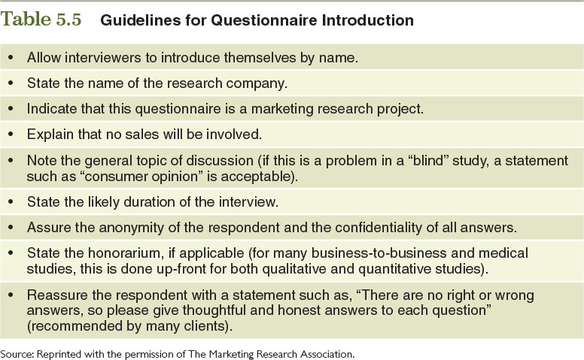
Table 5.5 – Guidelines for Questionnaire Introduction
© zayats-and-zayats
LO 5-5

Slide 47
International Issues in
Marketing Research
© zayats-and-zayats
Marketers must modify data-gathering methods to account for differences in sociocultural, economic, political, legal, and technological forces
LO 5-5

Slide 48
International Issues in
Marketing Research
© zayats-and-zayats
Use two-pronged approach to international marketing research:
  A detailed search for and analysis of secondary data to gain greater understanding of a particular marketing environment and its issues before gathering primary data
  Conduct field research using the methods described earlier to refine a firm’s understanding of specific customer needs and preferences
LO 5-5

Slide 49

Thank you for your attention!

