Slide 1


Chapter 4
Social Responsibility and Ethics in Marketing
Course Instructor:
Mamurjon Rahimov

Slide 2


Learning Objectives
© zayats-and-zayats
LO 4-1 Define the four dimensions of social responsibility
LO 4-2 State the importance of marketing ethics
LO 4-3 Describe the three factors of ethical decision making
LO 4-4 Comment on the requirements for improving ethical decision making
LO 4-5 Critique the role of social responsibility and ethics in improving marketing performance

Slide 3
Social Responsibility
© zayats-and-zayats
Social Responsibility
  Is an organization’s obligation to maximize its positive impact and minimize its negative impact on society
    Can generate positive publicity
  Promotes goodwill
    Attracts potential customers and employees
    Generates indirect long term benefits such as greater employee commitment and improved business performance
LO 4-1

Slide 4
Dimensions of Social Responsibility
© zayats-and-zayats
Marketing citizenship
  The adoption of a strategic focus for fulfilling the economic, legal, ethical and philanthropic social responsibilities expected by stakeholders
  Stakeholder orientation
    Understanding and addressing the needs of all stakeholders, including communities and special-interest groups
LO 4-1

Slide 5
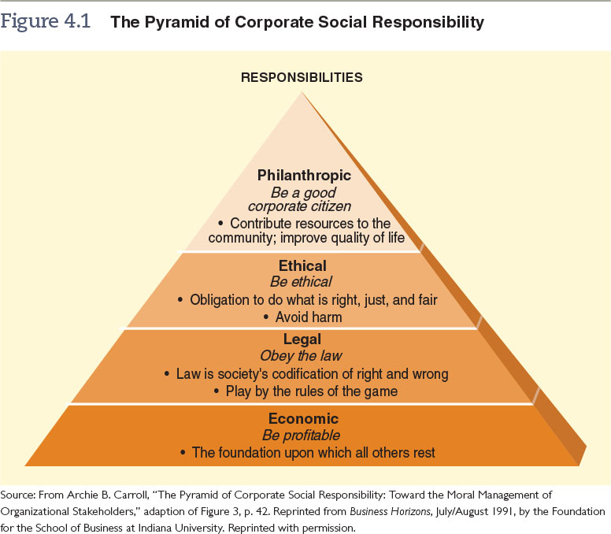
Figure 4.1 – The Pyramid of Corporate Social Responsibility
© zayats-and-zayats
LO 4-1

Slide 6
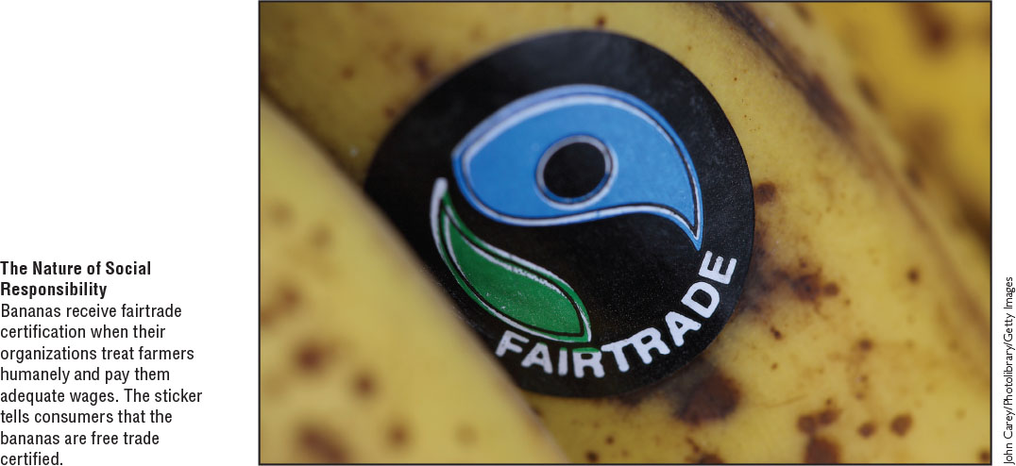
Dimensions of Social Responsibility
© zayats-and-zayats
LO 4-1

Slide 7
Economic Responsibility
© zayats-and-zayats
At the most basic level, all companies have an economic responsibility to be profitable so they can
  Provide a return on investment to their owners and investors
  Create jobs for the community
  Contribute goods and services to the economy
Economic responsibilities require finding a balance in stakeholder interests while recognizing a firm must make a profit to be sustainable
LO 4-1

Slide 8
Legal Responsibility
© zayats-and-zayats
Marketers are expected to follow all laws and regulations designed to keep U.S. companies’ actions within the range of acceptable conduct and fair competition
Economic and legal responsibilities are the most basic levels of social responsibility for a good reason
  Failure to consider them may mean a marketer is not around long enough to engage in ethical or philanthropic activities
LO 4-1

Slide 9
Ethical Responsibility
© zayats-and-zayats
Marketing Ethics
  Principles and standards defining acceptable conduct in marketing as determined by various stakeholders including:
    The public
    Government regulators
    Private-interest groups
    Consumers
    Industry
    The organization itself
LO 4-2

Slide 10
Philanthropic Responsibility
© zayats-and-zayats
Philanthropic responsibilities are not required of a company, but they promote human welfare or goodwill
  Cause-related marketing – the practice of linking products to a particular social cause on an ongoing or short-term basis
  Strategic philanthropy – the synergistic use of organizational core competencies and resources to address key stakeholders’ interests and achieve both organizational and social benefits
LO 4-2

Slide 11
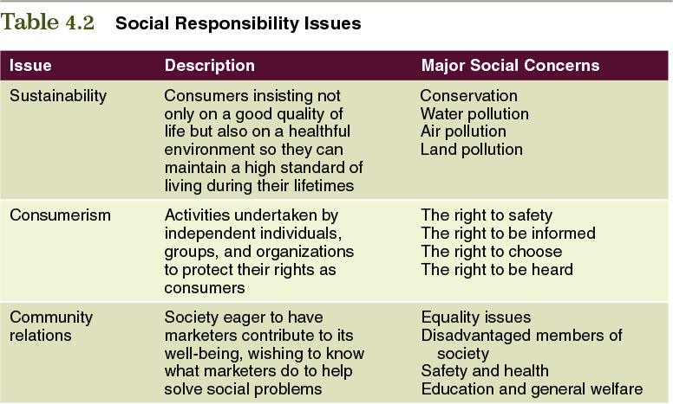
Table 4.2 – Social Responsibility Issues
© zayats-and-zayats
LO 4-2

Slide 12
Sustainability Issue
© zayats-and-zayats
Sustainability is the potential for the long-term well-being of the natural environment, including all biological entities, as well as the interaction among nature and individuals, organizations and business strategies
  Many companies are adopting eco-friendly business practices and/or supporting environmental initiatives
  Many products have been certified “green” by environmental organizations
LO 4-2

Slide 13
Sustainability Issue
© zayats-and-zayats
Some environmentalists and marketers believe companies should work toward implementing the following goals:
  Eliminate the concept of waste
  Reinvent the concept of a product
    Consumables, durable goods and unsalables
  Make prices reflect the cost
  Make environmentalism profitable
LO 4-2

Slide 14
Consumerism Issue
© zayats-and-zayats
Consumerism is the efforts of independent individuals, groups, and organizations to protect the rights of consumers
  Ralph Nader and others pushed for legislation requiring many car safety features such as seat belts, air bags, padded dashboards and collapsible steering columns
  The Federal Trade Commission provides a wealth of consumer information at its website
LO 4-2

Slide 15
Community Relations Issue
© zayats-and-zayats
Being a good community citizen means avoiding harmful actions that could damage the community
Marketers can improve a community’s quality of life through
  Employment opportunities
  Economic development
  Financial contributions to educational, health, cultural and recreational causes
LO 4-2

Slide 16
Marketing Ethics
© zayats-and-zayats
Marketing ethics is a dimension of social responsibility that involves principles and standards that define acceptable conduct in marketing
  These standards are determined by
    Various stakeholders and
    The organization’s ethical climate
  Marketers must also use their own values and knowledge of ethics to
    Act responsibly and
    Provide ethical leadership for others
LO 4-2

Slide 17
Marketing Ethics
© zayats-and-zayats
When marketing activities deviate from accepted standards:
  The exchange process can break down
  Resulting in customer dissatisfaction
  Lack of trust and lawsuits
LO 4-2

Slide 18
Marketing Ethics
© zayats-and-zayats
Trust is an important concern for marketers as it is the foundation of long-term relationships
  Consumer lack of trust has increased in recent years due to the financial crisis and deep recession
  Once trust is lost, it can take a lifetime to rebuild
  Deal with ethical issues proactively during the strategic planning process, not after major problems materialize
LO 4-2

Slide 19
Ethical Issues in Marketing
© zayats-and-zayats
An ethical issue is an identifiable problem, situation or opportunity requiring a choice among several actions that must be evaluated as right or wrong, ethical or unethical
  Any time an activity causes marketing managers or customers to feel manipulated or cheated, a marketing ethical issue exists, regardless of the legality of that activity
  Regardless of the reasons behind specific ethical issues, marketers must be able to identify and resolve these issues
LO 4-2

Slide 20
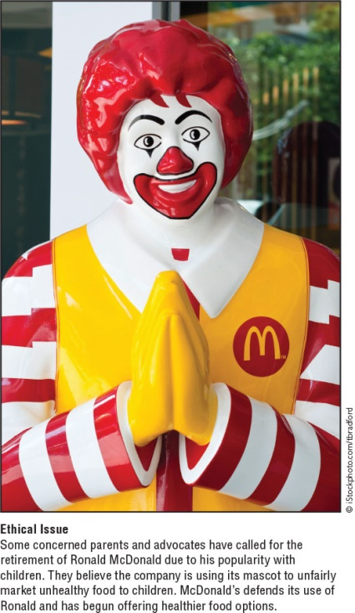
Ethical Issues in Marketing
© zayats-and-zayats
LO 4-2

Slide 21
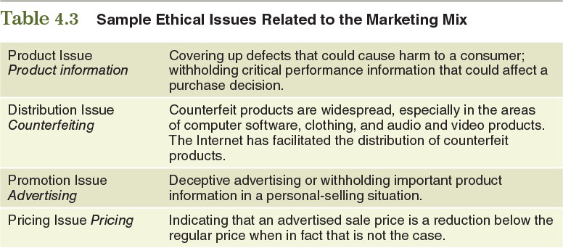
Table 4.3 – Sample Ethical Issues Related to the Marketing Mix
© zayats-and-zayats
LO 4-2

Slide 22
Ethics and the Marketing Mix
© zayats-and-zayats
Product ethical issues arise when:
  Marketers fail to disclose risks associated with a product or
  Fail to disclose information regarding the function, value or use of a product
  Marketers fail to inform customers about existing conditions or changes in product quality
    Such failure is a form of dishonesty about the nature of the product
    Product recalls happen when customers are asked to return defective products
LO 4-2

Slide 23
Ethics and the Marketing Mix
© zayats-and-zayats
Promotion can create ethical issues in a variety of ways:
  False or misleading advertising
  Manipulative or deceptive sales promotions, tactics and publicity
    Greenwashing happens when products are promoted as being more environmentally friendly than they really are
  Bribery occurs when an incentive is offered in exchange for an illicit advantage
  Another major ethical issue is promoting products to children that might be construed as harmful
LO 4-2

Slide 24
Ethics and the Marketing Mix
© zayats-and-zayats
Pricing’s common ethical issues are:
  Price fixing
  Predatory pricing
  Failure to disclose the full price of a purchase
  Examples:
    Price gouging – pricing products at exorbitant levels
    Bait and switch
    Quantity surcharges
LO 4-2

Slide 25
Ethics and the Marketing Mix
© zayats-and-zayats
Ethical issues in distribution involve relationships among producers and marketing intermediaries
  Manipulating a product’s availability for purposes of exploitation
  Using coercion to force intermediaries to behave in a specific manner
  Channel stuffing is shipping surplus inventory to wholesalers and retailers at an excessive rate
  Counterfeiting is a worldwide problem as the market for fake or pirated goods is enormous
LO 4-2

Slide 26

Discussion Point – Ethical Issues and the Marketing Mix
Determine whether the example pertains to a product, distribution, pricing, or promotion ethical issue:
  An owner of four California dealerships is suing Mitsubishi for allegedly forcing it to stock more vehicles than it could sell
  POM Wonderful sued PepsiCo for marketing its pomegranate blueberry flavored juice blend because the product contains little juice
  Engineers at General Motors knew there were ignition-switch defects in some of its cars, but the company did not immediately issue a recall
  Apple got in trouble for partnering with publishers to set the prices of electronic books
LO 4-2
Notes:
Answers:
Distribution
Promotion
Product
Price

Slide 27
Ethics and the Supply Chain
© zayats-and-zayats
Managing supply chains responsibly is one of the greatest difficulties of marketing ethics
  Supply chains require constant vigilance on the part of marketers
  Marketers need to anticipate unforeseen circumstances
  Managing supply chain ethical decision making is important because many stakeholders hold the firm responsible for all ethical conduct related to product availability
LO 4-2

Slide 28
Ethics and the Supply Chain
© zayats-and-zayats
Good supply chain ethics is important because it ensures the integrity of the product and the firm’s operations in serving customers
  Companies often create a Supplier Code of Conduct and/or a Global Supplier Code of Conduct
  Companies must perform regular audits on its suppliers and, if necessary, discipline those found to be in violation of company standards
LO 4-2

Slide 29
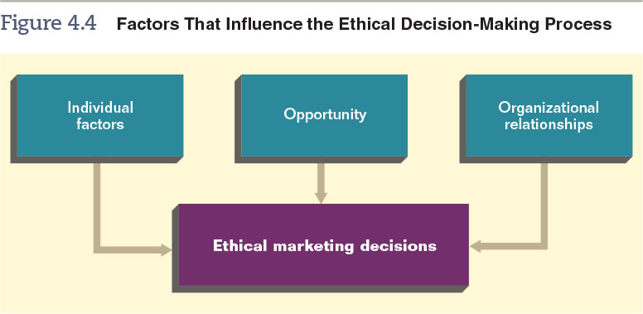
Figure 4.4 – Factors that Influence the Ethical Decision-Making Process
© zayats-and-zayats
LO 4-3

Slide 30
Individual Factors and Ethics
© zayats-and-zayats
People learn values and principles through
  Socialization by family members
  Social groups
  Religion
  Formal education
LO 4-3

Slide 31
Individual Factors and Ethics
© zayats-and-zayats
Because of different levels of personal ethics in an organization, there will be significant ethical diversity among employees
An organization’s culture often has more influence on marketing decisions than an individual’s own values
LO 4-3

Slide 32
Organization Relationships and Ethics
© zayats-and-zayats
Organizational (corporate) culture is a set of values, beliefs, goals, norms and rituals that members of an organization share
An organization’s culture gives members meaning and suggests rules for how to behave and deal with problems
LO 4-3

Slide 33
Organization Relationships and Ethics
© zayats-and-zayats
The interaction between corporate culture and executive leadership helps determine the firm’s ethical value system
Formally expressed | Informally conveyed
Codes of conduct | Work habits
Memos | Extracurricular activities
Manuals | Stories
Dress codes
Ceremonies
LO 4-3

Slide 34
Organization Relationships and Ethics
© zayats-and-zayats
Most marketing employees take their cues from coworkers in learning how to solve problems, including ethical problems
Organizational pressure plays a key role in creating ethical issues
  Pressure to meet a schedule
  Pressure to meet a sales quota
LO 4-3

Slide 35
Discussion Point – Factors that Influence the Ethical Decision Making Process
Determine whether the following examples involves individual, organizational, or opportunity factors:
  Cisco’s code of conduct has strict policies regarding conflict of interest and bribery
  Sally provides a quote that is much higher than what it should be because her boss does it all the time
  Retailers try to prevent employee theft by having a manager count the money in a cashier’s cash register at the end of the day
  Veronica believes it is all right to tell little white lies and applies this belief to the workplace
LO 4-3
Notes:
Answers:
Opportunity
Organizational
Opportunity
Individual

Slide 36
Opportunity and Ethics
© zayats-and-zayats
Opportunity is conditions that limit barriers to provide rewards
An employee that acts unethically and is rewarded or suffers no penalty may repeat such acts as other opportunities arrive
LO 4-3

Slide 37
Opportunity and Ethics
© zayats-and-zayats
The larger the rewards and the milder the punishment for unethical conduct, the greater the likelihood that unethical behavior will occur
Research suggests that most marketing managers refrain from taking advantage of unethical opportunities
LO 4-3

Slide 38
Codes of Conduct and Ethics
© zayats-and-zayats
Codes of conduct (also called codes of ethics) consist of formalized rules and standards that describe what the company expects of its employees
  Not all codes are effective if implemented improperly
  Codes must be periodically revised
  These codes should provide guidelines instead of being so detailed as to take every situation into account
LO 4-4

Slide 39
Improving Marketing Ethics
© zayats-and-zayats
It is possible to improve ethical conduct by
  Hiring ethical employees
  Eliminating unethical employees
The greatest decrease in ethical risks for an organization involve
  A well-implemented ethics program
  A strong corporate culture
LO 4-4

Slide 40
Improving Marketing Ethics
© zayats-and-zayats
The American Marketing Association provides a Code of Ethics
Global Compliance helps companies integrate ethical and compliance solutions
LO 4-4

Slide 41
Social Responsibility, Ethics, and Strategic Planning
© zayats-and-zayats
It is important to distinguish between Ethics and Social Responsibility
  Ethics relates to individual and group decisions, judgments about right and wrong, in a particular decision-making situation
  Social Responsibility relates to the total effect of marketing decisions on society
Both are interrelated and profitable, an increasing number of companies are incorporating them into their overall strategic market planning
LO 4-5

Slide 42
Social Responsibility, Ethics, and Strategic Planning
© zayats-and-zayats
Many of society’s demands impose costs
  Companies must carefully balance product cost with costs of producing, packaging and distributing those products in an environmentally responsible manner
In satisfying one group’s interests, marketers may dissatisfy other groups
  Balancing society’s demands to satisfy all members of society is difficult, if not impossible
LO 4-5

Slide 43
Social Responsibility, Ethics, and Marketing Performance
© zayats-and-zayats
Increasing evidence indicates that being socially responsible and ethical results in increased profits
Being ethically and socially concerned is consistent with meeting the demands of customers and other stakeholders
LO 4-5

Slide 44
Social Responsibility, Ethics, and Marketing Performance
© zayats-and-zayats
A direct association exists between corporate social responsibility and customer satisfaction, profits and market value
Recognition is growing that the long-term value of ethical, responsible acts far outweighs short-term costs
LO 4-5

Slide 45
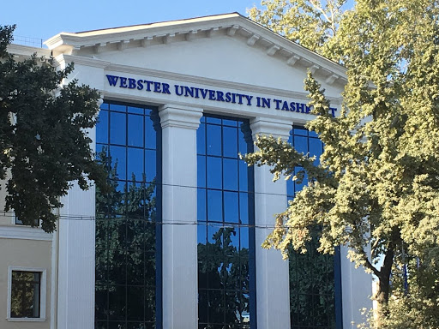
Thank you for your attention!

