Slide 1


Chapter 3
The Marketing Environment
Course Instructor:
Mamurjon Rahimov

Slide 2


Learning Objectives
© zayats-and-zayats
LO 3-1 Summarize why it is important to examine and respond to the marketing environment
LO 3-2 Explain how competitive factors affect an organization’s ability to compete
LO 3-3 Articulate how economic factors influence a customer’s ability and willingness to buy products
LO 3-4 Identify the types of political forces in the marketing environment

Slide 3
Learning Objectives
© zayats-and-zayats
LO 3-5 Explain how laws, government regulations, and self-regulatory agencies affect marketing activities
LO 3-6 Describe how new technology impacts marketing and society
LO 3-7 Outline the sociocultural issues marketers must deal with as they make decisions

Slide 4

Environmental Forces
© zayats-and-zayats
Competitive
Economic
Political
Environmental
Forces
Legal and Regulatory
Technological
Sociocultural
LO 3-1

Slide 5
The Marketing Environment
© zayats-and-zayats
Environmental Scanning
  The process of collecting information about forces in the marketing environment
Environmental Analysis
  The process of assessing and interpreting the information gathered through environmental scanning
  How you deal with the information collected during scanning
LO 3-1

Slide 6
Responding to Environmental Forces
© zayats-and-zayats
Marketers take two approaches to environmental forces:
  Passive – Accepting them as uncontrollable
  Proactive – Attempting to influence and shape them
No best way to react
Depends on the organization, management, and the situation
LO 3-1

Slide 7
Competitive Forces
© zayats-and-zayats
Competition – Other organizations that market products that are similar to or can be substituted for a marketer’s products in the same geographic area
  Most firms have competition
  When marketing managers define the target market(s) their firm will serve, they establish a set of competitors
  Marketing managers must consider the type of competitive structure in which the firm operates
LO 3-2

Slide 8
Types of Competitors
© zayats-and-zayats
Brand Competitors – Firms that market products with similar features and benefits to the same customers at similar prices
Product Competitors – Firms that compete in the same product class but market products with different features, benefits, and prices
LO 3-2

Slide 9
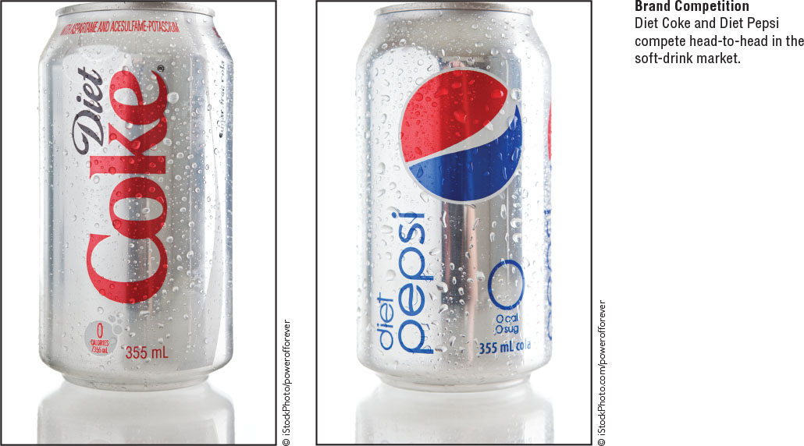
Types of Competitors
© zayats-and-zayats
LO 3-2

Slide 10
Types of Competitors
© zayats-and-zayats
Generic Competitors – Firms that provide very different products that solve the same problem or satisfy the same basic customer need
Total Budget Competitors – Firms that compete for the limited financial resources of the same customers
LO 3-2

Slide 11
Competitive Structures
© zayats-and-zayats
Monopoly
  A competitive structure in which an organization offers a product that has no close substitutes, making that organization the sole source of supply
Oligopoly
  A competitive structure in which a few sellers control the supply of a large proportion of a product
LO 3-2

Slide 12
Competitive Structures
© zayats-and-zayats
Monopolistic Competition
  A competitive structure in which a firm has many potential competitors and tries to develop a marketing strategy to differentiate its product
Pure Competition
  A market structure characterized by an extremely large number of sellers, none strong enough to significantly influence price or supply
  Does not exist in the real world, although some industries come close
LO 3-2

Slide 13
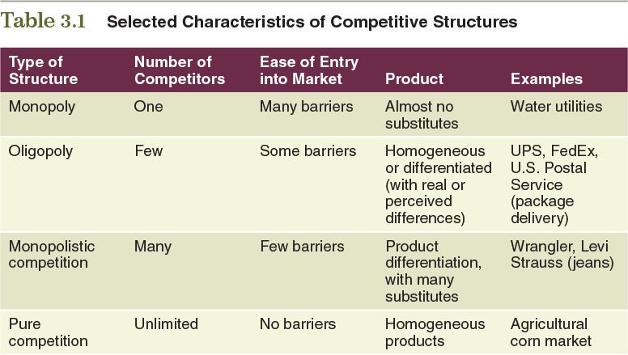
Table 3.1 – Selected Characteristics of Competitive Structures
© zayats-and-zayats
LO 3-2

Slide 14
Monitoring Competition
© zayats-and-zayats
Helps determine competitor’s strategies and their effects on firm’s own strategies
  Guides development of competitive advantage and adjusting firm’s strategy
  Provides ongoing information about competitors
  Information about competitors allows marketing managers to assess the performance of their own marketing efforts and to recognize the strengths and weaknesses in their own marketing strategies
LO 3-2

Slide 15
The Business Cycle
© zayats-and-zayats
A pattern of economic fluctuations that has four stages:
  Prosperity – Low unemployment and relatively high total income, which together ensure high buying power (provided the inflation rate stays low)
  Recession – Unemployment rises and total buying power declines, stifling both consumer and business spending
LO 3-3

Slide 16
The Business Cycle
© zayats-and-zayats
  Depression – Unemployment is extremely high, wages are very low, total disposable income is at a minimum, and consumers lack confidence in the economy
  Recovery – The economy moves from depression or recession to prosperity
    Difficult to ascertain how quickly and to what level prosperity will return
    Maintain as much flexibility in marketing strategies as possible to allow for any needed adjustments
LO 3-2

Slide 17
Buying Power and Income
© zayats-and-zayats
Buying Power – Resources, such as money, goods, and services, that can be traded in an exchange
Income – For an individual, the amount of money received through wages, rents, investments, pensions, and subsidy payments for a given period
LO 3-2

Slide 18
Buying Power and Income
© zayats-and-zayats
Disposable Income – After-tax income
Discretionary Income – Disposable income available for spending and saving after an individual has purchased the basic necessities of food, clothing, and shelter
LO 3-2

Slide 19
Credit
© zayats-and-zayats
Credit enables people to spend future income now or in the near future
Credit increases current buying power at the expense of future buying power
Factors affecting credit use:
  Must be available
  Interest rates
  Credit terms (such as size of down payment and amount and number of monthly payments)
LO 3-2

Slide 20
Wealth
© zayats-and-zayats
The accumulation of past income, natural resources, and financial resources
  Global wealth is increasing
  Like income, wealth is unevenly distributed
As people become wealthier, they gain buying power:
  To make current purchases
  To generate income
  To acquire large amounts of credit
LO 3-2

Slide 21
Willingness to Spend
© zayats-and-zayats
An inclination to buy because of expected satisfaction from a product, influenced by the ability to buy and numerous psychological and social forces
  Factors that affect consumers’ general willingness to spend:
    Expectations about future employment
    Income levels
    Prices
    Family size
    General economic conditions
LO 3-2

Slide 22

Political Forces
© zayats-and-zayats
Enactment of legislation
Legal decisions interpreted by courts through civil and criminal cases
LO 3-4

Slide 23
Political Forces
© zayats-and-zayats
Influence of regulatory agencies
Marketers may:
  View political forces as beyond their control and simply adjust to conditions that arise
  Influence the process through contributions and lobbying
LO 3-4

Slide 24
Legal and Regulatory Forces
© zayats-and-zayats
Legal and
Regulatory
Forces
Pro-competitive
Legislation
Consumer
Protection
Legislation
Encouraging
Compliance
with Laws and
Regulations
Regulatory
Agencies
Self-Regulatory
Forces
LO 3-5

Slide 25
Legislation
© zayats-and-zayats
Procompetitive Legislation
  Preserves competition
  Laws have been created to prevent businesses from gaining an unfair advantage through bribery
Consumer Protection Legislation
  Protects people from harm
  Prohibits hazardous products
  Requires information disclosure
  Aimed at particular marketing activities
LO 3-5

Slide 26
Encouraging Compliance with Laws
© zayats-and-zayats
Current trend is away from legally-based organizational compliance programs
  Emphasis on providing incentives to create ethical and responsible corporate cultures
LO 3-5

Slide 27
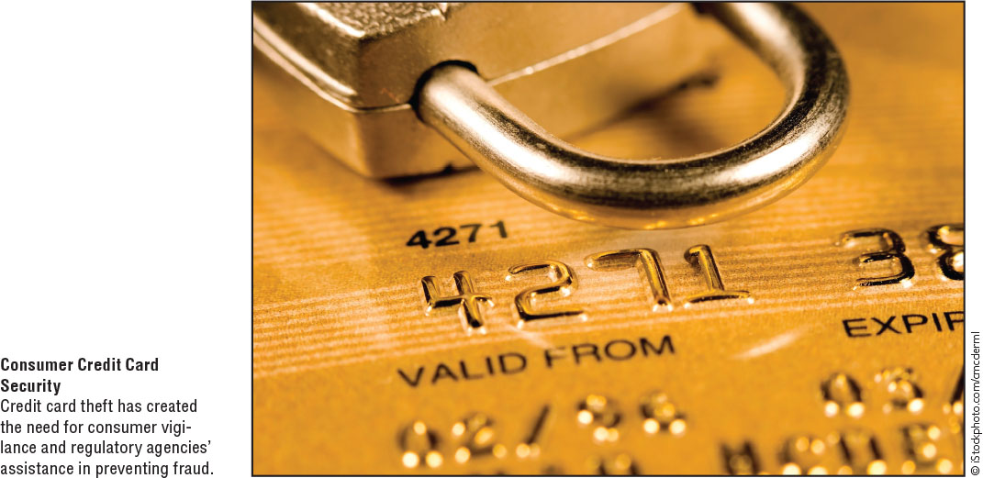
Encouraging Compliance with Laws
© zayats-and-zayats
Regulatory agencies monitor marketing activities and may enforce some laws
LO 3-5

Slide 28
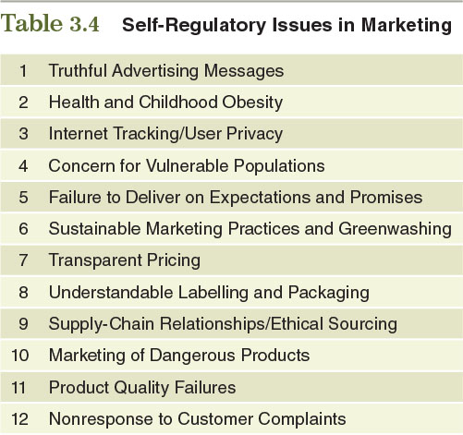
Table 3.4 – Self-Regulatory Issues in Marketing
© zayats-and-zayats
LO 3-5

Slide 29


Technological Forces
© zayats-and-zayats
Technology
Dynamic
Change
Ability to Reach
Customers
Self-Sustaining
Technology
LO 3-6

Slide 30
Technological Forces
© zayats-and-zayats
Technology
  The application of knowledge and tools to solve problems and perform tasks more efficiently
  Impacts of technology:
    Dynamic change
    Ability to reach customers
    Self-sustaining in nature; spurs more development
  Rapid technological growth and change are expected to accelerate
LO 3-6

Slide 31
Impact of Technology
© zayats-and-zayats
Mobile devices and consumers’ increasing use of the Internet have changed:
  How people communicate
  How marketers reach consumers
Can improve productivity and opportunities for e-commerce
Negative impacts include:
  Concerns over privacy
  Intellectual property protection issues
LO 3-6

Slide 32
Adoption and Use of Technology
© zayats-and-zayats
Firms must keep up with technology to maintain their status as market leaders
  Must ensure that their technology is not easily copied
Use a technological assessment to learn about and attempt to foresee the effects of new products and processes
  Estimate whether benefits of adopting a specific technology outweigh costs
LO 3-6

Slide 33


Sociocultural Forces
© zayats-and-zayats
Demographic
and Diversity
Characteristics
Sociocultural
Forces
Consumerism
Cultural
Values
LO 3-7

Slide 34
Sociocultural Forces
© zayats-and-zayats
The influences in a society and its culture(s) that change people’s:
  Attitudes
  Beliefs
  Norms
  Customs
  Lifestyles
Determine what, where, how, and when people buy products
LO 3-7

Slide 35
Demographic and Diversity Characteristics
© zayats-and-zayats
Changes in a population’s demographic characteristics lead to changes in how people live and consume products
  Increasing market of retired Baby Boomers
  Generation Y
  Growing Hispanic/Latino market in the U.S.
A more diverse customer base means marketing practices must be modified and diversified to meet changing needs
LO 3-7

Slide 36
Cultural Values
© zayats-and-zayats
Changes in cultural values alter people’s needs/desires for products
  Health, nutrition, and exercise growing in importance (sales of organic foods, herbal remedies, and vitamins have escalated)
  Definition of family is changing
  Children continue to be very important
  Trend towards eat-out and take-out meals
  Green marketing helps establish long-term consumer relationships by maintaining, supporting, and enhancing the natural environment
LO 3-7

Slide 37
Consumerism
© zayats-and-zayats
The organized efforts of individuals, groups, and organizations to protect consumers’ rights
  Lobbying government officials and agencies
  Letter-writing/e-mail sending campaigns
The movement’s major forces are:
  Individual consumer advocates
  Consumer organizations and other interest groups
  Consumer education
  Consumer law
LO 3-7

Slide 38

Thank you for your attention!

