Slide 1


Chapter 2
Planning, Implementing, and Evaluating Marketing Strategies
Course Instructor:
Mamurjon Rahimov

Slide 2


Learning Objectives
© zayats-and-zayats
LO 2-1 Explain the strategic planning process
LO 2-2 Identify what is necessary to effectively manage the implementation of marketing strategies
LO 2-3 Describe the four major elements of strategic performance evaluation
LO 2-4 Describe the development of a marketing plan

Slide 3
Strategic Marketing Management
© zayats-and-zayats
The process of planning, implementing, and evaluating the performance of marketing activities and strategies, both effectively and efficiently
  Effectiveness is the degree to which long-term customer relationships help achieve an organizations objectives
  Efficiency refers to minimizing the resources an organization uses to achieve a specific level of desired customer relationships
LO 2-1

Slide 4
Strategic Planning Process
© zayats-and-zayats
Strategic planning is the process of establishing an organizational mission and formulating goals, corporate strategy, marketing objectives, and marketing strategy
  Should be guided by a market orientation to ensure that a concern for customer satisfaction is an integral part of the process and permeates the entire company
  A market orientation is also important for the successful implementation of marketing strategies
LO 2-1

Slide 5
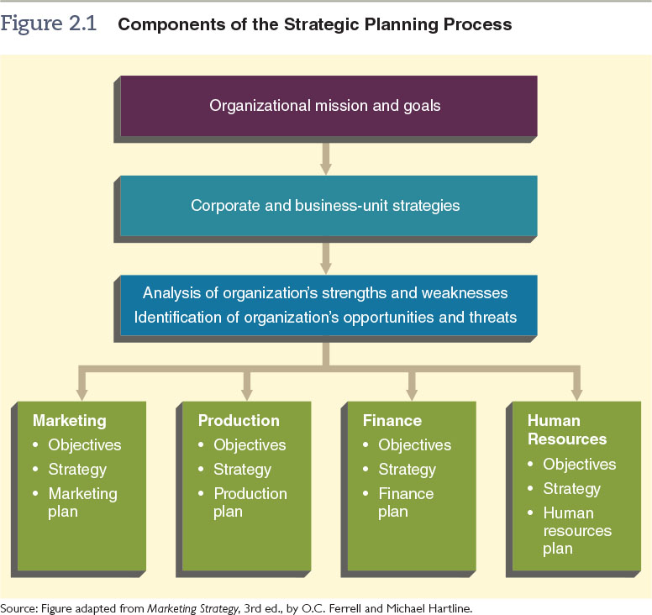
Figure 2.1 – Components of the Strategic Planning Process
© zayats-and-zayats
LO 2-1

Slide 6
Organizational Mission Statements and Goals
© zayats-and-zayats
Mission statement is a long-term view, or vision, of what the organization wants to become
The goals of any organization should derive from its mission statement
An organization’s mission statement should answer two questions:
  Who are our customers?
  What is our core competency?
LO 2-1

Slide 7
Corporate Identity
© zayats-and-zayats
Companies develop and manage their corporate identity—their unique symbols, personalities, and philosophies—to support all the firm’s activities, including marketing
Managing identity requires:
  Broadcasting a company’s mission, goals, and values
  Sending a consistent image
  Implementing a visual identity with stakeholders
LO 2-1

Slide 8
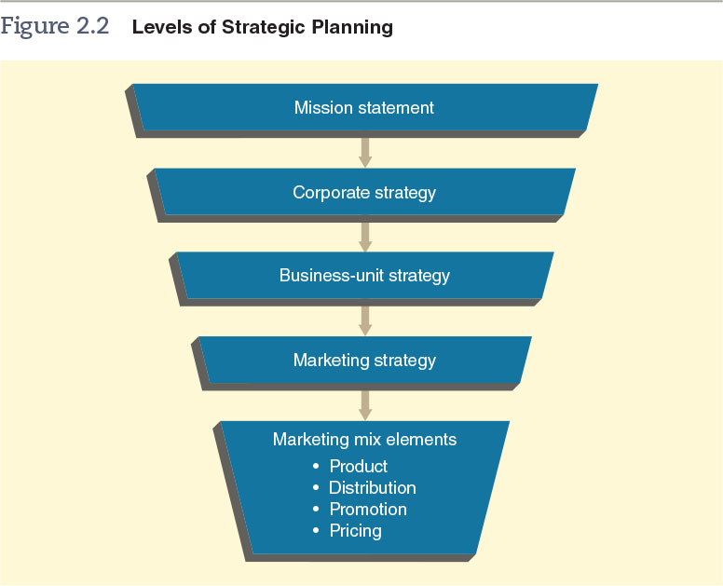
Figure 2.2 – Levels of Strategic Planning
© zayats-and-zayats
LO 2-1

Slide 9
Corporate Strategies
© zayats-and-zayats
Corporate strategy determines the means for utilizing resources in the functional areas of marketing, production, finance, research and development, and human resources to reach the organization’s goals
  The broadest of the three levels of strategy (corporate, business unit, and marketing) and should be developed with the organization’s overall mission in mind
    Who are our customers? What is our core competency?
LO 2-1

Slide 10
Corporate Strategies
© zayats-and-zayats
Corporate strategy planners are concerned with broad issues such as:
  Corporate culture
  Competition
  Differentiation
  Diversification
  Interrelationships among business units
  Environmental and social issues
Match the resources of the organization with the opportunities and threats in the environment
LO 2-1

Slide 11
Business-Unit Strategies
© zayats-and-zayats
Business-unit strategy should be consistent with corporate strategy
  Strategic business unit (SBU) is a division, product line, or other profit center within the parent company
  Each of these units sells a distinct set of products to an identifiable group of customers, and each competes with a well-defined set of competitors
  The revenues, costs, investments, and strategic plans of each SBU can be separated from those of the parent company and evaluated
LO 2-1

Slide 12
Business-Unit Strategies
© zayats-and-zayats
Strategic planners should recognize the strategic performance capacities of each SBU and allocate scarce resources among those divisions
  A market is a group of individuals and/or organizations that have needs for products in a product class and have the ability, willingness, and authority to purchase those products
  The percentage of a market that actually buys a specific product from a particular company is referred to as that product’s (or business unit’s) market share
LO 2-1

Slide 13
Market Growth/Market Share Matrix
© zayats-and-zayats
The market growth/market share matrix is a helpful business tool, based on the philosophy that a product’s market growth rate and its market share are important considerations in determining its market strategy
  All the companies SBUs and products should be integrated into a single, overall matrix and evaluated to determine strategies for individual products and overall portfolio strategies
LO 2-1

Slide 14
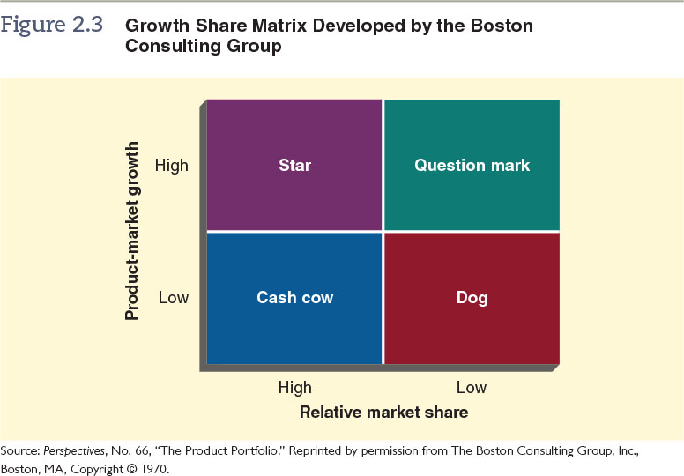
Figure 2.3 – Growth Share Matrix
© zayats-and-zayats
LO 2-1

Slide 15
Growth Share Matrix
© zayats-and-zayats
Stars are products with a dominant share of the market and good prospects for growth
Cash cows have a dominant share of the market but low prospects for growth
Dogs have a subordinate share of the market and low prospects for growth
LO 2-1

Slide 16
Growth Share Matrix
© zayats-and-zayats
Question marks have a small share of a growing market and generally require a large amount of cash to build market share
Long-term health of an organization depends on having some products that generate cash and others that use cash to support growth
LO 2-1

Slide 17

Discussion Point – Market Growth/ Market Share Matrix for
Coca-Cola
Look at the following Coca-Cola products. Determine whether they qualify as dogs, cash cows, stars, or question marks.
Coca-Cola soft drink
Energy drink Full Throttle
Hi-C juice drink
Dasani Bottled Water
LO 2-1
Notes:
Answers:
Cash cow
Question Mark
Dog
Star

Slide 18
Assessing Organizational Resources and Opportunities
© zayats-and-zayats
The strategic planning process begins with an analysis of the marketing environment, including a thorough analysis of the industry in which the company is operating or intends to sell its products
  Any strategic planning effort must assess the organization’s available financial and human resources and capabilities as well as how the level of these factors is likely to change in the future
LO 2-1

Slide 19
Core Competencies
© zayats-and-zayats
Core competencies are things a company does extremely well, which sometimes gives it an advantage over its competition
  Walmart’s core competency, which is efficiency in supply chain management, has enabled the chain to build a strong reputation for low prices at high quality levels on a wide variety of goods
LO 2-1

Slide 20
Market Opportunities and Strategic Windows
© zayats-and-zayats
Market opportunity is a combination of circumstances and timing that permits an organization to take action to reach a particular target market
Strategic windows are temporary periods of optimal fit between the key requirements of a market and the particular capabilities of a company competing in that market
LO 2-1

Slide 21
Competitive Advantage
© zayats-and-zayats
Competitive advantage is the result of a company matching a core competency to opportunities it has discovered in the marketplace
  Tesco, a large-scale grocery chain from the U.K., entered the western U.S. market with its Fresh & Easy Neighborhood Markets
    The company seeks competitive advantage by offering cheap, healthy food options such as 98-cent produce packages and cheap cuts of meat
    The store seeks to source produce and meats locally as much as possible, offer organic and hormone-free foods, and use less energy than typical grocery stores
LO 2-1

Slide 22



Competitive Advantage
© zayats-and-zayats
Core
Competencies
Competitive
Advantage
Strategic
Windows
Market
Opportunities
The place where opportunities, core competencies, and strategic windows meet
LO 2-1

Slide 23
SWOT Analysis
© zayats-and-zayats
SWOT analysis is a tool marketers use to assess an organization’s strengths, weaknesses, opportunities, and threats
  Strengths and weaknesses are internal factors that can influence an organization’s ability to satisfy its target market
  Opportunities and threats exist independently of the company and therefore represent issues to be considered by all organizations, even those that do not compete with the company
LO 2-1

Slide 24
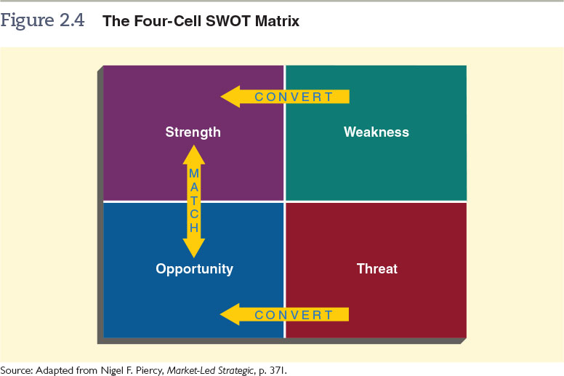
Figure 2.4 – The Four-Cell SWOT Matrix
© zayats-and-zayats
LO 2-1

Slide 25
SWOT Analysis
© zayats-and-zayats
Strengths refer to competitive advantages or core competencies that give the company an advantage in meeting the needs of its target market
Weaknesses refer to any limitations a company faces in developing or implementing a marketing strategy
LO 2-1

Slide 26
SWOT Analysis
© zayats-and-zayats
Opportunities refer to favorable conditions in the environment that could produce rewards for the organization if acted on properly
Threats refer to conditions or barriers that may prevent the company from reaching its objectives
LO 2-1

Slide 27
First-Mover Advantage
© zayats-and-zayats
First-mover advantage is the ability of an innovative company to achieve long-term competitive advantages by being the first to offer a certain product in the marketplace
  Build a firm’s reputation as a market leader
  Market is free of competition
  Establish brand loyalty for the firm due to its customer’s costs to switch later on
  Firm can protect its trade secrets or technology through patents
LO 2-1
Notes:
Korzinka

Slide 28
First-Mover Risks
© zayats-and-zayats
Risks of being the first to enter a market:
  High cost associated with creating a new product from scratch
    Market research, product development, production, and marketing or buyer education costs
  Early sales growth may not be as high as the company predicted if it makes mistakes with regard to the product or its marketing
  Risk that the product will fail due to market uncertainty, or that the product might not meet consumers’ expectations or needs
LO 2-1

Slide 29
Late-Mover Advantage
© zayats-and-zayats
Late-mover advantage is the ability of later market entrants to achieve long-term competitive advantages by not being the first to offer a certain product in a marketplace
  Learn from first mover’s mistakes and thus create an updated/improved product design and marketing strategy
  Lower initial costs since first mover has developed an infrastructure/educated buyers
  More certainty about the success of the market for the product
LO 2-1
Notes:
Makro

Slide 30
Late-Mover Risks
© zayats-and-zayats
Disadvantages of being a late mover:
  First mover may have patents on its technology and trade secrets that prevent the late mover from reverse engineering its product or producing a product that is too similar
  Customers who have already purchased the first mover’s product may believe that switching to the late mover’s product is too expensive or time-consuming for them
  Timing of entry to the market is crucial and can determine the amount of late-mover advantage that is actually possible
LO 2-1

Slide 31
Marketing Objective
© zayats-and-zayats
A statement of what is to be accomplished through marketing activities
  Should:
    Be based on a study of the SWOT analysis
    Match strengths to opportunities and/or eliminate weaknesses or threats
    Be stated in clear, simple terms
    Be accurately measurable
    Specify a time frame for accomplishment
    Be consistent with business-unit and corporate strategy
LO 2-1

Slide 32



Marketing Strategy
© zayats-and-zayats
A plan of action for identifying and analyzing a target market and developing a marketing mix to meet the needs of that market
Marketing Strategy
Target Market Selection
Creating a Marketing Mix
LO 2-1

Slide 33
Target Market Selection
© zayats-and-zayats
Selecting an appropriate target market may be the most important decision a company makes in the strategic planning process
  Identification and analysis of a target market provide a foundation on which a company can develop a marketing mix
  Marketers should also assess whether the company has the resources to develop the right marketing mix to meet the needs of a particular target market
LO 2-1

Slide 34
Creating the Marketing Mix
© zayats-and-zayats
Decisions made in creating a marketing mix are only as good as the organization’s understanding of its target market
Requires:
  In-depth research into the characteristics of the target market
  Analysis of customer needs, preferences, and behaviors with respect to product design, pricing, distribution, and promotion
LO 2-1

Slide 35
Creating the Marketing Mix
© zayats-and-zayats
All marketing mix decisions should be:
  Consistent with the business-unit and corporate strategies
  Flexible to permit the organization to alter the marketing mix in response to changes in market conditions, competition, and customer needs
LO 2-1

Slide 36
Sustainable Competitive Advantage
© zayats-and-zayats
At the marketing mix level, a company can detail how it will achieve a competitive advantage
A sustainable competitive advantage is one that the competition cannot copy in the foreseeable future
How can an organization make its competitive advantage sustainable over time?
LO 2-1

Slide 37
Marketing Implementation
© zayats-and-zayats
The process of putting marketing strategies into action
Depends on:
  Organization of the marketing department
  Motivating marketing personnel
  Effectively communicating within the marketing unit
  Coordinating all marketing activities
  Establishing a timetable for the completion of each marketing activity
LO 2-2

Slide 38
Organizing the Marketing Unit
© zayats-and-zayats
Companies that truly adopt the marketing concept develop a distinct organizational culture:
  A culture based on a shared set of beliefs that makes the customer’s needs the pivotal point of the company’s decisions about strategy and operations
LO 2-2

Slide 39
Organizing the Marketing Unit
© zayats-and-zayats
Centralized organizations
  Authority is concentrated at the top level
  Very little delegation to lower levels
Decentralized organizations
  Decision making authority is delegated as far down the chain of command as possible
LO 2-2

Slide 40

Organizing the Marketing Unit
© zayats-and-zayats
LO 2-2

Slide 41
Motivating Marketing Personnel
© zayats-and-zayats
To motivate marketing personnel, managers must discover their employees’ needs and then develop motivational methods that will help employees satisfy those needs
  Rewards to employees should be tied to organizational goals and be fair, ethical, and well understood by employees
  Selecting effective motivational tools has become more complex because of greater differences among workers in terms of race, ethnicity, gender, and age
LO 2-2

Slide 42
Communication within the Marketing Unit
© zayats-and-zayats
One of the most important types of communication in marketing is communication that flows upward from the frontline of the marketing unit to higher-level marketing managers
  Communication is facilitated by an:
    Effective training program where employees can learn, ask questions, and become accountable for marketing performance
    Information system within the marketing unit and with other departments in the organization
LO 2-2

Slide 43
Coordinating Marketing Activities
© zayats-and-zayats
Marketing managers must work with other departments to ensure marketing activities mesh with other functions of the firm
  Must coordinate the activities of marketing staff within the firm and integrate those activities with the marketing efforts of external organizations
  Managers can improve coordination by making each employee aware of how his or her job relates to others and how his or her actions contribute to achieving marketing objectives
LO 2-2

Slide 44
Establishing a Timetable for Implementation
© zayats-and-zayats
Establishing an implementation timetable involves several steps:
  Identifying the activities to be performed
  Determining the time required to complete each activity
  Separating the activities to be performed in sequence from those to be performed simultaneously
  Organizing the activities in the proper order
  Assigning responsibility for completing each activity to one or more employees, teams, or managers
LO 2-2

Slide 45
Evaluating Marketing Strategies
© zayats-and-zayats
Strategic performance evaluation consists of:
  Establishing performance standards
  Measuring actual performance
  Comparing actual performance with established standards
  Modifying the marketing strategy, if needed
LO 2-3

Slide 46
Establishing Performance Standards
© zayats-and-zayats
Performance standard is an expected level of performance against which actual performance can be compared
  For example, a 20% reduction in customer complaints, a monthly sales quota of $150,000, or a 10% increase per month in new-customer accounts
  Performance standards are derived from marketing objectives that are set while developing marketing strategies
LO 2-3

Slide 47
Analyzing Actual Performance
© zayats-and-zayats
Sales analysis uses sales figures to evaluate a firm’s current performance
  Most common method of evaluation because sales data partially reflect the target market’s reactions to a marketing mix and often are readily available
  Current sales data must be compared with forecasted sales, industry sales, specific competitor’s sales, or the costs incurred to achieve the sales volume
LO 2-3

Slide 48
Analyzing Actual Performance
© zayats-and-zayats
Marketing cost analysis breaks down and classifies costs to determine which are associated with specific marketing efforts
  One way to analyze costs is by comparing a company’s costs with industry averages
    When looking at industry averages, a company should take into account its own unique situation
    Company’s costs can differ from the industry average for several reasons, including its own marketing objectives, cost structure, geographic location, types of customers, and scale of operations
LO 2-3

Slide 49
Comparing Actual Performance with Performance Standards
© zayats-and-zayats
If actual performance exceeds performance standards:
  Marketing strategy is viewed as being effective
  Try to gain an understanding of why the strategy is effective
If actual performance does not meet performance standards:
  Determine why a marketing strategy was less effective
  Determine whether the marketing objective, against which performance is measured, is realistic or not
LO 2-3

Slide 50
Marketing Plan
© zayats-and-zayats
Written document that specifies the activities to be performed to implement and control the firm’s marketing strategies
  The systematic process of:
    Assessing marketing opportunities and resources
    Determining objectives
    Defining Strategies
    Establishing guidelines for implementation and control of the marketing program
  Aligned with corporate/business-unit strategies and is accessible/shared with employees
LO 2-4

Slide 51
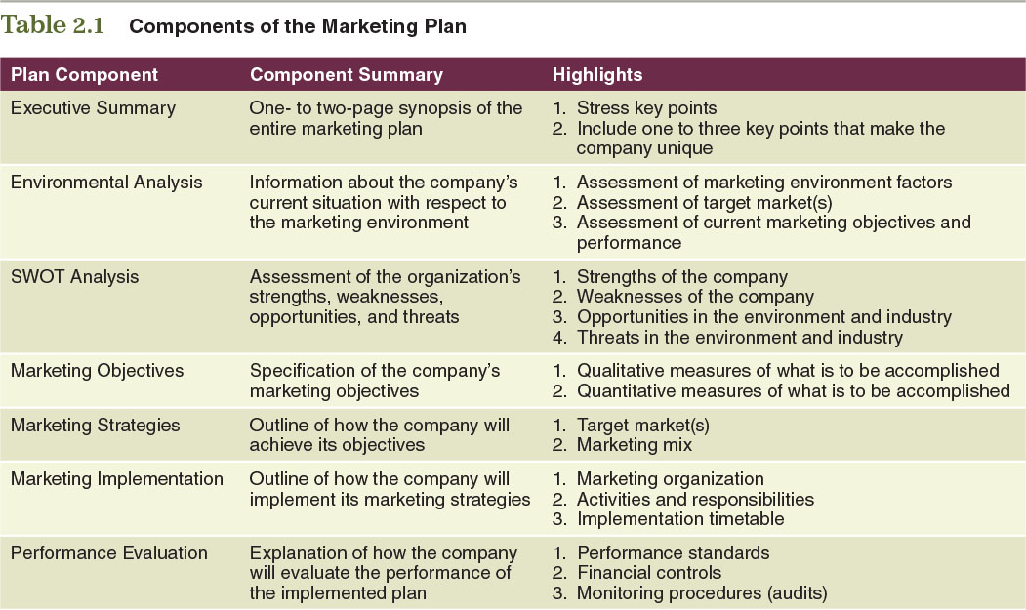
Table 2.1 – Components of the
Marketing Plan
© zayats-and-zayats
LO 2-4

Slide 52

Thank you for your attention!

