Slide 1


Chapter 1
An Overview of Strategic Marketing
Course Instructor:
Mamurjon Rahimov

Slide 2


Learning Objectives
© zayats-and-zayats
LO 1-1 Define marketing
LO 1-2 Explain the different variables of the marketing mix
LO 1-3 Describe how marketing creates value
LO 1-4 Briefly describe the marketing environment
LO 1-5 Summarize the marketing concept
LO 1-6 Identify the importance of building customer relationships
LO 1-7 Explain why marketing is important to our global economy

Slide 3
Defining Marketing
© zayats-and-zayats
Marketing is the process of:
  Creating, distributing, promoting, and pricing goods, services, and ideas
  To facilitate satisfying exchange relationships with customers
  To develop and maintain favorable relationships with stakeholders in a dynamic environment
LO 1-1

Slide 4
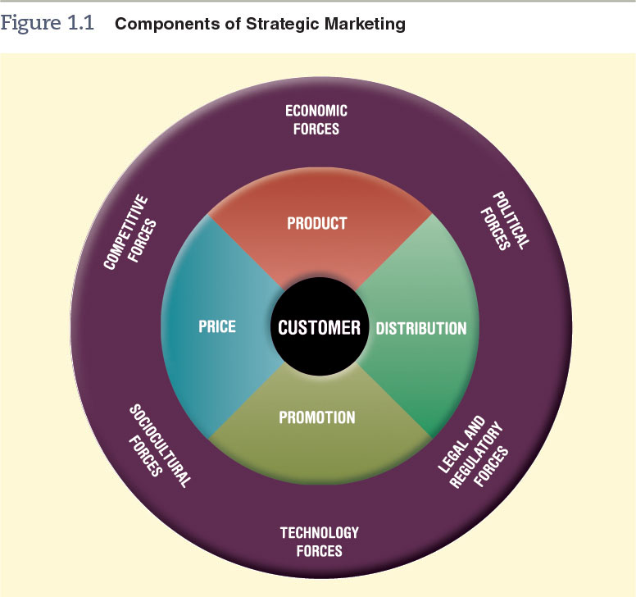
Figure 1.1 - Components of Strategic Marketing
© zayats-and-zayats
LO 1-1

Slide 5
Marketing Focuses on Customers
© zayats-and-zayats
Customers
  Purchasers of the products that organizations develop, promote, distribute, and price
  Focal point of all marketing activities
Target Market
  A specific group of customers on whom an organization focuses its marketing efforts
LO 1-1

Slide 6

Discussion Point – Who Is the
Target Market?
Gap Inc. owns three major brands: its Gap brand, Old Navy, & Banana Republic
Despite having the same owner, all three of these brands have different target markets
Identify the target market for each brand:
  Gap
  Old Navy
  Banana Republic
LO 1-1
Notes:
Answers:
Although originally Gap was intended toward the younger generation, today it is now targeted toward a wide range of consumers. Old Navy targets those who appreciate its “fun” and “trendy” image. Banana Republic, on the other hand, is targeted toward higher-income consumers who can afford the higher prices of its products.

Slide 7
Marketing Mix Variables
© zayats-and-zayats
Marketing is more than simply advertising or selling a product
Involves:
  Developing and managing a product
  Making the product available in the right place
  Pricing the product at an acceptable level for buyers
  Communicating information to help customers determine if the product will satisfy their needs
LO 1-2

Slide 8
Marketing Mix Variables
© zayats-and-zayats
Marketing mix
  Four marketing activities
    Product
    Distribution
    Promotion
    Price
  That a firm can control to meet the needs of customers within its target market
    There is a limit to how much these variables can be controlled
LO 1-2

Slide 9
Marketing Mix Variables
© zayats-and-zayats
Marketers must:
  Aim to create and maintain the right mix of elements to satisfy customers in the target market
  Collect detailed and up-to-date information on:
    Their target market
    Consumer preferences
    Competitors in order to develop the marketing mix
LO 1-2

Slide 10
Discussion Point – Starbucks: Transforming into a Health-Conscious Brand
Starbucks has long-term strategic plan to transform into healthy snack/meal alternative
Acquired Evolution Fresh, a juice bar brand
Strategic alliance with Danone, a French yogurt producer, to create Greek yogurt for its Evolution Fresh brand
Products available both in Starbucks and grocery stores
How is Starbucks changing their marketing mix to become more health conscious?
LO 1-2

Slide 11
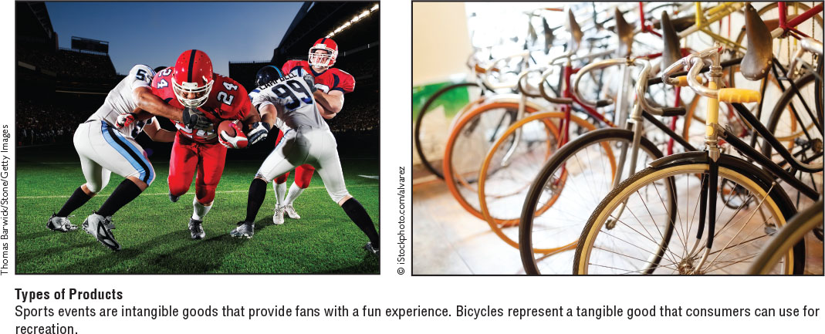
Product Variable
© zayats-and-zayats
Product can be:
  Good—a physical entity that you can touch
  Service—the application of human and mechanical efforts to people or objects to provide intangible benefits to customers
  Idea—concept, philosophy, image, or issue
LO 1-2
© 2016 Cengage Learning. All Rights Reserved. May not be copied, scanned, or duplicated, in whole or in part, except for use as permitted in a license distributed with a certain product or service or otherwise on a password-protected website for classroom use.

Slide 12
Product Variable
© zayats-and-zayats
Product variable includes the creation or modification of brand names and packaging
  May also include decisions regarding warranty and repair services
Product variable decisions and activities directly impact the creation of products that meet customers’ needs and wants
LO 1-2

Slide 13
Distribution Variable
© zayats-and-zayats
Make products available in quantities desired to as many target market customers as possible
While minimizing these three costs:
  Inventory
  Transportation
  Storage
To satisfy customers, products must be available at the right time and in convenient locations
LO 1-2

Slide 14
Distribution Variable
© zayats-and-zayats
Marketing managers may:
  Select/motivate intermediaries (wholesalers and retailers)
  Establish/maintain inventory control procedures
  Develop/manage transportation and storage systems
LO 1-2

Slide 15

Distribution Variable
© zayats-and-zayats
Internet has dramatically impacted distribution
  Making it faster and more wide-spread
  Netflix uses digital distribution that allows consumers to stream movies right off its website.
LO 1-2

Slide 16
Promotion Variable
© zayats-and-zayats
Relates to activities used to inform individuals or groups about the organization and its products
  Aim to increase public awareness of the organization and of new or existing products
  Educate customers about product features
  Urge people to take a stance on a political or social issue
  Help sustain interest in established products
LO 1-2

Slide 17
Price Variable
© zayats-and-zayats
Relates to decisions and actions associated with establishing pricing objectives and policies and determining product prices
  Price is a critical component of the marketing mix as customers are concerned about value obtained in an exchange
  Price is often used as a competitive tool
  Intense price competition sometimes leads to price wars
LO 1-2

Slide 18


Marketing Creates Value
© zayats-and-zayats
Value
Customer Benefits
–
Customer Costs
=
Value is a customer’s subjective assessment of benefits relative to costs in determining the worth of a product
  Customer benefits include anything a buyer receives in an exchange
  Customer costs include anything a buyer must give up to obtain the benefits the product provides including cost, time, effort, and risk
LO 1-3

Slide 19
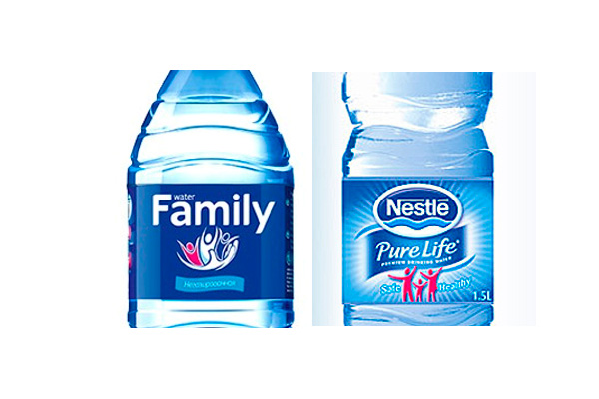
Marketing Creates Value
© zayats-and-zayats
Value is a subjective assessment of benefits relative to costs
Marketing has the ability to increase consumers’ perceptions of a product’s quality and social approval
LO 1-3

Slide 20
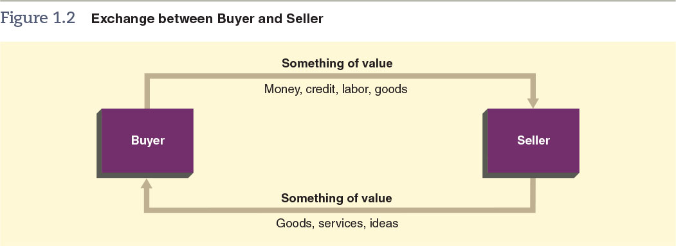
Marketing Builds Relationships
© zayats-and-zayats
Exchanges are the provision of transfer of goods, services, or ideas in return for something of value
LO 1-3

Slide 21
Relationships with Customers
© zayats-and-zayats
For an exchange to take place:
  Two or more parties must participate, and each must possess something of value that the other party desires
  The exchange should provide a benefit or satisfaction to both parties
  Each party must have confidence in the promise of the something of value held by the other
  To build trust, the parties to the exchange must meet expectations
LO 1-3

Slide 22
Relationships with Stakeholders
© zayats-and-zayats
Stakeholders are constituents who have a stake, or claim, in some aspect of a company’s products, operations, markets, industry, and outcomes
Stakeholders include:
  Customers
  Employees
  Investors and shareholders
  Supplies
  Government, communities and more
LO 1-3

Slide 23
Discussion Point – Stakeholders
Starbucks is adept at using the marketing concept to offer a customized experience for its customers
Customers have even come in with their own coffee recipes and, if able, baristas will make them
Starbucks considers its other stakeholders as well; name some ways that Starbucks meets the needs of:
Employees
Suppliers
The Environment
Investors
LO 1-3
Notes:
Sample answers:
Employees: healthcare for part-time employees
Suppliers: Establishment of farmer support centers
Environment: Small discount for customers who bring in their own cups
Investors: Strong return on investment

Slide 24
Marketing Environment
© zayats-and-zayats
The marketing environment is dynamic and includes the following forces:
  Competitive
  Economic
  Political
  Legal and regulatory
  Technological
  Sociocultural
LO 1-4

Slide 25
Figure 1.1 - Components of Strategic Marketing
© zayats-and-zayats
LO 1-4

Slide 26
Marketing Environment
© zayats-and-zayats
These forces affect a marketer’s ability to facilitate value-driven exchanges in three ways:
  Influence customers by affecting their lifestyle, standards of living, and preferences and needs for products
  Help to determine whether and how a marketing manager can perform certain marketing activities
  May affect a marketing manager’s decisions and actions by influencing buyers’ reactions to the firm’s marketing mix
LO 1-4

Slide 27
Marketing Environment
© zayats-and-zayats
Effects of these forces on buyers/sellers can be dramatic and difficult to predict
Impact on value can be extensive as market changes can easily impact how stakeholders perceive certain products
Unlike marketing mix variables, a firm has little control over marketing environment forces
LO 1-4

Slide 28
Understanding the
Marketing Concept
© zayats-and-zayats
According to the marketing concept, an organization should try to provide products that satisfy customers’ needs through a coordinated set of activities that also allows the organization to achieve its goals
  A management philosophy guiding an organization’s overall activities
  A firm must satisfy not only its customers’ objectives but also its own objectives
LO 1-5

Slide 29
Evolution of the
Marketing Concept
© zayats-and-zayats
Production Orientation
  Second half of the 19th century, the Industrial Revolution improved speed and efficiency
  As a result of new technology and new ways of using labor, products poured into the marketplace, where demand for manufactured goods was strong
  Firms were developing the ability to produce more products, and competition was becoming more intense
LO 1-5

Slide 30
Evolution of the
Marketing Concept
© zayats-and-zayats
Sales Orientation
  During the first half of the 20th century competition increased and focus shifted to selling products to buyers
  Marketers were able to learn that many products did not meet consumers needs
  Businesses viewed sales and selling as the main means of increasing profits
  Some people incorrectly equate marketing with a sales orientation
  Some firms still use a sales orientation
LO 1-5

Slide 31
Evolution of the
Marketing Concept
© zayats-and-zayats
Marketing Orientation
  Emerged in the mid-20th century
  Market orientation requires an organization-wide generation of market intelligence pertaining to:
    Current and future customer needs
    Dissemination of the intelligence across departments
    Organization-wide responsiveness to it
  New-product innovation by developing a strategic focus to explore and develop new products to serve target markets
LO 1-5

Slide 32
Implementing the
Marketing Concept
© zayats-and-zayats
Management must first establish an information system to discover customers’ real needs and then use the information to create satisfying products
  An information system is usually expensive; management must commit money and time for its development and maintenance
  Without an adequate information system, however, an organization cannot be market oriented
LO 1-5

Slide 33
Implementing the
Marketing Concept
© zayats-and-zayats
To satisfy customers’ objectives as well as its own, a company also must coordinate all of its activities
Implementing the marketing concept demands the support not only of top management but also of managers and staff at all levels of the organization
LO 1-5

Slide 34
Customer Relationship Management
© zayats-and-zayats
Customer relationship management (CRM) means using information about customers to create marketing strategies that develop and sustain desirable customer relationships
Achieving the full profit potential of each customer relationship should be the fundamental goal of every marketing strategy
LO 1-6

Slide 35
Customer Relationship Management
© zayats-and-zayats
Profits can be obtained through relationships in the following ways:
  By acquiring new customers
  By enhancing the profitability of existing customers
  By extending the duration of customer relationships
Implementing the marketing concept means optimizing the exchange relationship
LO 1-6

Slide 36
Discussion Point – Uber and Customer Relationship Management
Uber is a company that uses a mobile app to connect customers with drivers. The app enables customers to call for a ride where ever they may be, whenever. The rides are less expensive & more convenient for customers than taking a cab.
The taxi industry is trying to stop Uber, by claiming that Uber is operating as a taxi service but not following relevant laws.
  Do you think the CRM used by Uber will continue to make it successful, enabling it to compete with the taxi market?
LO 1-6
Notes:
Student answers will vary.

Slide 37
Relationship Marketing
© zayats-and-zayats
Relationship marketing:
  Refers to long-term mutually beneficial buyer/seller relationships
  Focused on value enhancement through the creation of more satisfying exchanges
  Continually deepens the buyers trust
  Increases the company’s understanding of the customer’s needs
  Through the use of e-marketing, companies can personalize customer relationships on a nearly one-on-one basis
LO 1-6

Slide 38
Customer Lifetime Value
© zayats-and-zayats
Customer lifetime value predicts the net value (profit or loss) for the future relationship with a customer
  Requires identifying patterns of buying behavior and using that to focus on the most promising and profitable customers
  Intangible asset that can be augmented by addressing the customer’s varying needs and preferences
  May include an individual’s strong word-of-mouth communication about the company’s products
LO 1-6

Slide 39
Customer Lifetime Value
© zayats-and-zayats
Emphasis changes from share of market to share of customer
  Most basic application of this idea is 80%of business profits come from 20% of customers
Calculated by taking the sum of the customer’s present value contributions to profit margin over a specific time frame
  Helps determine how best to allocate resources to marketing strategies to sustain a customer over a lifetime
LO 1-6

Slide 40
The Importance of Marketing in Our Global Economy
© zayats-and-zayats
Costs consume a sizable portion of Buyer’s dollars
  About ½ of buyer’s dollars goes toward marketing cost
Used in nonprofit organizations
  Government agencies at all levels engage in marketing activities to fulfill their mission and goals
  Private nonprofit organizations employ marketing activities to create, price, distribute and promote programs that benefit particular segments of society
LO 1-7

Slide 41
The Importance of Marketing in Our Global Economy
© zayats-and-zayats
Important to business and the economy
  Marketing activities help produce profits which are essential to the survival of individual businesses, help create a successful economy and contribute to the well-being of society
Fuels our global economy
  Advances in technology, falling political and economic barriers, and the universal desire for a higher standard of living, have made international marketing commonplace while stimulating global economic growth
LO 1-7

Slide 42
The Importance of Marketing in Our Global Economy
© zayats-and-zayats
Knowledge enhances consumer awareness
  Studying marketing allows us to understand the importance of marketing to customers, firms, and our economy and make better purchasing decisions
Connects people through technology
  Technology helps marketers understand and satisfy more customers than ever before
  Internet allows marketers to disseminate information about products and interact with target markets
LO 1-7

Slide 43
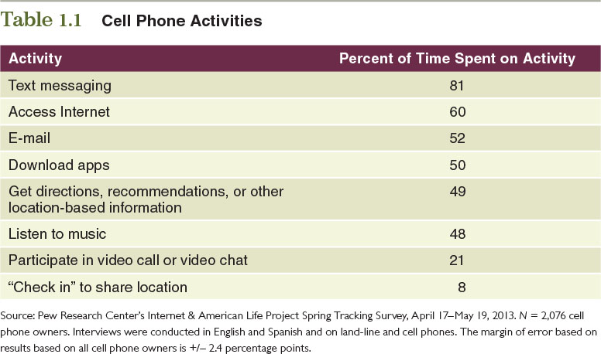
Table 1.1 – Cell Phone Activities
© zayats-and-zayats
LO 1-7

Slide 44
The Importance of Marketing in Our Global Economy
© zayats-and-zayats
Can promote the welfare of customers and stakeholders
  Green marketing—is a strategic process involving stakeholder assessment to create long-term relationships with customers while maintaining, supporting, and enhancing the natural environment
  Market orientation combined with social responsibility improves business performance
Offers many exciting career prospects
  25-33% of civilian workers in the U.S. perform marketing activities
LO 1-7

Slide 45
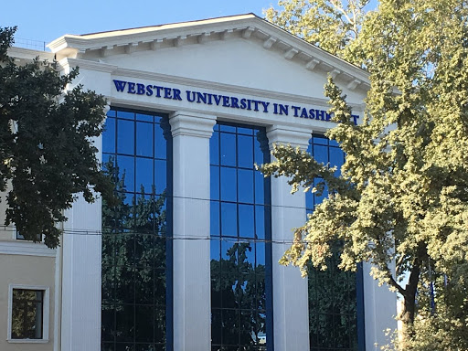
Thank you for your attention!

