Slide 1
Basic Drawing:
Hand, hand pose variations and movements

Slide 2
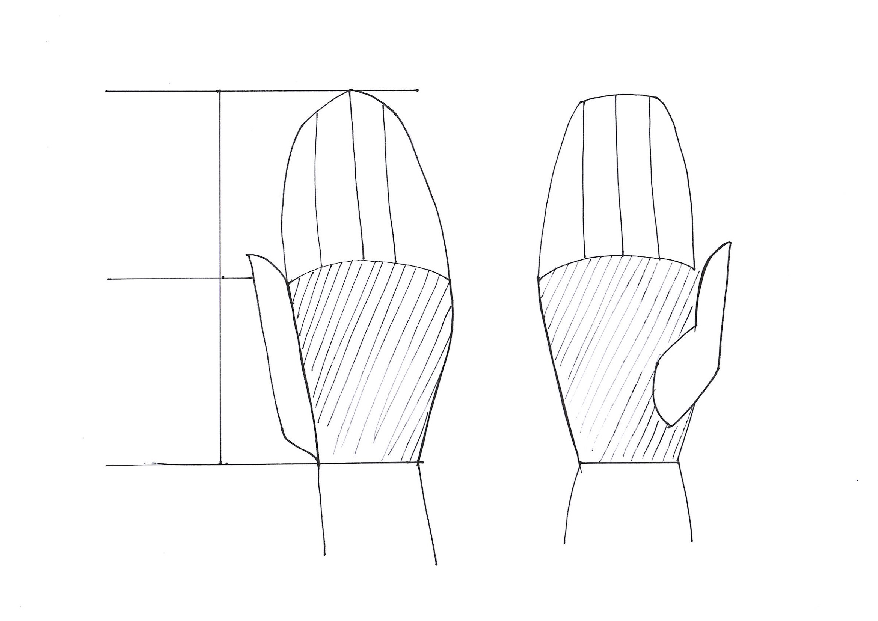
Hand
In Fashion Design Illustration it’s important and enough to catch a total big movement of a hand. There’s no need to draw fingers one by one.
Fingers
Palm

Slide 3
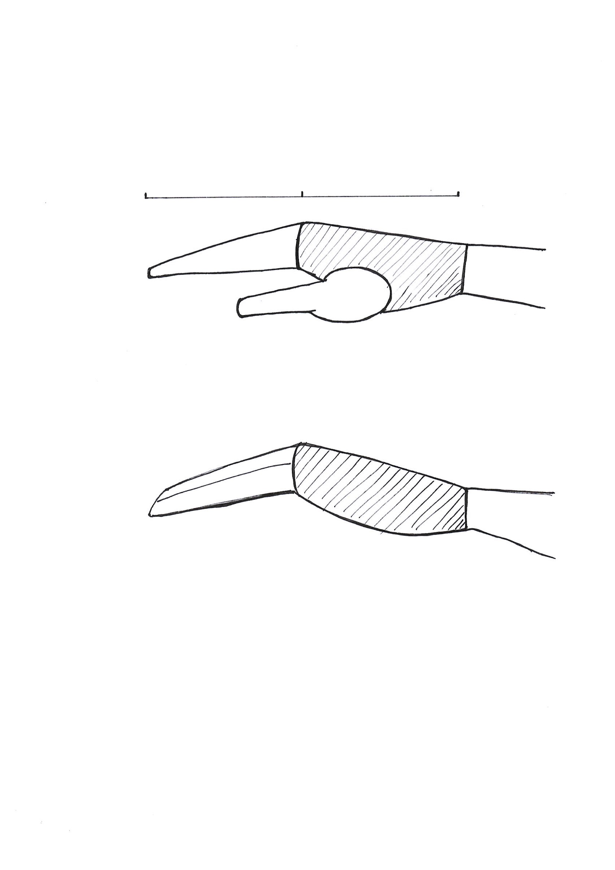
Hand
It’s crucial to think and draw a hand by dividing a structure of it into 4 fingers, palm and a thumb parts.

Slide 4
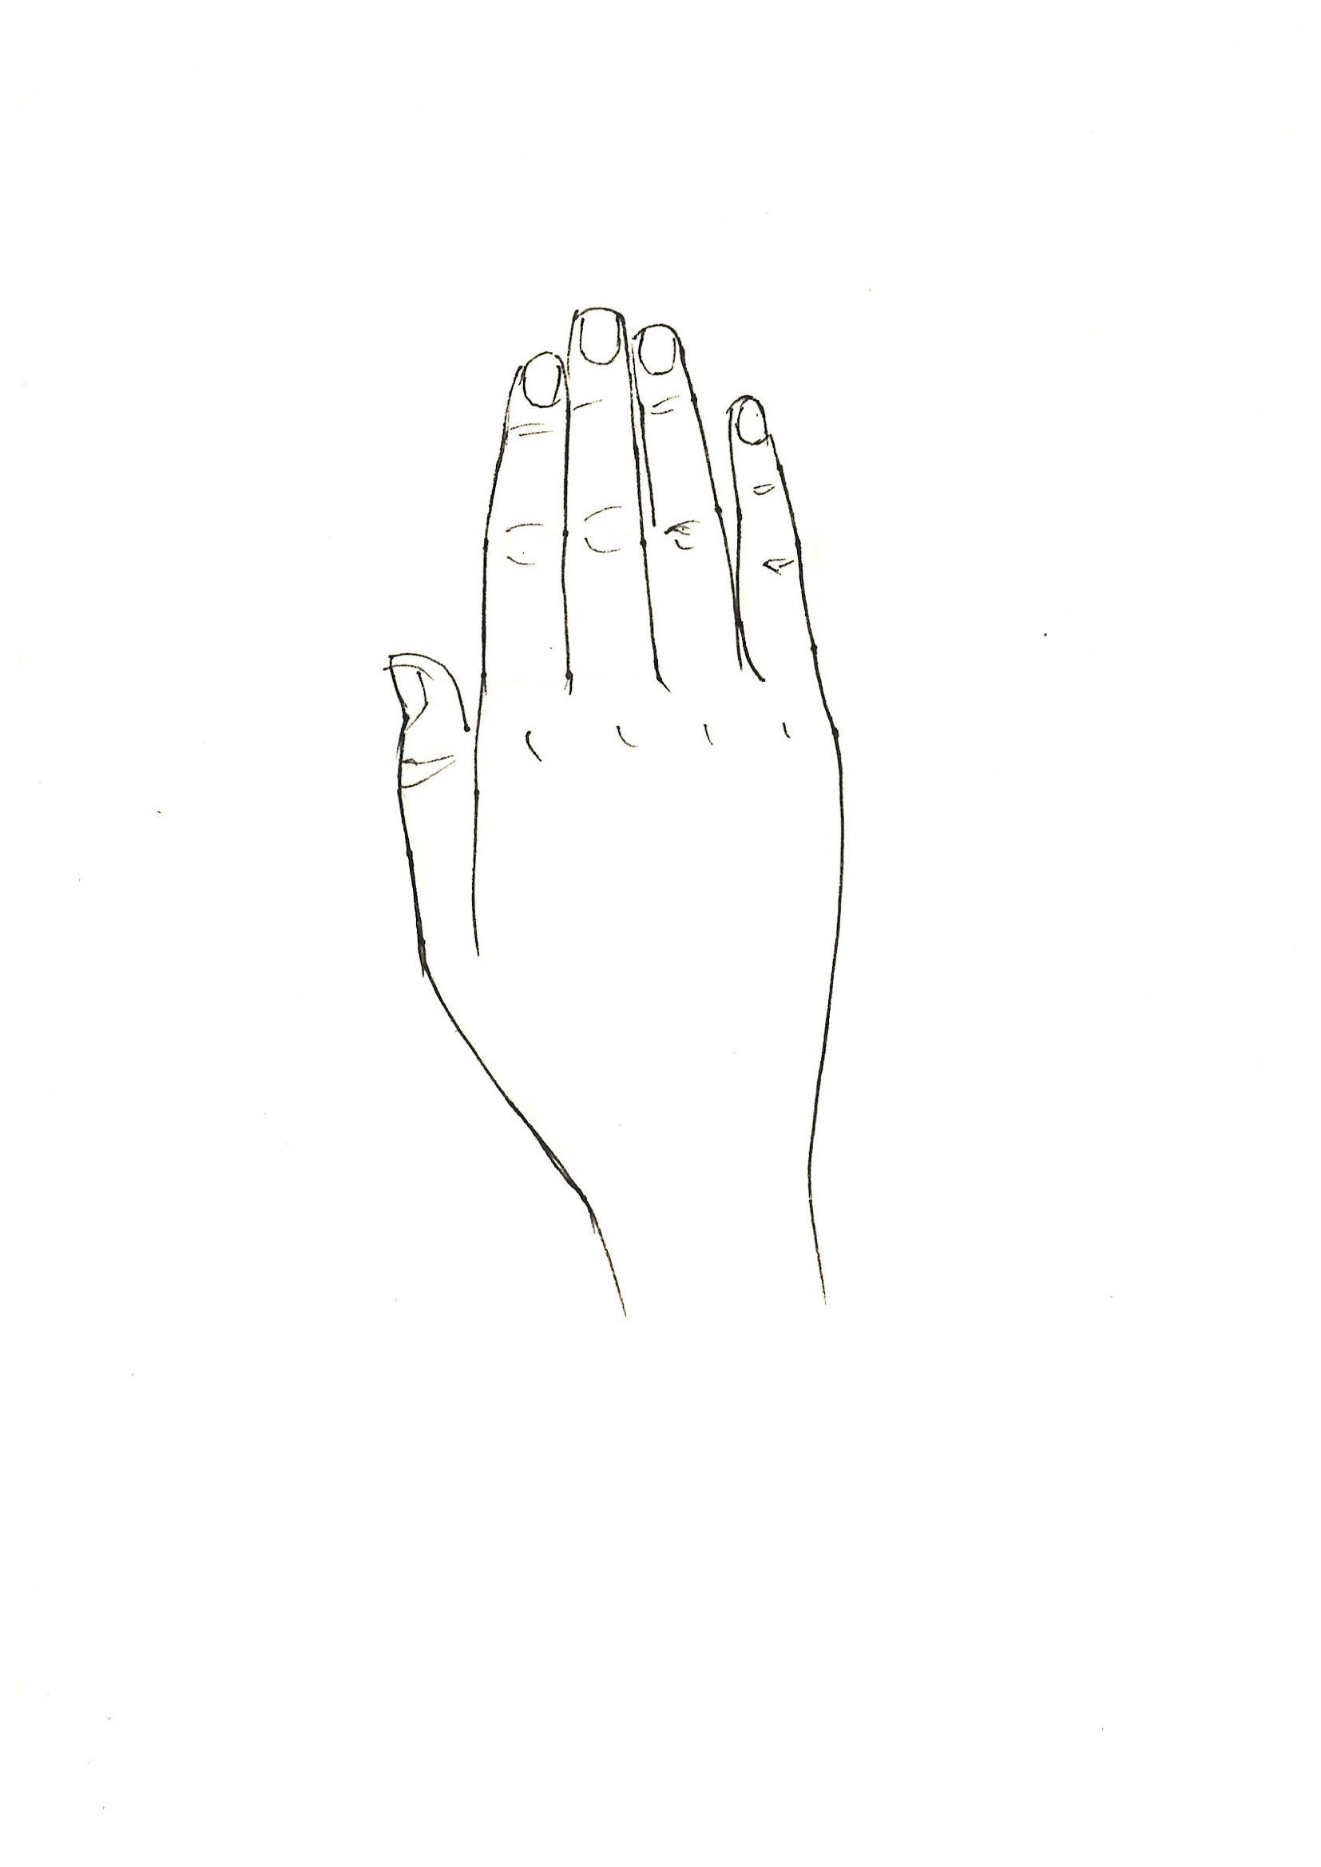
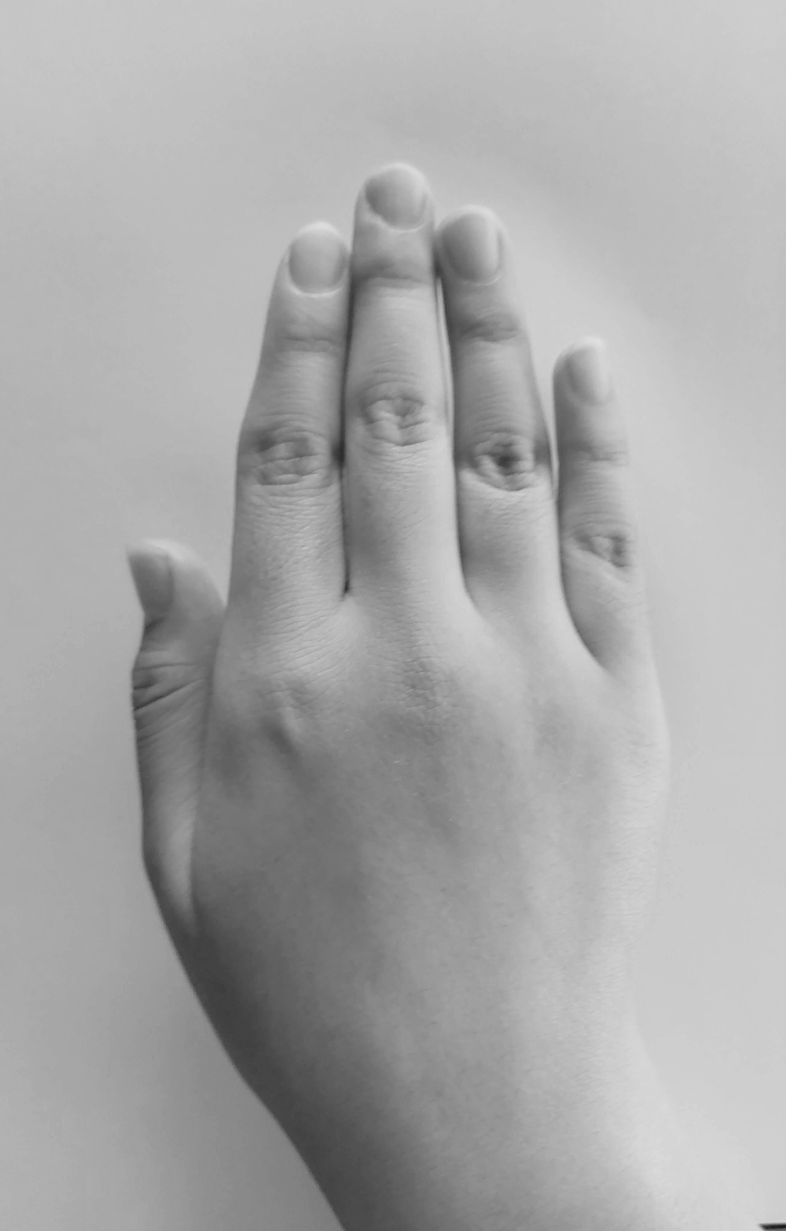
Basic: Hand

Slide 5
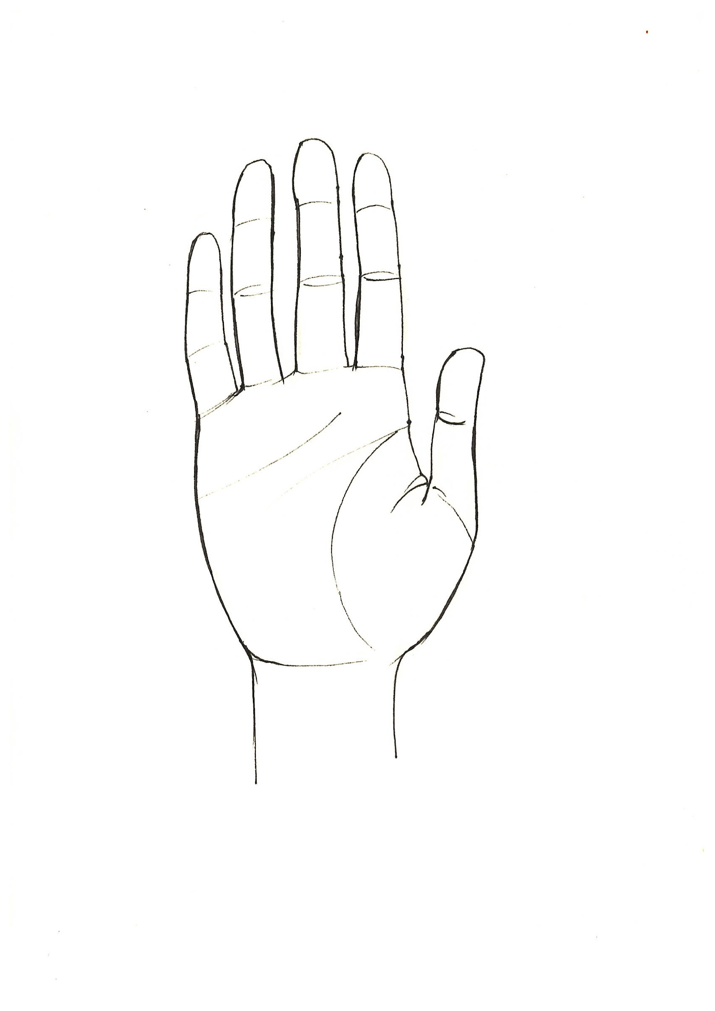
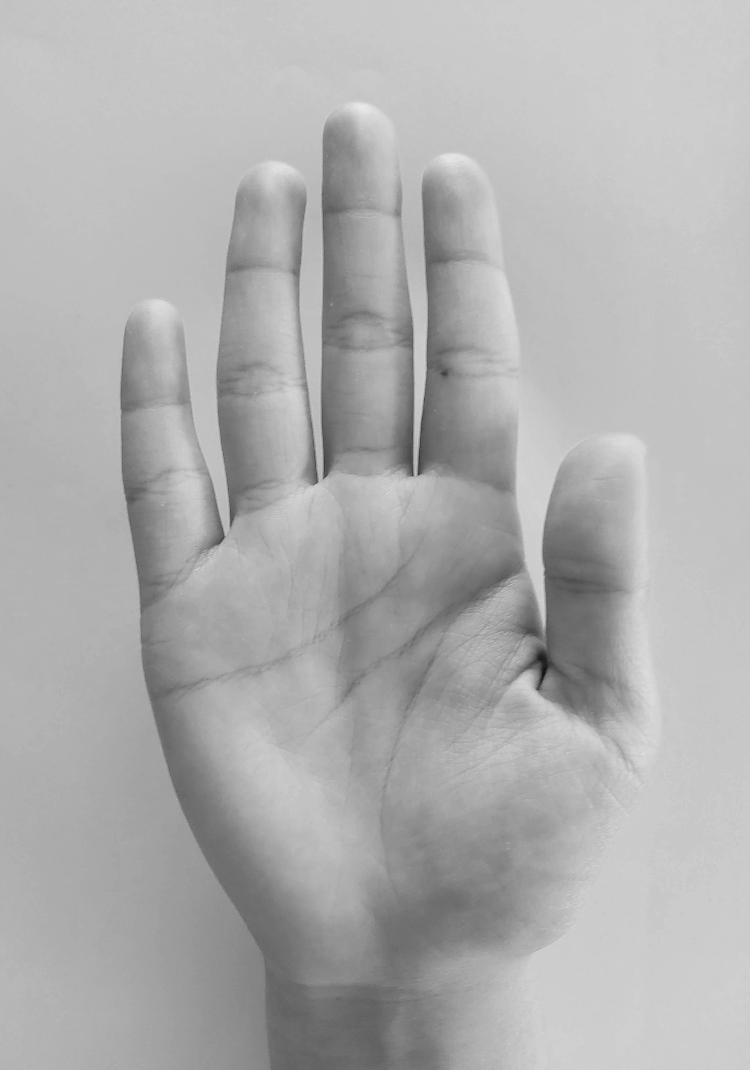
Basic:Hand

Slide 6
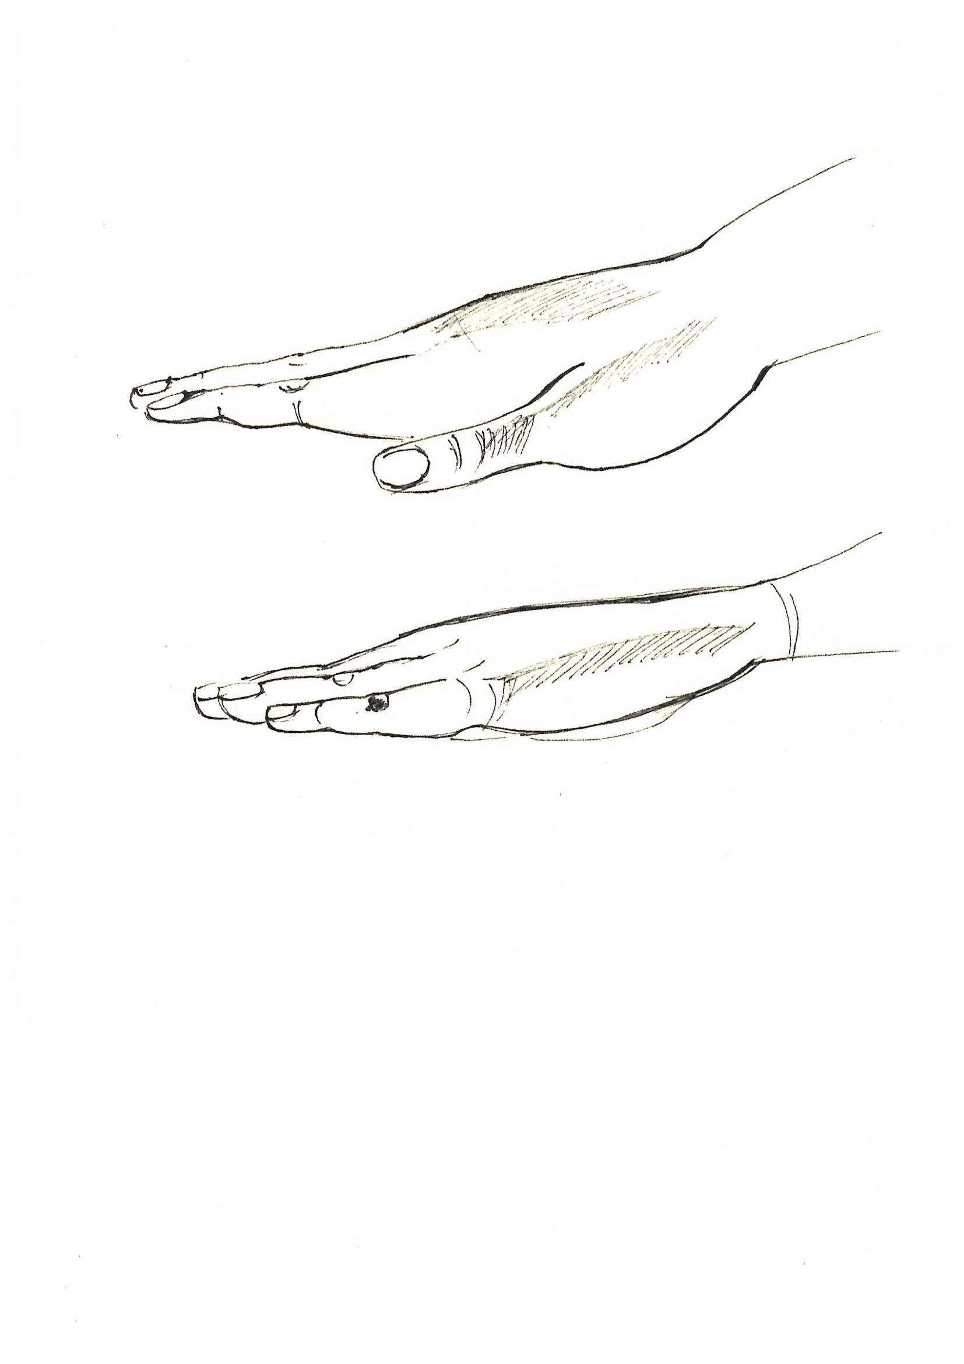
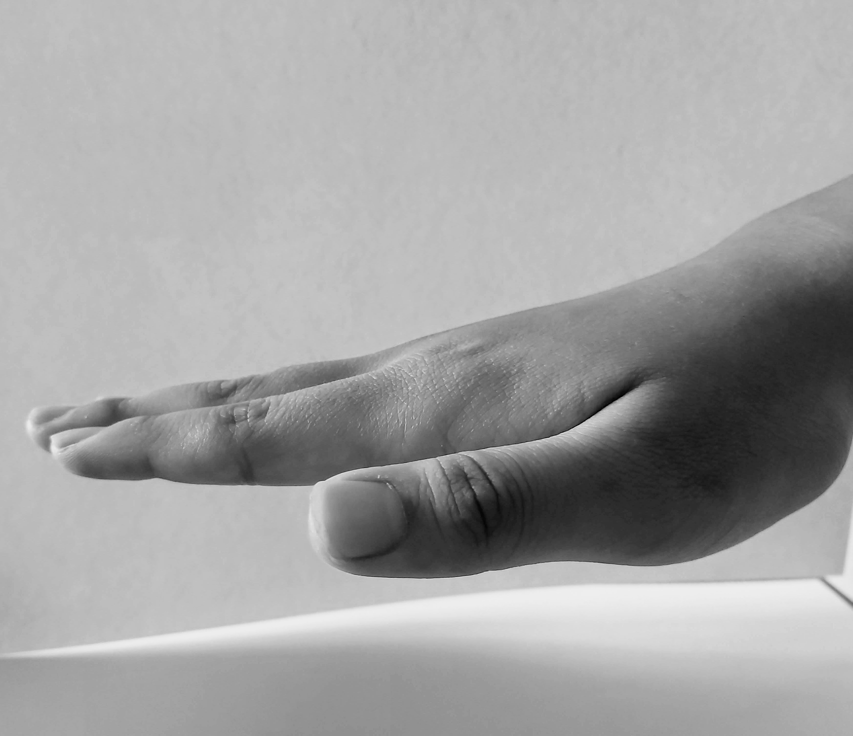
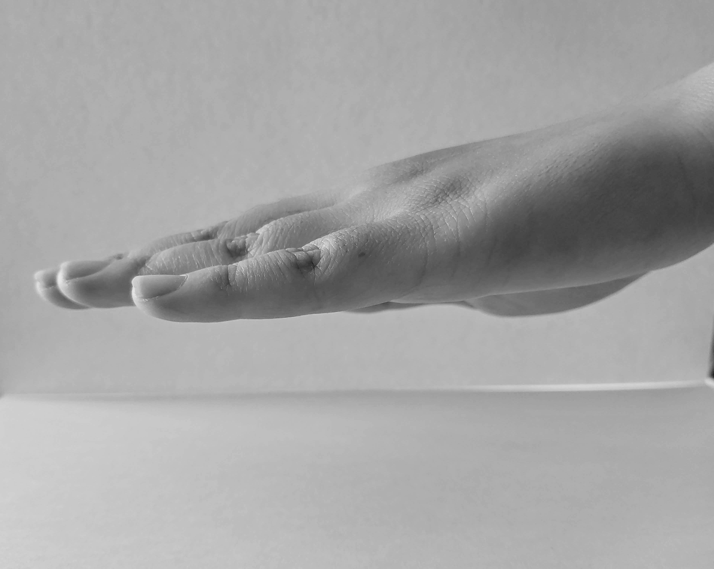

Slide 7
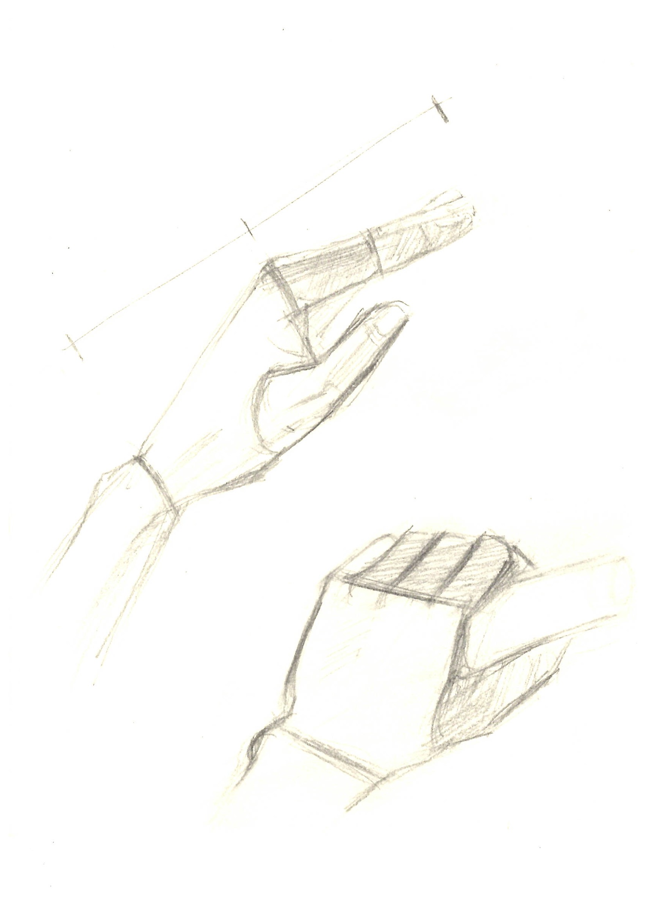
Homework:
Let’s draw our own hand and make 9 pose variations.

