Slide 2


Motivation and Leadership

Slide 3
What is it Motivation?
Motivation Definition:
Internal and external factors that stimulate desire and energy in people to be continually interested and committed to a job, role or subject, or to make an effort to achieve goal.

Slide 4
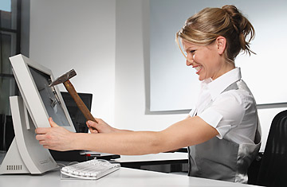
Unhappy Worker

Slide 5

Happy Worker

Slide 6
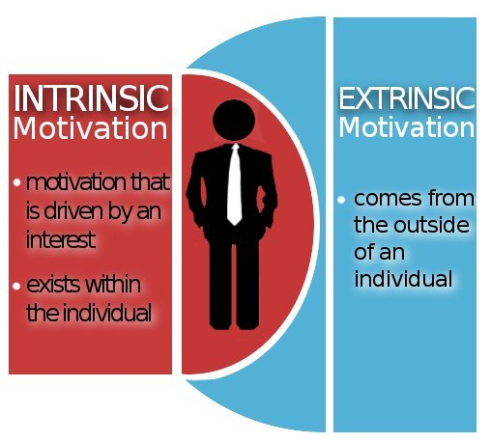
Tools for Motivation

Slide 7

Techniques for Increasing Motivation
Creative a Positive Work Environment
Set Goals
Provide Incentives
Recognize Achievements
Share Profits
Solicit Employee Input
Provide Professional Enrichment

Slide 8



Slide 9

What is it Leadership?
the action of leading a group of people or an organization, or the ability to do this.

Slide 10
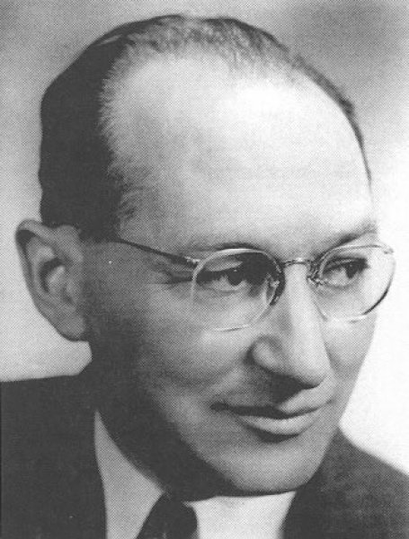
Kurt Lewin

Slide 11

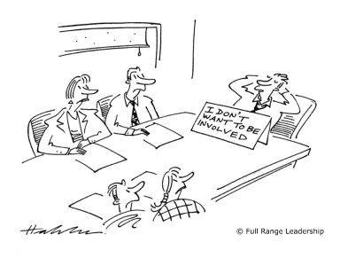

Lewin's Leadership Styles
Autocratic leaders
Laissez-faire leaders
Democratic leaders

