Slide 2

Organizational Culture

Slide 3
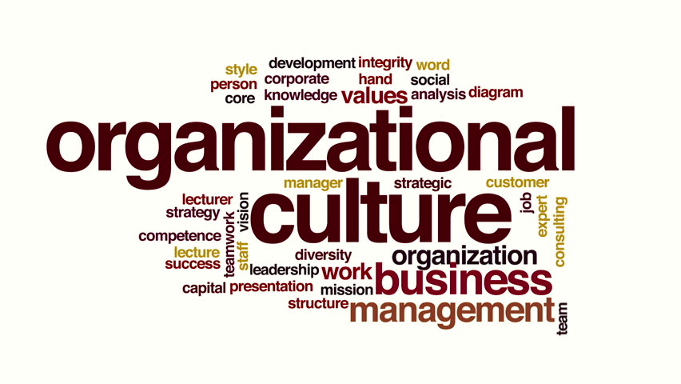
So what is it Organizational Culture?
Organizational culture is defined as the underlying beliefs, assumptions, values and ways of interacting that contribute to the unique social and psychological environment of an organization.

Slide 4
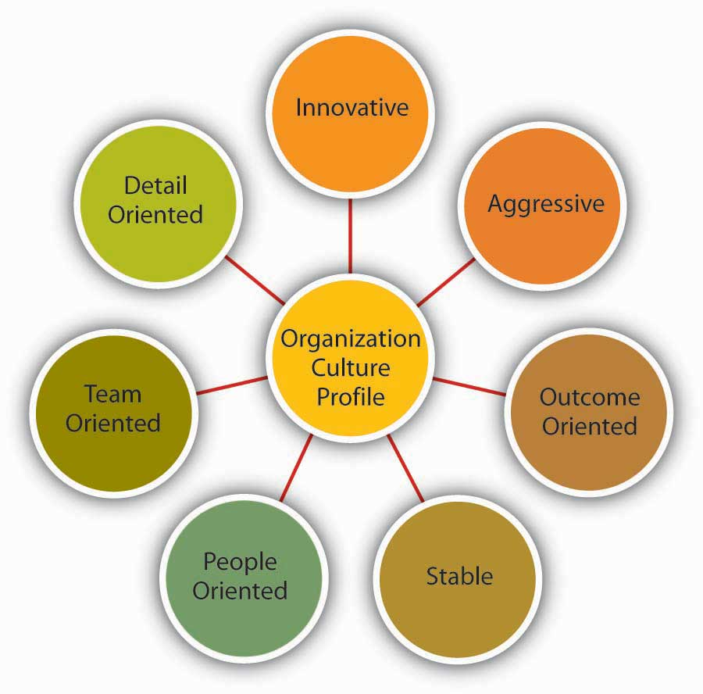
Characteristics of Organizational Culture
Innovation - Risk Orientation
Attention to Detail - Precision Orientation
Emphasis on Outcome - Achievement Orientation
Emphasis on People - Fairness Orientation
Teamwork - Collaboration Orientation
Aggressiveness

Slide 5
An Ideal Organization Culture
• Creating equal opportunities for employees to perform.
• Showing no discrimination in reward or punishment for similar jobs done.
• Rewarding or reprimanding an employee accordingly.
• Understanding the individual as a person and keeping oneself informed on their personal and social aspects efficiency as a person.
• Standing by employees in terms of crisis.
• Not bending organizational rules but allowing room for flexibility and humaneness.
• Allowing true delegation of responsibility or authority.
• Changing roles and responsibilities appropriately.

Slide 6


Business Professors
Robert E. Quinn
and
Kim S. Cameron
From
University of Michigan

Slide 7
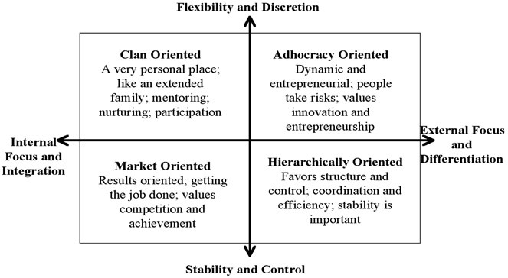
Quinn and Cameron framework

Slide 8
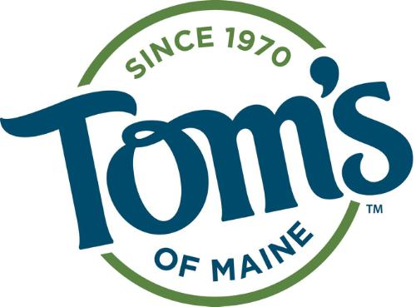
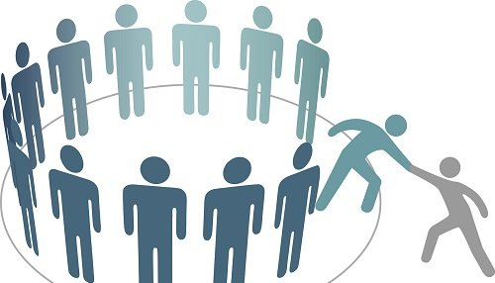
The Clan Culture
A very friendly place to work where people share a lot of themselves. It is like an extended family.

Slide 9
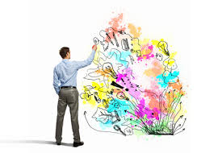
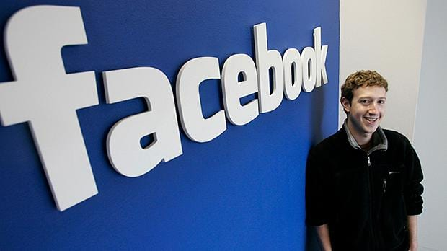
The Adhocracy Culture
Is concerned about achievement of results and providing excellent services to the customers. Here people stick their necks out and take risks.

Slide 10

The Market Culture
A results oriented organization whose major concern is with getting the job done. People are competitive and goal-oriented.

Slide 11
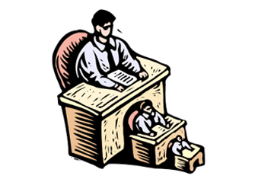
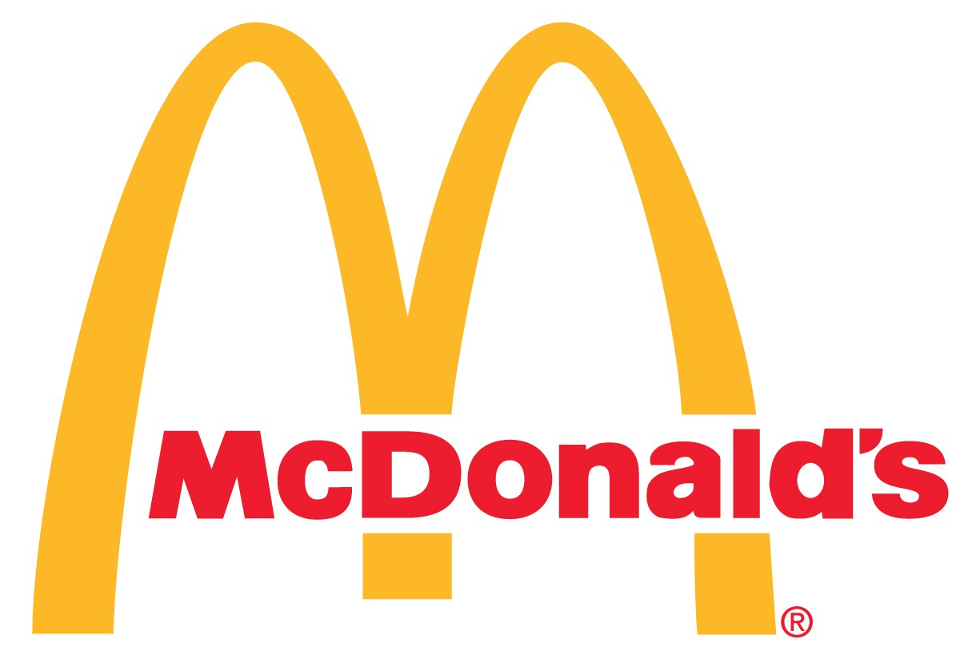
The Hierarchy Culture
Characterized by primacy of procedures and rules, hierarchy and distant and impersonal relationship.

