Slide 2

Forming, Maintaining and Working in Multicultural Teams

Slide 3

Agenda:
Types of labor
Approaches to international staffing
Selection criteria
Expatriate failure
Types of international assignments

Slide 4

Types of Labor
Parent country (HQ location) nationals (citizenship)
Host country nationals
Third country nationals
Expatriates (both PCNs and TCNs)
Expatriate – employee assigned to work and reside in a foreign country for an extended period (over 1 year).

Slide 5

APPROACHES TO INTERNATIONAL STAFFING
Ethnocentric approach
Polycentric approach
Geocentric approach
Regiocentric approach
Notes:
Ethnocentric:
Strategic decisions are made at headquarters;
Limited subsidiary autonomy;
Key positions in domestic and foreign operations are held by headquarters’ personnel; PCNs manage subsidiaries
Polycentric:
Each subsidiary is a distinct national entity with some decision-making autonomy; HCNs manage subsidiaries who are seldom promoted to HQ positions;
PCNs rarely transferred to subsidiary positions
Geocentric
A global approach - worldwide integration; View that each part of the organization makes a unique contribution; Nationality ignored in favour of ability:
Best person for the job; Colour of passport does not matter when it comes to rewards, promotion and development
Regiocentric:
Reflects a regional strategy and structure; Regional autonomy in decision making; Staff move within the designated region, rather than globally;
Staff transfers between regions are rare

Slide 6
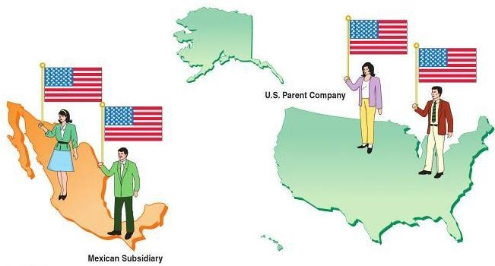
ETHNOCENTRIC APPROACH
The ethnocentric approach places natives of the home country of a business in key positions at home and abroad.
MOTTO this works in my country, so it must work in all other countries.
In this example, the U.S. parent company places natives from the United States in key positions in both the United States and Mexico

Slide 7

REASONS for ETHNOCENTRIC APPROACH:
Lack of qualified HCNs particularly senior management talent.
A desire to maintain good communication, coordination, tighter control and a unified corporate culture linked with corporate HQ.
A desire to transfer parent firm’s core competencies to a foreign subsidiary more expeditiously.

Slide 8

ADVANTAGES OF ETHNOCENTRIC APPROACH:
Organizational control and coordination is maintained and facilitated.
Promising managers are given international experience.
Assure that subsidiary will comply with company objectives.

Slide 9

DISADVANTAGES OF
ETHNOCENTRIC APPROACH
Limits the promotion opportunities of HCNs which may lead to reduced productivity and increased turnover among that group.
The adaptation of expatriate managers to new environment takes time during which these expatriates make poor decisions.
Income packages of expatriates are 4 times higher than locals.

Slide 10
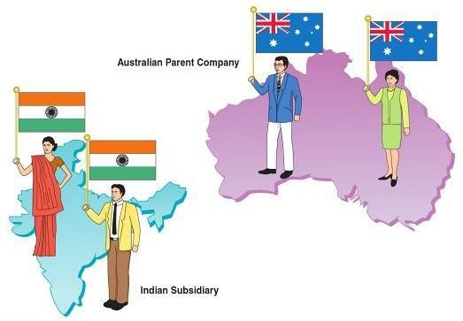
POLYCENTRIC APPROACH
The polycentric approach uses natives of the host country to manage operations in their country and natives of the parent country to manage in the home office.
MOTTO: When in Rome, do as the Romans do.
In this example, the Australian parent company uses natives of India to manage operations at the Indian subsidiary. Natives of Australia manage the home office.

Slide 11
ADVANTAGES OF POLYCENTRIC APPROACH
Eliminates language barriers.
Avoids adjustment problems of expatriates and their families and removes the need for cultural awareness training.
Less expensive.
Gives continuity to the management of foreign subsidiaries, thus reduces turnover.

Slide 12
DISADVANTAGES OF POLYCENTRIC APPROACH
The gap between HQ and subsidiaries increased which becomes difficult to be managed.
Limited career opportunities for HCN and PCN managers.

Slide 13

GEOCENTRIC APPROACH
The geocentric approach uses the best available managers for a business without regard for their country of origin.
In this example, the UK parent company uses natives of many countries at company headquarters and at the U.S. subsidiary.

Slide 14
REASONS FOR GEOCENTRIC APPROACH:
Highly competent employees are available not only at HQs but also in subsidiaries.
International experience is a condition for success in top positions.
Managers with high potential are constantly ready to be transferred from one country to another.

Slide 15
ADVANTAGES OF GEOCENTRIC APPROACH:
Enables an MNC to develop an international executive team.
Overcome the federation drawback of polycentric approach

Slide 16
DISADVANTAGES OF
GEOCENTRIC APPROACH
Host govt. pressurizes MNC to employ high number of HCNs.
Expensive to implement because of training and relocation expense.
Time consuming.
Requires more centralized control of staffing.

Slide 17
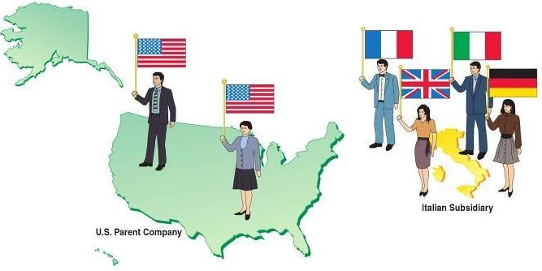
REGIOCENTRIC APPROACH
The regiocentric approach places managers from various countries within geographic regions of a business.
In this example, the U.S. parent company uses natives of the United States at company headquarters. Natives of European countries are used to manage the Italian subsidiary.

Slide 18
ADVANTAGES OF REGIOCENTRIC APPROACH:
Allows interaction between executives transferred to regional HQs.
A step for MNC to move from purely poly or ethnocentric or geocentric approach.

Slide 19
DISADVANTAGES OF
REGIOCENTRIC APPROACH
It provides federalism at regional basis rather than country basis. This serves as a barrier in taking a global stance.
Limits career progression opportunities to the regional level.

Slide 20

Selection Criteria
Highly developed technical skills
Good language and communication skills
Tolerance towards other culture, race, creed, colour, habits, and values
High level of motivation
Stress resistance
Goal-oriented behavior

Slide 21
EXPATRIATE FAILURE
The premature return of an expatriate before completion of assignment is referred to as Expatriate Failure.
It incurs direct as well as indirect cost on the organization.
DIRECT COST:
Airfares
Associated relocation expenses
Salary
Training

Slide 22

REASONS OF EXPATRIATE FAILURE:
Spouse/partner dissatisfaction
Family concerns
Ability to adapt
Wrong Candidate selection
Job fails to meet expectations
Job performance
Quality of life

Slide 23

Types of International Assignments
Short-term
Up to 3 months
Extended
Up to 1 year
Long-term
Varies from 1 to 5 years

Slide 24
Indicative reading
Mead, R (2009). International Management. Chapter 19
Deresky, H (2014). International Management: Managing Across Borders and Cultures. Chapter 9
Dowling, P (2013) International Human Resource Management, 6 edn. Chapter 5
Luthans, F & Doh, J.P. (2012) International Management: Culture, Strategy and Behavior. 8th edn. Chapter 14
Reiche & Harzing (2009) International Assignments, <http://www.harzing.com/download/ihrmchapter.pdf>

