Slide 2

Cross cultural negotiations

Slide 3
Agenda:
What is it Negotiation
Problems in Cross Cultural Negotiation Processes
Stakeholders in the Negotiation Process
Negotiation Process
Tips of Successful Negotiators

Slide 4

What is it Negotiation?
The term negotiation describes the process of discussion by which two or more parties aim to reach an acceptable agreement.
To resolve disputes
To produce agreements
Achieve some goals

Slide 5
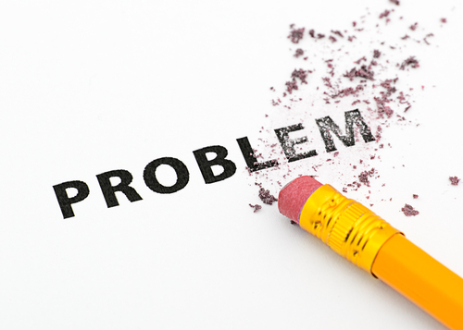
Problems in Cross Cultural Negotiation Processes
Language
Non verbal behavior
Values
Thinking and decision making processes

Slide 6
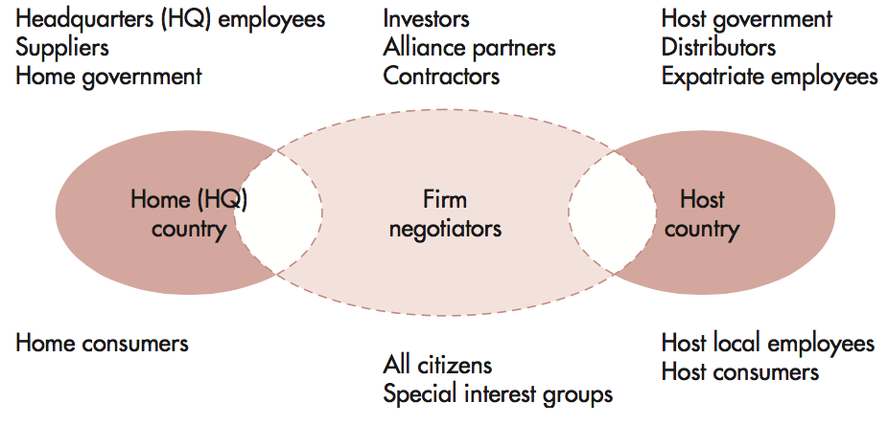
Stakeholders in Cross-Cultural Negotiation
Notes:
An additional problem is that there is often a greater number of stakeholders involved in international negotiations.

Slide 7
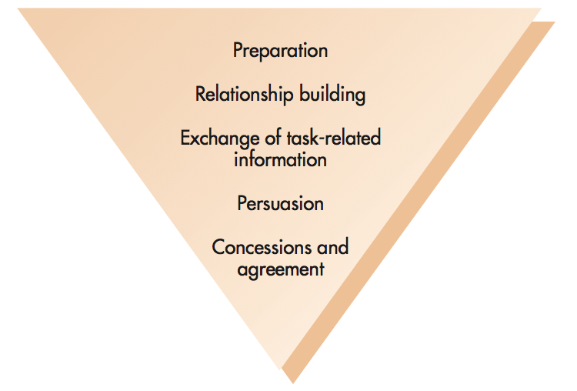
The Negotiation Process
Notes:
The Negotiation Process
Negotiations generally proceed in five stages the ordering of which may vary according to the cultural norms:
preparation,
relationship building,
exchanging task-related information,
persuasion, and
concessions and agreement.
In reality, these stages may overlap and negotiators may temporarily return back to a previous stage.

Slide 8

Stage 1 – Preparation
Develop profile of counterparts.
Find out likely demands, team composition, and counterpart authority.
Choose a negotiation site.

Slide 9

Stage 2 – Relationship Building
•Getting to know one’s and building mutual trust
•Non-task sounding
•Use an intermediary

Slide 10

Stage 3 – Exchanging Task-Related Information
Cultural differences remain an issue.
The French enjoy debate and conflict.
Mexicans can be suspicious and indirect.
The Chinese ask many questions, but provide ambiguous information in return
Show understanding of the other viewpoint

Slide 11
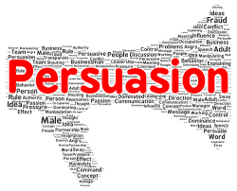
Stage 4 – Persuasion
Dirty tricks are in the eye of the beholder:
  False information
  Ambiguous authority
  Non-verbal messages
  Individualism vs. Collectivism

Slide 12

Stage 5 – Concessions and Agreement
Russians and Chinese start with extreme positions
Swedes start with what they will accept
Starting with extremes may be most effective
Linear vs. holistic
Importance of contracts

Slide 13

Tips for Successful Negotiation
Consider a wider range of options and pay greater attention to areas of common ground
Tend to make twice as many comments regarding long-term issues
More likely to set upper and lower limits regarding specific points
Make fewer irritating comments: “We’re making you a generous offer”
Make counter proposals less frequently and use fewer reasons to back up arguments
Actively listen

