Slide 2

Culture and communication

Slide 3

What is it communication
The Communication Process
Intercultural Communication

Slide 4
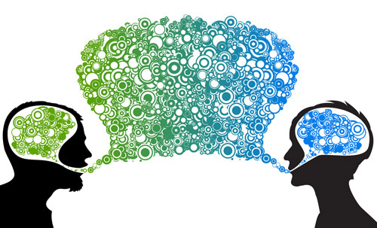
What is it Communication?
Two-way process of reaching mutual understanding, in which participants not only exchange information, news, ideas and feelings but also create and share meaning.

Slide 5
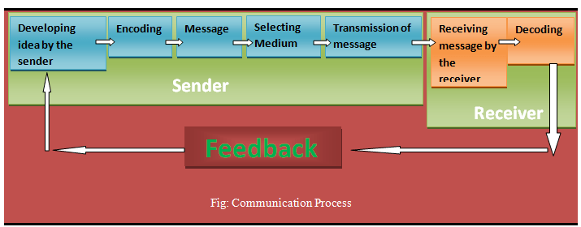
Communication process:

Slide 6
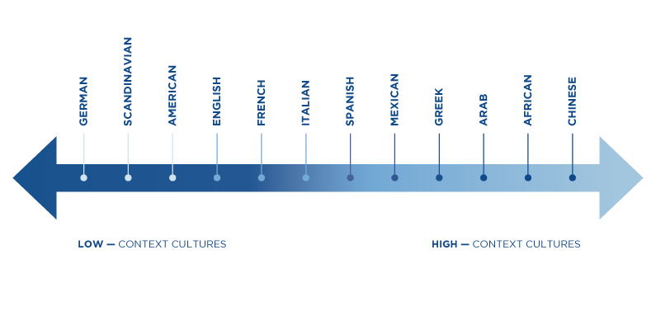
Intercultural Communication
Intercultural communication can be define as a form of communication that shares information across different cultures and social groups.

Slide 7
High Context Cultures
High-context cultures often display the following tendencies:
Association: Relationships build slowly and depend on trust. Productivity depends on relationships and the group process. An individual’s identity is rooted in groups (family, culture, work). Social structure and authority are centralized.
Interaction: Nonverbal elements such as voice tone, gestures, facial expression and eye movement are significant. Verbal messages are indirect, and communication is seen as an art form or way of engaging someone. Disagreement is personalized, and a person is sensitive to conflict expressed in someone else’s nonverbal communication.
Territoriality: Space is communal. People stand close to each other and share the same space.
Temporality: Everything has its own time, and time is not easily scheduled. Change is slow, and time is a process that belongs to others and nature.
Learning: Multiple sources of information are used. Thinking proceeds from general to specific. Learning occurs by observing others as they model or demonstrate and then practicing. Groups are preferred, and accuracy is valued.

Slide 8
Low Context Cultures
Low-context cultures often display the following tendencies,
Association: Relationships begin and end quickly. Productivity depends on procedures and paying attention to the goal. The identity of individuals is rooted in themselves and their accomplishments. Social structure is decentralized.
Interaction: Nonverbal elements are not significant. Verbal messages are explicit, and communication is seen as a way of exchanging information, ideas and opinions. Disagreement is depersonalized; the focus is on rational (not personal) solutions. An individual can be explicit about another person’s bothersome behavior.
Territoriality: Space is compartmentalized. Privacy is important, so people stand farther apart.
Temporality: Events and tasks are scheduled and to be done at particular times. Change is fast, and time is a commodity to be spent or saved. One’s time is one’s own.
Learning: One source of information is used. Thinking proceeds from specific to general. Learning occurs by following the explicit directions and explanations of others. Individual orientation is preferred, and speed is valued.

Slide 9

Conclusion

