Slide 1
Cultural Frameworks
Westminster International University in Tashkent
Notes:
Show video, then provide a problem. By the end of the lecture they should reflect on concepts and provide their opinions

Slide 2

So what is it Cultural Frameworks?
Cultural framework is a term used in social science to describe traditions, value systems, symbols that are common in a given society.

Slide 3

Outline
Hofstede
Kluckhohn and Strodtbeck
Hall
Trompenaars
GLOBE study
Notes:
+Video

Slide 4

Hofstede’s Model
50 countries, 116000 people
Power distance
Uncertainty avoidance
Individualism vs. collectivism
Masculinity vs. femininity
Long vs. short-term orientation

Slide 5
1. Power Distance
Definition: “degree to which the less powerful members of a society accept and expect that power is distributed unequally”
Attitude towards hierarchy and authority, leadership style, decision making

Slide 6

PDI Implications
Small
Large
e.g. Israel, Austria
Practical, systematic managers admit the need for support
(participative leadership)
Subordinates consulted in decision making
e.g. Malaysia, Mexico
Autocratic/paternalistic managers
Centralized decision making
Hierarchy and inequality is accepted, differences encouraged

Slide 7
2. Uncertainty Avoidance
Definition: extent to which people in a society feel threatened by ambiguous situations
Adherence to laws and procedures, subordinate’s initiative, job security and career stability

Slide 8
UAI Implications
Low
High
e.g. Singapore, Denmark
Employees more willing to take risks, less resistance to change
Managers may break formal rules and by-pass hierarchy if necessary
Competition and conflict are considered as healthy and desirable
e.g. Greece, Japan
Subordinates have little initiative (video)
Clear rules and procedures adhered closely
Job security and career stability are emphasized
Precise job descriptions
Notes:
Financial system: banks or stock market?

Slide 9
3. Individualism vs. Collectivism
Individualism – tendency of people to look after themselves and their immediate families with less emphasis on needs of society.
Collectivism – emphasis on group achievements and harmony, and the importance of extended family and group.
Attitude towards conformity, pursuit of personal/group interests, loyalty vs. efficiency, hiring/promotion decisions, adaptation of foreign employees
Notes:
Video explanation

Slide 10
IND Implications
Low
High
e.g. Pakistan, Panama
Loyalty
Group over individual interests
Avoid conflicts, value harmony and saving face
Hiring/promotion based on paternalism
e.g. Australia, UK
Democracy, individual initiative, autonomy
Personal achievements, own needs
Expressing a different opinion, less conformity, efficiency
Hiring/promotion based on achievements and personal capabilities

Slide 11
4. Masculinity vs. Femininity
Masculinity – the degree of traditionally “masculine” values – assertiveness, materialism, and lack of concern for others – prevail on society.
Femininity – emphasizes “feminine” values – concern for others, for relationships and for quality of life.
Roles differentiation, business vs. relationship, attitude towards competition and conflict

Slide 12
MAS Implications
Low
High
e.g. Switzerland, New Zealand
Men and women have more equal access to same jobs at all levels
Human contacts, relationship, quality of life
Collaboration
e.g. Japan, Austria
Roles sharply differentiated
Power and property
Competition, assertiveness, materialism
Business over relationship
Notes:
Welfare well-developed, education subsidized

Slide 13
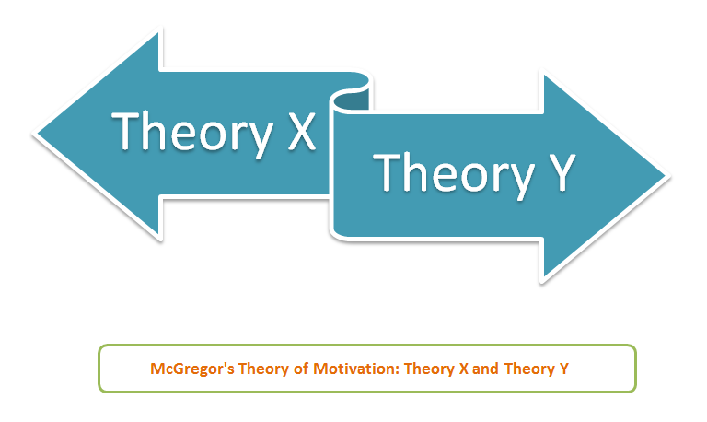
Kluckhohn and Strodtbeck (1961)
What is the nature of people? (e.g. motivation)
Good, evil, a mixture of good and evil
What is the person’s relationship to nature? (e.g. planning, conflict)
Dominant, in harmony, subjugation
What is the person’s relationship to other people ?
(e.g. competition vs. collaboration)
Individual, collateral (collectivist), hierarchical
Notes:
Motivation, planning and conflict, competition vs collaboration,

Slide 14
Kluckhohn and Strodtbeck (1961)
What is the modality of human activity?
(e.g work/business vs. relationships/feelings)
Doing, being
What is temporal focus of human activity ?
(e.g planning)
Future, present, past
What is the conception of space? Private, public
Notes:
Social proximity, public meetings

Slide 15
Hall (1976)
High-context cultures
Low-context cultures
Communication is indirect, environment/context is important in interpreting communications, non-verbal signaling used widely
Agreements tend to be spoken
Relationships are long-lasting
Insiders and outsiders closely distinguished
Messages are explicit
Agreements tend to be written
Relationships relatively shorter
Insiders/outsiders less distinguished
Notes:
Video, Countries? Why written vs spoken agreements? Foreigners adaptation

Slide 16

Global Leadership and Organizational Effectiveness (GLOBE) Project
170 researchers, 7 years collected data on cultural variable, practices and leadership attributes
18,000 managers in 62 countries, varied industries and organization sizes

Slide 17
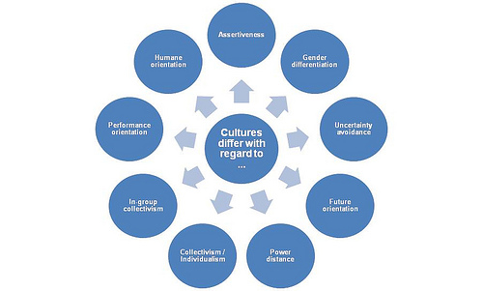
GLOBE Project
Notes:
In-group vs. institutional collectivism

Slide 18
Reading
Mead (2005) Chapter 2
Deresky (2014) Chapter 3
Online sources:
Emerald. Google scholar
HBR 10 Must Reads: On Managing Across Cultures
TED Talks:
Cross cultural communication by Pellegrino Riccardi
Cultural difference in business by Valerie Hoeks
Riding the waves of culture by Fons Trompenaars

