Slide 2
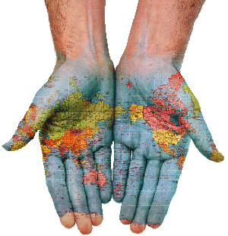
Cultural Differences and People Management

Slide 3

Course Syllabus:
Introduction Cultural Differences and People Management
Cultural Frameworks
Culture and communication
Cross cultural negotiations
Human Resource Management in global companies
Forming, maintaining and working in Multicultural Teams
Cultural Differences and Management Development: Different approaches
Interacting spheres: organizational and national culture
Preparing Expatriates and the “international” manager; training for international assignments
HRM in a Global Company
Organizational Culture
Motivation and Leadership

Slide 4

Lecture 1:
Introduction Cultural Differences and People Management

Slide 5

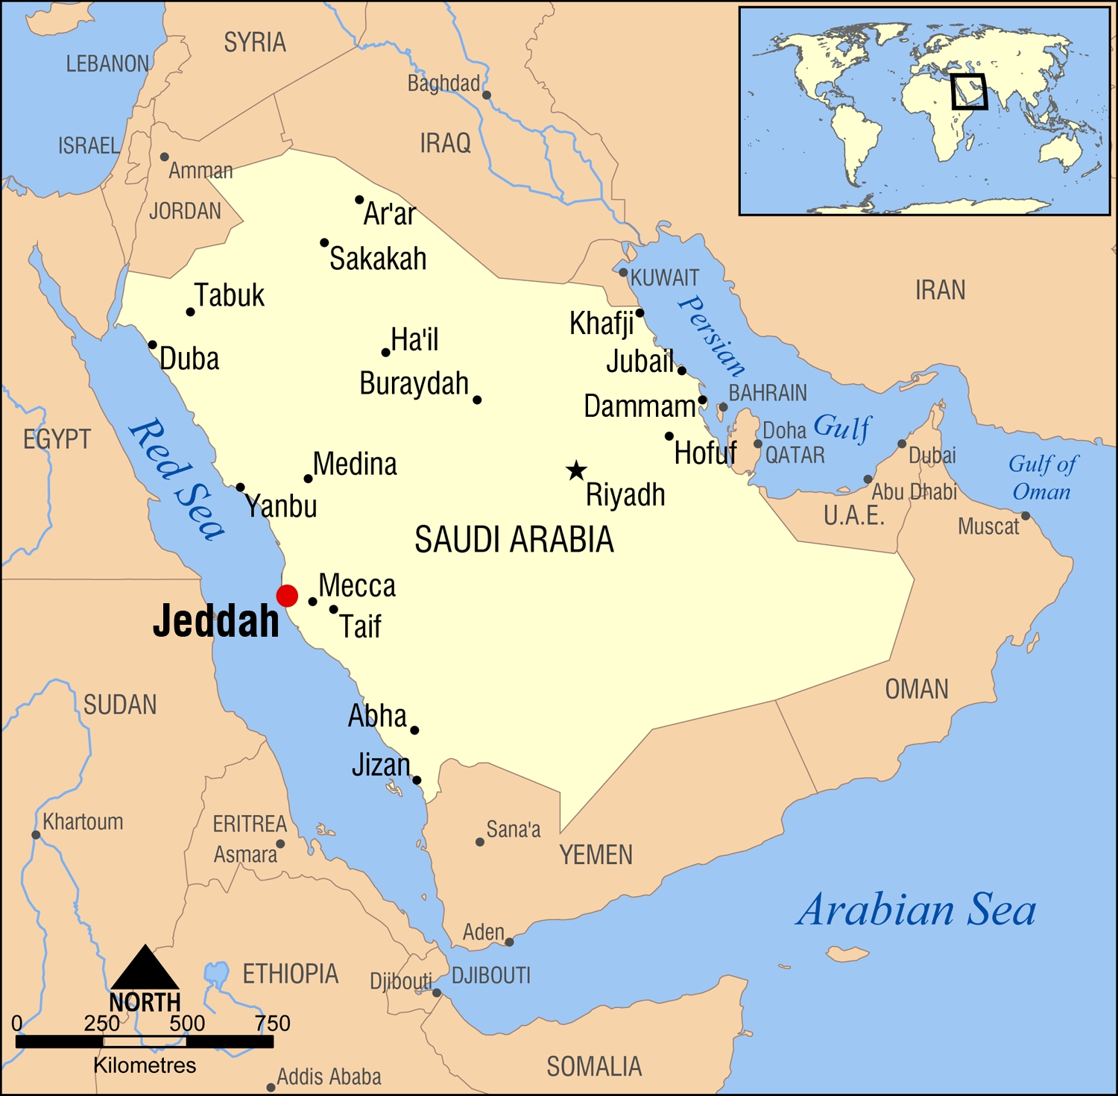
Business in Saudi Arabia

Slide 6
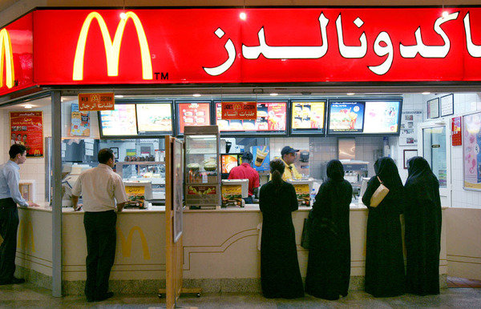
McDonald`s in Saudi Arabia

Slide 7
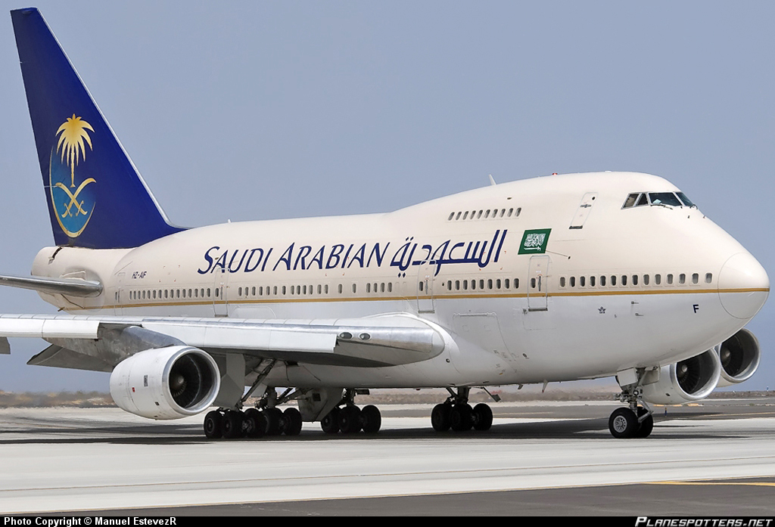

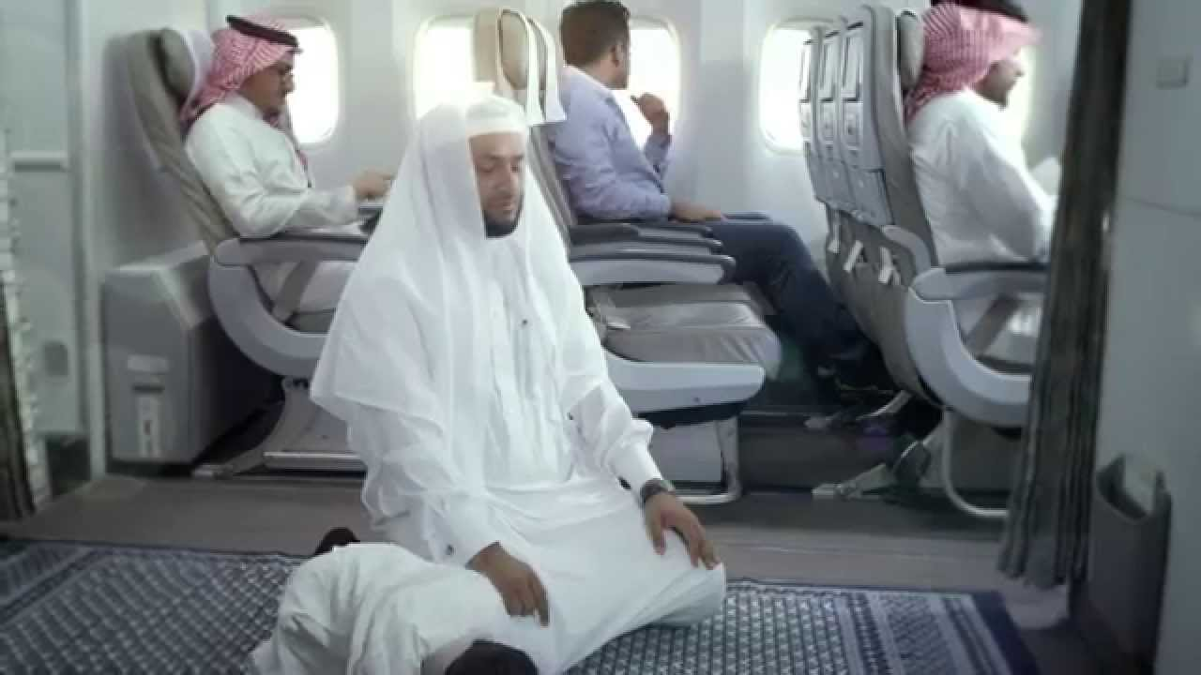

Slide 8
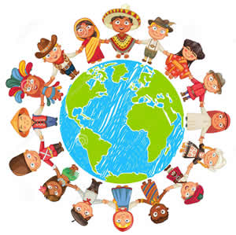
So what is a Culture?
A set of shared values, understandings, assumptions, and goals that are learned from earlier generations, imposed by present members of a society, and passed on to succeeding generations.

Slide 9
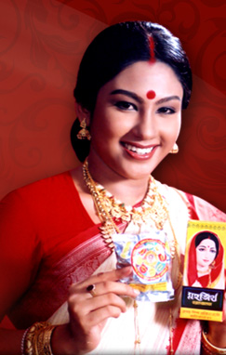
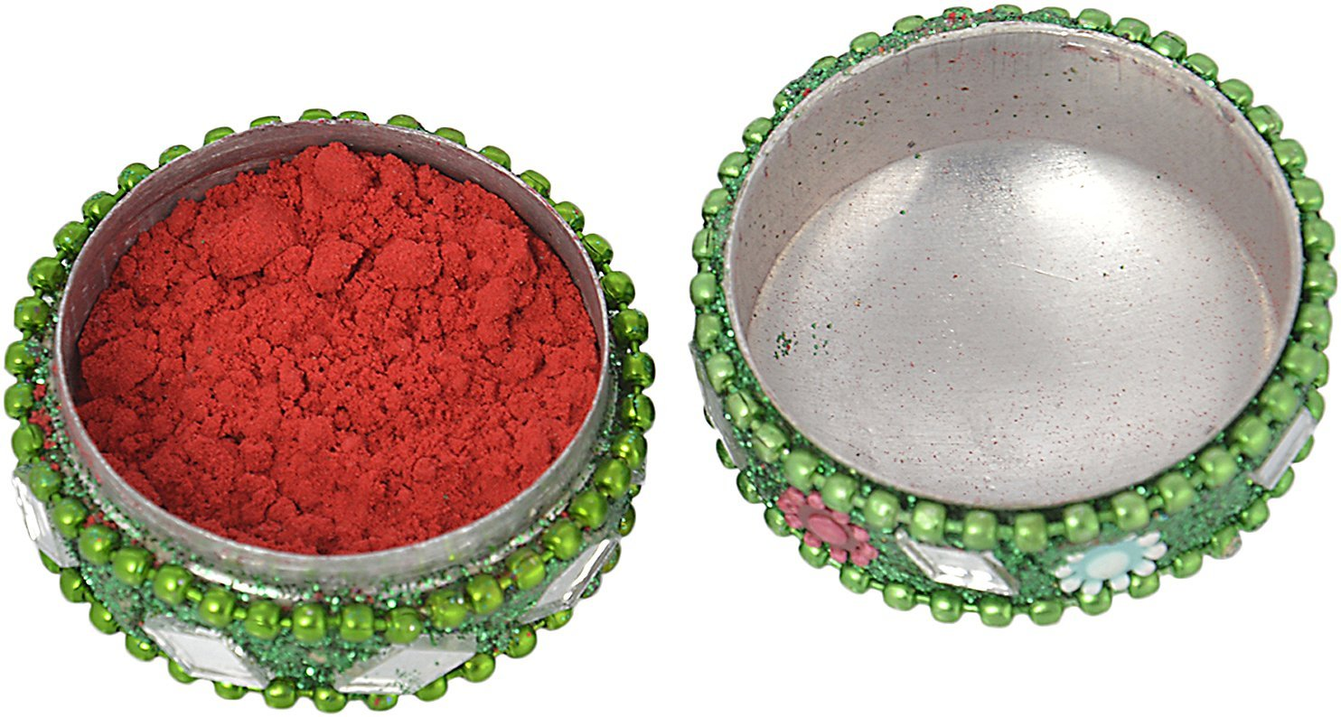
Example:
Women in Indian Society wear Kumkum/Sindur on their foreheads because their parents told them to wear. The parents did the same because their parents had done so.

Slide 10

ELEMENTS OF CULTURE
Language
Nationality
Sex
Education
Profession
Religion
Social class
Family
Norms
Attitudes

Slide 11
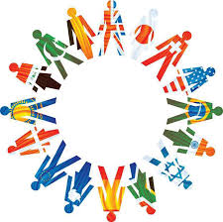
Characteristics of Culture
Culture is learned
Culture is shared
Culture is integrated
Culture is a way of life
Culture is unconscious

Slide 12
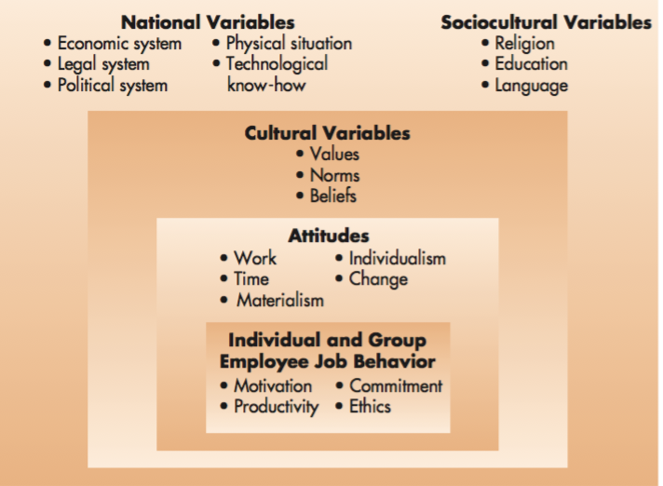
Environmental Variables Affecting Management Functions

Slide 13

Cultural Intelligence
Refers to the capability of individuals to function effectively in multicultural contexts

Slide 14
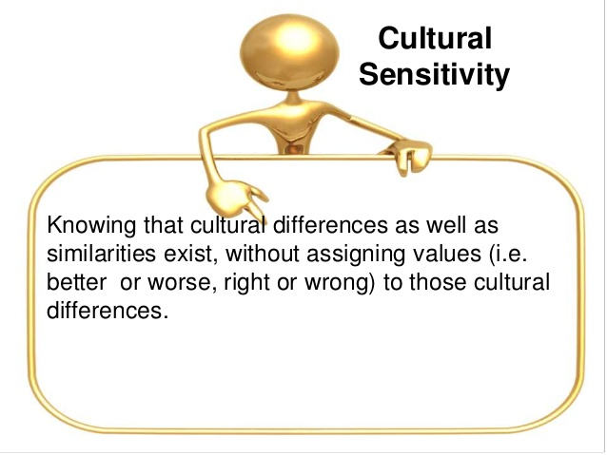
Cultural sensitivity or cultural empathy

Slide 15
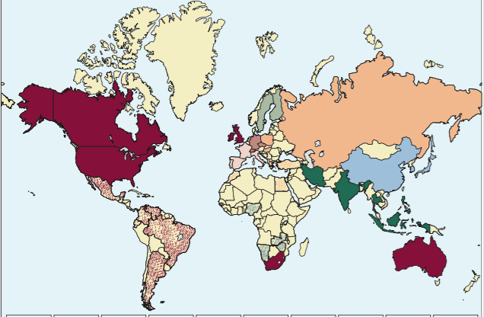
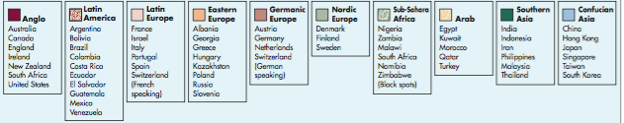
Cultural Cluster

Slide 16

Examples of Company Failure Due to Cultural Mistakes
When Gerber, a Nestle product of baby foods first started selling their baby food in Africa, they used the same packaging as in the USA – with the cute baby on the label. Later they found out that in Africa companies routinely put pictures on the label of what is inside the package, since most people cannot read.

Slide 17
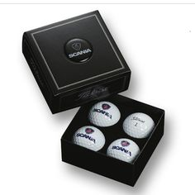
Examples of Company Failure Due to Cultural Mistakes
A golf ball manufacturing company packed golf balls in packs of four for convenient purchase in Japan. Unfortunately, pronunciation of the word “Four: in Japanese sounds like the word “Death” and items packaged in four are unpopular.

Slide 18
Summary
Each society has its own unique culture
Managers must pay more attention to cultural differences
Managers can use research results and personal observations to develop cultural profiles of countries

Slide 19
Reading Materials
1. Bartlett, Ch. & Beamish, P. (2011), Transnational Management, 6th ed., McGraw-Hill Higher
Education.
2. Brown, A. (1995), Organisational Culture, Pitman Publishing: London.
3. Deresky, H. (2014), International Management - Managing across borders and cultures, 8th
ed., Pearson.
4. Gannon, M. and Newman, K.L. (2001), Handbook of Cross-Cultural Management,
Blackwell: Oxford.
5. Gannon, M.J. (2001), Understanding Global Cultures: Metaphorical Journeys Through
Twenty-Three Nations, Sage Publications: London.

