Slide 1
Lecture 4. E-commerce Basics
Keywords: e-commerce, business models, revenue models

Slide 2
Lecture plan
Plan
Main definitions
Business and Revenue Models
Payment and Security
Infrastructure
Main Definitions
Business and Revenue Models
Payment and Security
Infrastructure
Reading and References

Slide 3
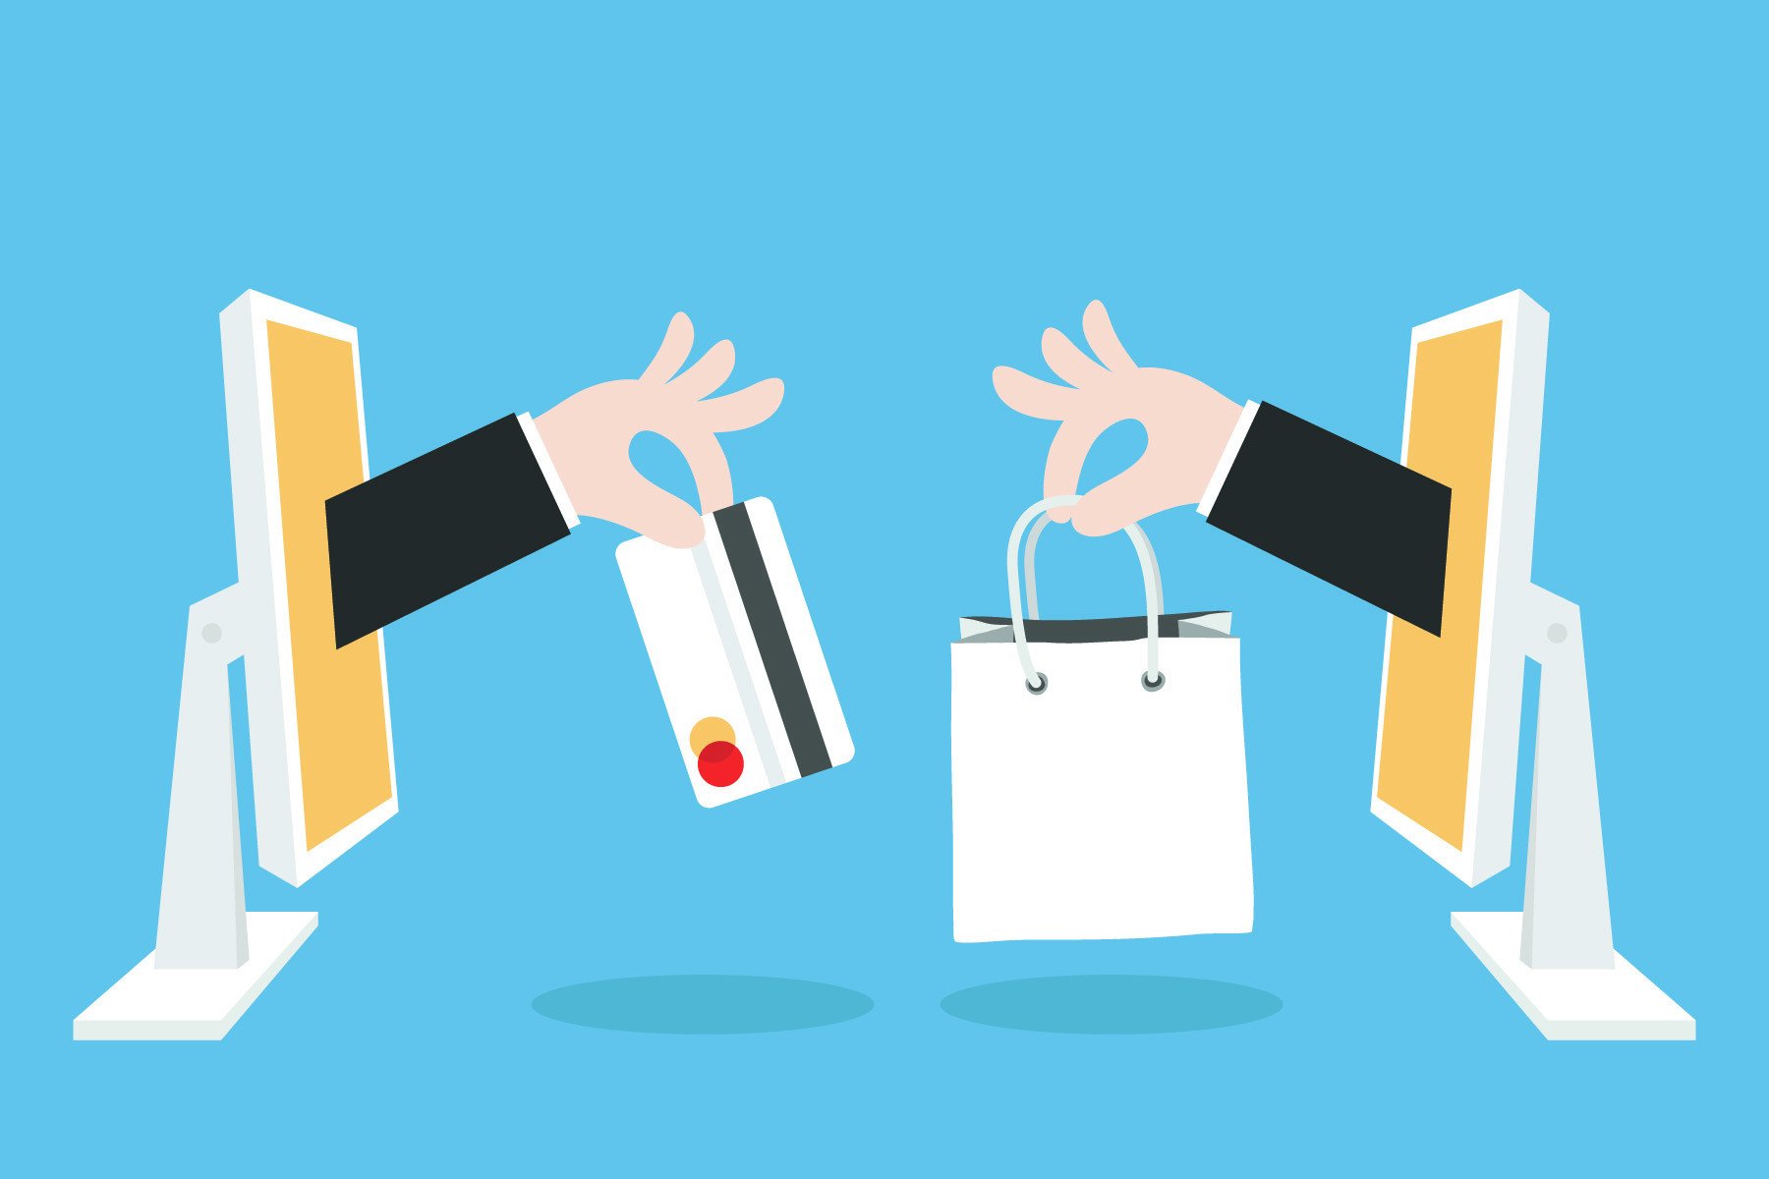
E- Commerce
Plan
Commercial transactions conducted electronically on the Internet.
Main Definitions
Business and Revenue Models
Payment and Security
Infrastructure
Reading and References

Slide 4
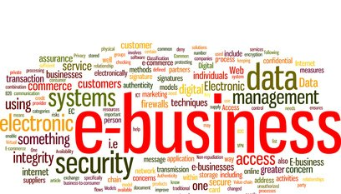
E- Business
Plan
E-business is the conduct of business processes on the Internet
Main Definitions
Business and Revenue Models
Payment and Security
Infrastructure
Reading and References

Slide 5
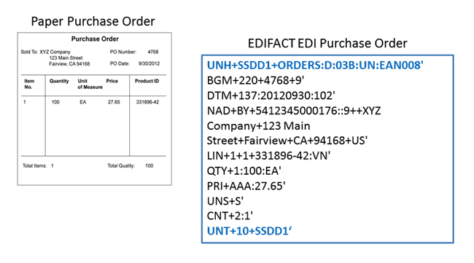
Electronic Data Interchange
Plan
Electronic Data Interchange (EDI) is the electronic interchange of business information using a standardized format; a process which allows one company to send information to another company electronically rather than with paper.
Main Definitions
Business and Revenue Models
Payment and Security
Infrastructure
Reading and References

Slide 6
Plan
E-commerce Business Models
Business - to - Business (B2B)
Business - to - Consumer (B2C)
Consumer - to - Consumer (C2C)
Consumer - to - Business (C2B)
Business - to - Government (B2G)
Government - to - Business (G2B)
Government - to - Citizen (G2C)
Main Definitions
Business and Revenue Models
Payment and Security
Infrastructure
Reading and References

Slide 7
Plan
Business Models examples
B2B – vsem.uz
B2C – arba.uz
C2C – olx.uz
C2B – uzjobs.uz
B2G – chamber.uz
G2B – Toshkent.uz
G2C – mygov.uz
Main Definitions
Business and Revenue Models
Payment and Security
Infrastructure
Reading and References

Slide 8
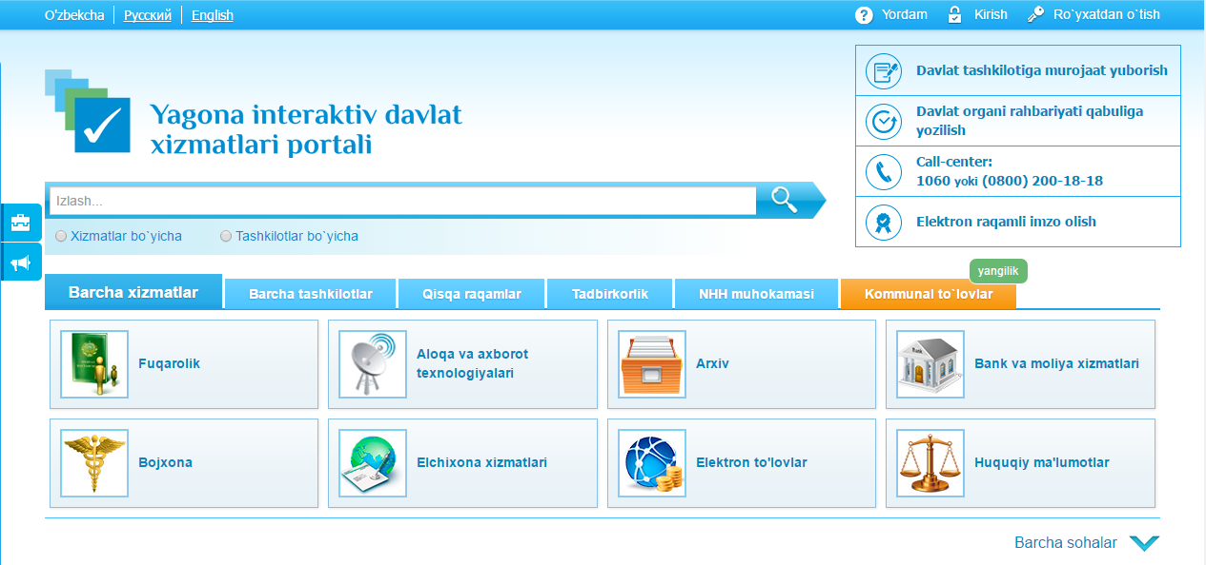
Plan
Mygov.uz – G2C
Main Definitions
Business and Revenue Models
Payment and Security
Infrastructure
Reading and References

Slide 9
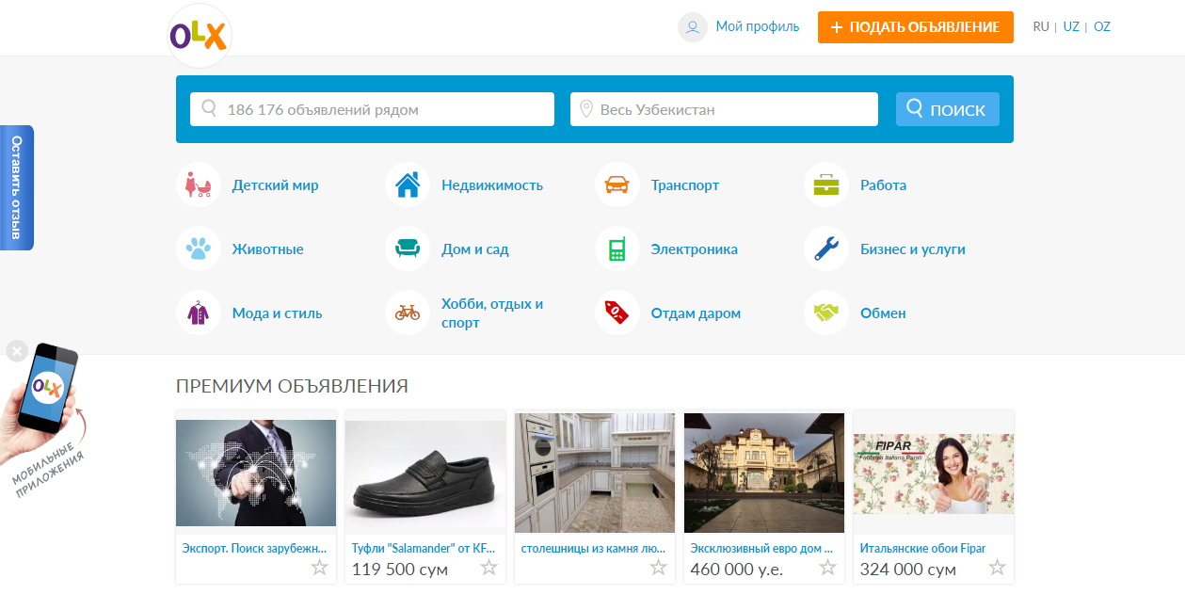
Plan
olx.uz – C2C
Main Definitions
Business and Revenue Models
Payment and Security
Infrastructure
Reading and References

Slide 10
E-commerce - Revenue Models
Plan
Advertising
Subscription fee
Affiliate marketing
Direct sales
Transaction fee
Service fee
Freemium
Main Definitions
Business and Revenue Models
Payment and Security
Infrastructure
Reading and References

Slide 11




How to pay?
Plan
Cards
Bank transfers
Cash in Hand
SMS
Bank transfers
E-money
E-wallets
Main Definitions
Business and Revenue Models
Payment and Security
Infrastructure
Reading and References

Slide 12
Security
Plan
Password protected accounts
Pin numbers
Intermediaries
https
Encryption
Main Definitions
Business and Revenue Models
Payment and Security
Infrastructure
Reading and References

Slide 13
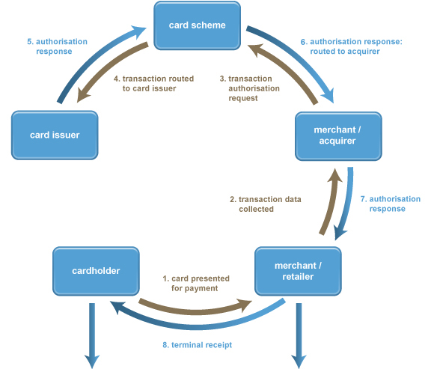
Payment
Plan
Main Definitions
Business and Revenue Models
Payment and Security
Infrastructure
Reading and References

Slide 14
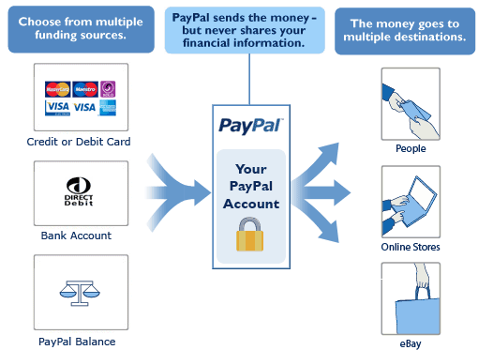
Plan
Intermediary Payment
Main Definitions
Business and Revenue Models
Payment and Security
Infrastructure
Reading and References

Slide 15
Plan
Infrastructure
E- commerce
internet
banks
storage
logistics
customer service
Main Definitions
Business and Revenue Models
Payment and Security
Infrastructure
Reading and References

Slide 16
Reading
Plan
http://www.ecommercetimes.com/story/Google-Gets-Rid-of-17-Billion-Bad-Ads-84258.html
https://successstory.com/companies/alibaba-group
https://www.snapagency.com/blog/7-reasons-why-amazon-is-so-successful
Main Definitions
Business and Revenue Models
Payment and Security
Infrastructure
Reading and References

Slide 17
References
Plan
Main Definitions
E-commerce image: http://www.huffingtonpost.com/andre-averbug/time-for-ecommerce-entrep_b_10162124.html
E-commerce definition: https://en.oxforddictionaries.com/definition/us/e-commerce
E-business definition: http://searchcio.techtarget.com/definition/e-business
E-business image: https://www.linkedin.com/pulse/e-business-important-points-achievement-marcos-de-araujo
EDI Definition: http://www.up.com/suppliers/order_inv/edi/what_is_edi/
PayPal image: http://techwelkin.com/how-to-use-paypal-how-does-paypal-work
Business and Revenue Models
Payment and Security
Infrastructure
Reading and References

