Slide 1
Lecture 6. Information systems
Keywords: information system, data processing, generic model of a system

Slide 2
Lecture plan
Plan
Definitions and Types of Information Systems
Benefits and Risks
Development of Information Systems
Definitions and Types of IS
Benefits and Risks
Development of IS
Reading and References

Slide 3
System
Plan
An organized, purposeful structure that consists of interrelated and interdependent elements (components, entities, factors, members, parts etc.).
These elements continually influence one another (directly or indirectly) to maintain their activity and the existence of the system, in order to achieve the goal of the system.
Definitions and Types of IS
Benefits and Risks
Development of IS
Reading and References

Slide 4
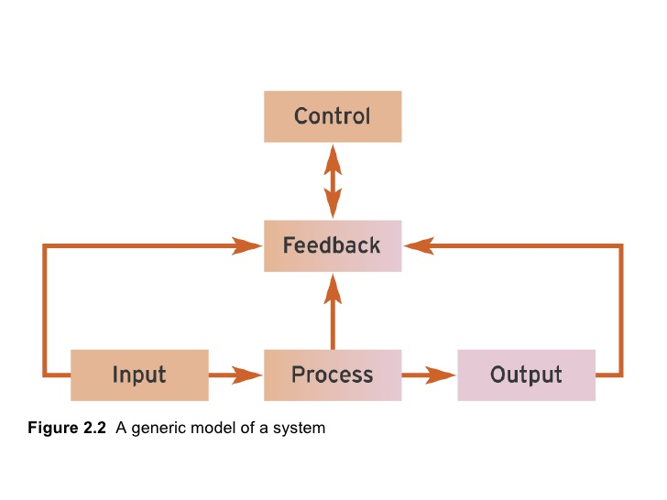
Generic System Model
Plan
Definitions and Types of IS
Benefits and Risks
Development of IS
Reading and References

Slide 5

Input
Plan
Input – the set of entities that enter the system and go through the transformation process.
Normally input is classed as data – raw facts, that lack meaning before being processed.
Definitions and Types of IS
Benefits and Risks
Development of IS
Reading and References

Slide 6
Process
Plan
Process – a set of functions or operations performed by the system in order to transform input into output.
Definitions and Types of IS
Benefits and Risks
Development of IS
Reading and References

Slide 7
Output
Plan
Output – a set of entities that leave the system after being obtained from the input, though application of transformation processes.
Normally, output is information - useful facts obtained as output from a computer by means of processing input data
Definitions and Types of IS
Benefits and Risks
Development of IS
Reading and References

Slide 8
Feedback
Plan
Feedback – a set of facts, data, information collected that relate to the performance of system, i.e. if the output is useful, if the system fulfils its goals etc.
Definitions and Types of IS
Benefits and Risks
Development of IS
Reading and References

Slide 9
Control
Plan
Control – a mechanism by which changes in the system can be introduces , normally in order to enhance its performance or respond to the changing environment.
The main stimulus for control mechanism trigger is analysis of feedback.
Definitions and Types of IS
Benefits and Risks
Development of IS
Reading and References

Slide 10
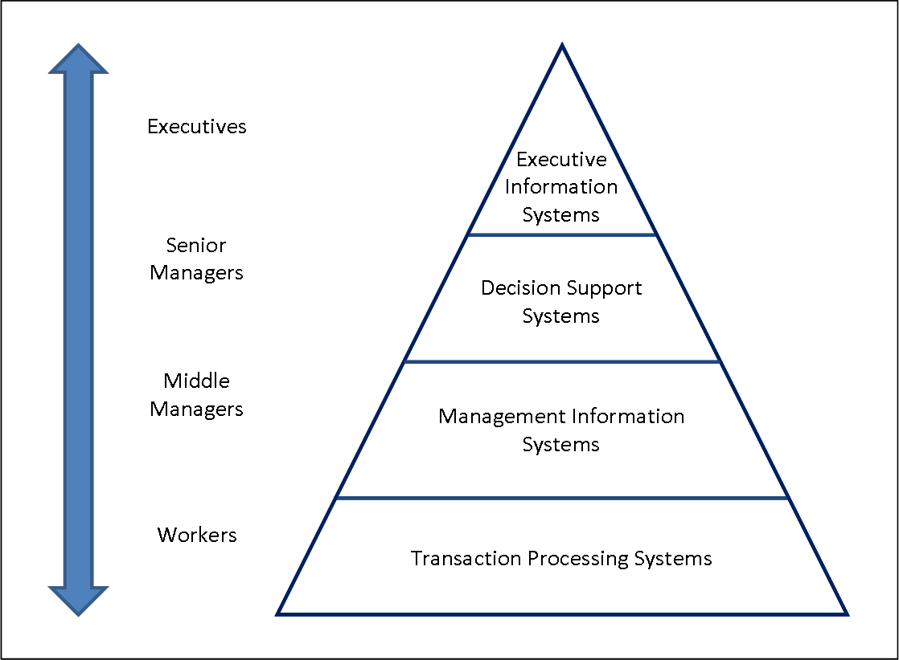
Types of Information Systems
Plan
Definitions and Types of IS
Benefits and Risks
Development of IS
Reading and References

Slide 11
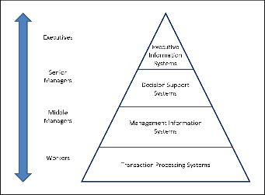
Transaction Processing Systems
Plan
Transaction Processing Systems (TPS) – are mainly designed for processing day to day routine activities such as sales, stock levels, invoices etc. The are normally dealing with large volume of raw data and provide tools for basic analysis of these data such as summaries, averages, balances etc.
Definitions and Types of IS
Benefits and Risks
Development of IS
Reading and References

Slide 12
Management Information Systems
Plan
Management Information Systems (MIS) – provide data for analysis and assist in analysis of these data for supporting managerial decision making. Management information systems are used to identify problems, propose solutions, control and monitor implementation.
Definitions and Types of IS
Benefits and Risks
Development of IS
Reading and References

Slide 13
Decision Support Systems
Plan
Decision Support Systems (DSS) – Higher level of data analysis to assist in tactical planning and forecasting
Definitions and Types of IS
Benefits and Risks
Development of IS
Reading and References

Slide 14
Executive Information Systems
Plan
Executive Information Systems (EIS) – is a type of DSS, but it assists in making strategic level decision and serves the purpose in assisting the executive management in forward planning and decision making.
Definitions and Types of IS
Benefits and Risks
Development of IS
Reading and References

Slide 15
Plan
Benefits of IS
Economy of resources
Improved decision making base
Standardization
Enhanced business processes
Definitions and Types of IS
Benefits and Risks
Development of IS
Reading and References

Slide 16
Plan
Economy of Resources
Data storage physical spacing reduction
Staff costs optimization
Data processing costs minimization
Data analysis automation
Investment in new technology
Definitions and Types of IS
Benefits and Risks
Development of IS
Reading and References

Slide 17
Plan
Standardization
Administrative standardization
Automation of processing
Automation of data entry
Utilization of standard formats for data entry
Development of cross departmental/cross country protocols for information exchange
Definitions and Types of IS
Benefits and Risks
Development of IS
Reading and References

Slide 18
Plan
Improved Decision Making
Reports generation
Data analysis automation
On demand statistics
Access to historical data
Definitions and Types of IS
Benefits and Risks
Development of IS
Reading and References

Slide 19
Plan
Enhanced business processes
Reduction of data redundancy incidents
Centralization of training and business process development
Use of single database
Centralized management
Definitions and Types of IS
Benefits and Risks
Development of IS
Reading and References

Slide 20
Plan
Risks in IS
Security of data
Development costs
Maintenance cost
Infrastructure costs
Reliance on the system
Definitions and Types of IS
Benefits and Risks
Development of IS
Reading and References

Slide 21
Plan
Security of Data
Levels of access
Management of unauthorised access to data
Information security handling
Encryption and Decryption of data
Security protocols development
Definitions and Types of IS
Benefits and Risks
Development of IS
Reading and References

Slide 22
Plan
Development costs
Outsourcing of development
Costs of development and/or customization
Project management costs
Staff training costs
Resistance to change management
Definitions and Types of IS
Benefits and Risks
Development of IS
Reading and References

Slide 23
Plan
Maintenance costs
Outsourcing of maintenance
In-house maintenance
Dependence of business process on maintenance of the system
Management of system problems and failures
Definitions and Types of IS
Benefits and Risks
Development of IS
Reading and References

Slide 24
Plan
Infrastructure costs
Investment in computer equipment
Investment in Software
Investment in Server equipment
Investment in outsourcing of services
Investment in technical support
Definitions and Types of IS
Benefits and Risks
Development of IS
Reading and References

Slide 25
Plan
Reliance on the system
Training for system changes
Business processes in case of system failure
Communication protocols outside the system
Influence of the system on culture and diversity
Definitions and Types of IS
Benefits and Risks
Development of IS
Reading and References

Slide 26
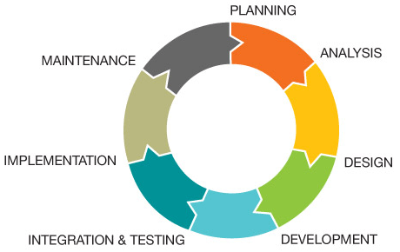
Systems development lifecycle
Plan
Definitions and Types of IS
Benefits and Risks
Development of IS
Reading and References

Slide 27
Planning
Plan
Planning of costs, problems, staff, goals etc.
Implementation plan and development of the expectations from the system once developed.
Definitions and Types of IS
Benefits and Risks
Development of IS
Reading and References

Slide 28
Analysis
Plan
Requirements gathering and analysis of customer expectations. Identification of all components of the system and their inclusion into the plan.
Definitions and Types of IS
Benefits and Risks
Development of IS
Reading and References

Slide 29
Design
Plan
Details of the system based on requirements such as components, interfaces, security, communication etc. within the system and at the system boundary are developed at this stage.
Definitions and Types of IS
Benefits and Risks
Development of IS
Reading and References

Slide 30
Development
Plan
The system is developed based on the design stage outcomes. All functionality is programmed in accordance with system documentation.
Definitions and Types of IS
Benefits and Risks
Development of IS
Reading and References

Slide 31
Integration and Testing
Plan
The system is tested under all possible test scenarios, problems are logged and resolved. User feedback is carefully analysed. All system components are integrated with the business processes.
Definitions and Types of IS
Benefits and Risks
Development of IS
Reading and References

Slide 32
Implementation (Deployment)
Plan
The system is launched in real life setting and its life begins as part of the organisation.
Definitions and Types of IS
Benefits and Risks
Development of IS
Reading and References

Slide 33
Maintenance
Plan
The system is supported and maintained both in terms of technical support and in terms of training and information support. All issues are logged and the cycle repeats after this stage.
Definitions and Types of IS
Benefits and Risks
Development of IS
Reading and References

Slide 34
Plan
Reading and References
http://www.chris-kimble.com/Courses/World_Med_MBA/Types-of-Information-System.html
https://bus206.pressbooks.com/chapter/chapter-1/
Definitions and Types of IS
Benefits and Risks
Development of IS
Reading and References

Slide 35
Plan
Reading and References
Generic system: http://www.slideshare.net/saxon_1987/bis-chapter2-presentation
System definition: http://www.businessdictionary.com/definition/system.html
Information: http://www.dictionary.com/browse/information
Types of Information Systems: http://www.chris-kimble.com/Courses/World_Med_MBA/Types-of-Information-System.html
Systems Development Life Cycle: http://www.webserv.ca/developmentCycle.php
Definitions and Types of IS
Benefits and Risks
Development of IS
Reading and References

