Slide 1
Lecture 9. Cascading Style Sheets
Keywords: CSS, Web standards, presentation of HTML,

Slide 2
Lecture plan
Plan
CSS concept
Style
Using CSS
Inline CSS
CSS Classes
Classes
Changeability
Embedded CSS
External CSS
Pseudo-classes
CSS concept
Using CSS
CSS classes
Reading and References

Slide 3
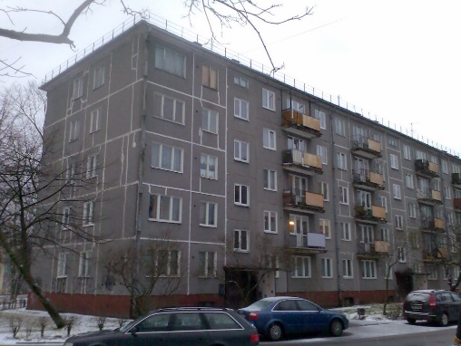

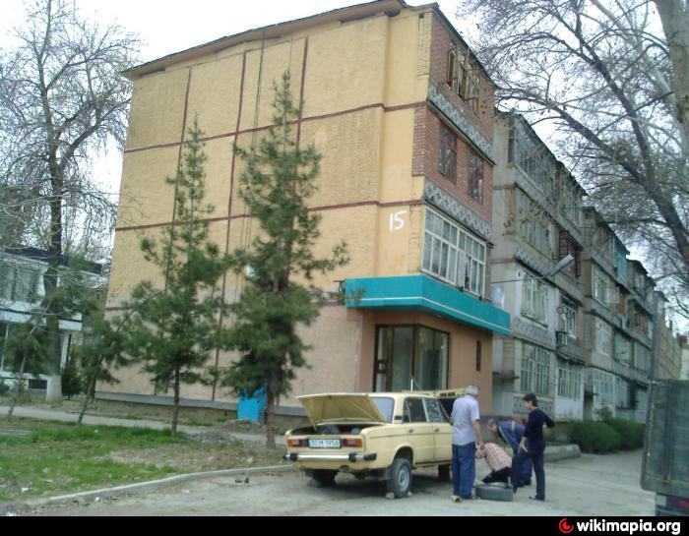
Plan
CSS Concept=Chilanzar Concept
CSS concept
Using CSS
CSS classes
Reading and References

Slide 4

CSS examples
Plan
http://www.csszengarden.com/
CSS concept
Using CSS
CSS classes
Reading and References

Slide 5

Where to learn CSS
Plan
CSS concept
Using CSS
CSS classes
Reading and References

Slide 6
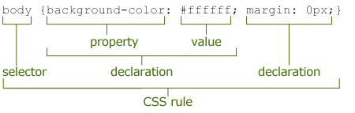
CSS Syntax
Plan
CSS concept
Using CSS
CSS classes
Reading and References

Slide 7
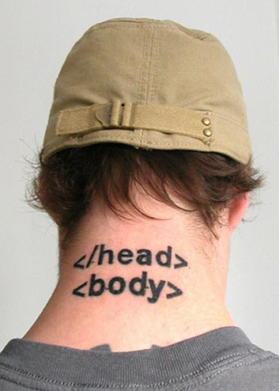
Plan
Linking CSS and HTML
Inline CSS – style attribute
Embedded CSS – style tag
External CSS – link to a file
CSS concept
Using CSS
CSS classes
Reading and References

Slide 8
Plan
Inline CSS
<!DOCTYPE html>
<html>
<head>
<title>CSS Explained</title>
</head>
<body>
<p style="background-color: blue;“>This is paragraph 1 </p>
<p style="background-color: blue;“>This is paragraph 2 </p>
<p style="background-color: blue;“>This is paragraph 3 </p>
<p>This is paragraph 4 </p>
<p>This is paragraph 5 </p>
<p>This is paragraph 6</p>
</body>
</html>
CSS concept
Using CSS
CSS classes
Reading and References

Slide 9
Plan
Embedded CSS
<!DOCTYPE html>
<html>
<head>
<title>CSS Explained</title>
<style>
p {background-color: blue;}
</style>
</head>
<body>
<p> This is paragraph 1 </p>
<p>This is paragraph 2 </p>
<p>This is paragraph 3 </p>
<p>This is paragraph 4 </p>
<p>This is paragraph 5 </p>
<p>This is paragraph 6</p>
</body>
</html>
CSS concept
Using CSS
CSS classes
Reading and References

Slide 10
Embedded and Inline CSS
Plan
<!DOCTYPE html>
<html>
<head>
<title>CSS Explained</title>
<style>
p {background-color: blue;}
</style>
</head>
<body>
<p> This is paragraph 1 </p>
<p>This is paragraph 2 </p>
<p>This is paragraph 3 </p>
<p>This is paragraph 4 </p>
<p style="background-color: yellow;">This is paragraph 5 </p>
<p>This is paragraph 6</p>
</body>
</html>
CSS concept
Using CSS
CSS classes
Reading and References

Slide 11
Plan
External CSS
<!DOCTYPE html>
<html>
<head>
<title>CSS Explained</title>
<link type="text/css" rel="stylesheet" href="mystyle.css" />
</head>
<body>
<p> This is paragraph 1 </p>
<p>This is paragraph 2 </p>
<p>This is paragraph 3 </p>
<p>This is paragraph 4 </p>
<p>This is paragraph 5 </p>
<p>This is paragraph 6</p>
</body>
</html>
CSS concept
Using CSS
CSS classes
Reading and References

Slide 12
Plan
External CSS file
CSS concept
@charset "utf-8";
/* CSS Document */
p {
border-style:double;
}
Using CSS
CSS classes
Reading and References

Slide 13
CSS Classes
Plan
<!DOCTYPE html>
<html>
<head>
<title>CSS Explained</title>
<link type="text/css" rel="stylesheet" href="mystyle.css" />
</head>
<body>
<p class=“one”> This is paragraph 1 </p>
<p>This is paragraph 2 </p>
<p class=“one”>This is paragraph 3 </p>
<p>This is paragraph 4 </p>
<p>This is paragraph 5 </p>
<p>This is paragraph 6</p>
</body>
</html>
CSS concept
Using CSS
CSS classes
Reading and References

Slide 14
External CSS file
Plan
CSS concept
@charset "utf-8";
/* CSS Document */
p {
border-style:double;
}
p.one {
border-style:none;
background-color:blue;
}
Using CSS
CSS classes
Reading and References

Slide 15
Pseudo - classes
Plan
<!DOCTYPE html>
<html>
<head>
<title>CSS Explained</title>
<link type="text/css" rel="stylesheet" href="mystyle.css" />
</head>
<body>
<p> This is paragraph 1 with link to <a href="http://www.wiut.uz"> WIUT </a> website </p>
<p>This is paragraph 2 </p>
<p>This is paragraph 3 </p>
<p>This is paragraph 4 </p>
<p>This is paragraph 5 </p>
<p>This is paragraph 6</p>
</body>
</html>
CSS concept
Using CSS
CSS classes
Reading and References

Slide 16
External CSS file
Plan
/* unvisited link */
a:link {
color: red;
}
/* visited link */
a:visited {
color: green;
}
/* mouse over link */
a:hover {
color: hotpink;
}
/* selected link */
a:active {
color: blue;
}
CSS concept
Using CSS
CSS classes
Reading and References

Slide 17
Plan
Reading
https://www.w3schools.com/css/default.asp
https://developer.mozilla.org/en-US/docs/Learn/CSS/Introduction_to_CSS/How_CSS_works
CSS concept
Using CSS
CSS classes
Reading and References

Slide 18
https://www.upwork.com/hiring/development/how-scripting-languages-work/
Reading and References
Plan
CSS definition: https://developer.mozilla.org/en-US/docs/Web/CSS
House images: http://www.afisha.uz/gorod/2016/08/23/most/ , http://wikimapia.org/22504426/ru/%D0%A7%D0%B8%D0%BB%D0%B0%D0%BD%D0%B7%D0%B0%D1%80-14-%D0%B9-%D0%BA%D0%B2%D0%B0%D1%80%D1%82%D0%B0%D0%BB-15 ,
http://apb1.ru/seriya-1-5155.html
CSS concept
Using CSS
CSS classes
Reading and References

