Slide 1
Lecture 10. Information Architecture
Keywords: information architecture, cognitive psychology, ontology , taxonomy

Slide 2
Lecture plan
Plan
What is Information Architecture (IA)?
Basic concepts in IA
How to apply IA in web design?
What tools can be used to apply IA?
Concepts of IA
Application of IA
Tools in IA
Reading and References

Slide 3
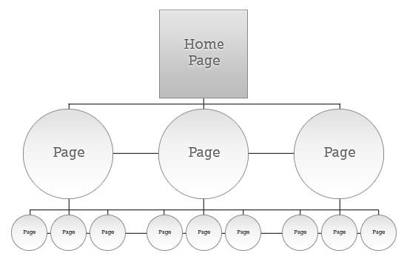
What is Information
Architecture (IA) ?
Plan
Concepts of IA
Information architecture is the practice of deciding how to arrange the parts of something to be understandable.
Application of IA
Tools in IA
Reading and References

Slide 4
Cognitive psychology
Plan
Concepts of IA
Cognitive psychology is the branch of psychology that focuses on the way people process information. It looks at how we process information we receive and how the treatment of this information leads to our responses. In other words, cognitive psychology is interested in what is happening within our minds that links stimulus (input) and response (output).
Application of IA
Tools in IA
Reading and References

Slide 5
Cognitive mapping and
mind mapping
Plan
Concepts of IA
A cognitive map is a mental picture or image of the layout of one's physical environment.
A mind map is a type of graphic organizer that uses a diagram to visually organize ideas and concepts.
Application of IA
Tools in IA
Reading and References

Slide 6
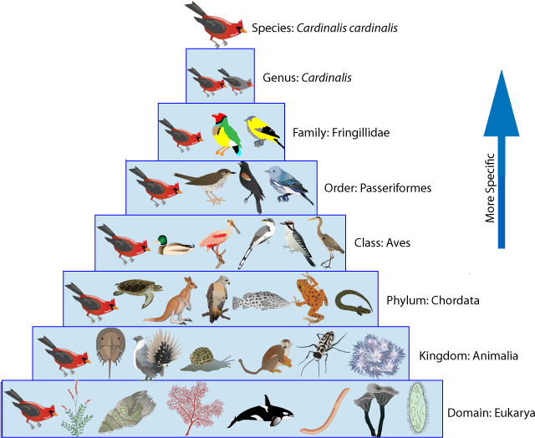
Taxonomy
Plan
The science or technique of classification
Concepts of IA
Application of IA
Tools in IA
Reading and References

Slide 7
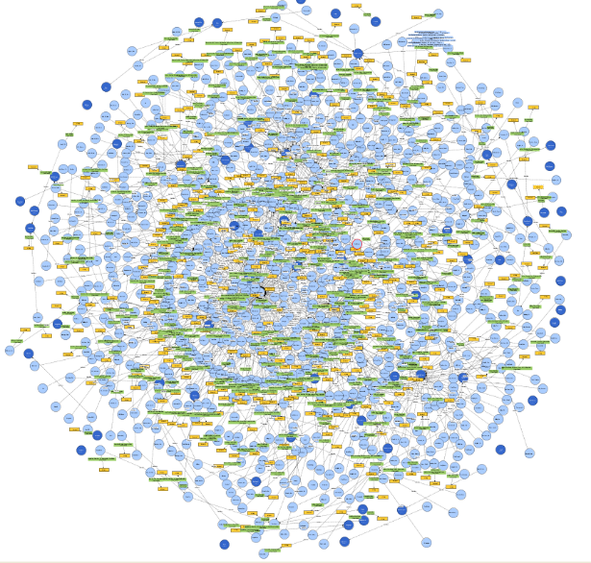
Ontology
Plan
In information technology, an ontology is the working model of entities and interactions in some particular domain of knowledge or practices
In this usage, an ontology is a set of concepts - such as things, events, and relations - that are specified in some way (such as specific natural language) in order to create an agreed-upon vocabulary for exchanging information.
Concepts of IA
Application of IA
Tools in IA
Reading and References

Slide 8
How to apply IA
Plan
Content inventory
Content audit
Information grouping
Taxonomy development
Descriptive information creation
Concepts of IA
Application of IA
Tools in IA
Reading and References

Slide 9
How to apply IA
Plan
Home | About Us | Our Services | Contact us
Concepts of IA
Where we live | Who we are | What we do | How to find us
Application of IA
Home | About | Services | Contact
Tools in IA
Shelter | Us | Activities | Links
Reading and References

Slide 10
Tools for IA
Plan
Card Sorting - https://www.optimalworkshop.com/optimalsort?gclid=CPfKytSPy9ICFR3gGQodS0IFMw
Wireframing - https://moqups.com/
Concepts of IA
Application of IA
Tools in IA
Reading and References

Slide 11
Reading
Plan
https://www.nngroup.com/articles/ia-vs-navigation/
http://sixrevisions.com/usabilityaccessibility/information-architecture-101-techniques-and-best-practices/
Concepts of IA
Application of IA
Tools in IA
Reading and References

Slide 12
References
Plan
Information Architecture definition: http://www.iainstitute.org/what-is-ia
IA picture: http://sixrevisions.com/usabilityaccessibility/information-architecture-101-techniques-and-best-practices/
Cognitive Psychology: http://study.com/academy/lesson/what-is-cognitive-psychology-definition-theories-quiz.html
Taxonomy: http://www.dictionary.com/browse/taxonomy
Ontology definition: http://whatis.techtarget.com/definition/ontology
Ontology image: http://www.semanco-tools.eu/urban-enery-ontology
Concepts of IA
Application of IA
Tools in IA
Reading and References

