Slide 1
SYSTEMS ANALYSIS AND DESIGN
Lecture 11. Rapid Applications development

Slide 2
Agenda
Rapid applications development
Systems development components essential to RAD
RAD techniques and tools
Advantages and disadvantages of RAD as an exclusive systems development methodology

Slide 3
What is RAD?
High speed
High quality
Low cost
People centered
Incremental development

Slide 4
What is rad?
Systems development methodology created to radically decrease the time needed to design and implement information systems radically.
Five key factors
  Extensive user involvement
  Joint Application Design sessions
  Prototyping
  Integrated CASE tools
  Code generators

Slide 5
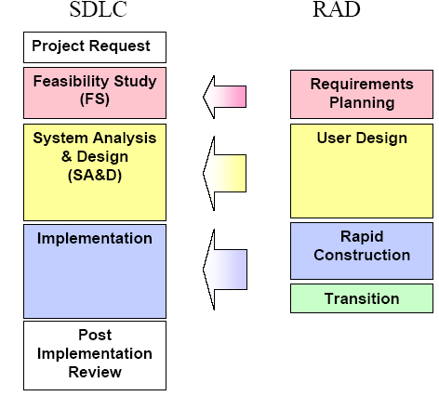
RAD vs. SDLC

Slide 6
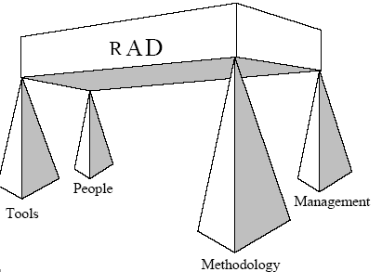
Components of RAD

Slide 7
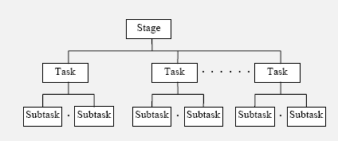
Structure of rad

Slide 8
RAD Stages: requirement planning
Research current situation
Define requirements
Finalize requirements

Slide 9
RAD Stages: User Design Stage
Produce detailed system area model
Develop outline system design
Refine system design | Prepare implementation strategies
Finalize system design
Obtain approval for construction

Slide 10
RAD Stages: rapid construction stage
Prepare for rapid construction
Construct system
Verify system construction
Generate test data and system documents
Prepare for transition

Slide 11
RAD Stages: rapid transition stage
Accept system installation
Conduct user training
Perform data conversion
Install production system

Slide 12
RAD roles
Facilitator
Scribe
SWAT team
Model Administrator
Database Administrator
Planning workshop team
User design team
Construction assistance team
Transition team

Slide 13
RAD techniques
User workshop – JAD, JRP
Facilitation
Timeboxing
Parallel development
LDM
Business Process Modeling
Function Decomposition
Interaction Analysis
Prototyping
Cluster Analysis
Entity state analysis
Event dependency analysis

Slide 14
User workshop
JRP – Requirements Planning Stage.
To gather the developers and users together to work out the requirements and agree the system boundary
JAD – User Design Stage
More technical details
Prototyping

Slide 15
facilitation
Used by Facilitator to facilitate the workshops.
To ensure that session participants work effectively together as a team.

Slide 16
Timebox management
Limited time period within which a well-defined deliverable must be produced with given resources.

Slide 17
Parallel development
Required for the high-speed development of large applications having a high level of complexity.
System is split into subsystems
Reduce cost
More control

Slide 18
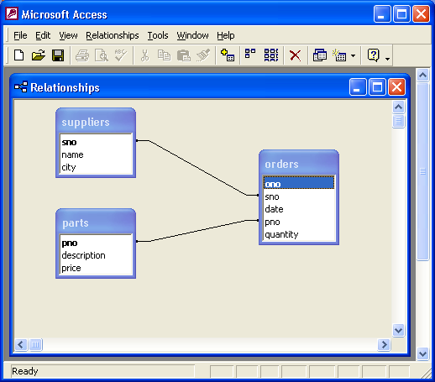
Logical data model
Entity relationship Modeling
Basis for Database design

Slide 19
Business processing model
To understand the current business processes and activities
Business Process Diagram
Business Process Description
Process Decomposition Diagram

Slide 20
Interaction analysis
Analysis of data usage per business activity/function.

Slide 21
prototyping
Quick and rough version of a desired system or parts of that system.

Slide 22
Cluster analysis
Investigates similarities among entities and identifies those that need to be dealt with as a group.

Slide 23
Entity state analysis
Study of what can happen during the lives of instances of a given entity.

Slide 24
Event dependency analysis
Understanding the significant events in the business, the business processes they trigger, and the relationships between the processes and entities

Slide 25
RAD tools
  Data Integration tools- IBM Rational Rapid Developer, Microsoft SQL server
  Development Environments – Microsoft Visual Studio.NET, Sun Java Studio Creator.
  Requirement gathering tools – Microsoft Visio, Rational Rose
  Data modeling tool – UML
  Code generation tool – CASE, Blue Inc

Slide 26
RAD advantages/disadvantages
Advantages | Disadvantages
Dramatic time savings the systems development effort | More speed and lower cost may lead to lower overall system quality
Can save time, money and human effort | Danger of misalignment of system developed via RAD with the business due to missing information
Tighter fit between user requirements and system specifications | May have inconsistent internal designs within and across systems
Works especially well where speed of development is important | Possible violation of programming standards related to inconsistent naming conventions and inconsistent documentation
Ability to rapidly change system design as demanded by users | Difficulty with module reuse for future systems
System optimized for users involved in RAD process | Lack of scalability designed into system
Concentrates on essential system elements from user viewpoint | Lack of attention to later systems administration built into system
Strong user stake and ownership of system | High cost of commitment on the part of key user personnel

