Slide 1
System Analysis and Design
Lecture 3
Systems Analysis and Design

Slide 2
Lecture plan
Project Initiation
Project Management
Project Scheduling
Feasibility Report
Requirement gathering in detail

Slide 3
What is a Project?
Ex 1:
If it takes 2 people 2 days to build a fence, can 4 people build the fence in one day? Or 16 people in 2 hours? Or 128 people in 15 minutes?
Ex 2:
The Great Pyramid of the Tomb of Cheops in Egypt contains 2,300,000 blocks of stone each weighing on average 1.5 tonnes.
The pyramid is 150 metres high and 230 metres in length. 4000 men took 20 years to build it. Imagine being the manager of this project...

Slide 4
Project Initiation
Define objectives, deliverables and scope of project
Establish a sound financial business case for the project
Assess costs and business benefits
Agree plans, resources and organization for the project
Establish key risks and success criteria
Formalize controls and reporting lines

Slide 5
Project Management (PM)
Three components:
Planning
Control
Organization

Slide 6
PM: Planning
Break the project into a number of stages or phases (e.g. project initiation, feasibility study, analysis, testing).
Identify the activities to be undertaken in each phase.
Break down the activities in the first stage into a detailed task list
Estimate effort required to complete each task or activity
Assign resources to each task and activity
Schedule the project

Slide 7
PM: Planning
Gantt Chart
  Visual tool to show scheduled and actual progress of the project.
PM Software
  MS Project
  Smartsheet.com
  Teambox.com and etc.

Slide 8

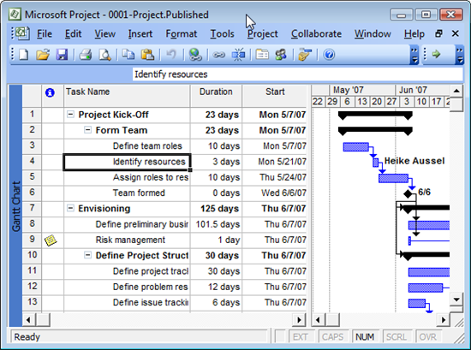
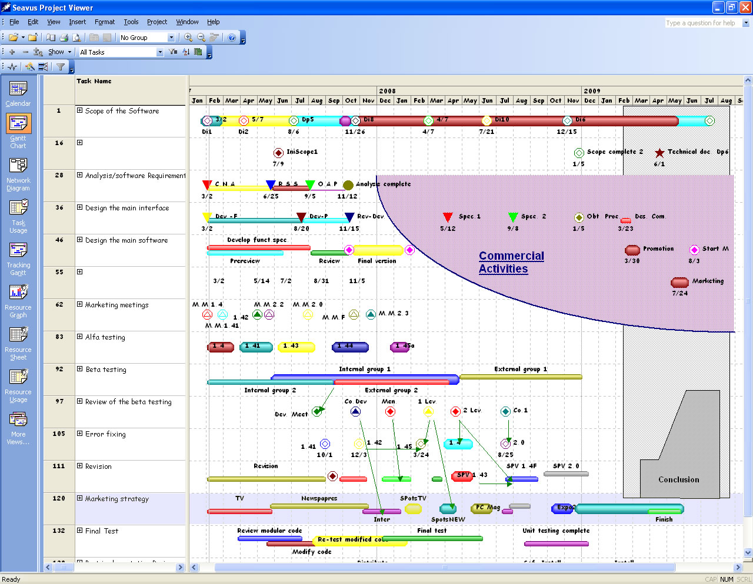

Slide 9
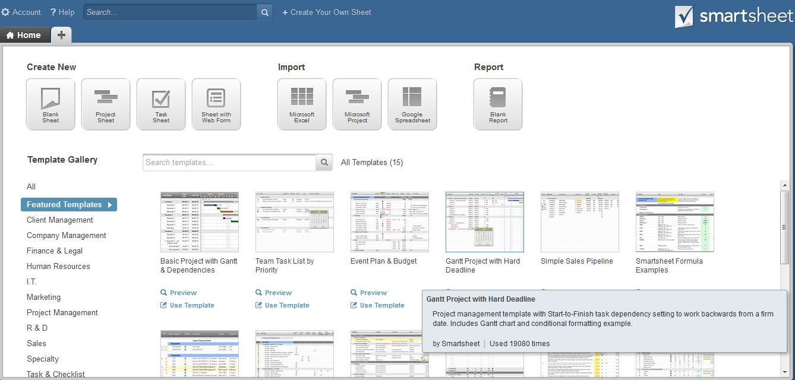
Smartsheet.com

Slide 10
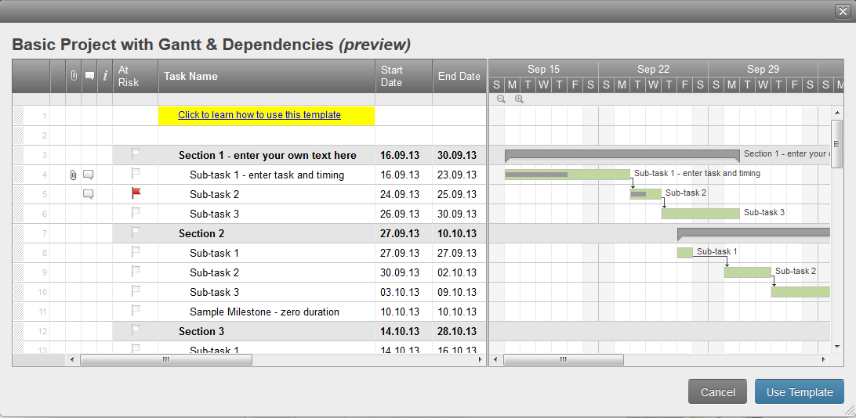
Smartsheet.com: Gantt chart

Slide 11
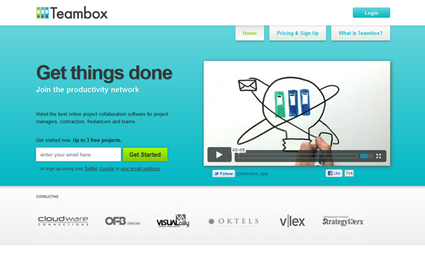
Teambox.com

Slide 12
PM: Project Organization
A well defined project structure ensures that the right people are involved in the project and that roles responsibilities are clearly defined.
Key Roles:
  Project Manager
  Project Supervisor
  User representation
  Project Board

Slide 13
Feasibility Study
…documents the analysis of a business problem
determines whether it can be solved effectively.
  operational (will it work?)
  economical (costs and benefits)
  technical (can it be built?)
Results of the study determine whether or not the solution should be implemented

Slide 14
Types of Project Feasibility
Economical
Technical
Social and operational

Slide 15
Technical feasibility
Concerned with the technical performance criteria that the system will have to meet to be accepted.
It is the configuration of the system that is initially more important than the actual hardware make.

Slide 16
Social and operational feasibility
Concerned with social, human, organizational and political aspects
Issues:
What job changes will the system bring?
What organizational structures are disturbed?
What new skills will be required? Do the current employees possess these skills?

Slide 17
Economic Feasibility
A financial return that outweighs the cost.
Approaches to assessing the cost of solution:
  Least Cost
  Time to payback
  Net present value
  Breakeven analysis

Slide 18
Economic Feasibility:
Least Cost
Principle: Costs are easier to control and identify than revenues.
Only the costs are listed and the option with the lower cost is selected.
Simplistic approach often used in public sector tendering, usually with disastrous results.

Slide 19
Economic Feasibility:
Time to payback
Attempt to answer the question:
  How long will it be until we get our money back on this investment in systems?
Requires data on both costs and benefits for calculating net cash flow.
Alternative which repays the initial investment the quickest is selected.
The approach does not recognize the time value of money.
Tends to reduce corporate risk.

Slide 20
Economic Feasibility:
Net present value
Builds in an allowance for the time value of money, represented by the Present Value Factor.
The net cash flows are reduced in value by applying this factor, so reducing the value of a cash flow to its present worth.

Slide 21
Economic Feasibility:
Breakeven analysis
Useful when the benefits accruing from the system vary with different workloads.
Data is plotted on a graph where the vertical axis is the amount of cost or benefit, and the horizontal axis is the increasing level of workload.

Slide 22
Feasibility report
Formal written report of the feasibility study.
Possible structure:
Introduction – background of the project
Management overview – summary of content
Terms of reference – to preliminary analysis and explanation how the system was selected, project scope, time-scale, client of study.
Existing system – description of currently operating system.

Slide 23
The feasibility report (cont.)
System requirements – derived from the existing system and discussions from users and operators.
Proposed logical system – business systems options for clients to select
Proposed physical system – number of outline technical solutions
Development plan – for detailed analysis and design phases

Slide 24
The feasibility report (cont.)
Costs and benefits
Alternatives considered
Conclusions and recommendations

Slide 25
Requirements gathering
stage

Slide 26
What is a Requirement?
Something that the product must do or a quality that the product must have.
  Functional requirements – are things the product must do
  Non-functional requirements – are the qualities the product must have
  Constraints – are global issues that shape the requirements.

Slide 27
Requirements Process
Project Blastoff
Trawling for Knowledge
Prototyping and scenario modelling
Writing them down
Quality Gateway
Reusing requirements
Taking Stock of the specification
Post Mortem
Tailoring your process

Slide 28
Requirements Process:
1. Project Blastoff
Is a short burst of activity that puts together all the pieces that are necessary to get your project off to flying start and to ensure that your project is viable and well founded.
Determines the precise purpose that the product is to fulfil

Slide 29

Requirements Process:
1. Project Blastoff (cont.)
Deliverables:
  Purpose of the project
  The client
  The customer
  The stakeholders
  The users
  Constraints
  Names
  Relevant facts and assumptions
  The scope of the work
  The estimated cost
  The risks

Slide 30
Requirements Process:
2. Trawling for Knowledge
Studying the work that is currently done in response to a business event;
Learning the desires and aspirations of the adjacent systems involved in the business event;
Determining the best response that the organization can make to the business event;
Determining the way that the product will contribute to the desired response;
Determining and describing the requirements for the product.

Slide 31
Requirements Process:
3. Prototyping and scenario modelling
The purpose of the prototype is to simulate aspects of the product and to make it real enough to help users think of requirements that might otherwise be missed.
Scenario modelling is used to illustrate a situation. Contains a number of scenes or episodes that tell a detailed story of a specific situation.

Slide 32
Requirements Process:
Writing them down
Quality Gateway

Slide 33

Requirements Process:
6. Reusing requirements
Entails making use of requirements that have been written for other projects. They can come from a number of sources – a reuse library of specifications, other requirements specifications that are similar or in the same domain, or informally from other people’s experience.

Slide 34
Requirements Process:
7. Taking stock of the specification
Considers all of the requirements and their effect on each.
The objective of the stocktake is to review the specification and find requirements that are:
  Missing
  Conflicting
  Ambiguous

Slide 35

Requirements Process:
8. Post Mortem
What did we do right?
What did we do wrong?
If we had to do it again, what would you do differently?

Slide 36

Requirements Process:
9. Tailoring your process
Once you understand the content and purpose of each deliverable, ask how each one would best be produced within your project environment using your sources.
The tailoring task is determining how your project will produce them.

Slide 37
Requirements types
Functional
Non-functional

Slide 38
Functional Requirements
Specifications of the product’s functionality;
Actions the product must take – check calculate, record, retrieve
Derived from the fundamental purpose of the product;
Not a quality

Slide 39
Non-functional requirements
Look and Feel – the spirit of the product’s appearance
Usability - the product’s ease to use, and any special usability considerations
Performance – the operating environment of the product, and what considerations must be made for this environment
Operational – the operating environment of the product, and what considerations must be made for this environment

Slide 40
Non-functional requirements (cont)
Maintainability and Portability – expected changes and the time allowed to make them
Security – the security and confidentiality of the product
Cultural and Political – special requirements that come about because of the people involved in the product’s development and operation
Legal – what laws and standards apply to the product.

Slide 41
UML Activity Diagram
is essentially a flowchart, showing flow of control from activity to activity.
represents the business and operational workflows of a system.
is a dynamic diagram that shows the activity and the event that causes the object to be in the particular state.
Notes:
Activity diagram are one of the five diagrams in the UML for modeling the dynamic aspects of systems.

Slide 42
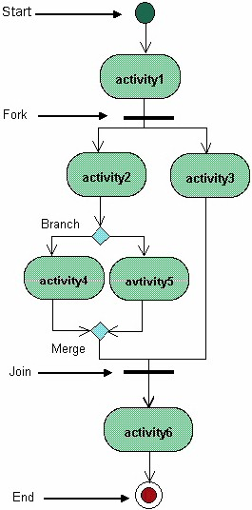

Slide 43
Reading
“Object-Oriented Systems Analysis and Design using UML” – S.Bennett, S. McRobb, R.Farmer – Chapter 5
Weaver, Walkley, Lambrou – Practical SSADM – chapter 4
Mastering the Requirements Process – Chapter 2
www.agilemodeling.com/artifacts/activityDiagram.htm

