Slide 1
Systems analysis and design
Lecture 2. Methodologies

Slide 2
Recap from lecture 1
What is SAD about?
Who is Business System Analyst?
Who is Programmer Analyst?
What skills are needed to be a good system analyst?
Where do analysts work?

Slide 3
Agenda
Systems development life cycle
System development methodologies
    Object oriented approach
    Data centered approach
    RAD
    Prototyping
    Agile
Tools

Slide 4
THE SYSTEMS DEVELOPMENT LIFE CYCLE
Theory

Slide 5
Major Attributes of the Life Cycle
The project --
  Moves systematically through phases where each phase has a standard set of outputs
  Produces project deliverables
  Uses deliverables in implementation
  Results in actual information system
  Uses gradual refinement

Slide 6
Project Phases
Planning (Why build the system? How should the team go about building it?)
Analysis (Who uses system, what will it do, where and when will the system be used?)
Design (How will the system work?)
Implementation (System delivery)

Slide 7
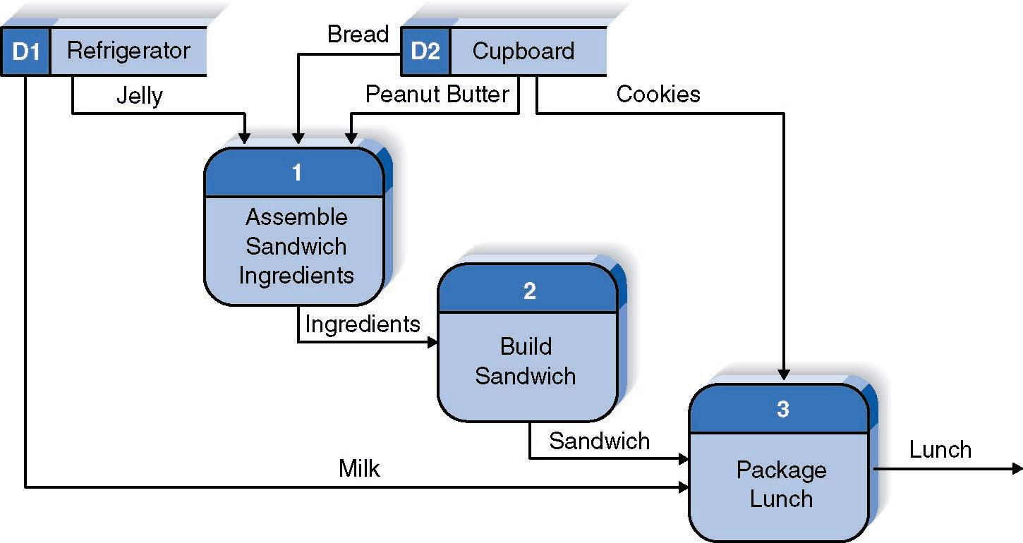
A simple process for making lunch

Slide 8
Project Phases
Planning (Why build the system? How should the team go about building it?)
Analysis (Who uses system, what will it do, where and when will the system be used?)
Design (How will the system work?)
Implementation (System delivery)

Slide 9
Planning
Identifying business value
Analyze feasibility
Develop work plan
Staff the project
Control and direct project

Slide 10
Analysis
Analysis strategy
Gathering business requirements
Requirements definition use cases
Process modeling
Data modeling

Slide 11
Design
Design selection
Architecture design
Interface design
Data storage design
Program design

Slide 12
Implementation
Construction
  Program building
  Program and system testing
Installation
  Conversion strategy
  Training plan
  Support plan

Slide 13
Processes and Deliverables
Process
Product
System Request
Feasibility Analysis
Workplan
System Proposal
System
Specification
New System and
Maintenance Plan
Planning
Analysis
Design
Implementation

Slide 14
SYSTEM DEVELOPMENT METHODOLOGIES
Structured analysis approach
Object oriented approach
Data centered approach
RAD
Prototyping
Agile development

Slide 15
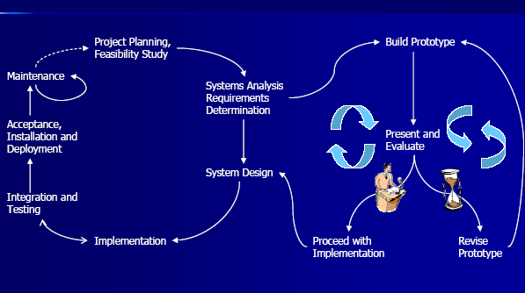
Information System development

Slide 16
Approaches to systems development
Structured analysis approach
Object oriented approach
Data centered approach
RAD
Prototyping
Agile development

Slide 17
The structured analysis approach (outdated)
Focuses upon what a system does rather than how it does it.
Top-down functional decomposition – systems development involves manual systems being computerized
SSADM

Slide 18
Object-Oriented approach
Create systems that are easily catalogued and managed – but is most appropriate to situations of frequent ‘repeat processing’.
C++, Visual Basic, Borland Delphi

Slide 19
Object-Oriented approach
One of the main principles in the object oriented (OO) approach is
  Abstraction of data structures and processes together, not separately
  An object is a set of data structures and the methods or operations needed to access those structures.

Slide 20
Data centered approach
Basic data that an organization uses is stable, whereas the procedures are not.
Most important:
  design of the database with the development of data dictionary.

Slide 21
Soft systems approach
Developed by Peter Checkland
Uses cartoon-like diagrams called rich pictures, representing communication flows, processes, areas of conflict, external observers and interactions.

Slide 22
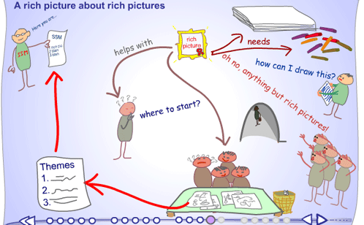
Soft systems approach

Slide 23
Rapid Application Development
Incorporate special techniques and tools:
  CASE tools
  JAD (joint application design) sessions
    Involve stakeholders (users, developers, analysts)
  Fourth generation/visualization programming languages
  Code generators

Slide 24
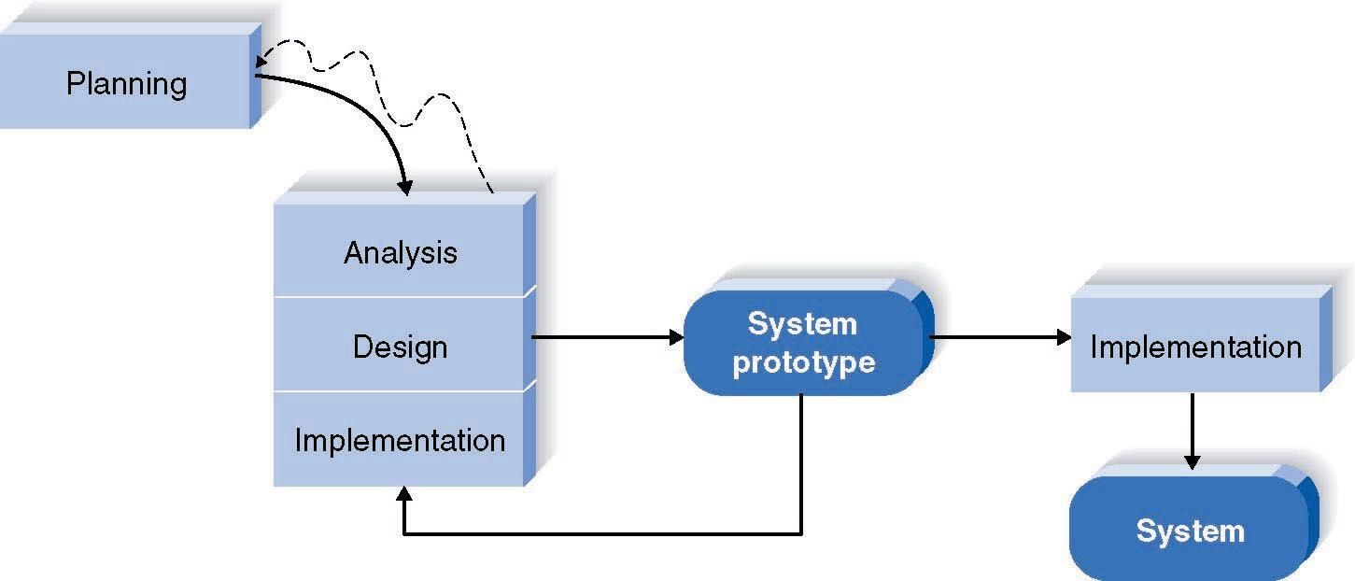
Prototyping approach

Slide 25
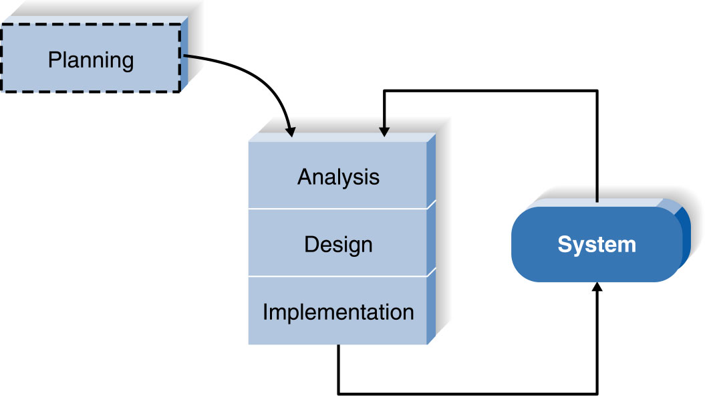
Agile Development: Extreme Programming

Slide 26
Criteria for Selecting the Appropriate Methodology
Clear user requirements
Familiarity with technology
Complexity of system
Reliability of system
Time schedule
Schedule visibility

Slide 27
CASE tools
Computer-aided software engineering tools
  Automated tools to help systems developer.
  Diagramming tools, data dictionaries, report generators, project management tools

Slide 28
Upper and Lower CASE tools
Upper CASE support:
  strategic planning and construction of concept-level products and ignore the design aspect.
  traditional diagrammatic languages such as ER diagrams, Data flow diagram, Structure charts, Decision Trees, Decision tables, etc
Lower CASE concentrate on:
  back end activities of the software life cycle
  E.g.: physical design, debugging, construction, testing, component integration, maintenance, re-engineering and reverse engineering.
For
End - users
For
Programmers

Slide 29


