Slide 1
SCW
Teaching Week 9
Corporate Governance
in Business

Slide 2
OWNERSHIP
Concentrated V Diffused ownership
Family ownership
State ownership
Notes:
3

Slide 3
GOVERNANCE
WHAT IS IT?
  STEWARDSHIP – ON BEHALF OF OTHERS
  EXTERNAL ACCOUNTABLITY
  MANAGE CONFLICTS OF INTEREST

Slide 4
CONFLICTS OF INTEREST
Principal-Agent conflicts:
Principal-Principal conflicts:

Slide 5
Principal-Agent Conflicts
RISKS
  ALWAYS be principal-agent conflicts, which result in agency costs
  information asymmetries between principals and agents (agents always know more about their tasks than principals)
Notes:
4

Slide 6
Principal-Principal Conflicts
Principal-Principal Conflicts
  controlling shareholders and minority shareholders
Expropriation of Minority Shareholders
  Family managers, who represent (or are) controlling shareholders, may engage in activities that enrich the controlling shareholders at the expense of minority shareholders
Notes:
4

Slide 7
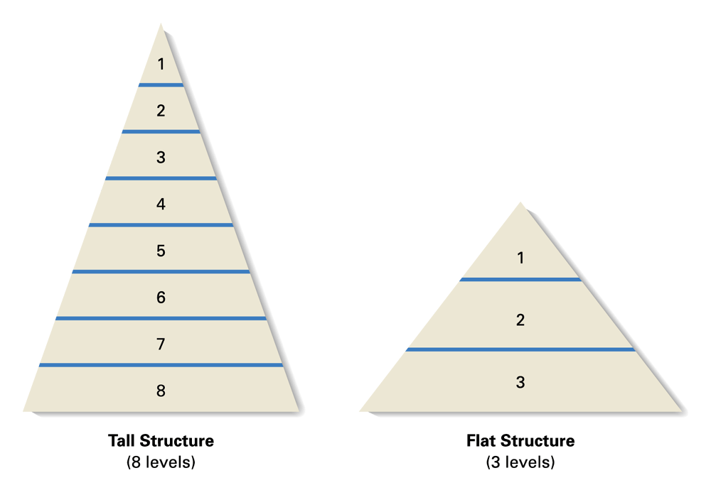
Tall and Flat Structures
DEPENDS ON:
Control
Autonomy
Innovation
Feed-Back
IS/IT

Slide 8
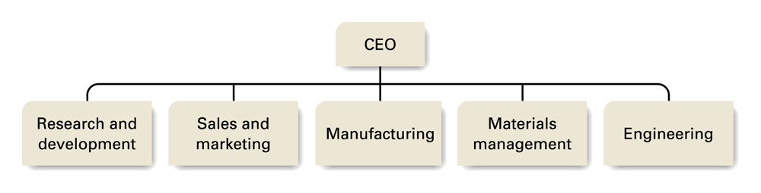
Functional Structure

Slide 9
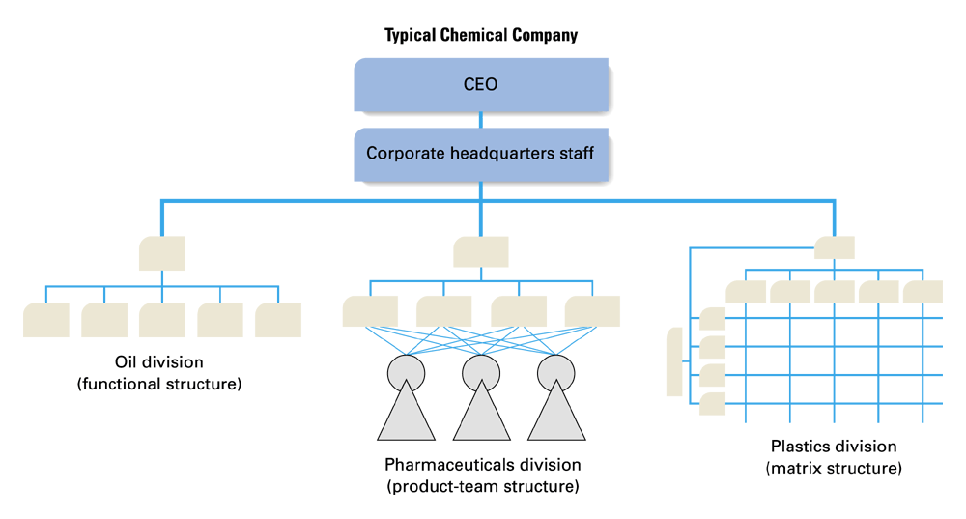
Multidivisional Structure

Slide 10
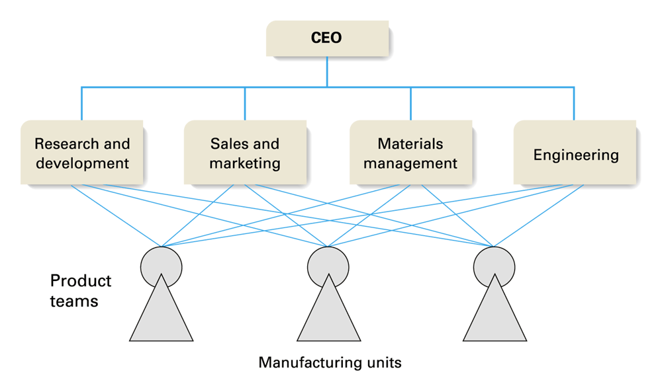
Product-Team Structure

Slide 11
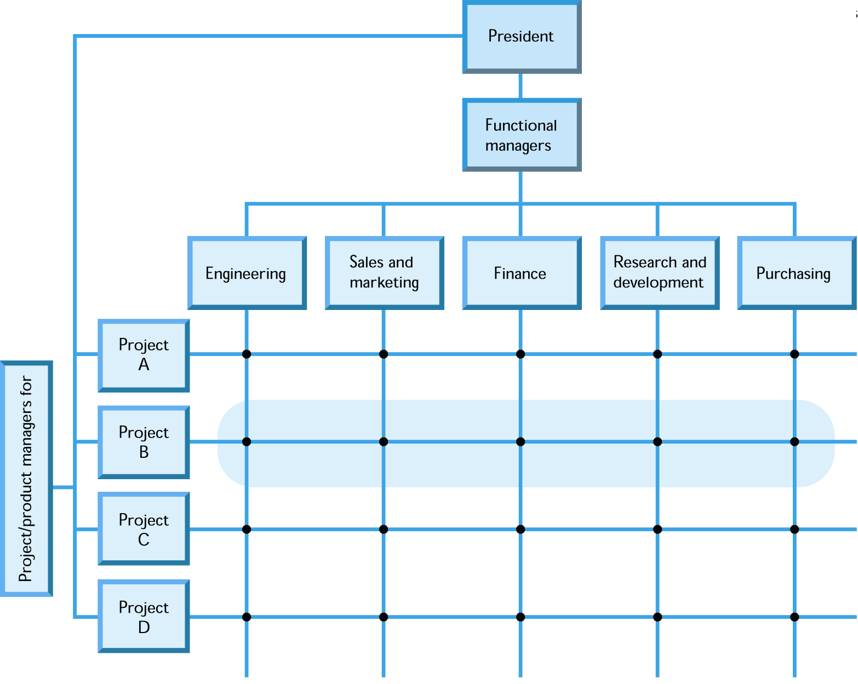
Matrix Structure
● Two-boss employee

Slide 12
The Network Structure
Supplier Z
Supplier Y
Specialist Component Supplier
Main Component
Supplier X
Core business Manufacturing
= supply relationships
and relative size
Packaging
Supplier - Casings

Slide 13
Board of Directors
  Board Composition: Insider/Outsider mix
  Leadership Structure: CEO duality or Separation
  Board Interlocks: When one person affiliated with one firm sits on the board of another firm
The role of Boards of Directors:
(1) control,
(2) service,
(3) resource acquisition functions
Directing strategically: Directors must strategically prioritize
Notes:
4

Slide 14
Governance Mechanisms
INTERNAL
  Voice-based mechanisms
    Shareholders’ “voicing” their concerns
  “Carrots” and “sticks”
EXTERNAL
  Mergers & Acquisitions
  Take Over
Notes:
4

Slide 15
Families of Corporate Governance Systems
USA/UK
EUROPEAN
Bank-oriented, network-based systems
Market-oriented, high-tension systems
Exit-based, external mechanisms
Voice-based, internal mechanisms
Shareholder capitalism
Stakeholder capitalism

Slide 16
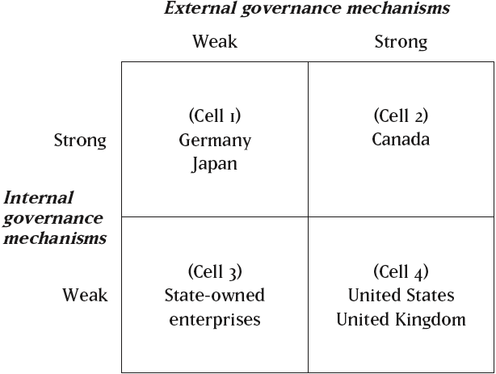
Global Governance
Gedajlovic/Shapria ’98
Source: Cells 1, 2, and 4 adapted from E. R. Gedajlovic & D. M. Shapiro, 1998, Management and ownership effects: Evidence from five countries (p. 539), Strategic Management Journal, 19: 533–553. The label of Cell 3 is suggested by the present author.

Slide 17
GOVERANCE IN TRANSITION
Privatization of Small Firms to Insiders Improves Performance
Privatization of Large Organisations to insiders, Reduces Performance
External Governance more likely to facilitate restructuring

