Slide 1


Tashkent state university of economics
Course: Money and banking
Lecture 13: Financial institutions
PhD in Economics Nasriddinov Fazliddin

Slide 2
COURSE OBJECTIVES
1.
2.
International Monetary Fund ( IMF)
World Bank Group
3.
European Reconstruction and Development bank ( ERDB)

Slide 3
The International Monetary Fund is an international organization that aims to promote global economic growth and financial stability, to encourage international trade, and to reduce poverty.

Slide 4
Objectives of IMF
Assistance of international cooperation on currency and financial sphere
Promoting sustainable development of international trade
Ensuring currency stability
Promote multilateral settlement in the payment system among countries
Facilitating sustainable economic growth of countries

Slide 5
IMF governance
Board of Directors
Executive Board

Slide 6
Activities of IMF
Monitoring
Making loans
Technical assistance
Holding forums

Slide 7
The World Bank Group
1. International Bank for Reconstruction and Development (IBRD)
2. The International Finance Corporation (IFC),
3. International Development Association (IDA),
4. The Multilateral Investment Guarantee Agency (MIGA)
5. The International Centre for Settlement of Investment Disputes (ICSID).

Slide 8
IBRD is an international financial institution that offers loans to middle-income developing countries.

Slide 9
SERVICES OF IBRD
Financial services
Advising services
Training and retraining services

Slide 10
IFC was established in 1956. This institution provides various forms of financing without sovereign guarantees, primarily to the private sector.

Slide 11
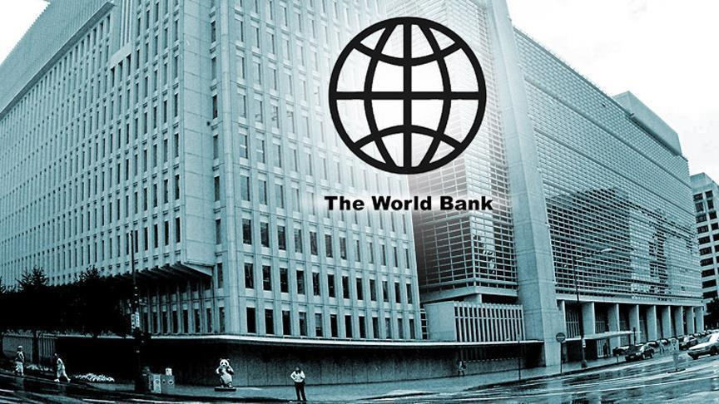
The International Development Association (IDA) was established in 1960 and it provides concessional financing such as interest-free loans or grants. It usually finances with sovereign guarantees.
The Multilateral Investment Guarantee Agency (MIGA) is was established in 1988 with the aim of providing insurance against certain types of risk, including political risk.
The International Centre for Settlement of Investment Disputes (ICSID) was established in 1965. The main activities of ICSID is that it works with governments to reduce investment risk

Slide 12

EBRD is an international financial institution founded and was founded in 1990. This institutions is referred to as developmental investment bank because the EBRD uses investment as a tool to build market economies.

Slide 13
The main objectives of EBRD
1.
2.
3.
Support regional integration
Supporting and strengthen private ownership
Supporting to privatization of state-owned enterprises

Slide 14
Organizational
Structure of EBRD
Board of governance
Board of Directors
President

Slide 15
THANK YOU FOR ATTENTION

