Slide 1


Tashkent state university of economics
Course: Money and banking
Lecture 5: The risk structure and the term structure of Interest Rates
PhD in Economics Nasriddinov Fazliddin

Slide 2
COURSE OBJECTIVES
1.
2.
Risk structure of Interest rates
Term structure of Interest rates

Slide 3
Meaning of risk structure of interest rate
Bonds with the same term to maturity have different interest rates. The relationship among these interest rates is called the risk structure of interest rates.

Slide 4
Factors that influences interest rate of a bond
Default risk
Liquidity
Income tax preference

Slide 5

Default risk occurs when issuer of the bond is unable or not willing to pay promised interest payment at the time bond mature.

Slide 6
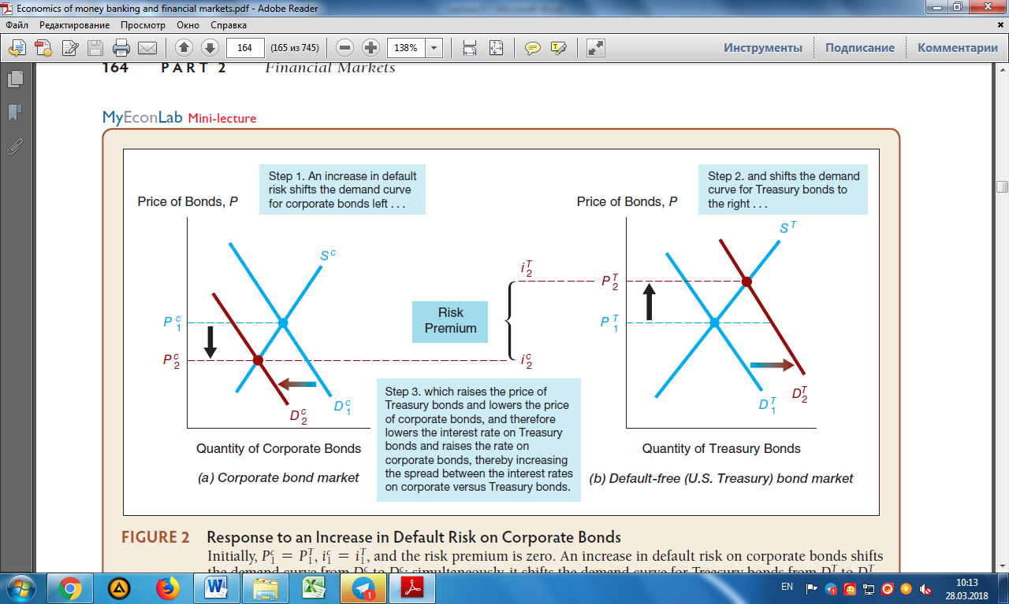
Response to an Increase in Default Risk on Corporate Bonds

Slide 7
Liquidity
Another important factor which influences the interest rate is the liquidity. The more liquid an asset is the more desirable it is. Government bonds are the most liquid all the time because they are widely traded and easiest to sell.

Slide 8
Income Tax
Tax taken from income is also one attribute which affects interest rate of the bond. Municipal bonds are tax free bonds and municipal bonds have lower interest rate than treasury bonds because of income tax preference. This preference increase demand for municipal bonds and increase their expected return.

Slide 9
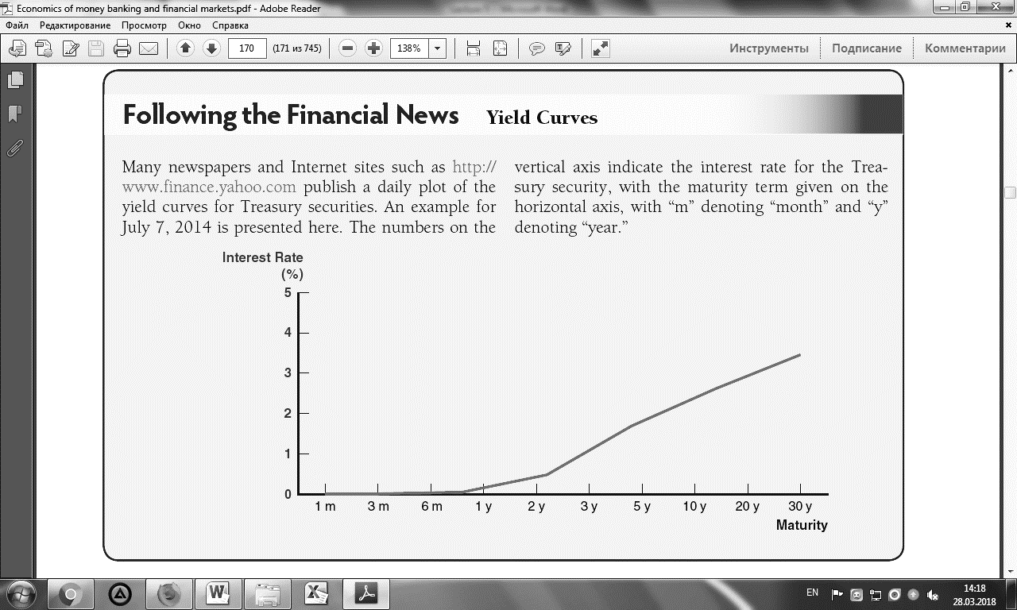
Example of yield to curve

Slide 10
Three important empirical facts of the term structure of interest rates
1
2
3
Interest rates on bonds of different maturities move together over time
When short-term interest rates are low, yield curves are more likely to have an upward slope; when short-term interest rates are high, yield curves are more likely to slope downward
Yield curves almost always slope upward

Slide 11
Expectation theory
The interest rate on a long-term bond will equal the average of the short-term interest rates that people expect to occur over the life of the long-term bond.

Slide 12
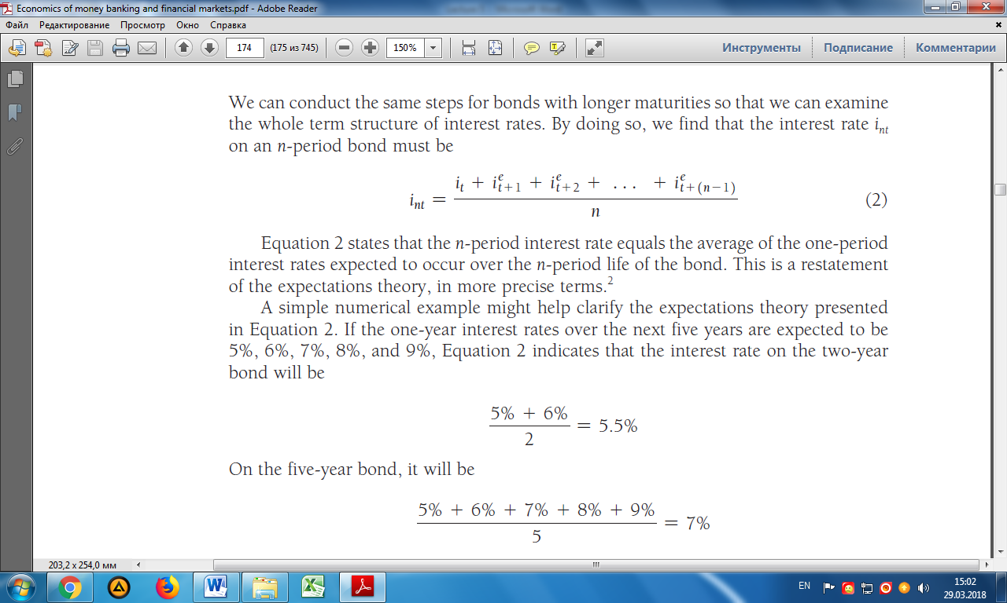
Numerical example of expectation theory
If the one-year interest rates over the next five years are expected to be 5%, 6%, 7%, 8%, and 9%, the interest rate on the two-year bond will be

Slide 13
Segmented markets theory
The segmented markets theory of the term structure sees markets for different-maturity bonds as completely separate and segmented.

Slide 14
Liquidity premium theory
The liquidity premium theory of the term structure states that the interest rate on a long-term bond will equal an average of short-term interest rates expected to occur over the life of the long-term bond plus a liquidity premium.

Slide 15
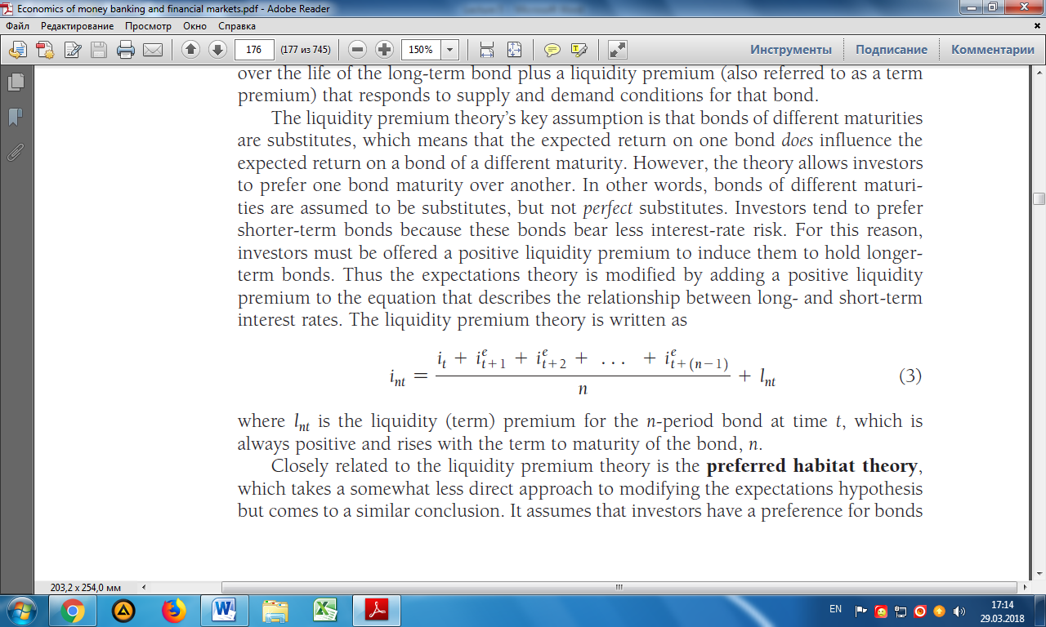
The liquidity premium theory is written as
l_{nt} - the liquidity (term) premium for the n-period bond at time t, which is always positive and rises with the term to maturity of the bond, n.

Slide 16
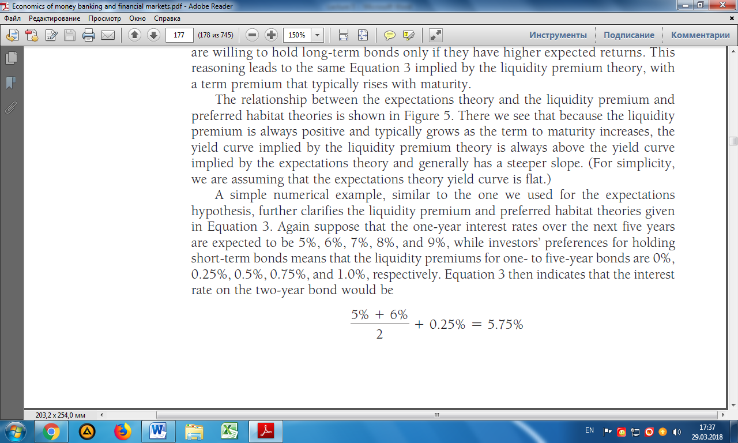
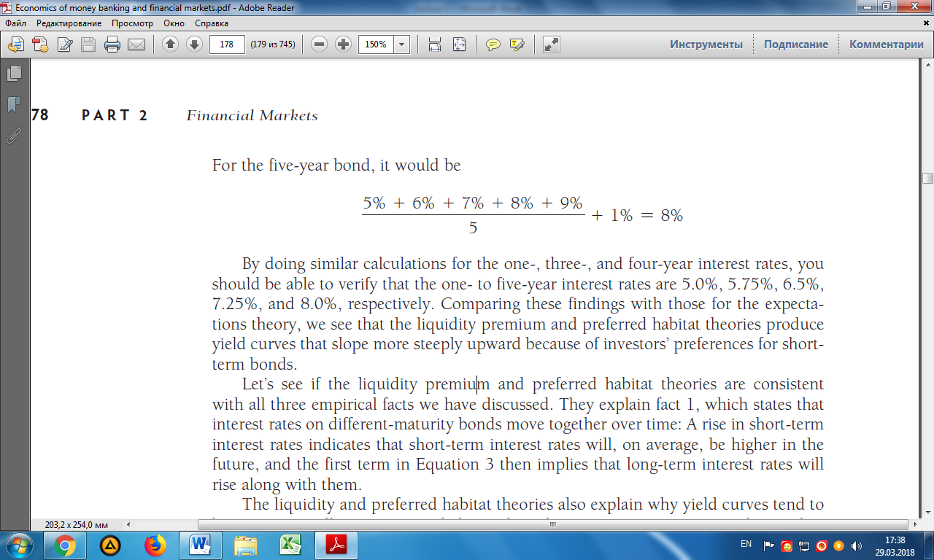
Numerical example liquidity premium theory
Interest rates over the next five years are expected to be 5%, 6%, 7%, 8%, and 9%, the liquidity premiums for one- to five-year bonds are 0%, 0.25%, 0.5%, 0.75%, and 1.0%, respectively. Equation below indicates that the interest rate on the two-year bond would be
For the five-year bond, it would be

Slide 17
THANK YOU FOR ATTENTION

