Slide 1


Tashkent state university of economics
Course: Money and banking
Lecture 2: Financial markets
PhD in Economics Nasriddinov Fazliddin

Slide 2
COURSE OBJECTIVES
1.
2.
3.
Types of Financial Markets
Participants of Financial Markets
Functions of Financial Markets
4.
Moral hazard and adverse selection

Slide 3
Definition of Financial Markets
Financial market is a place where buyers and sellers are met in the trade of assets such as equities, bonds, currencies and derivatives.

Slide 4
Types of Financial Markets
Capital Markets
Money Markets
Derivative Markets
Forex and the Interbank Market

Slide 5
Capital Markets
Stock Markets
Bond Markets

Slide 6
Money Markets
The most liquid and short-term instruments are traded on money markets.

Slide 7
Derivative markets
Derivative markets are markets which derivatives are bought and sold. Main types of derivatives are future, option and swap contracts.

Slide 8
Forex and the Interbank Market
The forex market is where currencies are traded.
The interbank market is the financial system and trading of currencies among banks and financial institutions.

Slide 9
Participants of financial markets
Securities Firms | Other Financial Institutions
Mutual funds | Pension funds
Hedge funds | Insurance companies
Brokers | Commercial banks
Dealers
Investment banks

Slide 10
Functions of financial markets
Matching savers and investors
Liquidity
Information Aggregation and Coordination.
Risk sharing
Price Determination

Slide 11
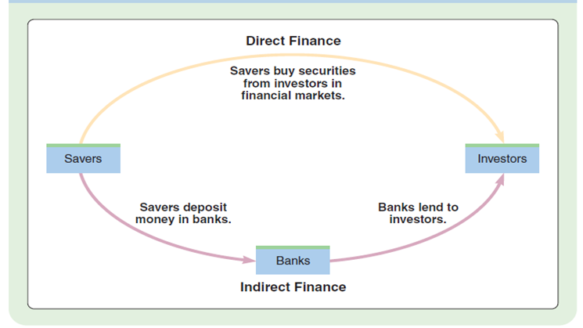

Slide 12
Adverse Selection
Adverse selection is a problem for buyers of securities because they have less information than issuers about the securities’ value.

Slide 13
Moral Hazard
The second asymmetric information problem prevalent in financial markets arises after a transaction has been made.
Moral hazard is the risk that one party to a transaction will act in a way that harms the other party.

Slide 14
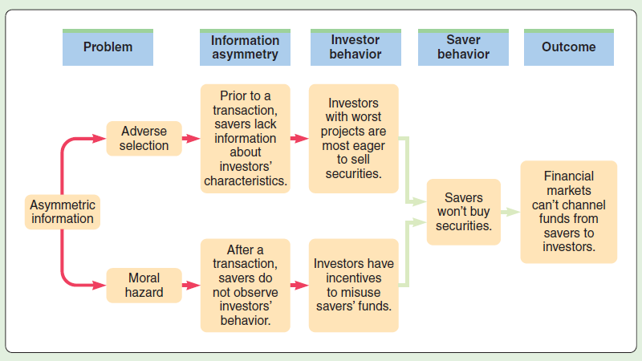
Moral Hazard and Adverse Selection

Slide 15
THANK YOU FOR ATTENTION

